Slide 1
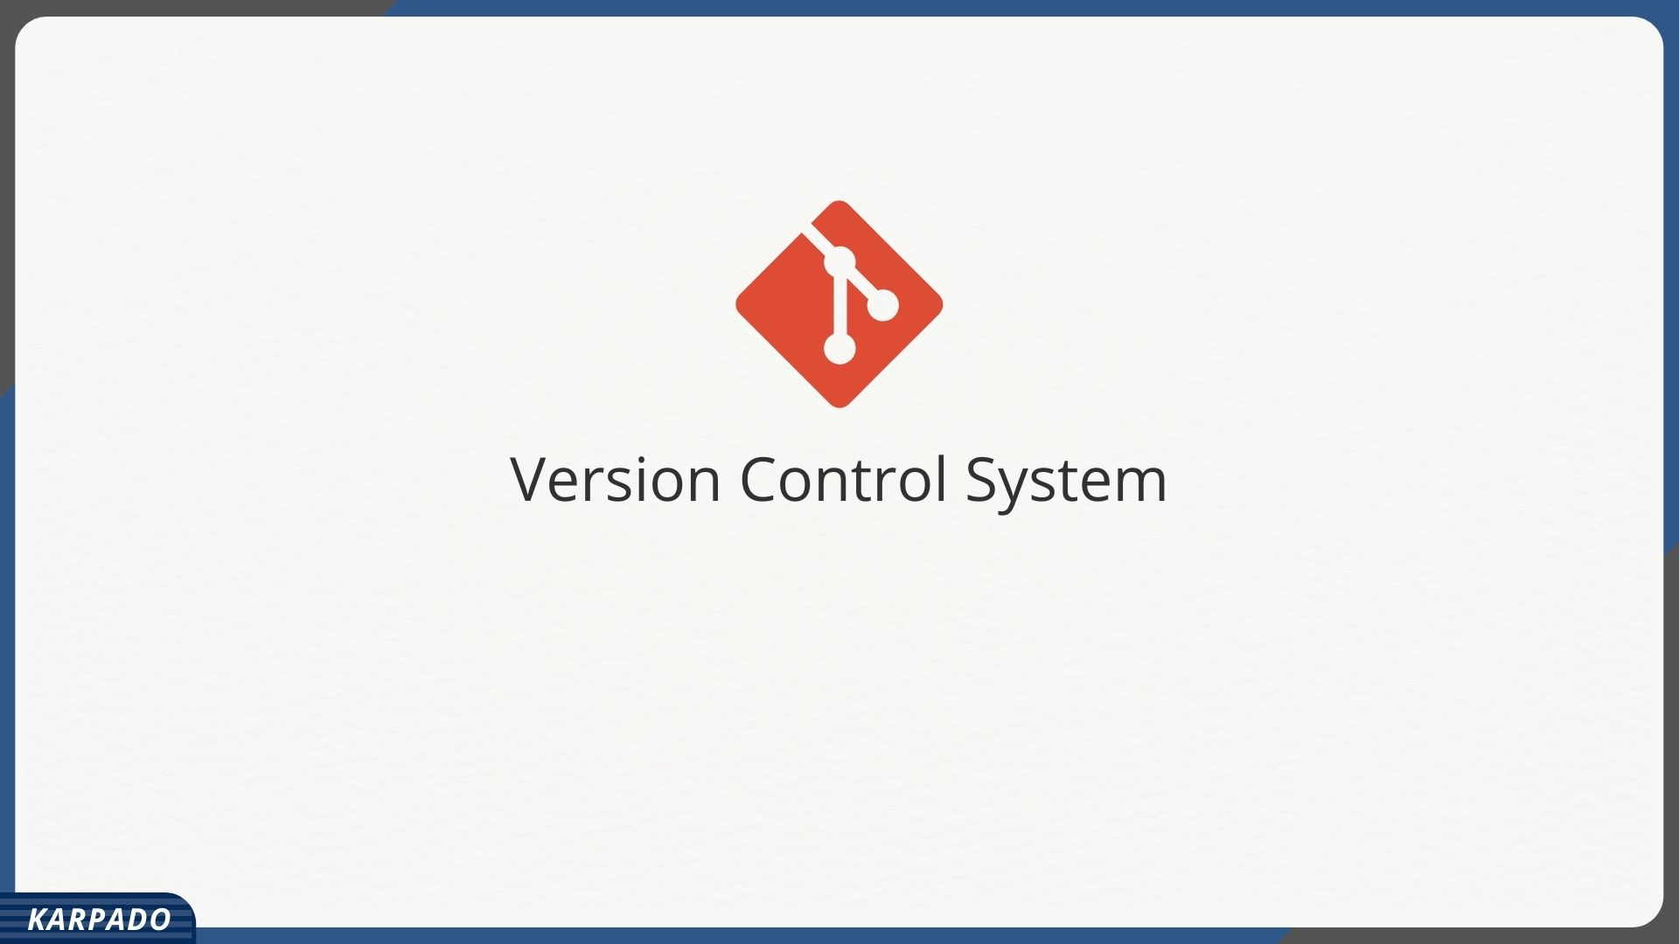

Slide 2


Slide 3


Slide 4


Slide 5
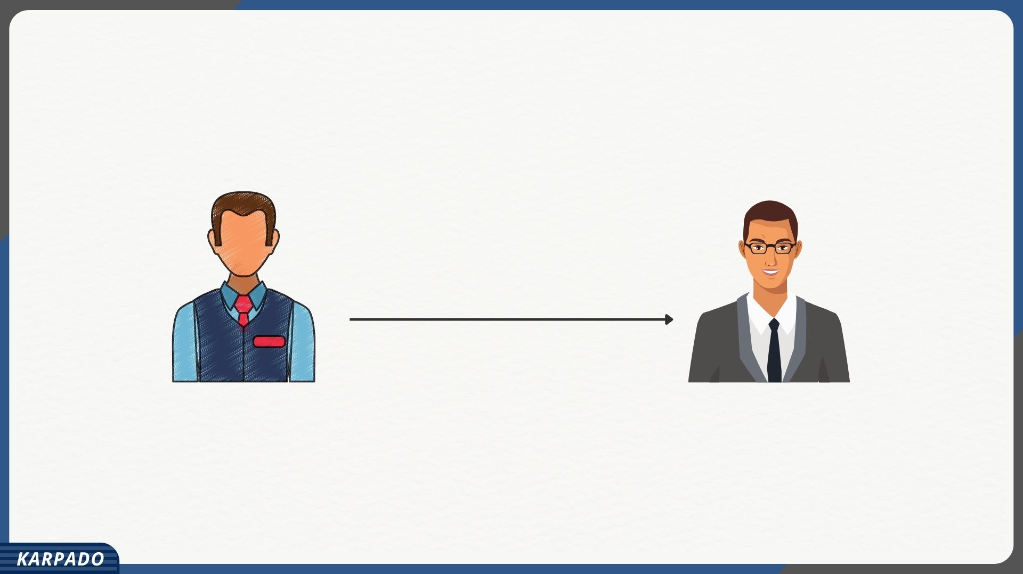

Slide 6
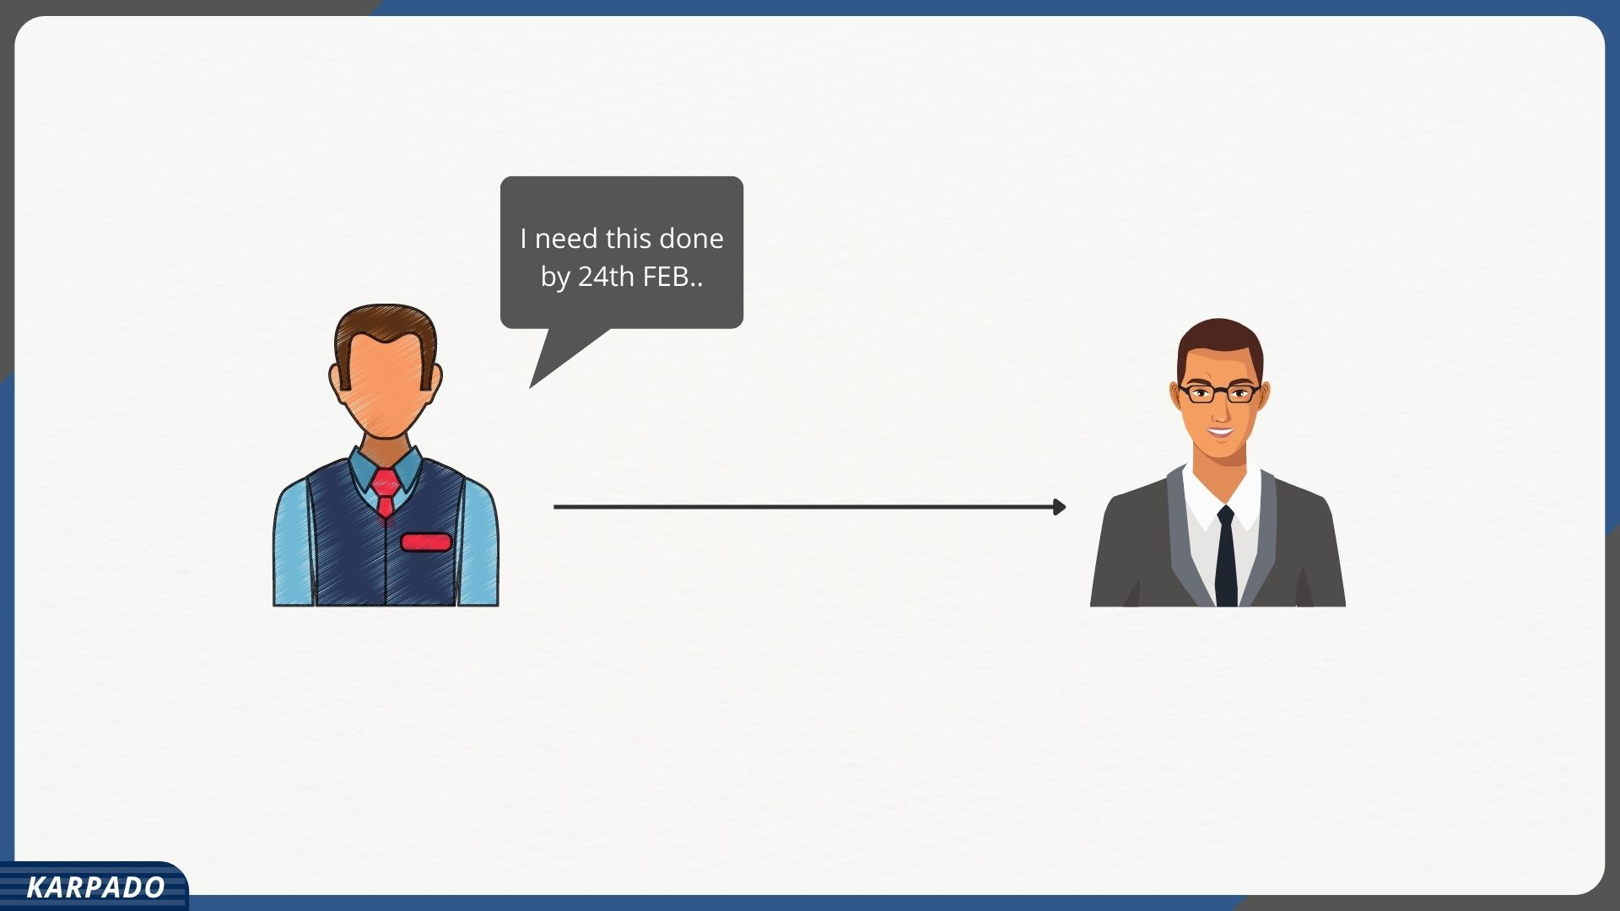

Slide 7
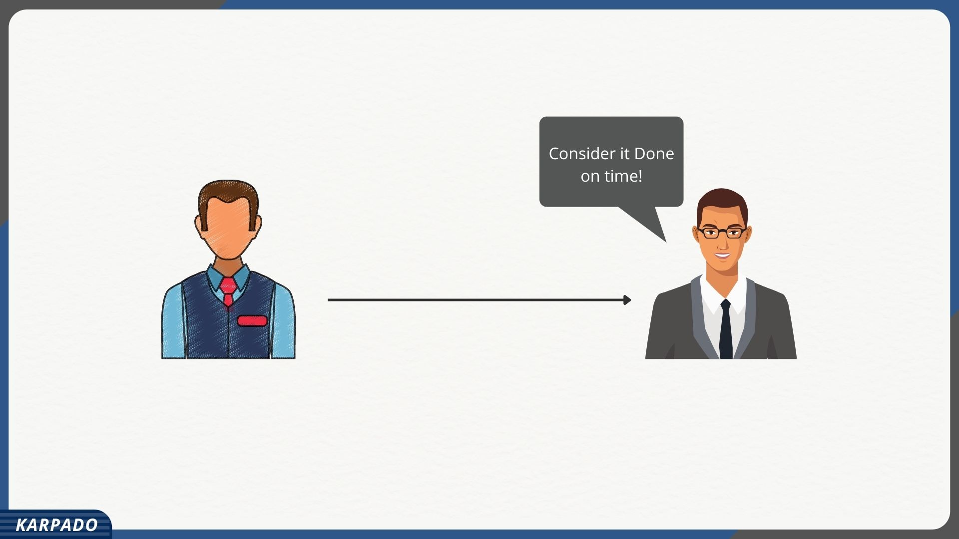

Slide 8
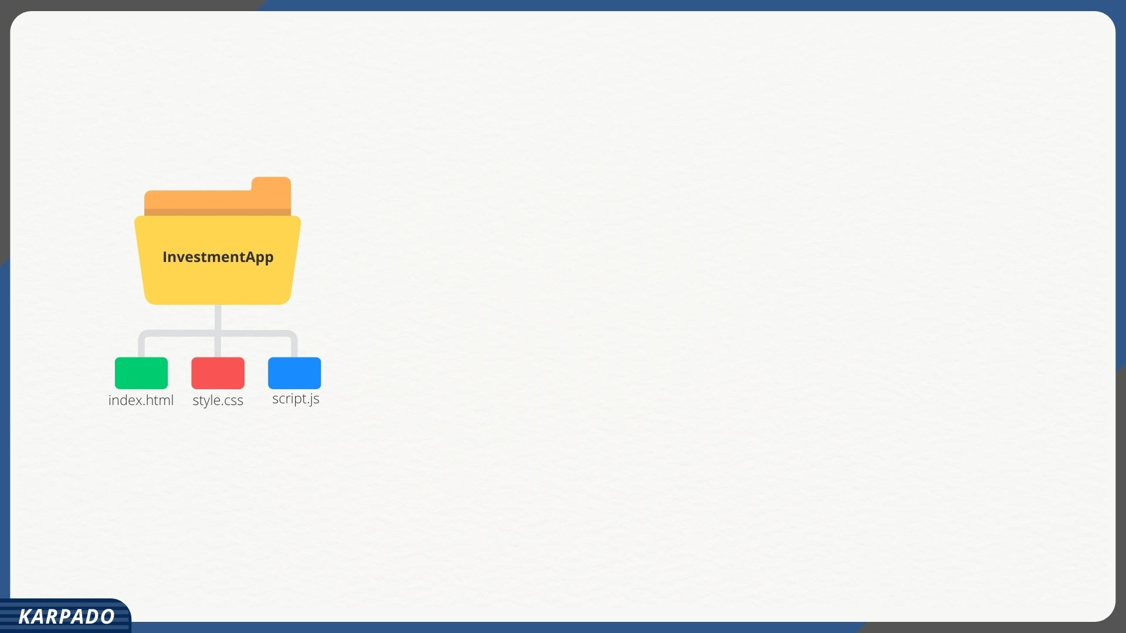

Slide 9
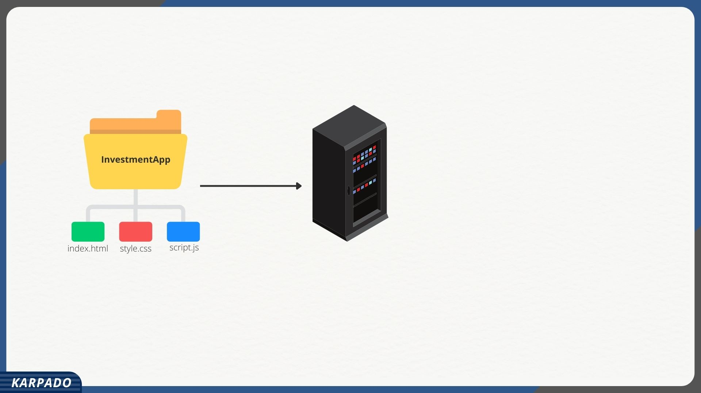

Slide 10
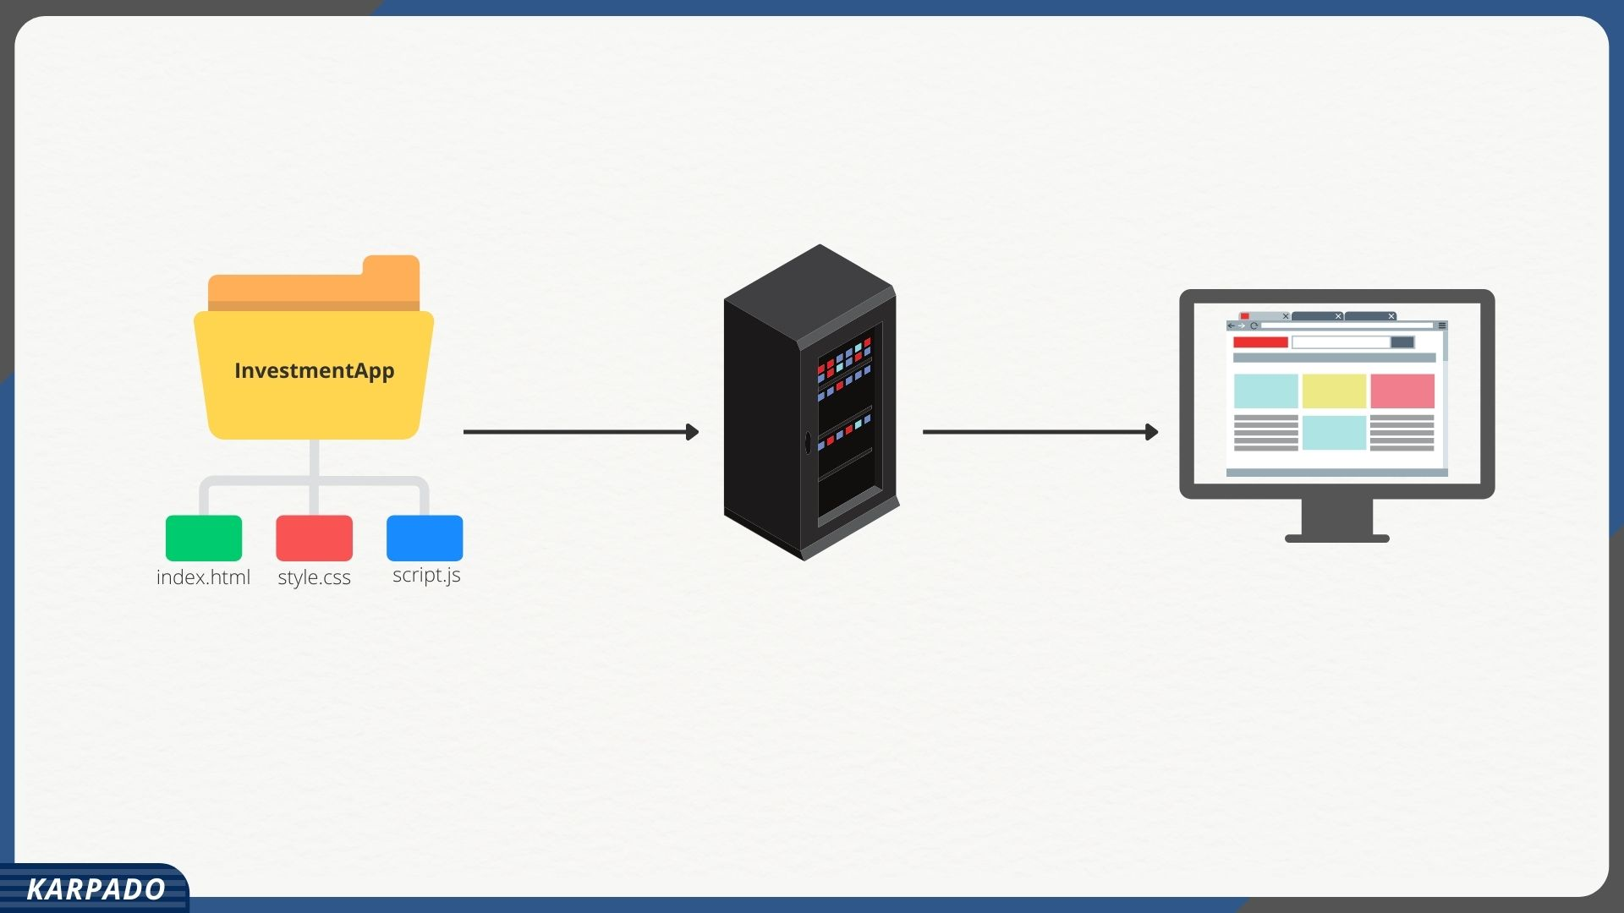

Slide 11


Slide 12
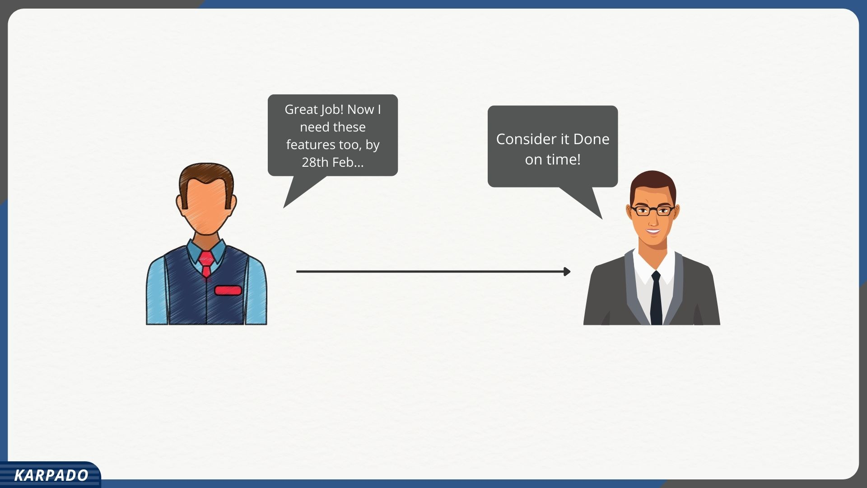

Slide 13


Slide 14


Slide 15


Slide 16


Slide 17


Slide 18
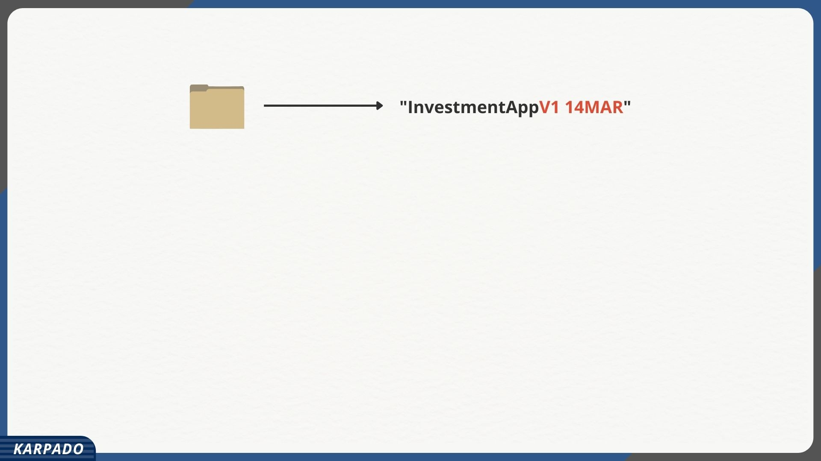

Slide 19
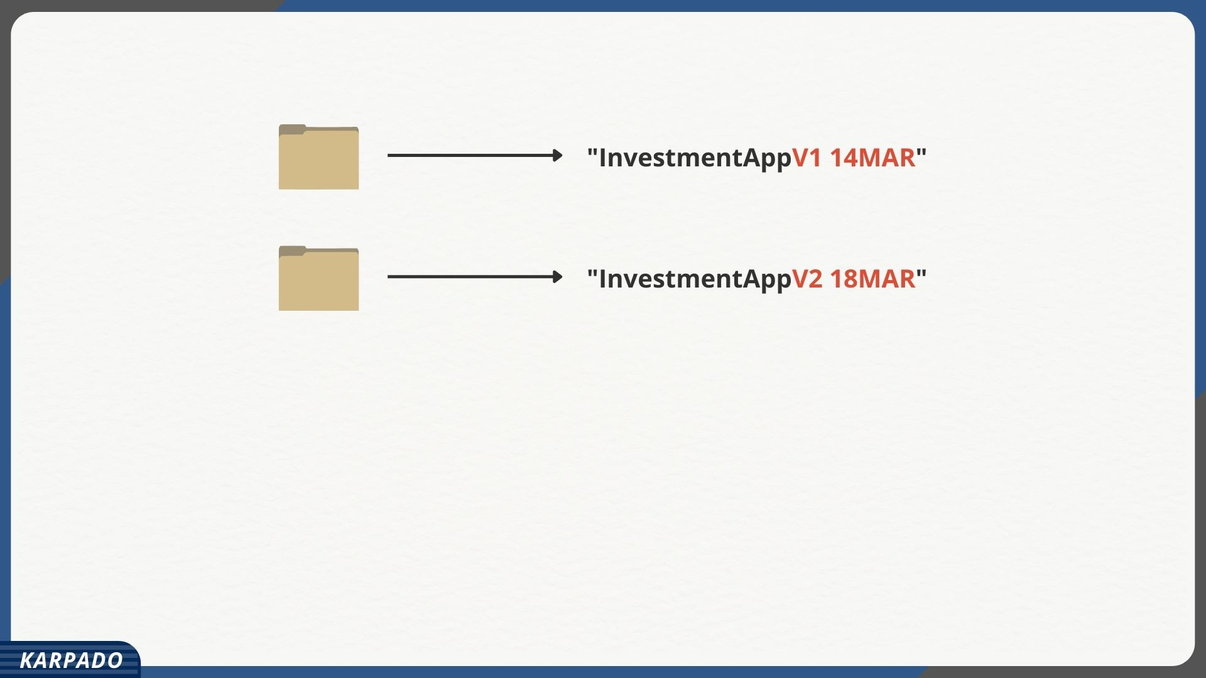

Slide 20
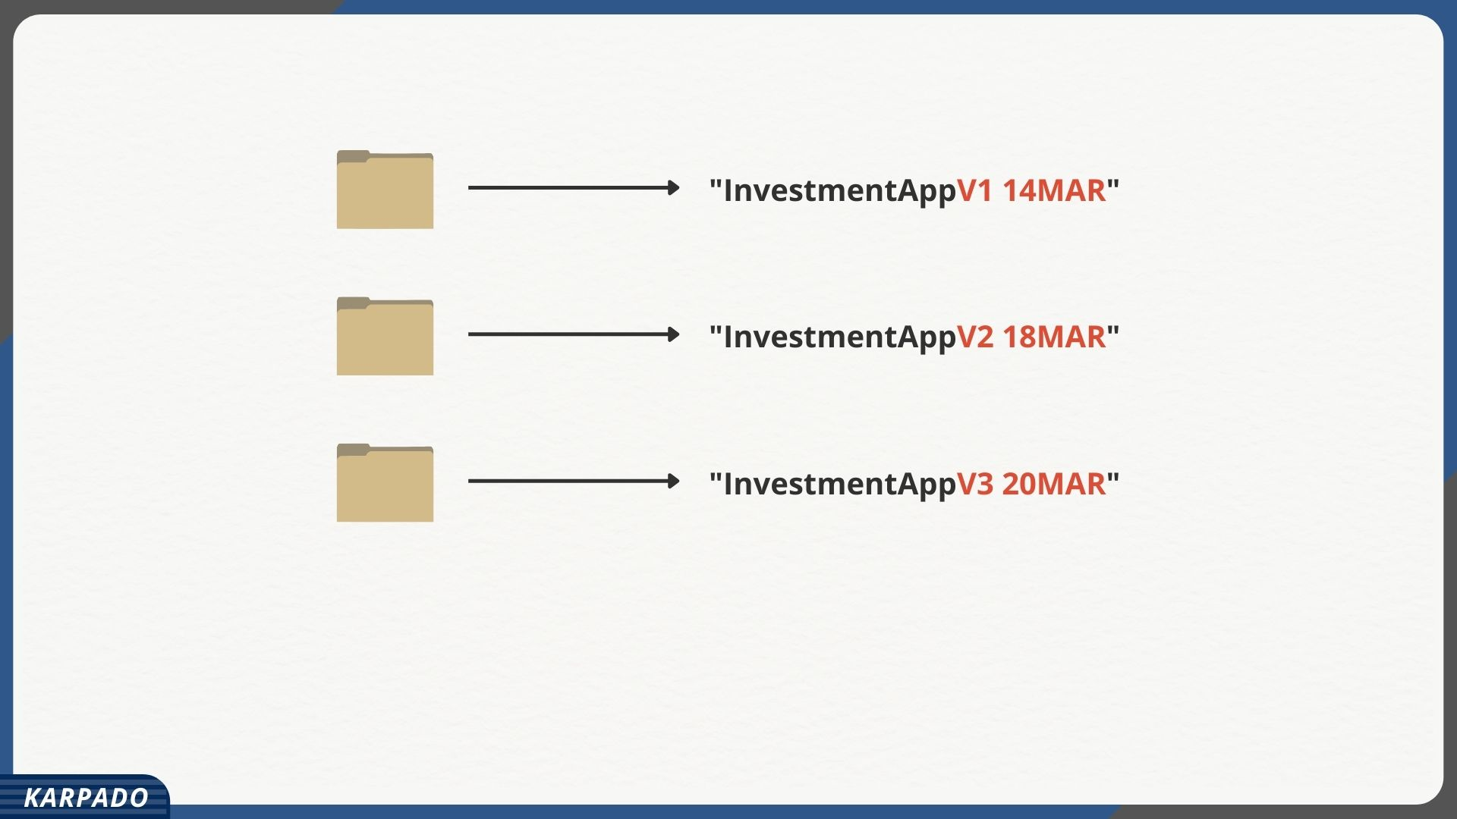

Slide 21
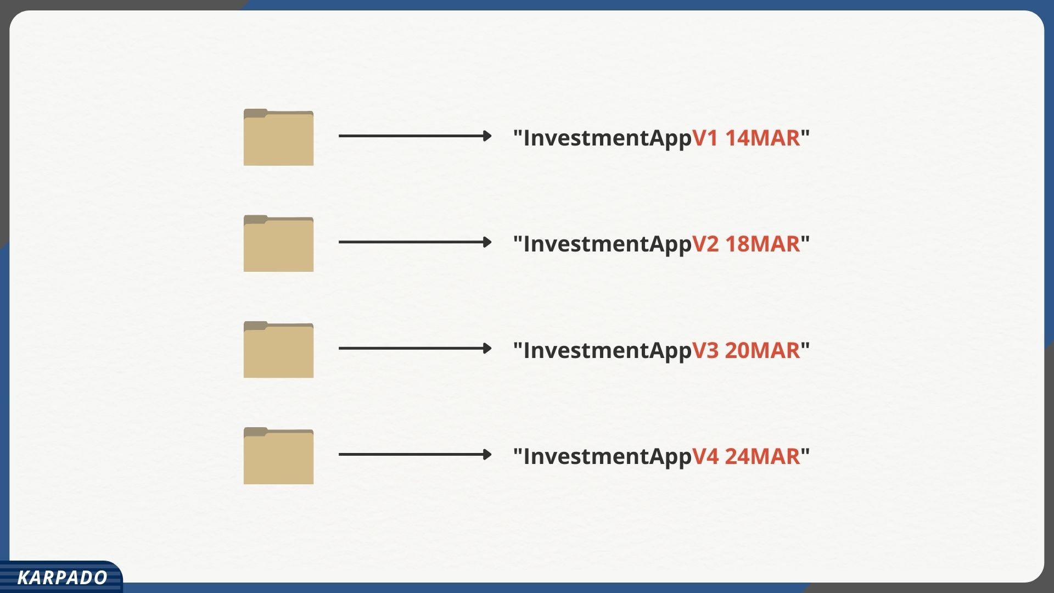

Slide 22
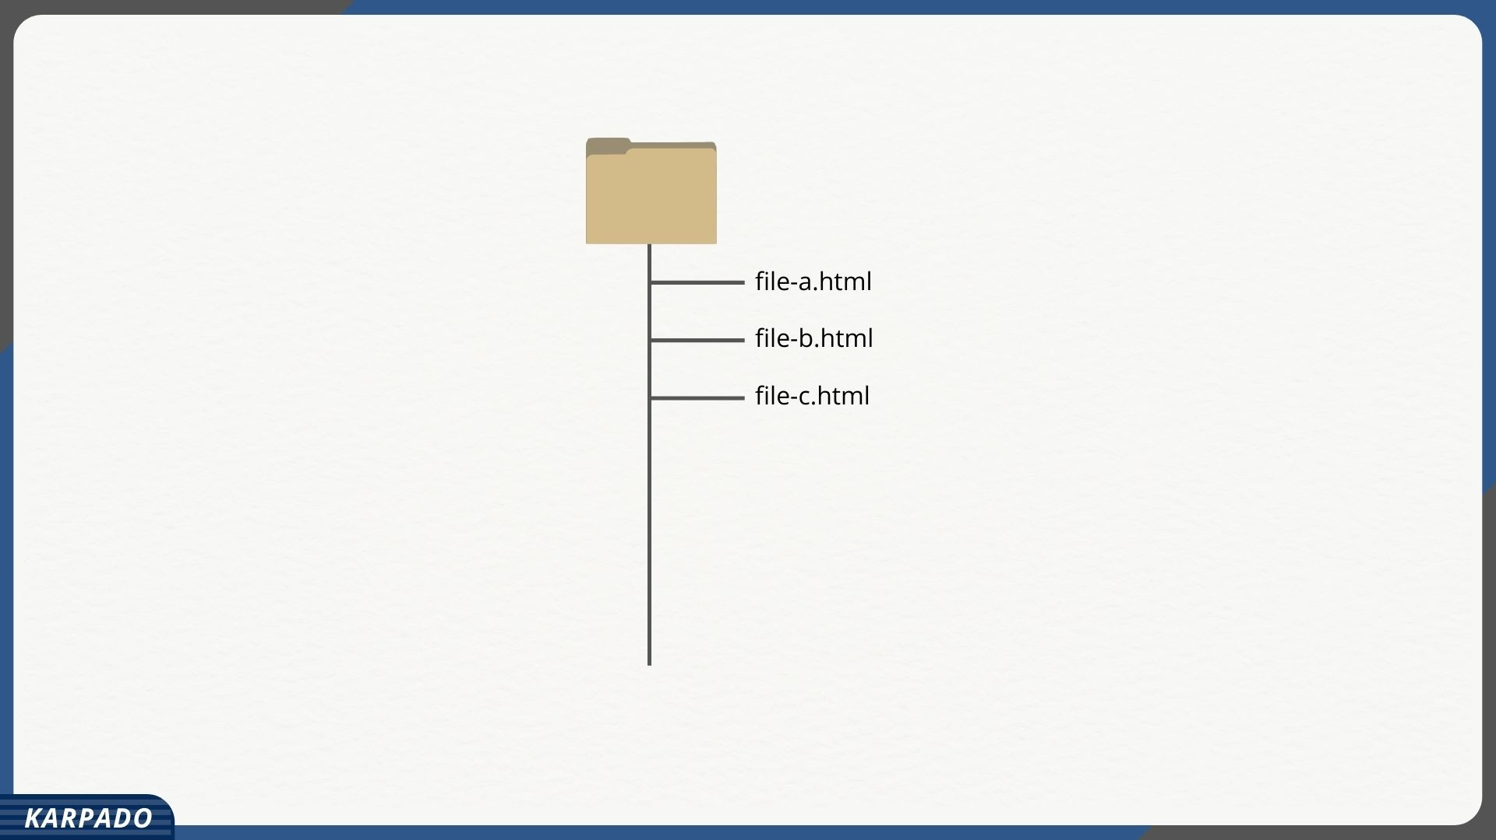

Slide 23
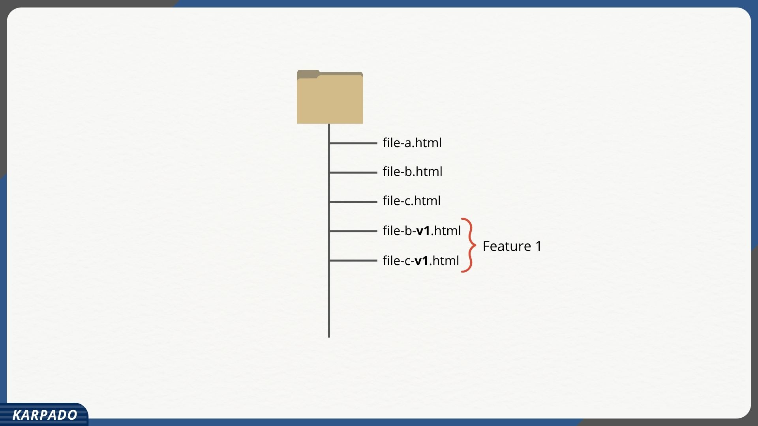

Slide 24
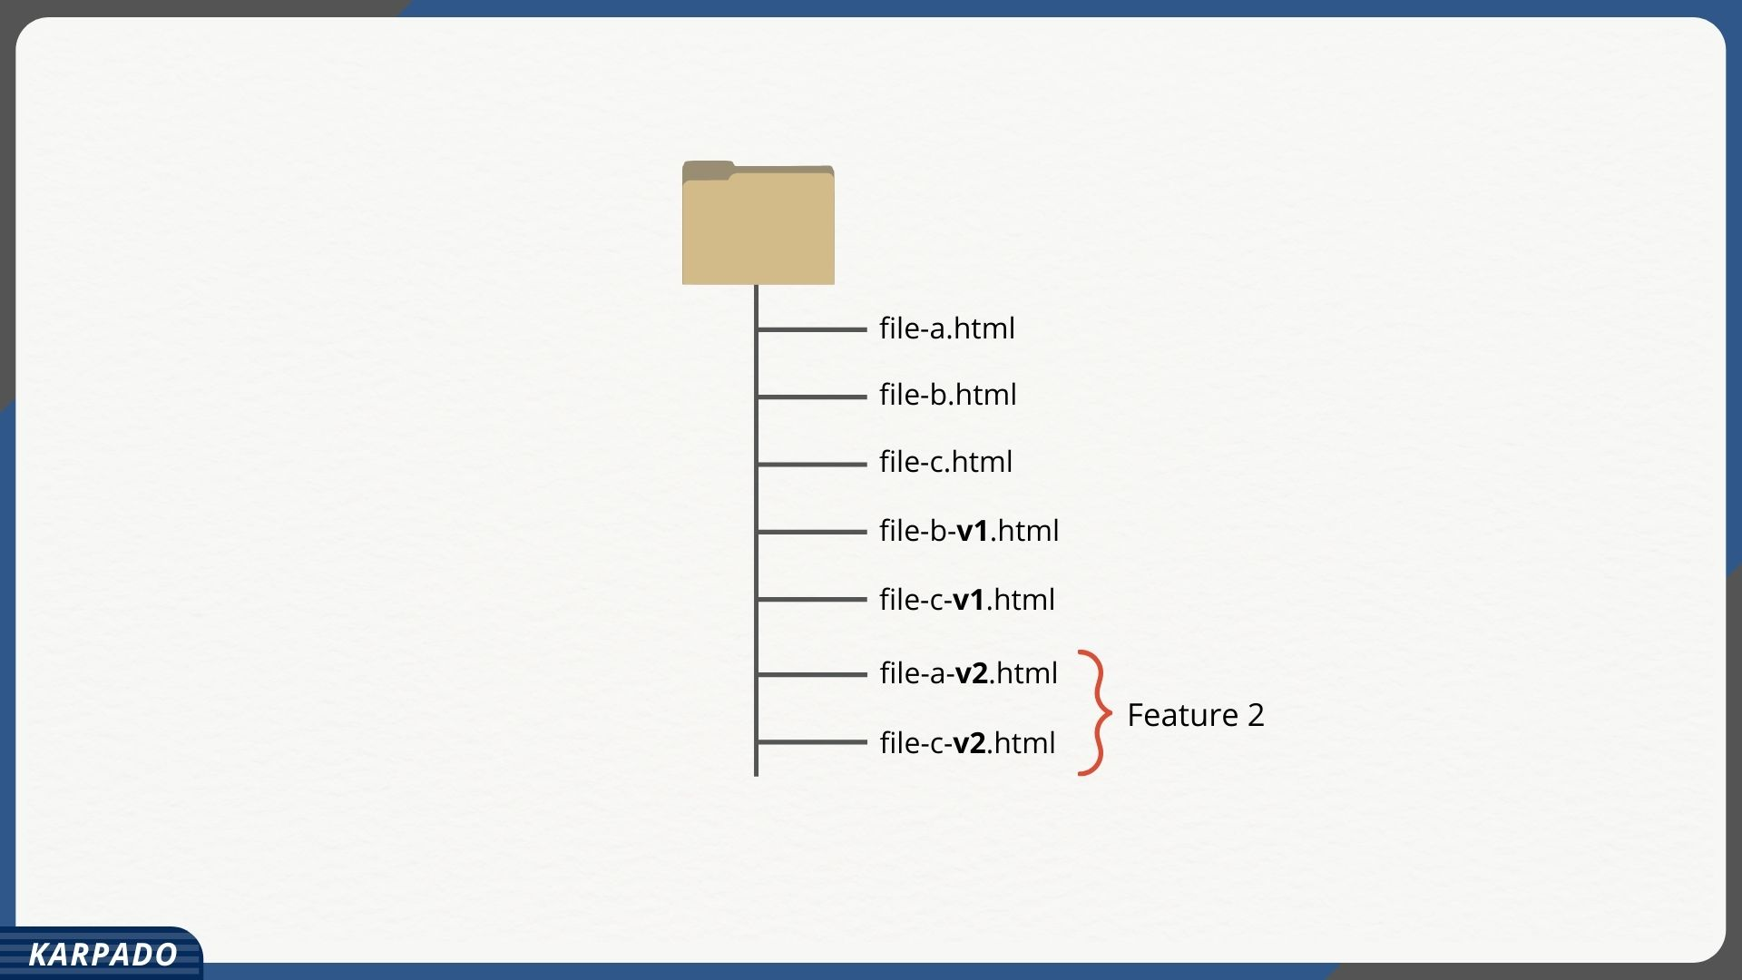

Slide 25
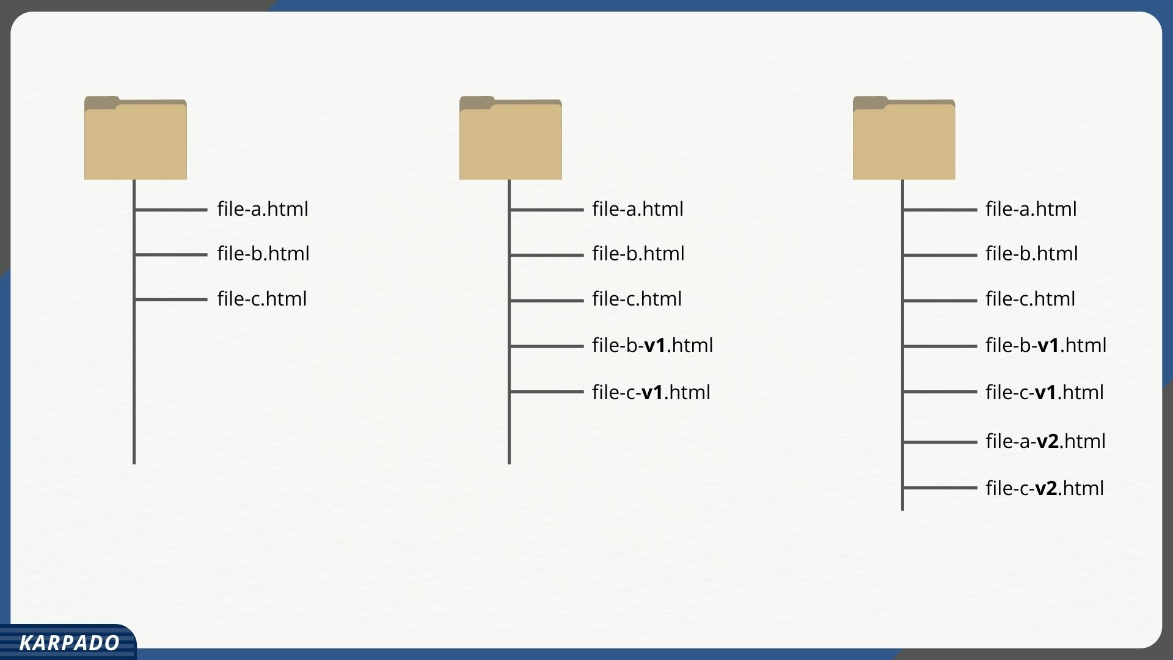

Slide 26

Manage versions
Track historical changes
Create backups
Allow reversal of changes

Slide 27
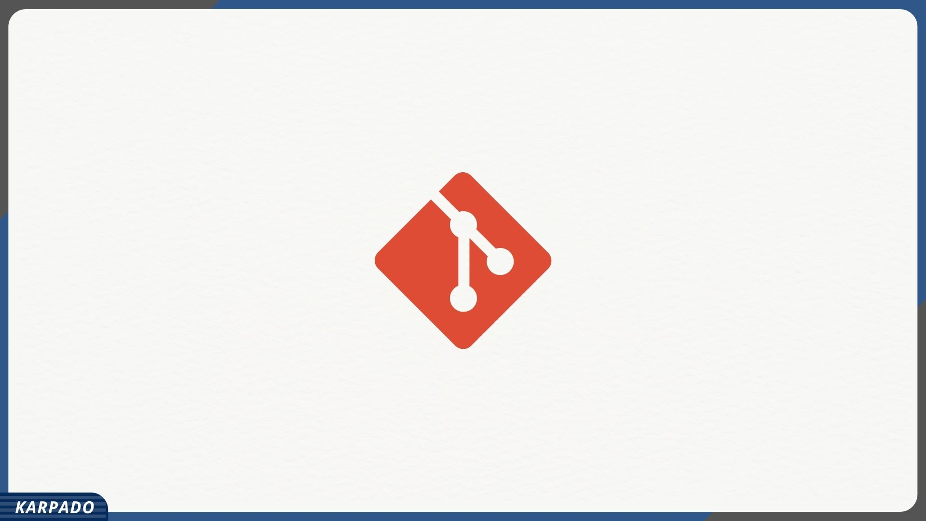

Slide 28
Manage versions
Track historical changes
Create backups
Allow reversal of changes

Slide 29

Manage versions
Track historical changes
Create backups
Allow reversal of changes

Slide 30

Manage versions
Track historical changes
Create backups
Allow reversal of changes

