Slide 1
Junos OS Fundamentals
Juniper software architecture and traffic handling

Slide 2
Control / Forwarding Planes
#
The Routing Engine and Packet Forwarding Engine

Slide 3
Control and Forwarding Planes
Control Plane
The control plane is made up of the Routing Engine (RE) which is responsible for rpd, handling chassis components, system management, user access, etc. Importantly, the RE manages the Routing Table (RT), and from it derives the Forwarding Table (FT)
Forwarding Plane
The forwarding plane is made up of the Packet Forwarding Engine (PFE). The PFE uses the FT to forward transit traffic through the device. Any traffic which does not match to the FT or requires further processing will be forwarded to the RE
Control Plane
RT
FT
Routing Engine
Packet Forwarding Engine
FT
Forwarding Plane

Slide 4
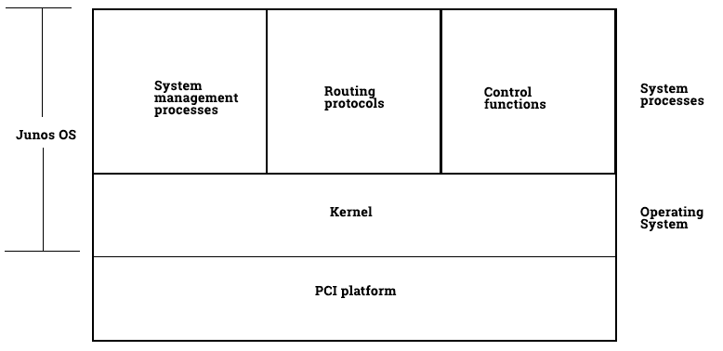
Routing Engine
Junos OS
The Routing Engine runs Junos OS
and consists of all processes and PCI
platform which the OS runs on
6 main functions
Handling of routing protocol packets
Management interface
Configuration management
Accounting and alarms
Modular Software
Scalability
Notes:
PCI - Peripheral Component Interconnect

Slide 5
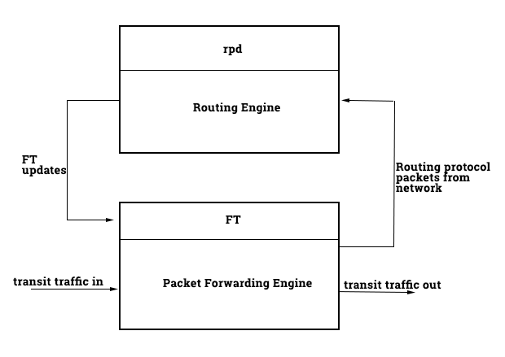
Packet Forwarding Engine
Transit traffic
The PFE’s primary job is to handle and forward
transit traffic to the correct destination, as quickly
as possible
3 components with ASICs
Switching control board
Physical Interface Card (PIC)
Flexible PIC Concentrator (FPC)
Notes:
PCI - Peripheral Component Interconnect

Slide 6
Additional Resources
https://www.juniper.net/documentation/en_US/junos/topics/concept/junos-software-architecture.html
Notes:
PCI - Peripheral Component Interconnect

