Slide 1
Junos OS Fundamentals
Juniper software architecture and traffic handling

Slide 2
Traffic Processing
#
Transit and Exception Traffic

Slide 3
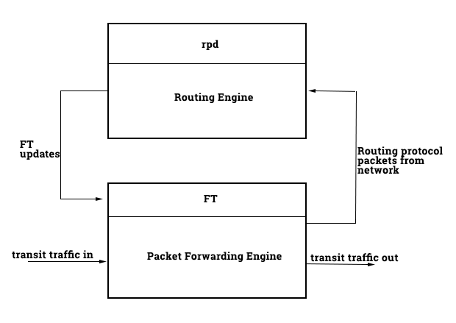
Transit Traffic
Handled by Packet Forwarding Engine
Transit traffic is never seen by the RE. This traffic is never destined for the Juniper device itself. Its destination has an entry in the FT and is entirely handled by the PFE

Slide 4
Exception Traffic
Destined for the router, examples:
Management (SSH,Telnet, etc.) to the device
Ping (ICMP) destined for the device
Routing protocol (OSPF, BGP, etc.) messages
Other exception traffic:
‘punted’ ICMP traffic
IP traffic with IP options set
Notes:
PCI - Peripheral Component Interconnect

Slide 5
INSR ICON

