Slide 1
Junos OS User Interfaces
Interacting with Junos OS

Slide 2
CLI Overview
#
BSD Shell and CLI modes

Slide 3
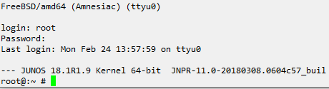
Unix BSD Shell
Accessible from root
When logging in as ‘root’ user, you will be placed into the BSD shell. No routing, switching, or security operations can be done here. This is for interacting with the underlying Unix OS and the filesystem.
Unix commands like top, mkdir, mount, cat.. Are accessible from here

Slide 4
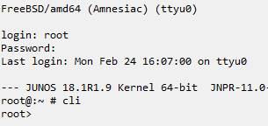
Operational Mode
Function
Operational mode allows for monitoring and troubleshooting the device.
Angle bracket prompt >
One is easily able to determine the CLI is currently in operational mode by the angle bracket prompt.

Slide 5
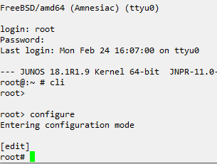
Configuration (edit) Mode
[edit]
Officially named configuration mode, some call it edit mode due to the [edit] string displayed above the prompt showing the current place in the configuration hierarchy
Hash prompt #
Configuration mode can be readily recognized by the # displayed at the prompt.
Notes:
Example steps:
Log into device as root and show shell prompt. Give example of unix commands to be used, like ls, pwd, top, mkdir. Perhaps show vi
Launch operational mode cli. Make note of the prompt change. Run show commands like show interfaces terse, show version, show chassis firmware.
Exit and enter cli again to show how
Enter edit mode using edit and config. Make note of prompt change
Run operational commands using the run command

