Slide 1
Junos OS User Interfaces
Interacting with Junos OS

Slide 2
CLI Overview – part 2
#
Navigation, configuration, help and filtering

Slide 3
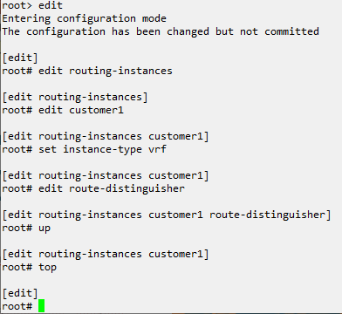
Navigating Configuration
Configuration Hierarchy
The current position in the configuration hierarchy is displayed above the edit mode prompt
Moving up and down
Using the up keyword will moving the current position one level out of the current hierarchy. The top keyword will return to the root or top of the hierarchy.

Slide 4
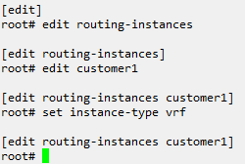
Setting Configuration
Directly or within hierarchy
Configuration is applied using the set keyword. This can be done at any point in the hierarchy if the correct location is specified.
Both sets of commands are equivalent

Slide 5
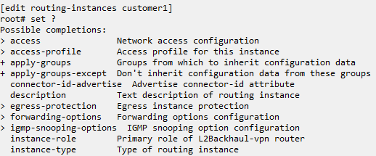
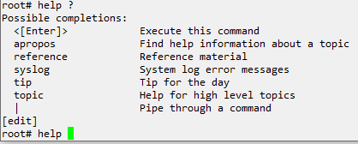
Using Help
Contextual help
Typing a ? Will show available commands or possible completions to the command currently written. This includes listing configured items like policies or address lists. Available in operational and configuration mode, but not Shell
Help command
The help command can provide detailed information for a command or list where the topic is referenced, to show commands or topics which are related or similar.

Slide 6
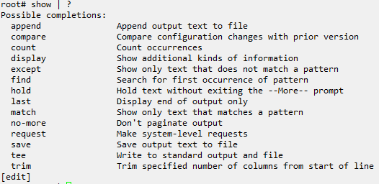
Filtering Outputs
Command outputs are filtered with pipe |
Options include counting lines returned, only returning a line of text which contains a matched subtext, comparing the current configuration with a previous configuration, along with several other options.
Notes:
Example steps:
Show configuration navigation. Going into hierarchy, up, top, exit.
Set a configuration. Type show to show the configuration. Delete a configuration line, show from higher
Show usage of the help command, apropos, contextual help, tab autocomplete.
Show usage of pipe and filtering output. Use match and compare as example.

