Slide 1
Junos OS User Interfaces
Interacting with Junos OS

Slide 2
Junos Config Concepts
#
Modifying the active and candidate configurations

Slide 3
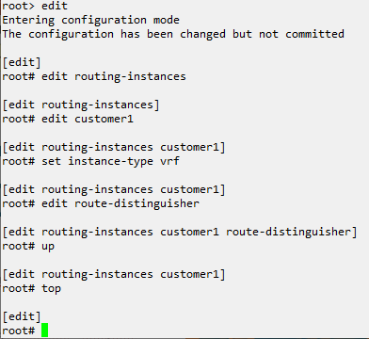
Candidate Configuration
Has not been committed
The candidate configuration is not yet active on the device; when entering configuration mode we are reminded of this.
Has no effect until committed
Any changes made to the candidate configuration have no effect on the device until it has been committed.

Slide 4
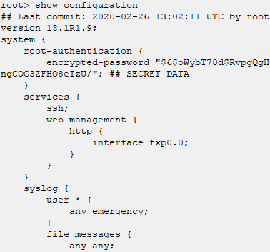
Active Configuration
Currently running configuration
The active configuration is what is currently running. It has been previously committed or is the default configuration.
Stored in /config/juniper.conf.gz

Slide 5
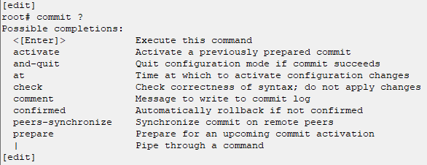
Committing Configuration
Commit Methods
Several methods exist for committing a candidate configuration to assist with checking its viability or saving/scheduling the configuration to be committed later.
Notes:
Example Steps:
edit system login user ben
set authentication plain-text-password
set class super-user
Exit, don’t commit, show warning
Try logging in, show it doesn’t work.
Re-apply configuration
Show commit check
show commit confirmed
Show commit
Verify login works

