Slide 1
Junos OS User Interfaces
Interacting with Junos OS

Slide 2
Working with Configs
#
Managing, viewing, comparing, and loading configurations

Slide 3
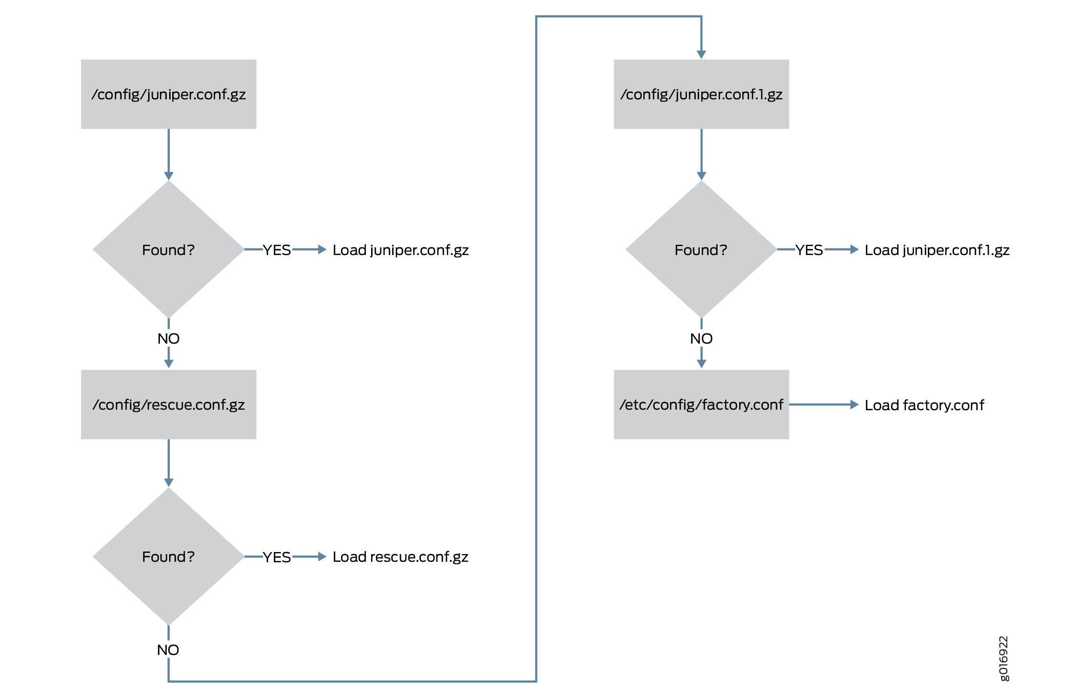
Configuration Load Sequence

Slide 4
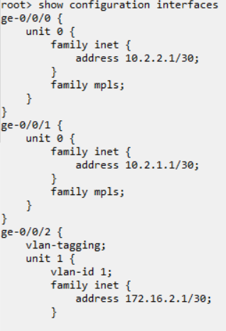
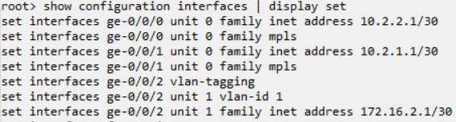
Viewing Configuration
Hierarchical
Default configuration view is in hierarchical format with sections defined within braces.
Set Display
Piping the command to ‘display set’ will show the configuration mode commands used to set the configuration.

Slide 5
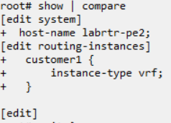
Comparing Candidate/Active
Show | compare
Piping to the compare command will give a set display of the delta of the candidate configuration in reference to the active configuration. Lines removed will have a minus (-) and lines added will have a plus (+)

Slide 6
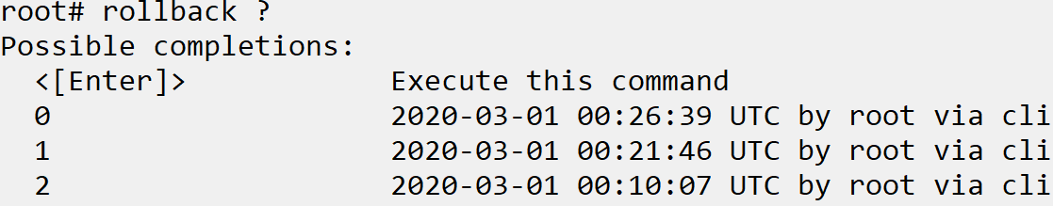
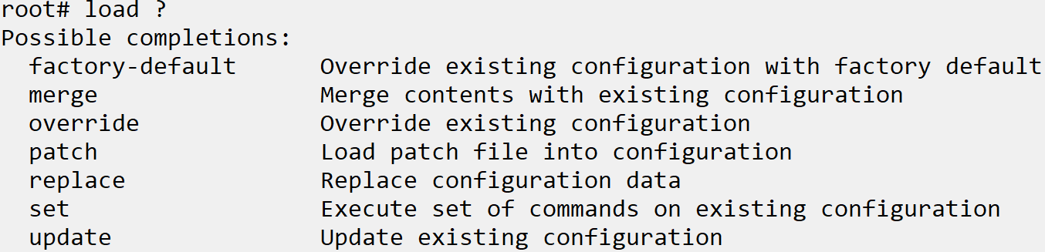
Loading and Rollback
Rollback configuration
Most Juniper devices store up to 50 previously committed configurations. Entering the ‘rollback #’ command will load the previously committed configuration as the candidate
Load configuration
Load a previously saved configuration to candidate from a file or external location using the ‘load’ command
Notes:
Example steps:
Show config locations: /config , /etc/config
Set rescue configuration, (set root pw, commit and set rescue) show location /config/rescue
Set hostname, interface IP then Show|compare
Commit, change interface IP then show|compare
Commit, display hierarchical and show| display set the IP
Rollback 1, show | compare
Save config to file. Rollback 0, show|compare, load merge, show | compare

