Slide 1
Junos OS User Interfaces
Interacting with Junos OS

Slide 2
J-Web Overview
#
Navigating the Junos web-based GUI

Slide 3
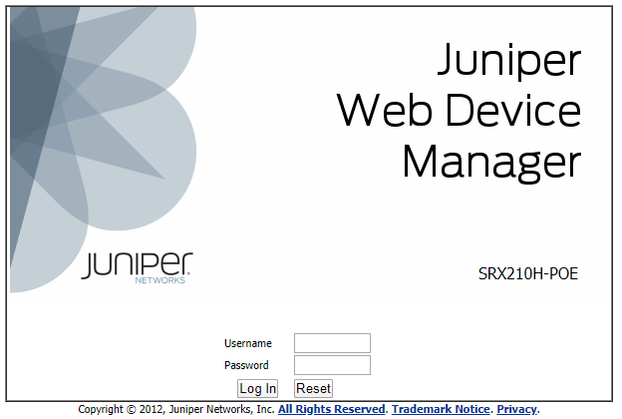
Accessing the GUI
Set root-authentication
In order to log into the web interface, the root-authentication password must first be set on the device by the CLI.
Check Juniper documentation
The configuration needed before the J-Web interface can be accessed varies slightly between platforms, check Juniper’s documentation for information on how to access your device’s J-Web interface.

Slide 4
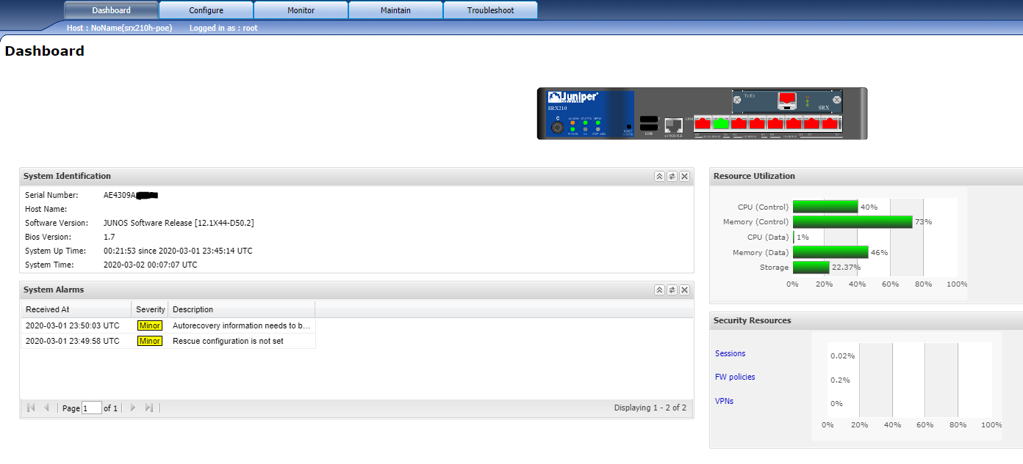
Dashboard
Notes:
Note: requires flash

Slide 5
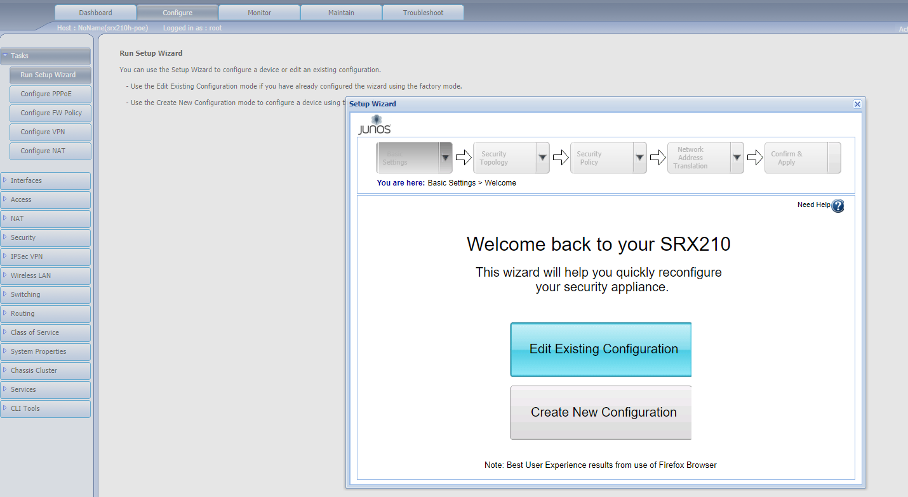
Configure and Setup Wizard

Slide 6
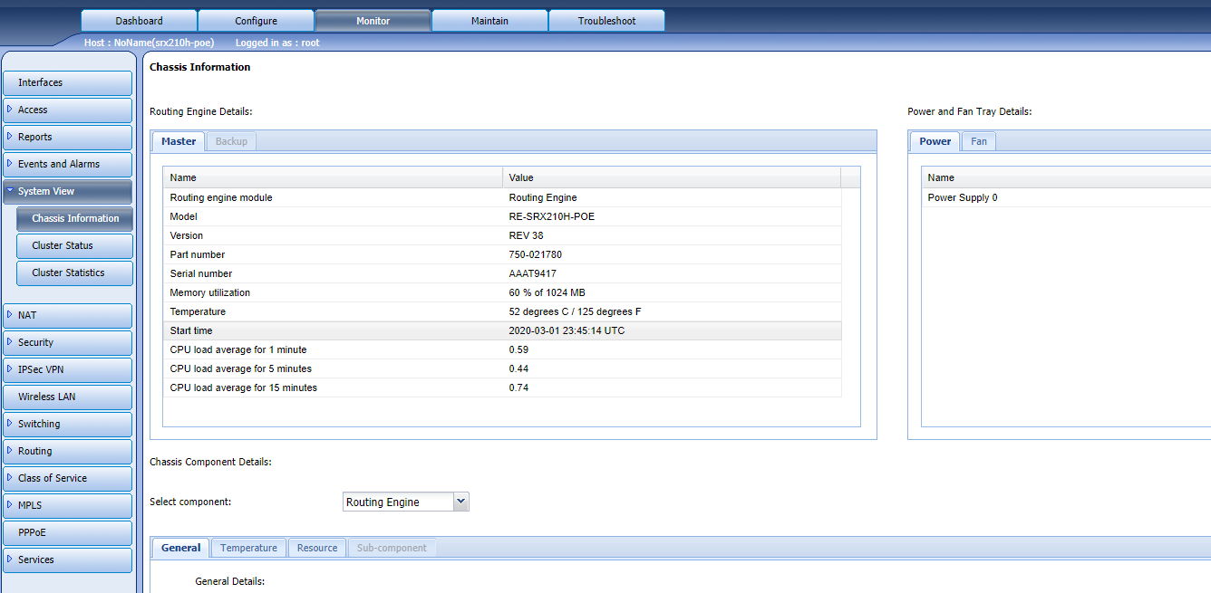
Monitoring Status

Slide 7
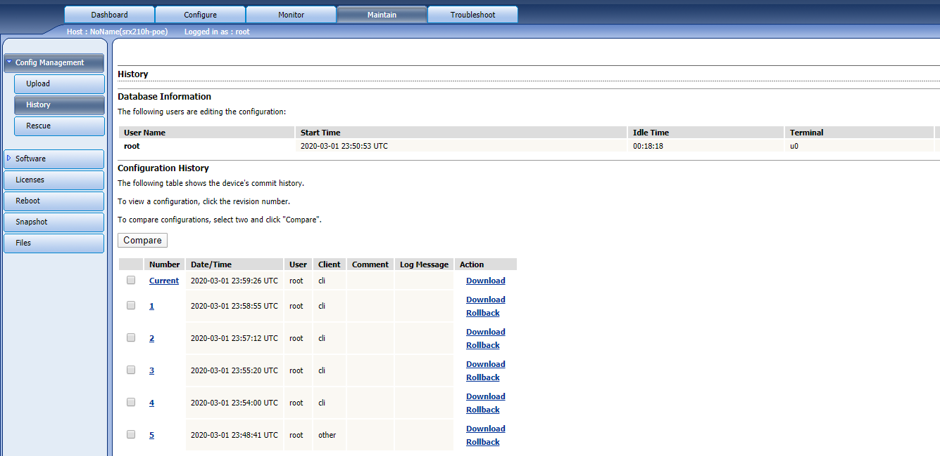
Maintenance

Slide 8
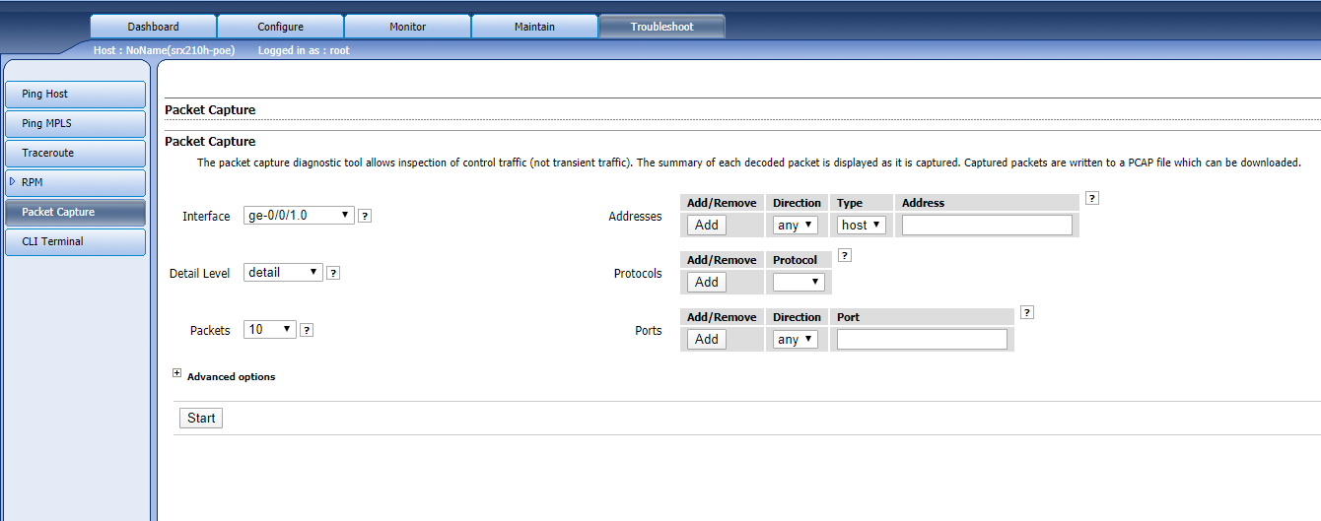
Troubleshooting

