Slide 1
Junos OS Configuration
Setting up a Juniper device

Slide 2
Authentication Config
#
Creating and setting login classes and authentication methods

Slide 3
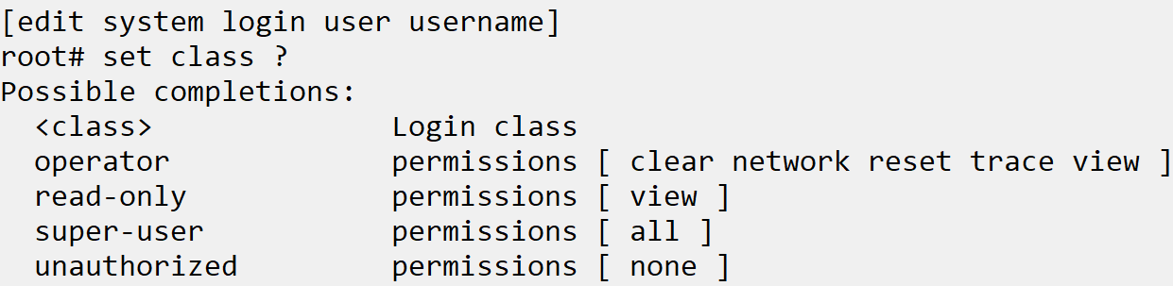
Login Classes
Role-Based Access Control
Login classes allow for a set of permissions to be applied to a user account. This is typically used for RBAC.
Default Login Classes
There are 4 default login classes:
Operator
Read-only
Super-user
Unauthorized

Slide 4
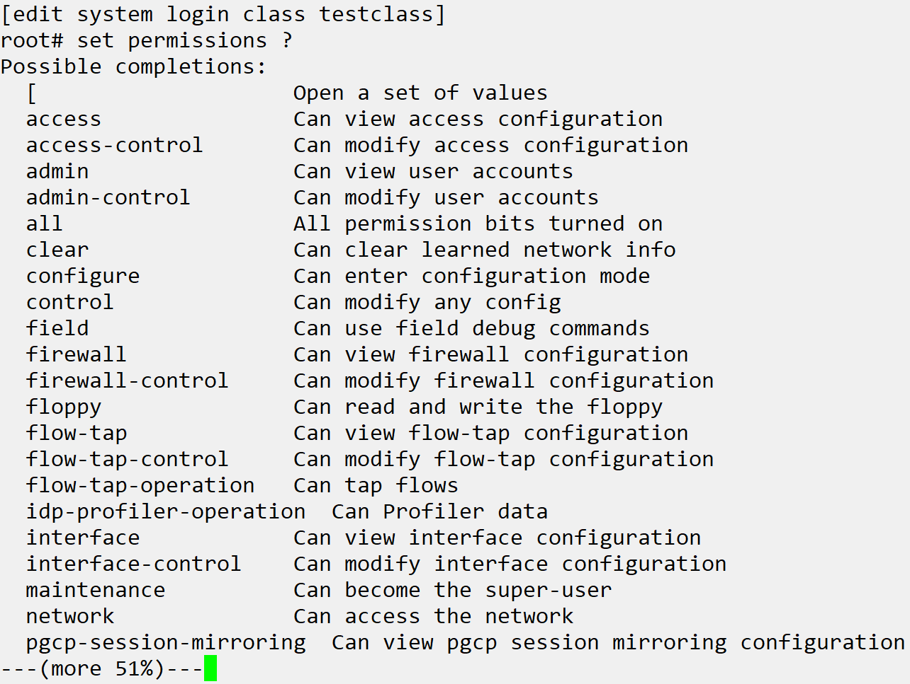
Creating Login Classes
Permission Bits
Access privileges for custom login classes are assigned by one or more permission bits. There are 30+ permission bits, more than can be listed here
Allow/Deny specific commands
In addition to permissions bits, you can explicitly deny or allow the use of operational and configuration mode commands that are otherwise permitted or not allowed by a permission bit.
All users must have a login class
In order to log into the deice, the username must be assigned a login class.

Slide 5
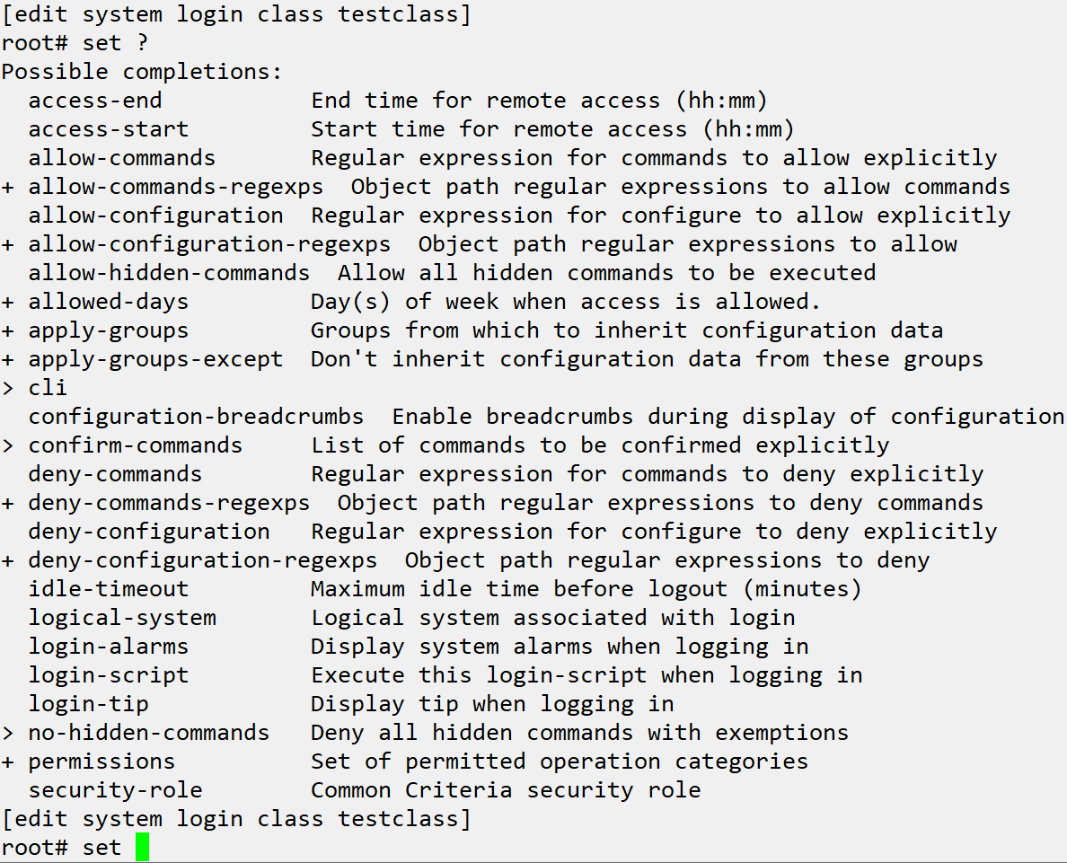
Creating Login Classes Cont.

Slide 6
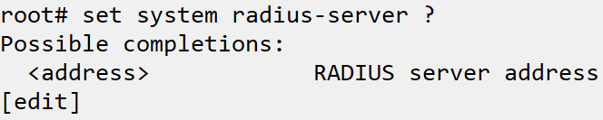
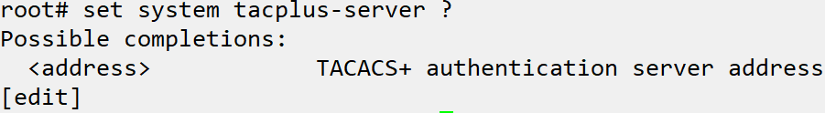
User Authentication Methods
3 methods supported by Junos
Junos OS supports authenticating users by local password authentication, Remote Authentication Dial-In User Service (RADIUS), and Terminal Access Controller Access Control System Plus (TACACS+).
JNCIA only concerned with management access
Junos OS support controlling access to the LAN via several authentication methods, but the JNCIA is only concerned with management access. Junos can be configured as both a RADIUS and TACACS+ client, along with having local accounts configured. The authentication methods can be prioritized to specify the order in which they are tried during login.

Slide 7
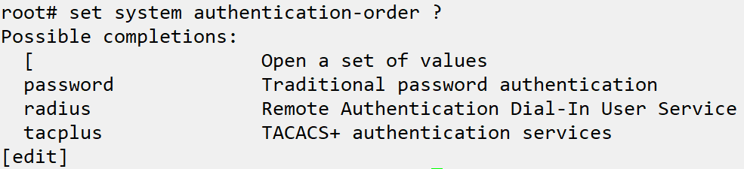
Authentication Method Order
Will always fallback on communication failure
If Junos tries to reach out to the TACACS+ or RADIUS authentication servers and there is communication error or no response, then the local database will always be checked next regardless of whether it is included in authentication order
Subsequent methods in order tried on rejection
If multiple authentication methods are defined in the authentication-order, they will be tried in the order entered if authentication is rejected or if there is a communication failure.
Notes:
Create local user
Set system login user tech plain-text-authentication
Assign to read only class, login and show effect
Create interface tech class with only interface access
set system login class int-tech permissions configure
set system login class int-tech permissions interface
set system login class int-tech permissions interface-control
set system login class int-tech permissions view
Assign, login and show effect
Set system login user tech class int-tech
Set authentication method order to radius only
set system authentication-order radius
Use local account, show able to log in even though password method is missing

