Slide 1
Junos OS Configuration
Setting up a Juniper device

Slide 2
Advanced Configuration
#
Configuration groups, archival and rescue

Slide 3
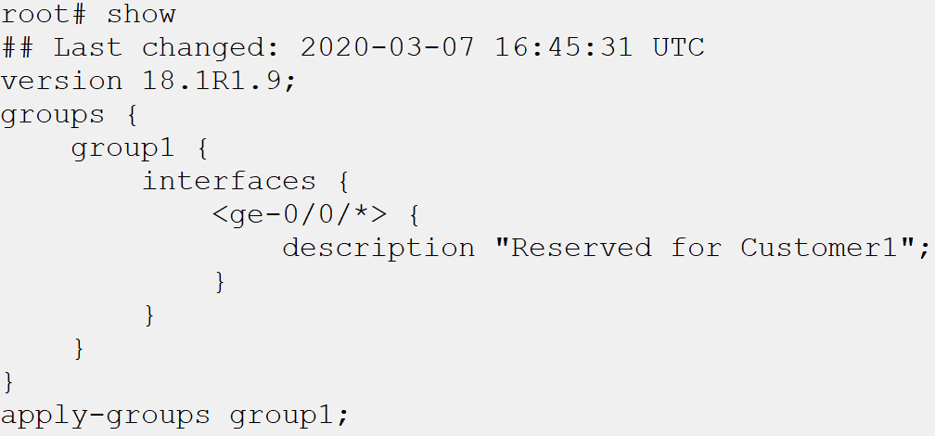
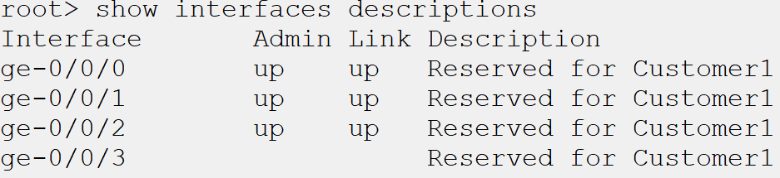
Configuration Groups
Used to limit repeated commands in configuration files
Inheritance can be excluded
Exclude a section from inheriting configuration from a group using the apply-groups-except command
Only apply within current logical system
To apply configuration groups to a nondefault logical system, the apply-groups command must be entered within that logical system

Slide 4
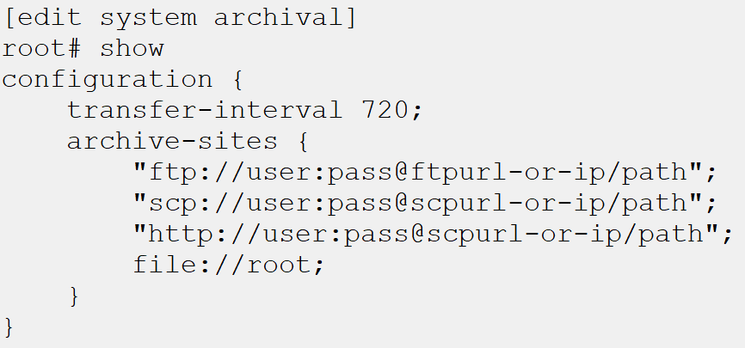
Archiving Configuration
Active configuration can be periodically backed up
Configuration archival will periodically backup the active configuration on the device to a location either physically on or off the device.
File name is not customizable
The file name used for the archived configuration follows the format of
<router-name>_YYYYMMDD_HHMMSS_juniper.conf.n.gz
Periodic interval can be immediate or specified
The transfer-on-commit command will archive the configuration on every commit, where transfer-interval will transfer periodically, every 15 to 2880 minutes

Slide 5
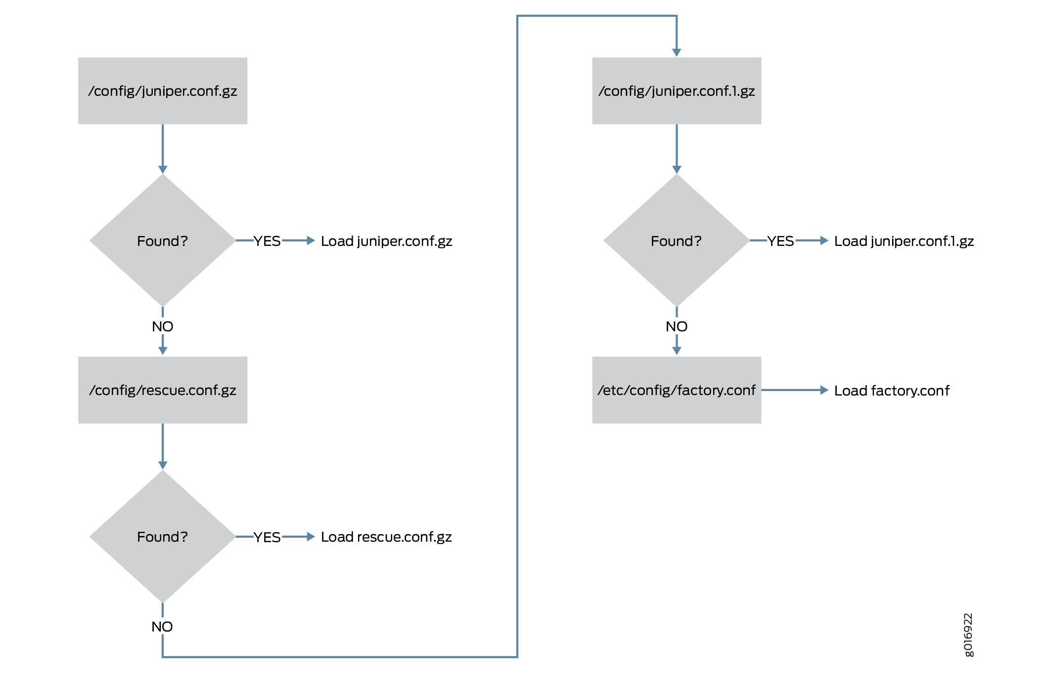
Rescue Configuration
Used if active configuration is corrupt
If the active configuration is corrupt or otherwise unable to be loaded or found, the next configuration Junos attempts to load is the rescue configuration.
Should be known working with management
This configuration should be one which is in a known state and has management access. It can be loaded on-demand with the rollback rescue command in configuration mode
Can be updated as baselines change
As your organization evolves, baselines for the devices may change. The rescue configuration can be updated with the request system configuration rescue save command in operational mode
Notes:
Example steps:
Create group for gigethernet interfaces, all ge interfaces.
Set description to be reserved for Customer1
set groups testgroup interfaces <ge-0/0/*> description "reserved for Customer1"
Commit and review changes
Disable inheritance on one of the interfaces, commit and show effect.
set interfaces ge-0/0/0 apply-groups-except testgroup
Set local file configuration archive
Set transfer on commit. Commit and show archive file
set system archival configuration transfer-on-commit
set system archival configuration archive-sites file://cf/root/
Home directory for root user. Commit again to ensure transfer.
Set an IP on an interface. Commit and set rescue configuration
Change IP, commit. Rollback rescue. Show | compare

Slide 6
Additional Resources
https://www.juniper.net/documentation/en_US/junos/topics/topic-map/configuration-groups-usage.html
https://www.juniper.net/documentation/en_US/junos/topics/task/configuration/junos-software-system-management-router-configuration-archiving.html

