Slide 1
Junos OS Configuration
Setting up a Juniper device

Slide 2
Logging and Tracing
#
Logging, syslog and trace options and locations

Slide 3
Logging
Facility (#) | Description
Kernel (0) | Events or errors for the Junos OS kernel
User (1) | Events or errors for the user-space processes
Daemon (3) | Events or errors for the system processes
Authorization (4) | Authentication and authorization attempts
ftp (11) | Events or errors for the FTP process
ntp (12) | Events or errors for the NTP processes.
Security (13) | Security related events or errors.
dfc (17) | Events related to dynamic flow capture
External (18) | Events or errors for the local external applications.
Firewall (19) | Packet filtering actions performed by a firewall filter
pfe (20) | Events or errors for the Packet Forwarding Engine
Conflict-log (21) | Specified configuration is invalid on the router type
Change-log (22) | Changes to the Junos OS configuration
Interactive-commands (23) | Commands issued at the Junos OS command-line interface (CLI) prompt or by a client application such as a Junos XML protocol or NETCONF XML client
Log files stored in /var/log/
Not all logging facilities can be configured
The facilities listed in this table are all those which can be configured at the [edit system syslog] hierarchy
View syslogs in the messages file
By default, syslog messages are stored in the /var/log/messages file. This can be viewed using the show log messages operational mode command
Notes:
Note facility name when syslogs sent to a collector are not the same as logged internally

Slide 4

Log Severity
Severity level includes all lower levels
When configuring the severity level to save to a log file or send to a remote server, the level specified includes all lower numbers (more severe)
Often referenced in exams
Take note of the order of severities; a question regarding this is very common in certification exams
Severity | Description
0 | Emergency
1 | Alert
2 | Critical
3 | Error
4 | Warning
5 | Notice
6 | Info
7 | Any

Slide 5
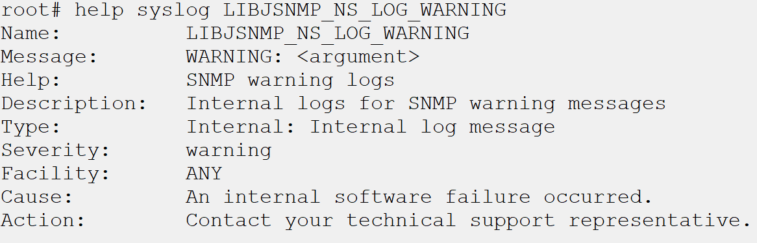
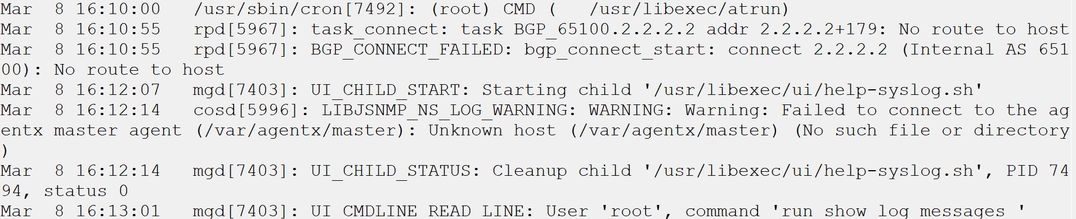
Syslog IDs
Consist of short all CAPS log titles
Severity not always in syslog message
Viewing the help topic on the syslog ID will provide more details on the message itself, and any recommended corrective action
Notes:
Point out LIBJSNMP_NS_LOG_WARNING
Will look up the syslog ID during example

Slide 6
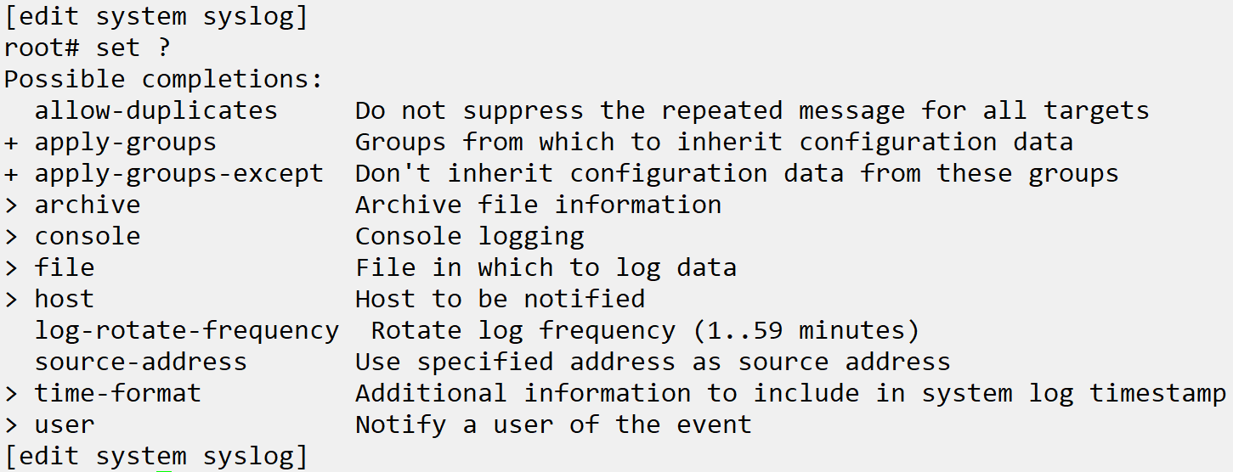
Syslog Configuration
Configured in [edit system syslog] hierarchy
Facility and Severity set for all destinations
When configuring user notification, file, host, or console logging the facility and severity are set for the configured destination

Slide 7
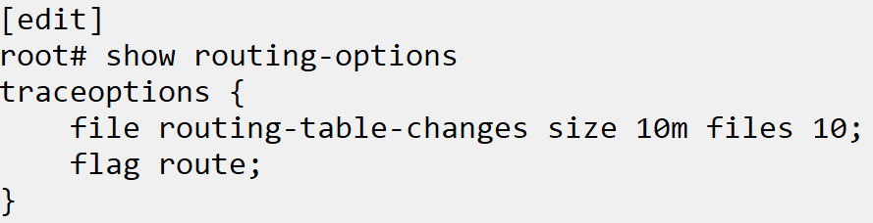
Traces
Used for debugging functions or areas
A trace provides debugging information, more detailed than syslogs, on any functional area or process of Junos OS.
Saved to a file in /var/log/ folder
The trace log can be viewed using the show log filename command at operational mode, and the file itself is stored in the /var/log/ directory.
Notes:
Example steps:
Review show log messages, match message type UI_CMDLINE_READ_LINE
Help syslog LIBJSNMP_NS_LOG_WARNING
Set system syslog console any any
set routing-options traceoptions file routing-table-changes
set routing-options traceoptions file size 10m
set routing-options traceoptions file files 10
set routing-options traceoptions flag route
set routing-options static route 1.1.1.2/32 next-hop 10.2.1.1
5. show log routing-table-changes

