Slide 1
Operational Monitoring and Maintenance
Maintaining a Juniper device

Slide 2
Gathering Information
#
Collecting device information via show and monitor commands

Slide 3
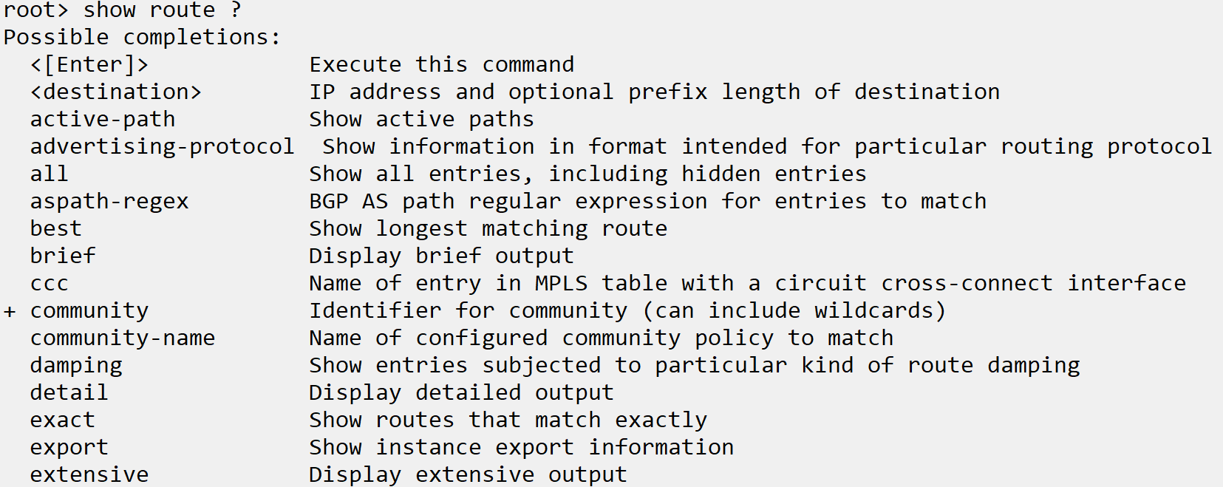
Useful show Commands
Show interfaces
This command can be modified with many keywords. Some useful and common ones are detail , descriptions, and terse
Show route
A very commonly used command which shows routes in all routing tables in Junos. Can be used with an IP address to only show routes containing the destination, and other keywords to limit the output

Slide 4
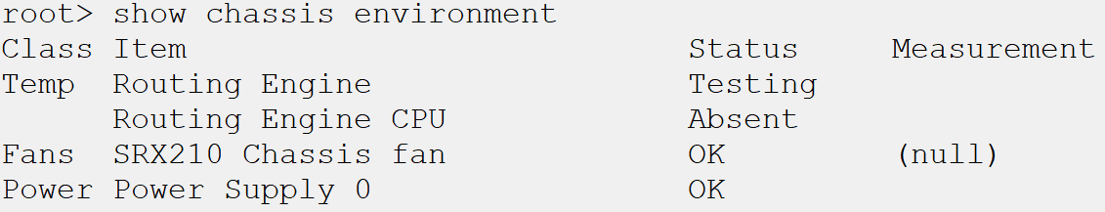
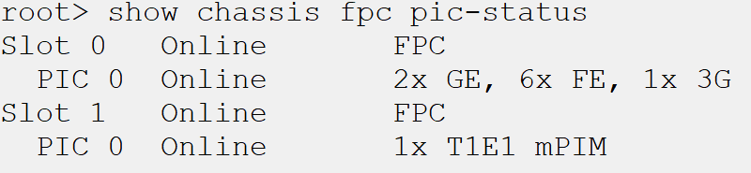
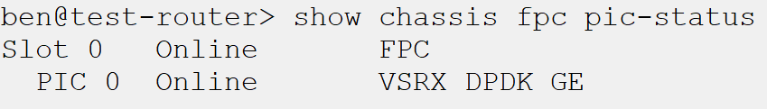
Useful show Commands cont’d
Show chassis environment
Used to display the temperature and voltage information from the onboard sensors.
Show chassis fpc pic-status
Displays the physical interface types contained in each PIC of each FPC. Useful for determining the type of transceiver inserted into an SFP slot.

Slide 5
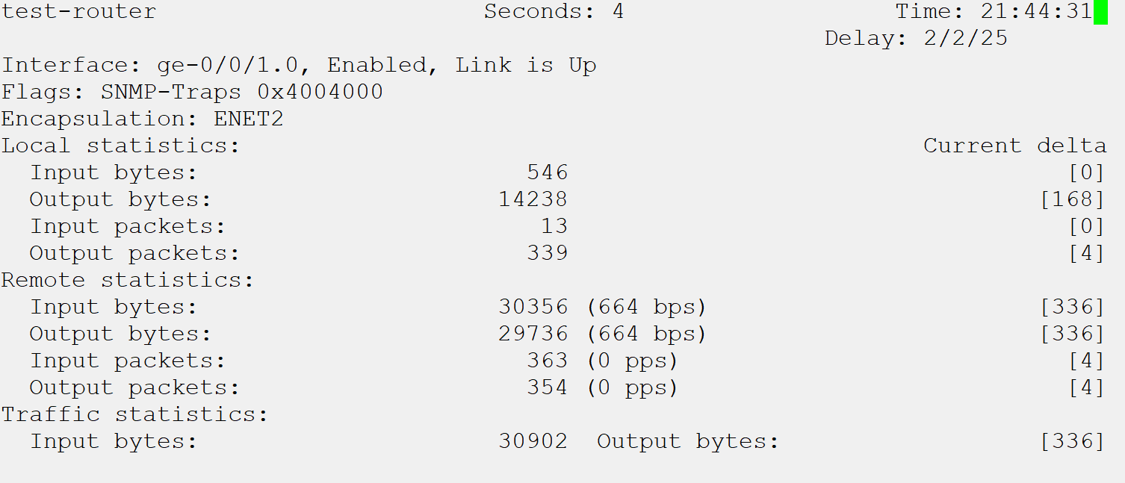
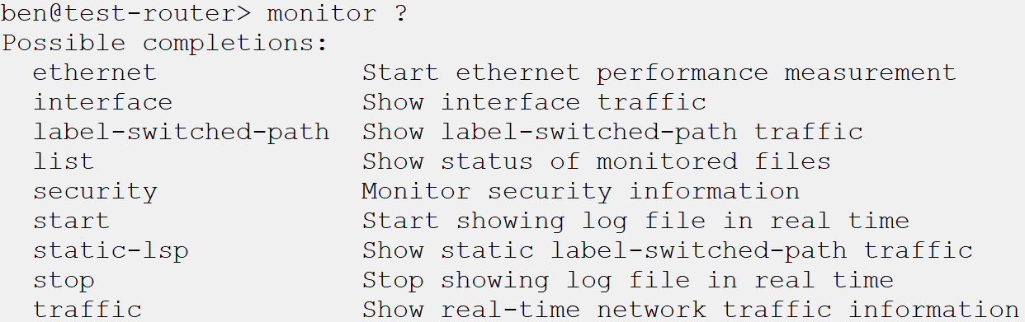
monitor Commands
Shows live information
Monitor commands are used to display real time information, usually traffic information or statistics
Can be used to display logs in real time

Slide 6
Output Modifiers
Required to efficiently gather information
Most show commands display a large amount of information. Output modifiers are required to weed out unwanted information
Severity not always in syslog message
Viewing the help topic on the syslog ID will provide more details on the message itself, and any recommended corrective action
Notes:
Example steps:
Show interfaces terse, show interfaces descriptions, show interfaces details
Show chassis environment, show fpc pic-status
Monitor interface. Monitor traffic, monitor start
Show | display set, show | find, show | match

