Slide 1
Operational Monitoring and Maintenance
Maintaining a Juniper device

Slide 2
Troubleshooting
#
Troubleshooting connectivity and access

Slide 3
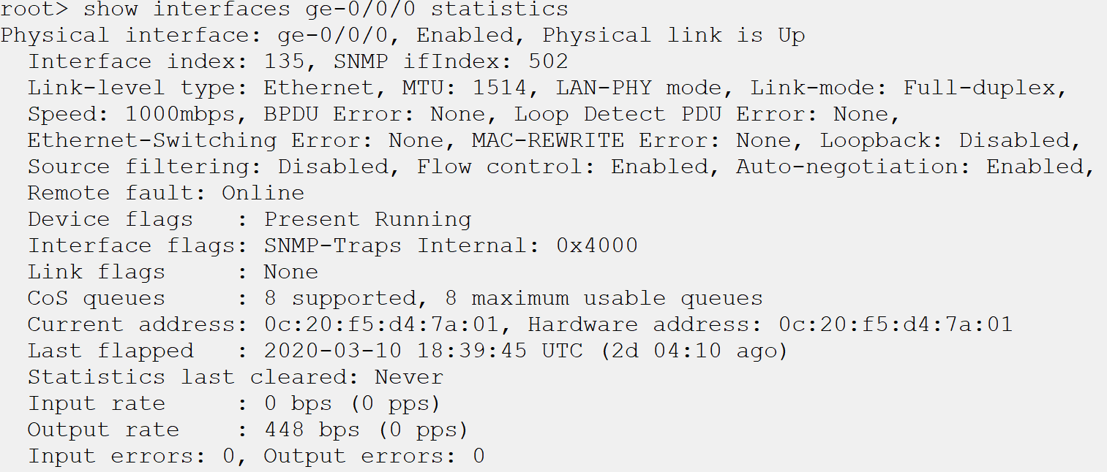
Interface Statistics
Provides a lot of detail
Interface statistics are viewed with the show interfaces <interface> statistics operational mode command.
More detail is found with the show interfaces <interface> statistics detail command
Great for layer 1 troubleshooting
Information provided in interface statistics can indicate layer 1 issues like duplex mismatch and bad cable runs.

Slide 4
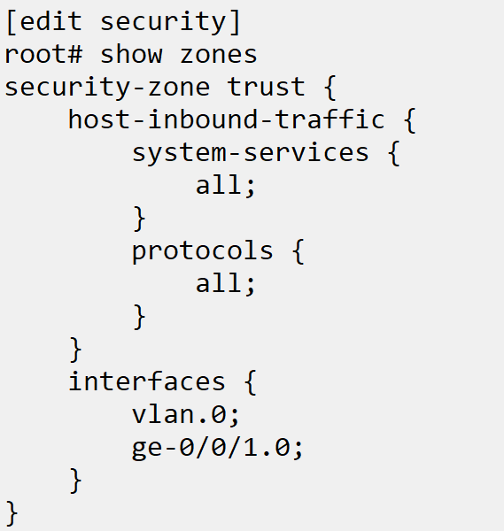
Connecting to the Device
SSH or Telnet may be used to manage
In order to connect to the device, the ssh or telnet service will need to be enabled in [edit system services] and the interface that receives the management traffic will need to be allowed in the firewall.
SSH keys are automatically created when it is allowed on the device.

Slide 5
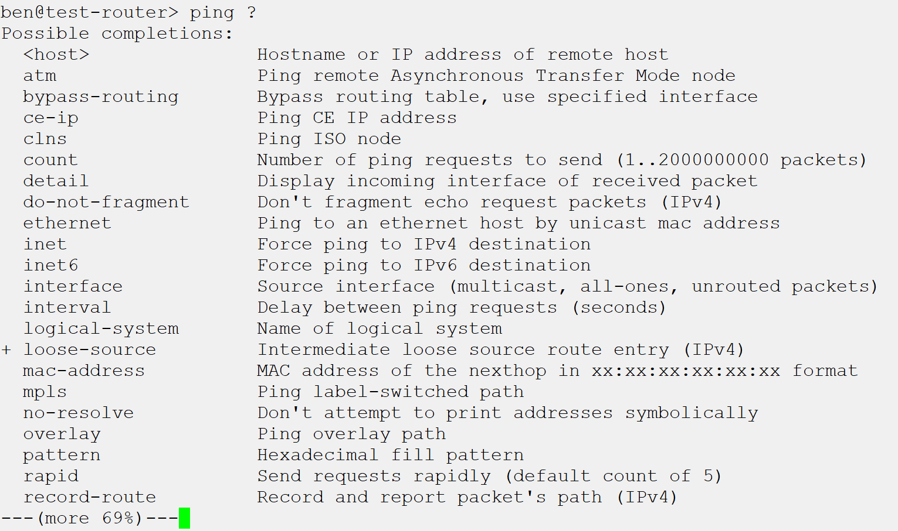
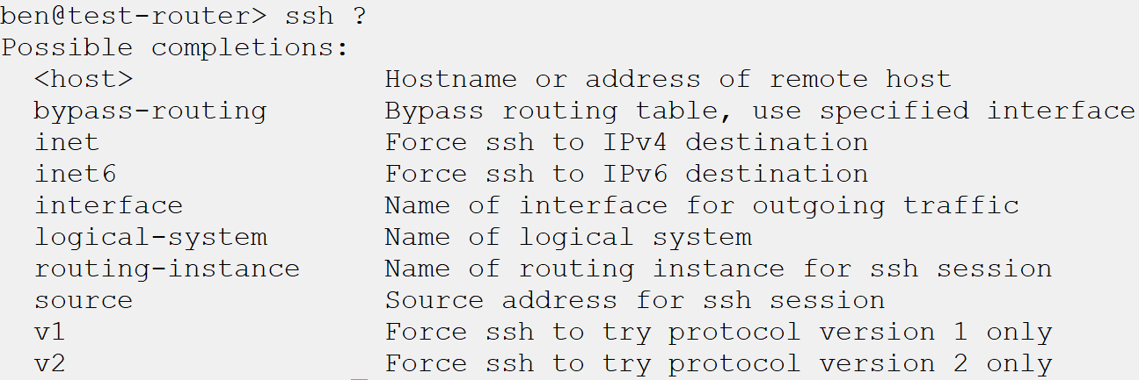
Tools in Junos
Telnet and SSH
From within Junos, the administrator is able to connect to other devices using the builtin telnet and SSH clients. This can be an invaluable tool when routing issues arise.
Ping and Traceroute
As the network administrator’s longtime friends for troubleshooting and verifying connectivity, these tools are also available as operational mode commands.

Slide 6
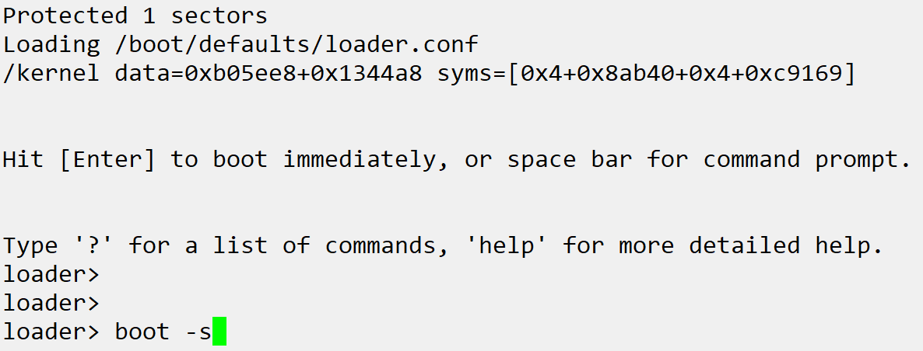
Root Password Recovery
It can happen to anyone
Perhaps the last administrator never wrote down the password; perhaps you were setting up a lab device and forgot what the password was set to. Regardless the reason, the need can arise for a root password recovery for even the most seasoned network administrators
Boot into single user mode
When configuring user notification, file, host, or console logging the facility and severity are set for the configured destination
Notes:
Example steps (requires 2 devices connected):
Review interface statistics and interface statistics detail
Set up SSH access on one device
Set IP on interface
Add interface to trust zone
Set IP on interface on connected device
Ping to confirm connectivity
SSH from connected device to original
Show traceroute
perform root password recovery (boot –s from loader prompt)

