Slide 1
Operational Monitoring and Maintenance
Maintaining a Juniper device

Slide 2
Maintenance
#
Software Installation and Upgrades

Slide 3
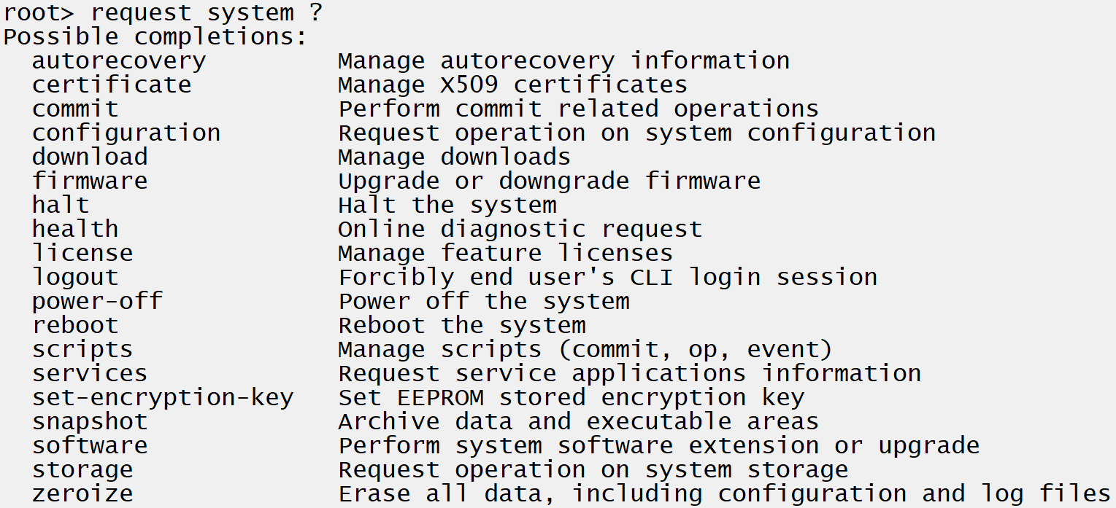
Startup / Shutdown
Startup takes time
Juniper devices are slow to start due to their modular nature and can take upwards of 5-10min to fully boot
Always shutdown properly
Unlike some other vendor devices which operate solely from memory, Juniper devices read and write with persistent storage very often. The device should always be shutdown from the GUI or by issuing the request system power-off command at the CLI to prevent data corruption

Slide 4
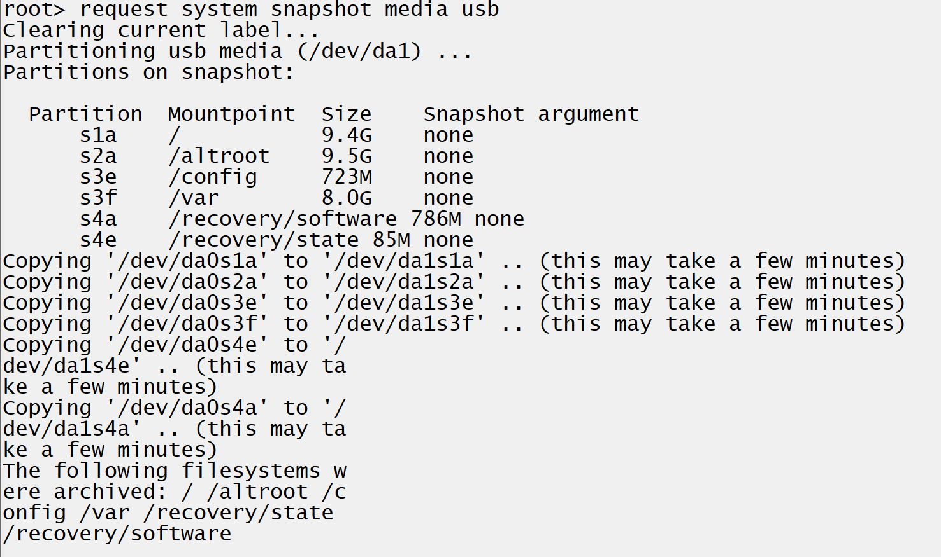
Software Upgrades
Image can be transferred or installed directly
If there’s enough space available on the flash, you can transfer the Junos image to the internal flash by scp or ftp.
Often administrators will install the software from USB.
Option to backup current installation
A snapshot of the current system can be taken which includes Junos and the configuration. This is done to a USB flash drive with the request system snapshot media usb command
NOTE: performing this will partition the USB and erase any existing data on it
Notes:
Log session when performing upgrade and during reboot in case something goes wrong and JTAC is needed.

Slide 5


Software Upgrade cont’d
Mount the USB
First determine what device label was given to the USB by checking ls /dev/da* before and after plugging in the USB. A new entry will appear when USB is plugged in. Create a temporary folder to mound the device to using mkdir /tmp/usb/ . Example mount command is shown.

Slide 6
Software Upgrade cont’d
Install the software
Once the USB which contains the Junos image is mounted, install the software from operational mode using the request system software add command
Install directly from ftp
Transfer the image from an ftp server using the same command but providing the ftp destination server path and filename instead of the mounted USB.
Reboot the device to complete installation
Request system reboot
Notes:
Example Steps:
Save snapshot to a USB
Install Junos software from another USB
Create tmp folder mkdir /tmp/usb
Mount USB mount –t msdosfs /dev/da1s1 /tmp/usb
Request system software add /tmp/usb/<filename>
Reboot the device, show full boot process
Confirm code version

