Slide 1
Routing Fundamentals
How a Juniper device makes forwarding decisions

Slide 2
RT vs. FT
#
The Routing Tables and the Forwarding Tables

Slide 3
Routing Tables – Control
The routing table is built by the control plane
Interactions with the control plane, by routing protocols or the network administrator, are used to build the routing table. The routing table lives only in the RE, which can be conceptualized as the control plane of the Juniper device
Separate tables for different protocols
Juniper devices split up their routing information into many different routing tables. Several of the routing tables are listed here, though this list is not complete.
Table | Description
inet.0 | For IP version 4 (IPv4) unicast routes. This table stores interface local and direct routes, static routes, and dynamically learned routes.
inet.1 | For the IPv4 multicast forwarding cache.
inet.2 | This table stores unicast routes that are used for multicast reverse-path-forwarding (RPF) lookup in a specific format needed for DVMRP.
inet.3 | For IPv4 MPLS. This table stores the egress address of an MPLS label-swiched path (LSP), the LSP name, and the outgoing interface name. This routing table is used only when the local device is the ingress node to an LSP.
inet6.0 | For IP version 6 (IPv6) unicast routes. This table stores interface local and direct routes, static routes, and dynamically learned routes.
mpls.0 | For MPLS label switching operations. This table is used when the local device is a transit router.
Juniper_private | For Junos OS to communicate internally between the Routing Engine and PIC hardware.
Notes:
inet.2—For subsequent address family indicator (SAFI) 2 routes, when multiprotocol BGP (MBGP) is enabled. This table stores unicast routes that are used for multicast reverse-path-forwarding (RPF) lookup. The routes in this table can be used by the Distance Vector Multicast Routing Protocol (DVMRP), which requires a specific RPF table. In contrast, Protocol Independent Multicast (PIM) does not need this table because it can perform RPF checks against the inet.0 table. You can import routes from inet.0 into inet.2 using routing information base (RIB) groups, or install routes directly into inet.2 from a multicast routing protocol.

Slide 4
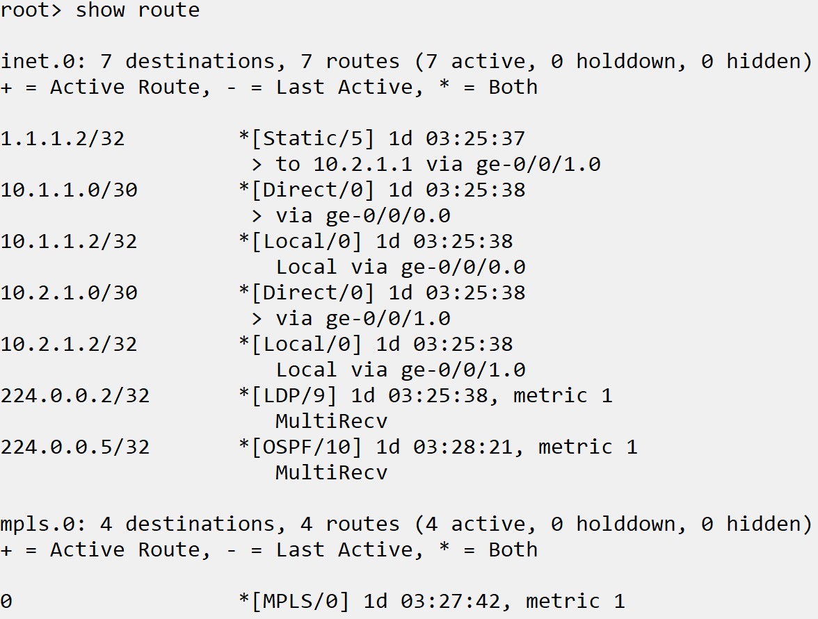
Routing Tables – Data
Routing table stores destination and path
The job of the routing table is to store the path information for a destination. This is done by using preference and metrics to choose the best path for a destination.
Viewed using the show route commands
The RT, stored in the RE, is viewed using the show route commands for various details about the tables.

Slide 5
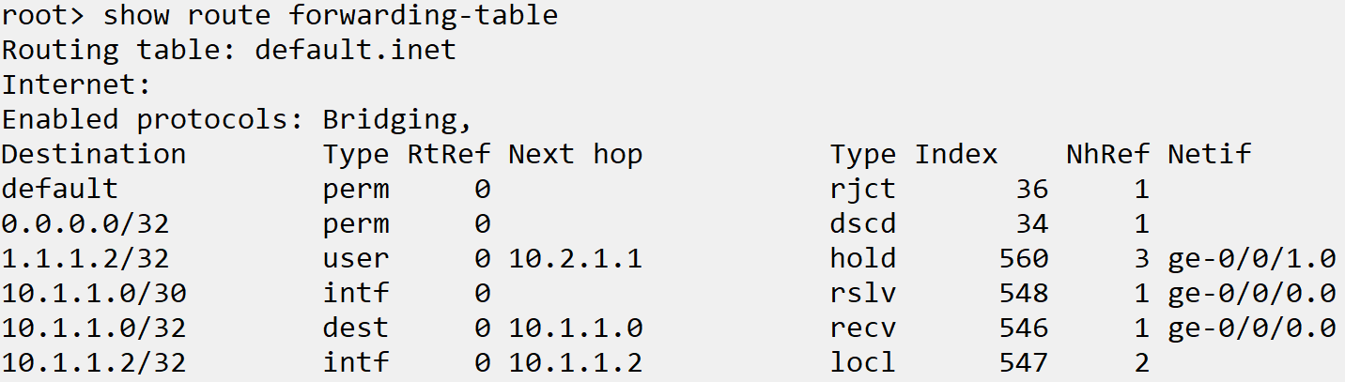
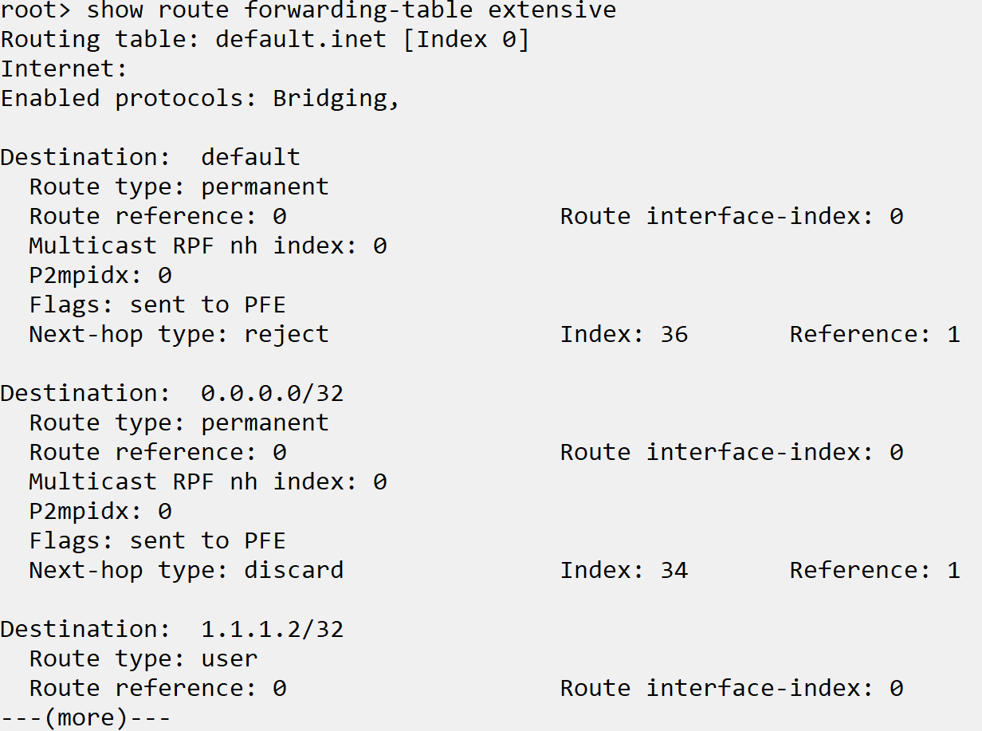
Forwarding Tables - RE
Derived from the routing tables
Where the routing tables contain destination and path information, the forwarding tables contain forwarding information with actions that the PFE uses to handle transit traffic at near wire-speed
Master copy stored in routing engine
The RE maintains the forwarding tables and copies them to the PFE through an internal link. The copy in the routing engine is viewed with the show route forwarding-table commands

Slide 6
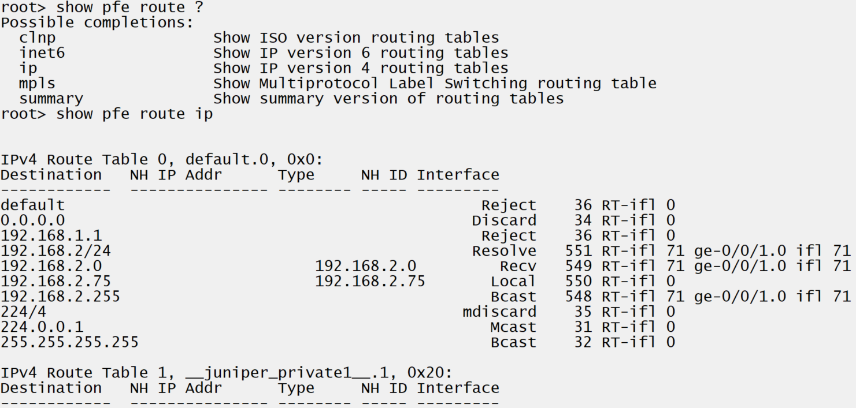
Forwarding Tables-PFE
In the PFE, forwarding table is the route table
To view the version of the forwarding tables located in the PFE, use the show pfe route command

Slide 7
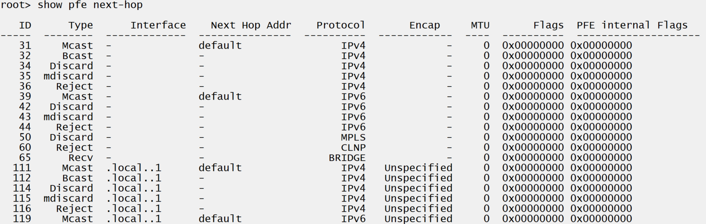
Forwarding Tables – PFE cont’d
Next-hop ID table
The NH ID can be located in the next-hop table in the PFE. This is viewed with the show pfe next-hop command.
Notes:
Example steps:
Show route (have OSPF, LDP, BGP running for MPLS to show tables)
Show route forwarding-table for the protocols
Show pfe route ip
Review types for traffic handling
Show pfe next-hop

Slide 8
INSR ICON

