Slide 1
Routing Fundamentals
How a Juniper device makes forwarding decisions

Slide 2
Forwarding Decisions
#
Route attributes used for path selection

Slide 3



Route Selection
Preference
Routing information sources each have a different preference. This can be thought of the same way as Administrative Distance in Cisco devices. If the same route is learned from multiple sources, the source with the lowest preference number will be used for entry into the forwarding table.
Metric
Routes learned always have a metric associated with them, or the cost of the route. The algorithm used for calculating metric varies by routing information sources, and can be manually set by the network administrator. The metric is used to select the best path for a destination when multiple paths to the same destination are learned within the same routing protocol/ information source.
Longest Match
When multiple routes exist in the forwarding table which include the same destination address, the routes with the longest prefix will be used. This means that the most specific route that exist will be used.

Slide 4
Preference
Relative trustworthiness
Preference (also known as Administrative Distance) defines what source of routing information is to be most trusted when the same routes are learned from multiple sources. Lower preference number indicates a more preferred source
Many are configurable
The preference of most sources of routing information are configurable by the network administrator. The default preference of some common sources of routing information are listed here.
Source | Default Preference
Directly Connected Routes | 0
OSPF Internal | 10
IS-IS Level 1 internal | 15
IS-IS Level 2 internal | 18
Router Discovery | 55
RIP | 100
Aggregate | 130
OSPF External | 150
BGP | 170
Notes:
Router Discovery – ICMP messages used for gateway discovery

Slide 5
Metric
Determines best path within a protocol
Metric is not comparable between sources of routing information, because many protocols calculate their metric differently.
Source | Default Metric Calculation
OSPF | Reference bandwidth per link
IS-IS | Hops x 10
RIP | Hops
BGP | Route Attributes*
Static | Configured
Aggregate | Configured

Slide 6
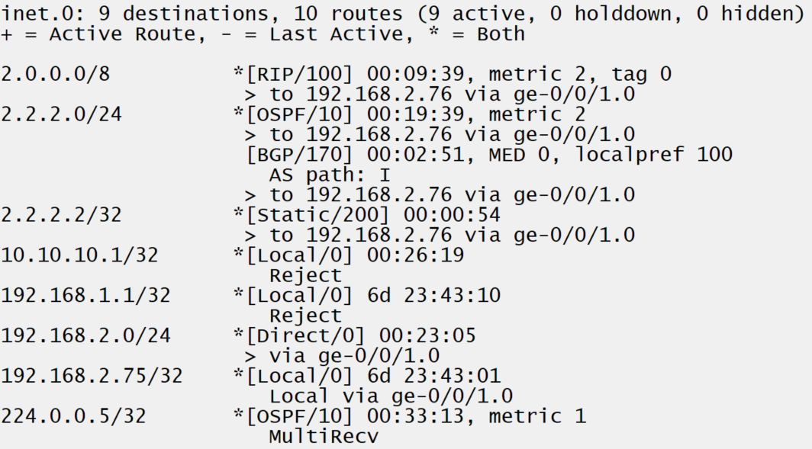
Longest Match
The length of subnet mask
The length of the subnet mask, also called the prefix length, defines the specificity of a route. (Ie. A /29 route is more specific than a /24)
Most specific route is always used
Regardless of the source of the routing information, the most specific active route which includes the destination address will be used to forward traffic.

Slide 7
INSR ICON

