Slide 1
Routing Fundamentals
How a Juniper device makes forwarding decisions

Slide 2
Dynamic Routing
#
An introduction to routing protocols

Slide 3



Introduction
Neighborship / Adjacency / Peering
Nearly all dynamic routing protocol have a concept of forming a relationship with another device that speaks the same routing protocol so that routing information may be exchanged. In OSPF neighbor routers form and adjacency, in BGP defined neighbors form a peering. These are equivalent concepts.
Automatic path finding
The overall purpose of a dynamic routing protocol is to allow for routers to automatically find the best and alternate paths to a destination host or network. In this fashion traffic can be much more reliable, bypassing troublesome areas of the network, and automatically adjusting when issues are resolved.
Not all protocols are alike
Each routing protocol operates differently and may be more appropriate in different cases. Two primary categories the protocols fall into are Distance Vector Protocols, and Link-State Protocols. Each with their own advantages.

Slide 4
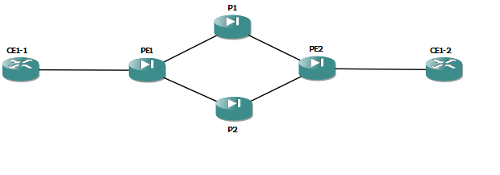
Link-State
Each router is aware of all other routers
In a link-state protocol, each router that participates in the protocol is provided a full database listing all other participating routers, the networks they’re connected to, along with the bandwidth of the links connecting to those networks.
All routes are calculated from own perspective
A link-state protocol router uses the database of links and networks to calculate the cost to reach all destination networks in the database. This can be CPU intensive in large networks.
Link-state Protocols
OSPF
IS-IS

Slide 5
Distance Vector
Only aware of their neighbor’s perspective
Distance vector protocols are unaware of the network as a whole. Routers using a distance vector protocol tell their neighbors about what destination hosts or networks they personally know about, and what the relative cost is to reach that network.
Highly scalable
Since the routers do not have to maintain a database of all links in the system, distance vector protocols are generally more scalable than link-state.
DV Protocols
RIP (v2)
BGP*
EIGRP

Slide 6
Use Cases
Distance (Path) Vector generally only EGP
The only standards-based IGP that uses distance vector calculation is RIP (v2) and is considered very outdated and recommended to only use if absolutely needed
We’re left with OSPF vs. IS-IS
In most cases this comes down to a personal preference. IS-IS is a bit more easily extensible in some cases due to use of Type-Length-Value (TLV) fields; and can be less CPU intensive in certain situations

Slide 7
INSR ICON

