Slide 1
Policies and Filters
Influencing routing and packet forwarding

Slide 2
Routing Policies
#
An introduction to routing policies

Slide 3
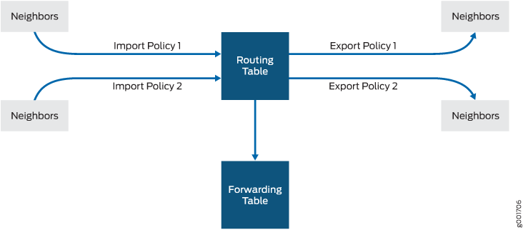
Purpose
Import vs. Export
Routing policies modify routing information, either when a protocol inserts (imports) a route into the routing table, or when a protocol advertises (exports) a route from the routing table.
Many modifications available
route metric
load balancing policy
tag
color
reject
etc.
Notes:
Note that only accept and reject actions are ‘terminating’

Slide 4
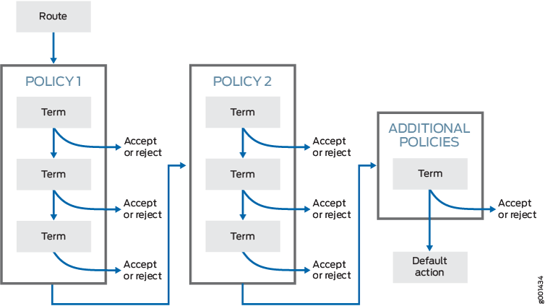
Evaluation
Organized into terms
Terms are named, and are evaluated from top to bottom, regardless of the name of the terms. Term names are only used for the network administrator to describe the term.
Evaluated until a terminating action is reached
Accept, reject, and default action are the only terminating actions. Evaluation continues until one of these are reached.
Notes:
Note the next term and next policy actions

Slide 5
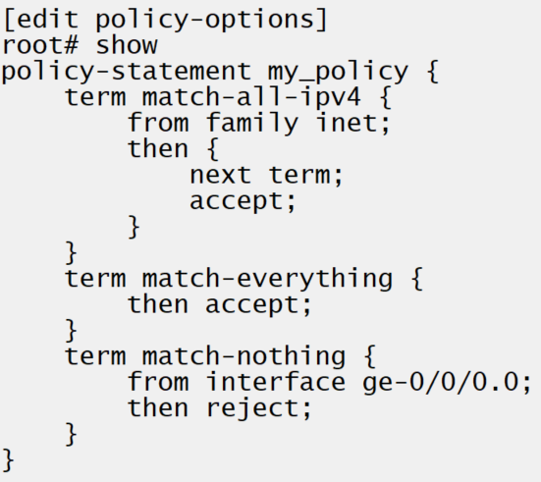
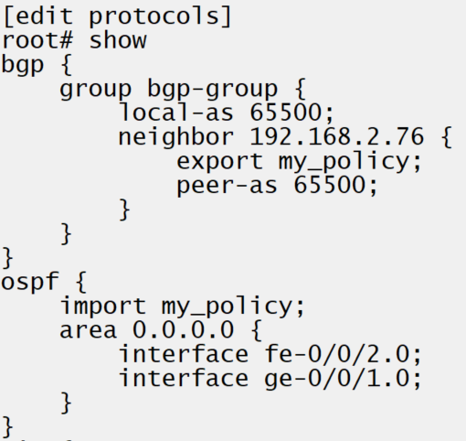
Example
Sets of from – then terms
In a routing policy routes must be identified using a from clause, then some action is defined to apply to the route in a then clause. The identification process can be specifying a specific route prefix, a protocol, a tag or color, a route distinguisher and many other options.
From term not necessary
If no from item is specified, the term would match all routes that are evaluated against it.
Must be applied to be evaluated
Can be applied to a whole protocol or specific neighbors.
Notes:
Show BGP learned 3.3.3.0/24
set policy-options policy-statement longer_24 term term1 then accept
set policy-options policy-statement longer_24 term term2 from route-filter 3.3.3.0/24 exact
set policy-options policy-statement longer_24 term term2 then reject
Apply import to BGP group
Commit and show effect
Move rejection term to above match-all term
Commit and show routes removed

Slide 6
INSR ICON

