Slide 1
Policies and Filters
Influencing routing and packet forwarding

Slide 2
Routing Policies
#
Configuring routing policies

Slide 3
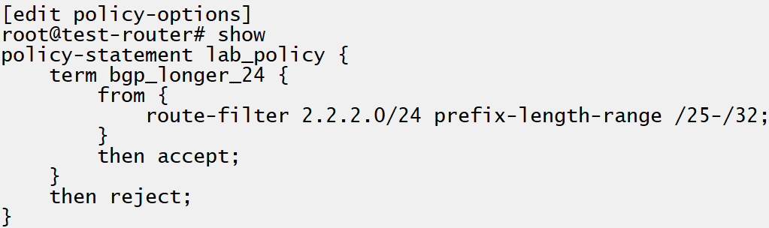
Match Criteria
Where is the route from
This can be the specific neighbor the route was learned from, the destination prefix of the route, a tag or some other attribute like external type for OSPF
Route-filters
Route-filters allow for specifying the destination prefix of the route in a flexible manner. This is done by either specifying the destination prefix exactly, or some range or condition where the mask is of some length (specificity)
Notes:
Note that only accept and reject actions are ‘terminating’

Slide 4
Default Policies
Some default policies cannot be changed
For protocols like OSPF, the protocol requires the LSDB of all participating routers to be identical. Because of this., all routes in the OSPF system must be imported.
Protocol | Default Import | Default Export
OSPFv2 | Accept all OSPF routes and import to inet.0. (cannot be overridden) | Reject everything.**
IS-IS | Accept all IS-IS routes and import to inet.0 and inet6.0 accordingly. | Reject everything.**
BGP` | Accept all received IPv4 and v6 routes from configured neighbors and import into inet.0 and inet6.0 respectively. | Readvertise all active BGP route to all BGP speakers while following protocol specific rules.*
RIP | Accept all RIP routes and import to inet.0 | Reject everything. To export RIP routes an export policy must be configured.
Pseudoprotocol^ | Accept all direct and explicitly configured routes. | N/A
Notes:
*IBGP cannot readvertise IBGP unless route reflector
**These protocols use update flooding (forwarding of update/advertisement packets) to announce routes). It does not ‘readvertise’ routes in its tables, only floods the advertisement.
^pseudoprotocols are direct routes, static routes, generated routes, aggregate routes. These cannot export anything because they do not interact with any other routers.

Slide 5
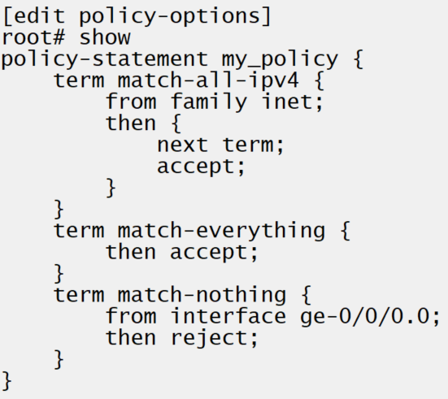
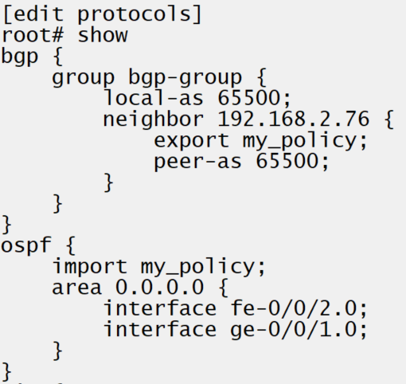
Configuration
Policy-options hierarchy
Routing policies are configured at the policy-options section of the configuration hierarchy.
Default policy is used if no terminating action
If no terminating actions are specified in a chain of policies, the action specified in the protocol’s default policy is used.
Square bracket [ ] to apply more than 1 policy
A chain of policies may be configured by using the square brackets. The policies are evaluated from left to right when defined in this fashion.
Notes:
Example:
Show route, point out BGP and OSPF learning 2.2.2.0/25
Edit policy-options policy-statement lab_policy term bgp_longer_24
Set from route-filter prefix-length 2.2.2.0/25 longer
Set then accept
Up -> set then next policy
Up -> edit policy-statement lab_policy2 term reject_all
Set then reject
Edit protocols bgp
Set import [lab_policy lab_policy2]
Show route

Slide 6
INSR ICON

