Slide 1
Policies and Filters
Influencing routing and packet forwarding

Slide 2
Firewall Filters
#
An introduction to firewall filters

Slide 3
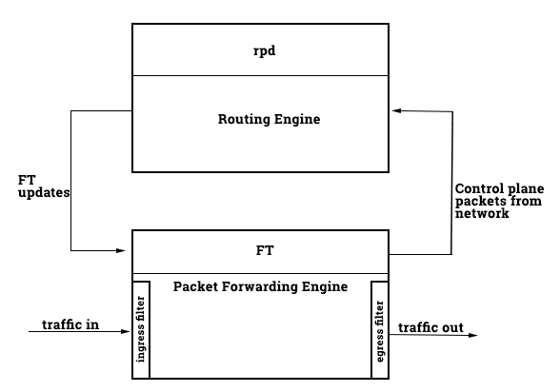
Purpose
Ingress vs. Egress
Filters are applied in a direction, so a different filter may be evaluated when a packet leaves an interface (egress) than when a packet is received on an interface (ingress)
Primarily used to accept/deny packets
Firewall filters identify traffic and either allow the traffic, drop the traffic, or reject the traffic.
Rejecting a packet sends an ICMP unreachable, discarding silently drops the packet.
Notes:
Note different from security zone filters and don’t match on from/to zone pairs
Only match on traffic header information

Slide 4
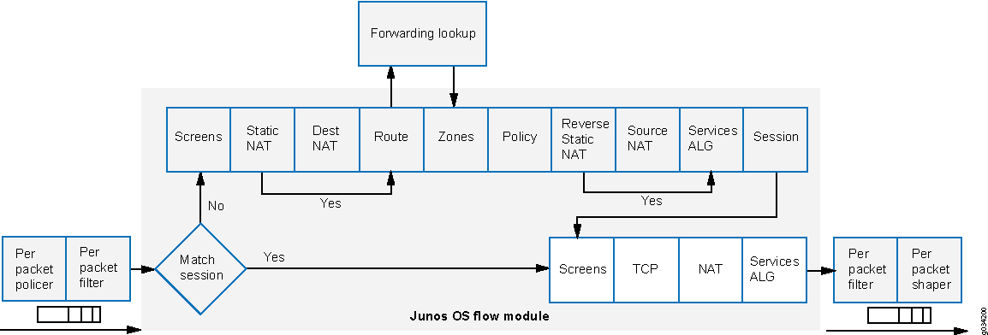
Packet Processing
Notes:
Note the per packet filter ingress and egress.
This is specifically the processing model for flow-based packet processing.

Slide 5
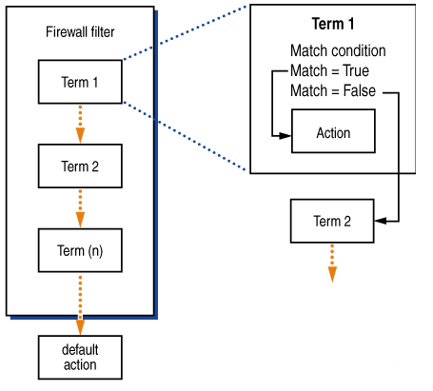
Evaluation
Organized into terms
Terms are named, and are evaluated from top to bottom, regardless of the name of the terms. Term names are only used for the network administrator to describe the term.
Like routing policies, utilizing from -> then statement structure
Evaluated until a terminating action is reached
Accept, reject, discard and default action are common terminating actions. Evaluation continues until a terminating action is reached.
Encapsulate, decapsulate, exclude-accounting, logical-system, and routing-instance are other terminating actions available.

