Slide 1
Policies and Filters
Influencing routing and packet forwarding

Slide 2
Firewall Filters
#
Configuring firewall filters

Slide 3
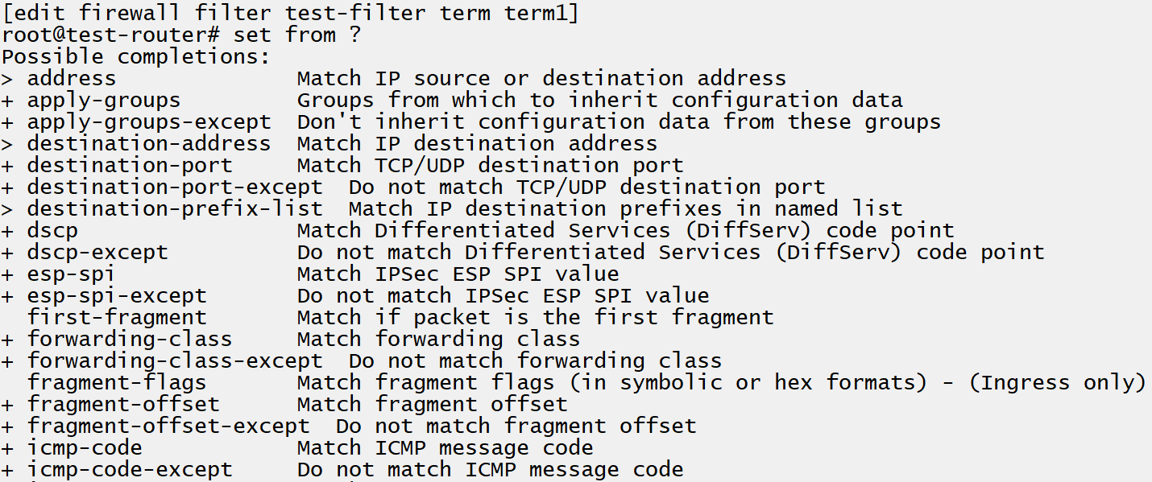
Match Criteria
Identify traffic
Firewall filters are matched against traffic using the packet header information such as source and destination port and address information.
Unidirectional
Mentioned previously, the firewall filter is applied either ingress (input) or egress (output) on an interface and is therefore unidirectional, unless applied in both directions.
Notes:
Note, application recognition in NGFW is not configured with a firewall filter

Slide 4
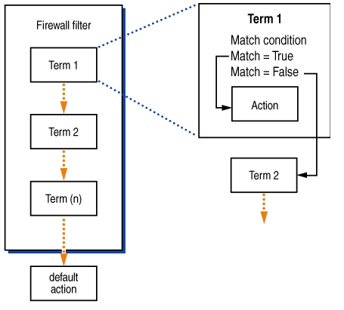
Evaluation
Evaluated until a terminating action is reached
Accept, reject, discard and default action are common terminating actions. Evaluation continues until a terminating action is reached.
Encapsulate, decapsulate, exclude-accounting, logical-system, and routing-instance are other terminating actions available.
If matched but term does not include a then
Traffic will have the accept action applied if it matches against a from statement in a term which contains no then statement.
Implicit deny
If traffic does not match against any from statements in a filter, the default action is to discard.
Notes:
Note the next term and next policy actions

Slide 5
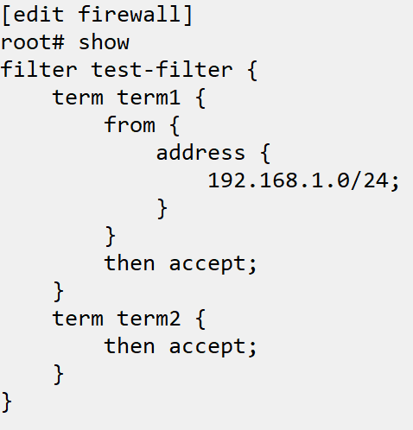
Configuration
Sets of from – then terms
In a routing policy routes must be identified using a from clause, then some action is defined to apply to the route in a then clause. The identification process can be specifying a specific route prefix, a protocol, a tag or color, a route distinguisher and many other options.
From term not necessary
If no from item is specified, the term would match all routes that are evaluated against it.
Must be applied to be evaluated
Can be applied to a whole protocol or specific neighbors.

Slide 6
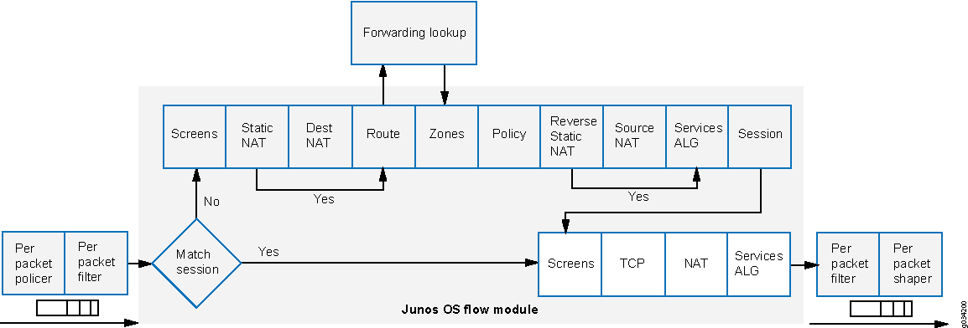
Packet Processing
Notes:
Show BGP and OSPF adjacencies established and learning route to 2.2.2.2
Monitor traffic ge-0/0/1.0 matching icmp
(on other router) ping 192.168.2.75 size 2000 (needs to fragment to show due to software/model)
Show monitor, show icmp received and sent
Configure firewall filter
set firewall filter ping-egress term deny-egress from destination-address 192.168.2.76
set firewall filter ping-egress term deny-egress then discard
set firewall filter ping-egress term allow-all then accept
Set filter egress on ge-0/0/1
set interfaces ge-0/0/1 unit 0 family inet filter output ping-egress
Commit and monitor traffic again
Ping from other router and show only icmp received, nothing sent, and pings timed out on other router
Show OSPF adjacency still up (communicates over multicast)
Show BGP peering down (communicates over unicast, and peering with 192.168.2.76)

Slide 7
INSR ICON

