Slide 1
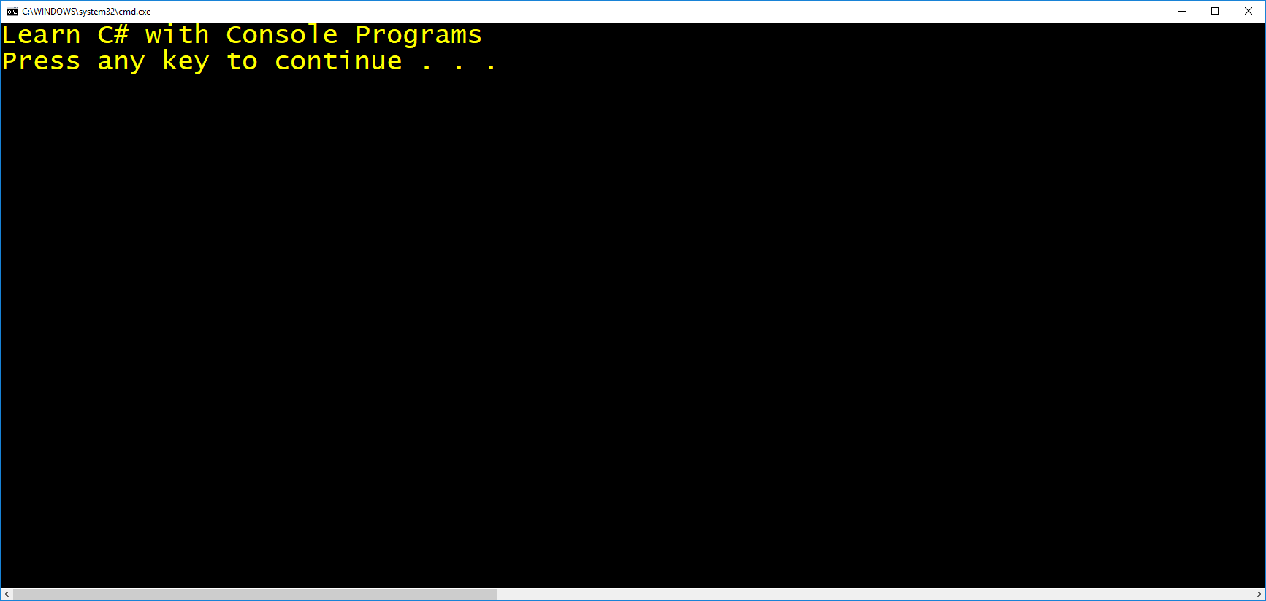

C#

Slide 2
In this lesson:
Find, download and
install Visual Studio

Slide 3
In this lesson:
Create a simple
class from scratch

Slide 4
Pause and try this:
What is WriteLine based on its icon?
In this lesson:
Print “Hello”

Slide 5
Pause and try this:
Write code to make your program beep.
In this lesson:
Use existing methods
Pause and try this:
Write code to clear the console window.

Slide 6
In this lesson:
Overview of the
.NET Framework
Don’t worry about the
code details, but at least
be aware of the overall
purpose of the .NET framework.
Pause and try this:
Trace Beep through the .NET Framework

Slide 7
Pause and try this:
How do you print the updated variable value?
In this lesson:
Writing less code
with using directives
Pause and try this:
What do you think will show on the screen now?

Slide 8
In this lesson:
Creating and displaying
one variable

Slide 9
In this lesson:
Data type consequences

Slide 10
Pause and try this:
Think of the data type and name to be used.
Pause and try this:
Decipher the tip.
In this lesson:
Different data types
Pause and try this:
Why does the red squiggle appear?

Slide 11
Pause and try this:
Display the other two variables.
Pause and try this:
Print desc to the console window.
In this lesson:
Different data types

Slide 12
Pause and try this:
Redo the code so Concat goes away and Format runs only once.
Note: feel free to remove
the breakpoint for the
debug->step into portion
In this lesson:
Using the debugger
Pause and try this:
How many Format and Concat calls now?

Slide 13
In this lesson:
Basic math, part 1
Pause and try this:
How can we format the sum with $?

Slide 14
In this lesson:
Basic math, part 2
Pause and try this:
Account for the addition of the new salary.

Slide 15
Note (please pause and read): You can type ReadLine() without Console.ReadLine() because it works the same way as WriteLine. We already have using static System.Console at the top of the program.
In this lesson:
Reading string input
Pause and try this:
Decide on the data type and variable name.
Pause and try this:
Show the input after it’s converted to lower case.

Slide 16
Pause and try this:
How can we still use String, with capital S, in our code? What should be placed in front of it ?
In this lesson:
Using string objects
with Concat
Pause and try this:
Save the result of running Concat, and display it to the user using the console window.
Pause and try this:
Account for the introduction of the s3 variable.

Slide 17
Pause and try this:
Display the input multiplied by 10.
In this lesson:
Using numeric input
Pause and try this:
What should go on the left side of the assignment operator?
Pause and try this:
How can you calculate the value of input+5?

Slide 18
Pause and try this:
In this lesson:
Using numeric input, 2
Pause and try this:
Get the right detail to use Double instead of double.
(double is an alias, in other words, for what? )

Slide 19
In this lesson:
Digging through an
error message

Slide 20
In this lesson:
Method chaining

Slide 21
Pause and try this:
How do we pull one color from the enumeration?
In this lesson:
Properties
Pause and try this:
Change the title on the window to “Method Chaining”

Slide 22
Pause and try this:
How do we make C# tell us the answer to “is 4 greater than 5”?
In this lesson:
Basic logical conditions
Pause and try this:
How can we avoid hard coding values?
Pause and try this:
Change the input in the boxes to replace the remaining value with y.

Slide 23
Pause and try this:
Rewrite the code so it uses two variables instead of values like 4 and 5.
In this lesson:
Basic logical conditions
Pause and try this:
Rewrite the code so it uses two variables instead of values like 4 and 5.

Slide 24
Pause and try this:
What can we put here so it makes sense?
In this lesson:
multiple if/else blocks
Pause and try this:
What’s the last logical condition and code that makes sense right after it.

Slide 25
Pause and try this:
How should this line be modified?
In this lesson:
if/else with methods
Pause and try this:
What would make sense to be put after the else?
Pause and try this:
What should fill the calls to WriteLine to produce
something like “The text ell is found in hello”.

Slide 26
In this lesson:
Using TryParse, part 1

Slide 27
In this lesson:
Using TryParse, part 2

Slide 28
Pause and try this:
Where should we place one more else?
Pause and try this:
How do you try to convert the second input ?
Pause and try this:
One of the WriteLine texts is not clear. Which one?
Pause and try this:
Where do we code another else?
Pause and try this:
What’s a good second prompt?
Pause and try this:
The second TryParse returns false. Which line runs?
In this lesson:
Using TryParse, part 3
Pause and try this:
The text of which WriteLine can be improved to make it more clear when it runs?
Pause and try this:
To be more exact, how do you read the second input?
Pause and try this:
One of the WriteLine texts is not clear. Which one?
Pause and try this:
Given the context of our lessons, if you want to collect input twice, how many TryParse calls are needed?
Pause and try this:
How do you collect the second input from the user?

Slide 29
Pause and try this:
How do you multiply the last value of x by 5?
Pause and try this:
What will be the output from this line?
In this lesson:
Compound operators
Pause and try this:
How do you divide the last value value of x by 4 using this kind of compact notation?

Slide 30
Pause and try this:
How do you print this list using a while loop?
In this lesson:
While loops, part 1

Slide 31
In this lesson:
While loops, part 1

Slide 32
Pause and try this:
What’s the starting value?
Pause and try this:
Change the code to show the list.
In this lesson:
While loops, part 2
Pause and try this:
What’s the lowest value you want to reach?
Pause and try this:
How do you decrease the value of the loop counter by 1 on each turn of the loop?

Slide 33
Pause and try this:
How can we introduce a space so all the words are separated?
Pause and try this:
Why is this red mark here?
In this lesson:
exiting while loops
Pause and try this:
How can you force ReadLine to run and save to temp so the red mark will disappear?

Slide 34
Pause and try this:
Show the squares of 11, 8 and 5, from high to low.
In this lesson:
for loops, part 1
Pause and try this:
Show the cubes of the values in the list.
Pause and try this:
Show the cubes of the values in the list.

Slide 35
In this lesson:
for loops, part 2

Slide 36
Note the general patterns.
When you shift the starting index in the loop, say by subtracting 2 from the initial value of 1 to get -1, you adjust with the opposite operation of adding 2 inside
WriteLine.
Be sure to watch the additional video stored under lesson resources.
Pause and try this:
Adjust inside WriteLine to still produce 1*1, 2*2 and 3*3.
In this lesson:
for loops, part 3
Pause and try this:
What should be the logical condition in the middle now?

Slide 37
In this lesson:
String indexes

Slide 38
In this lesson:
Strings with loops

Slide 39
In this lesson:
foreach with if/else

Slide 40
In this lesson:
strings in memory

Slide 41
In this lesson:
for loops mechanics

Slide 42
In this lesson:
Linq and lists, part 1

Slide 43
In this lesson:
Lists, part 2

Slide 44
In this lesson:
Lists with while and
TryParse

Slide 45
string s = "Hello, World!";
if (s.Contains("o"))
WriteLine($"Index: {s.IndexOf("o")}");
else
WriteLine("Not found.");

