Slide 1

Learn C# With Windows Forms And
SQL Server
My name is Tom.
This course is about 11 hours long.
It’s designed for intermediate students of C#.
The average video length is about 10 minutes.
Many of the examples are split over two videos.
The code has a lot of comments.
On the bottom is a fairly complete database project using SQL Server and C#

Slide 2
Database Project Features:
Write code to add records to tables
Write code to search records
Write code to add and preview pictures
Write code to export tables to Excel
Write code to export tables to MS Word
Configure SQL Server to store information in different language formats
and others!

Slide 3
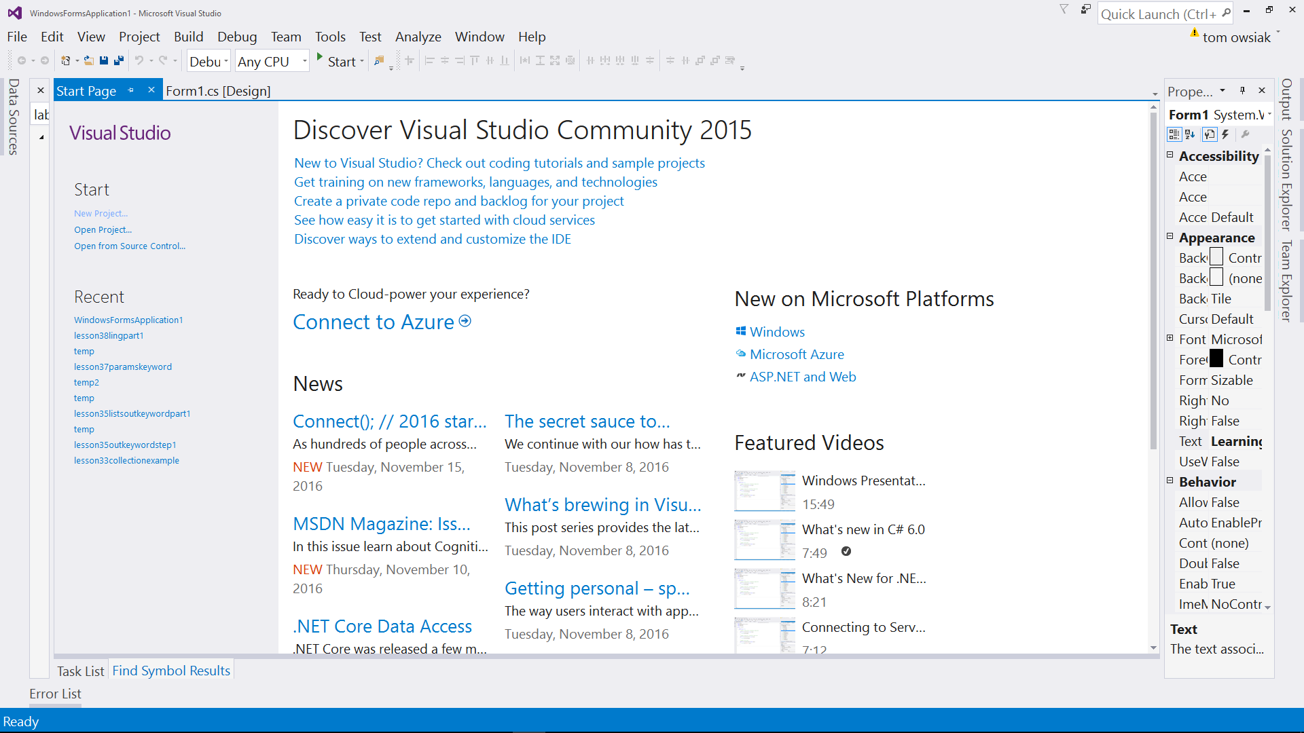
Learning C# 6.0 With Windows Forms
This course assumes you have VS Studio Community 2015 downloaded and installed already.
Please be sure to read through the curriculum before buying to be sure this course is right for you.

Slide 4
Learning C# 6.0 With Windows Forms
Project files can be downloaded from GitHub.
The links are stored under lesson resources.
Let’s take a look at an example of opening a project from GitHub.

Slide 5

Learning C# 6.0 With Windows Forms
To get most out of this course, it’s very important to
PRACTICE
Unyielding
Thoughtful

Slide 6
Learning C# 6.0 With Windows Forms
Thanks and let’s BEGIN!

