Slide 1
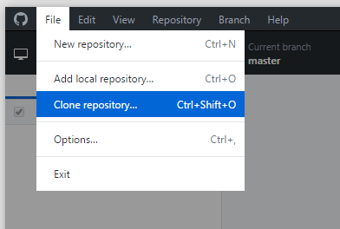
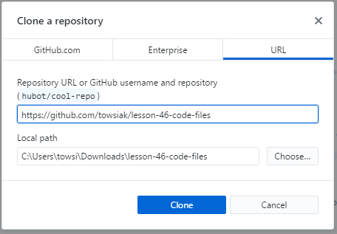
Download and install the GitHub client from
https://desktop.github.com/
Inside the GitHub client on your computer go to:
File -> Clone Repository
3. Choose URL and put in the URL shown below.

Slide 2
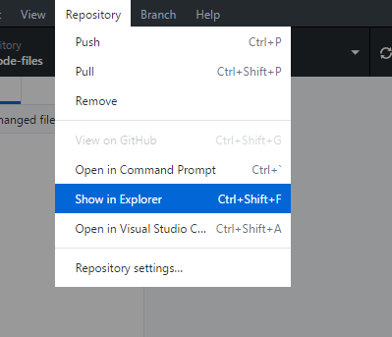
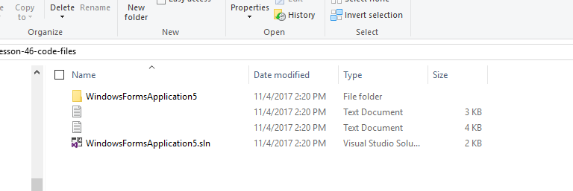
4. After the repository is cloned, go to Repository-> Show in Explorer.
5. File should open as shown below.

Slide 3
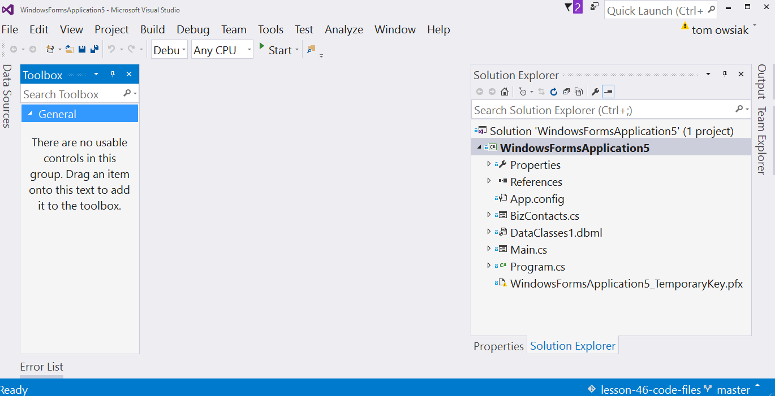
6. Click on WindowsFormsApplication5.sln in Windows Explorer so the project loads.

Slide 4
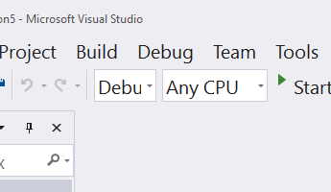
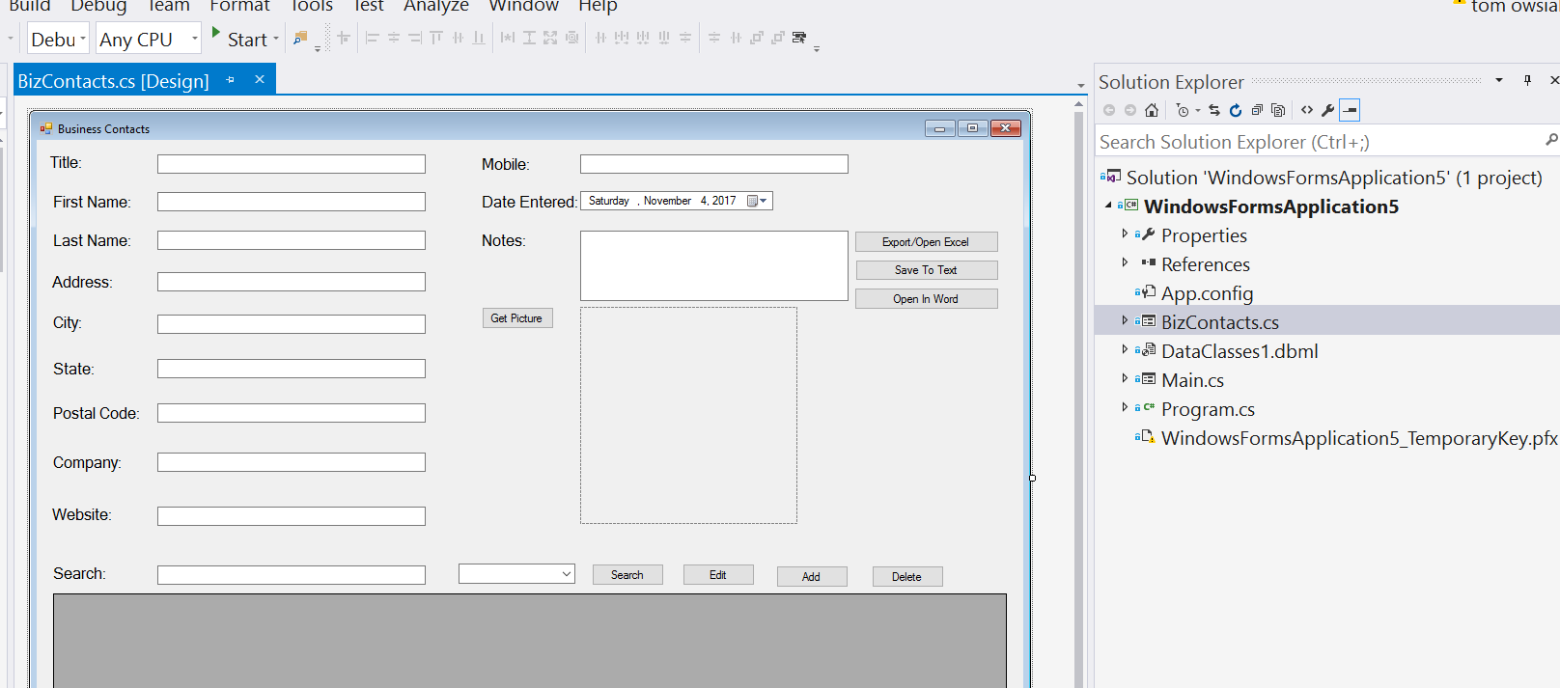
7. Build the project first.
8. Click through the project files to be sure each one opens.

Slide 5
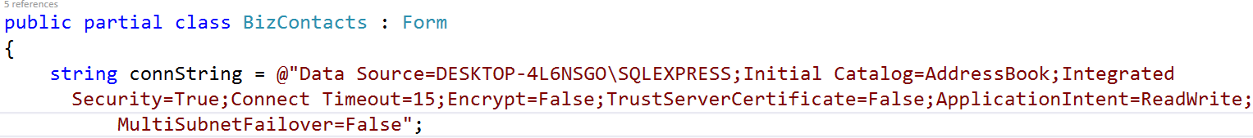
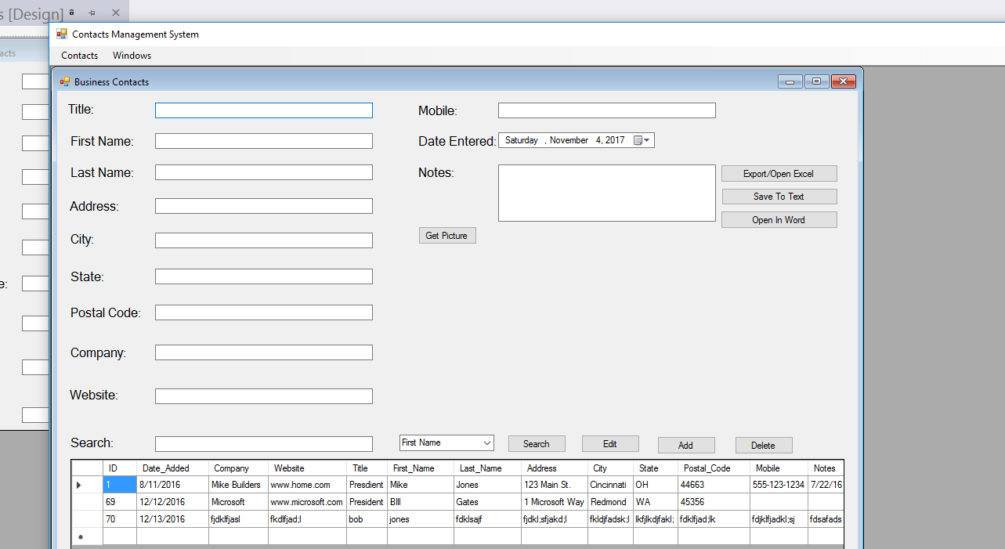
9. Start the project using Start from the tool bar.
10. Please remember the code depends on a connection string to SQL Server.
11. Please also remember the code depends on the table, so the structure must be the same.
12. I’ve put a copy of the database under lesson resources. You will have to restore it from back up to use it.

