Slide 1
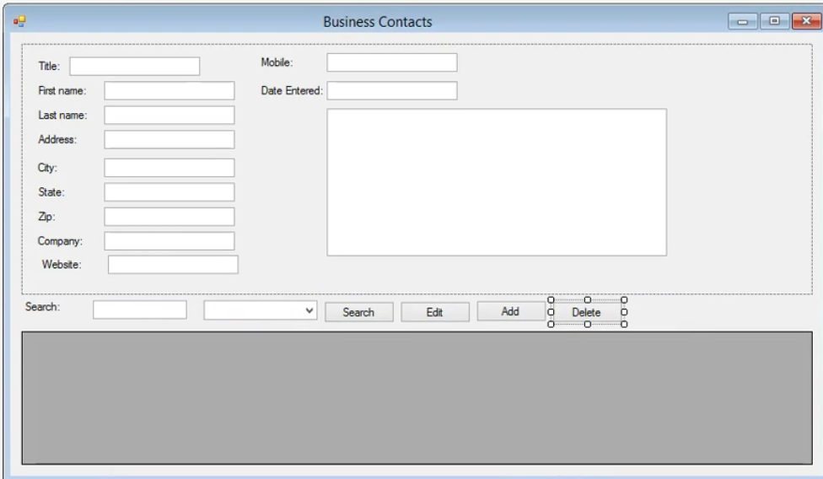
Panel
txtMobile
txtTitle
txtFName
dateTimePicker1
txtLName
txtAddress
txtNotes
txtCity
txtState
txtZip
txtCompany
txtWebsite
btnSearch
btnEdit
btnAdd
btnDelete
txtSearch
cboSearch
dataGridView1

