Slide 1
Learn Power BI: Chapter 2 Planning Projects with Power BI

Slide 2
Lesson Plan
Planning Business Intelligence Projects
Stakeholders, goals, and requirements
Required resources
Discovering data sources
Designing a model
Planning reports and dashboards
Example Scenario
Summary

Slide 3
Planning Business Intelligence Projects

Slide 4
Stakeholders, goals, and requirements
Stakeholders are individuals or groups with an interest in the outcome of a business intelligence project.
Stakeholders are vitally important to the success of any business intelligence project.
Stakeholders define the goals and requirements of the business intelligence project and ultimately determine whether the business intelligence project met or failed to meet the desired outcomes.
It is not uncommon to have multiple stakeholders for a given business intelligence.
Project sponsors are a special class of stakeholder that helps secure the funding and/or prioritization of resources for the business intelligence project.

Slide 5
Stakeholders, goals, and requirements
Goals or objectives are the purpose of the business intelligence project or the questions the business is trying to answer.
Goals can be quite diverse depending on the business domain.
Goals should be clearly stated and written down in one or two easily understood sentences (minimal jargon).
Goals help determine what data will be required in order to fulfill the purpose of the business intelligence project.

Slide 6
Stakeholders, goals, and requirements
Requirements help determine the size and scope of a business intelligence project.
Requirements can be very diverse.
Common requirements:
Who and how many individuals will need access to the report.
How frequently is the report used.
Whether certain report viewers will see partial data.
What are the regulatory concerns.
The lowest level of data granularity required.
How much historical data is required.
The required velocity of data, real-time, near real-time, daily, etc.
The Key Performance Indicators (KPI’s).
The business calendar.

Slide 7
Required resources
Business intelligence projects require several different skill sets and areas of expertise :
Domain experts – Resources with business domain or technical domain experise.
Data modelers – Connect to source systems, cleanse and transform data and create data models.
Report authors – Perform data analysis and create visuals that comprise reports and dashboards.
Administrators – Monitor usage and enforce organizational governance.

Slide 8
Discovering data sources
Source data systems contain the data that will comprise the model.
Data modelers and report authors collaborate with both IT and the business to discover the required source data repositories.
Repositories may be transactional systems such as Enterprise Resource Planning (ERP) systems, Customer Relationship Management (CRM) systems, data warehouses, or even individual files maintained by the business, such as in Excel spreadsheets.
Repositories must be accessible from the Power BI Service to support refresh.

Slide 9
Designing a model
A semantic or data model design includes the following steps:
Identify facts and dimensions – Infrastructure is shared between tenants, includes Free licenses and Pro licenses.
Fact tables, or facts, are the tables that contain numeric information about particular business processes such as sales, marketing, production, and inventory
Dimension tables, or dimensions, contain information about people, places, or things involved in the business process.
Create a bus matrix - A bus matrix is a data warehouse planning tool that is useful for visualizing the relationships between facts and dimensions.
Determine the model mode
Import – Uses a fast local model, requires refresh, size limits.
DirectQuery – Queries source systems in real time, slower.
Composite – Uses a mix of Import and DirectQuery tables.

Slide 10
Planning reports and dashboards
Power BI lends itself to an agile, iterative development process but take some time to understand the following:
The key KPI’s and metrics for the business
Single or multiple report pages
Discuss interactivity between visuals
Identify potential report features such as use of the Filters pane, slicers, drillthrough and drilldown.

Slide 11
Example Scenario

Slide 12
background
Regional professional services firm with offices located in Charlotte, Nashville, and Cleveland
Provides professional services related to technology, accounting, and management consulting.
Implementing unlimited Personal Time Off (PTO)
Requires organization to closely track and report on utilization so that managers can make informed business decisions around requests for time off.

Slide 13
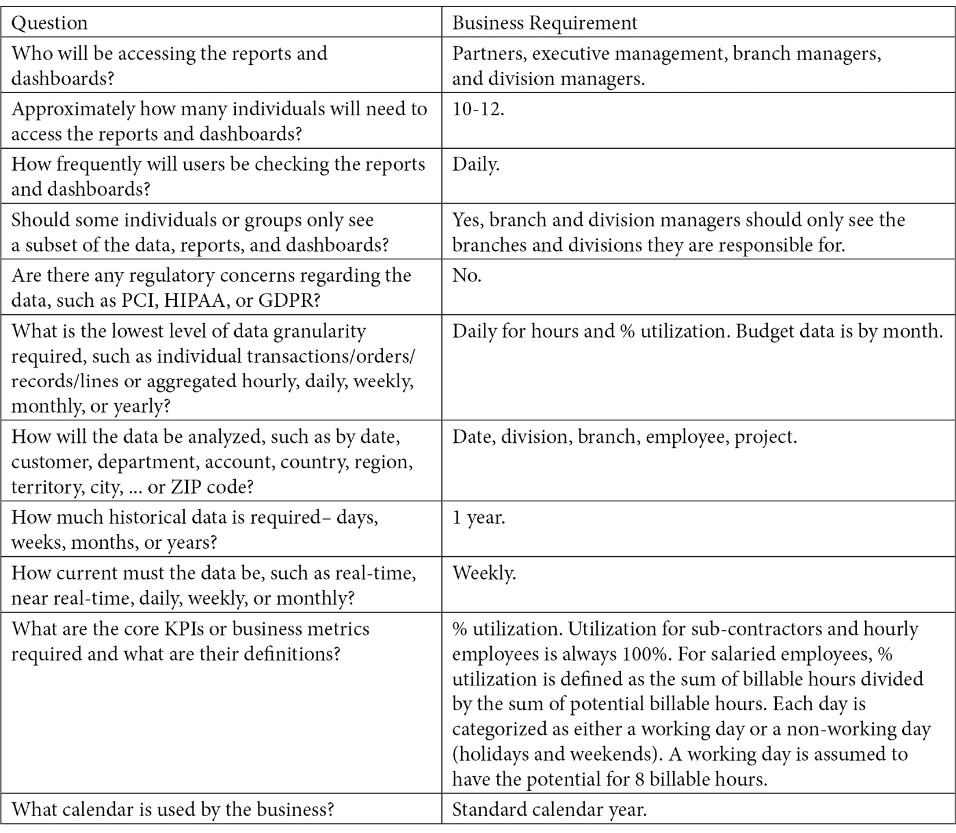
Requirements

Slide 14
Summary

Slide 15
Review Questions
What are the five elements of planning a business intelligence project?
What three things must a business intelligence project identify?
A project stakeholder that helps procure funding and prioritize resources is called what?
What are the four roles required for Power BI projects?
What is the difference between facts and dimensions?
What visual tool is used to design and organize a data model?
What are the three model modes that Power BI supports?

Slide 16
Follow-up and Next lesson
NEXT LESSON
To learn more about the topics that were covered in this chapter, please take a look at the following references:
Implementing different calendars in reporting: https://www.sqlshack.com/implementing-different-calendars-in-reporting/
The matrix: https://www.kimballgroup.com/1999/12/the-matrix/
The matrix: revisited: https://www.kimballgroup.com/2005/12/the-matrix-revisited/
Semantic model modes in the Power BI service: https://docs.microsoft.com/en-us/power-bi/connect-data/service-model-modes-understand
Manage workspaces: https://learn.microsoft.com/en-us/fabric/admin/portal-workspaces
Chapter 3

