Slide 1
Learn Power BI: Chapter 3 Up and Running with Power BI Desktop

Slide 2
Lesson Plan
Installing Power BI Desktop
Touring the Desktop
Generating data
Creating visualizations
Summary

Slide 3
Installing Power BI Desktop

Slide 4
Requirements
You will need a connection to the internet.
You will need Windows 8 or later or Windows Server 2012 R2 or later.
.NET 4.6.2 or later.
Internet Explorer 10 or later.
At least 2 GB of memory (RAM).
1440x900 or larger display resolution.
Microsoft Power BI Desktop is available for 32-bit (x86) and 64-bit (x64) platforms, but a 64-bit processor running at 1 GHz or better is recommended.

Slide 5
Three methods
Power BI Desktop (the trusted Microsoft Store app)
Power BI Desktop (EXE)
Power BI Desktop (Report Server edition)

Slide 6
Easiest method
In a web browser, enter http://aka.ms/pbidesktop into the browser bar and press the Enter key.
The Microsoft Store app will open automatically to the Power BI Desktop app. You may be prompted to Open the Microsoft Store app.
Click Install and this will start the download and installation process.
Once the download and installation process are complete, the Install button will turn into an Open button.
Click the Open button.

Slide 7
Required resources
Business intelligence projects require several different skill sets and areas of expertise :
Domain experts – Resources with business domain or technical domain experise.
Data modelers – Connect to source systems, cleanse and transform data and create data models.
Report authors – Perform data analysis and create visuals that comprise reports and dashboards.
Administrators – Monitor usage and enforce organizational governance.

Slide 8
Touring the Desktop

Slide 9
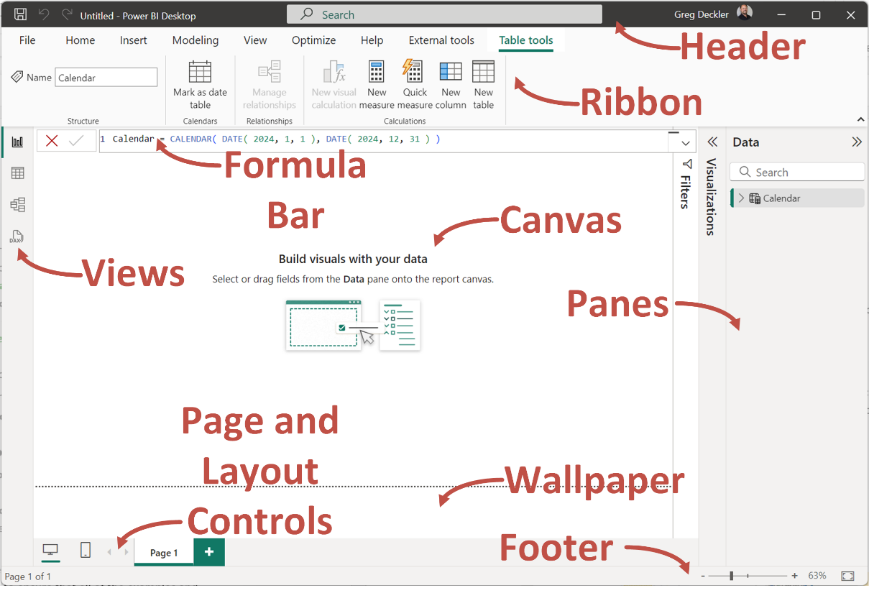

Slide 10
Touring the desktop
Header: Standard for Windows applications. Provides a search bar and the ability to Sign in to the Power BI Service.
Views: There are four views, the Report view for building visuals, Table view for viewing data, Model view for viewing and editing the semantic model, and DAX Query view for creating DAX queries.
Panes: Panes are contextual other than the Data pane and include the Filters, Visualizations, Bookmarks, Selection, Performance Analyzer, Sync Slicers, Properties, and Quick measure (preview).
Canvas: Main area where work is done. Is contextual depending on view.
Wallpaper: Only shown in Report view.
Page and Layout Controls: Contextual depending on view.
Footer: Contextual depending on view. Provides zoom controls.
Ribbon: Is contextual per view other than the File, Home, and Help tabs. Other tabs include Insert, Modeling, View, Optimize, Format, Drill/Data, Table tools, Column tools, Measure tools, and External tools.
Formula Bar: Is contextual and allows the creation of Data Analysis Expression (DAX) columns, measures and tables. DAX has similarities to the Excel formula language and DAX expressions are structured as:
Name = Formula

Slide 11
Generating Data

Slide 12
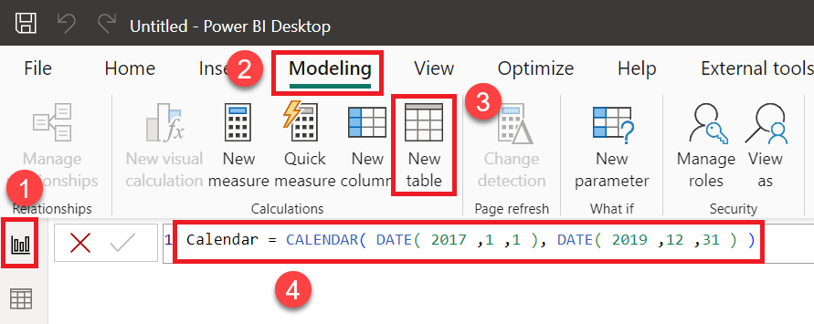
Create a Table using DAX
Calendar = CALENDAR( DATE( 2017 ,1 ,1 ), DATE( 2019 ,12 ,31 ) )

Slide 13
Create DAX Calculated Columns
Make sure that the Calendar table is selected in the Data pane and then click the Table tools tab in the ribbon.
Click on New Column in the ribbon and a new column named Column will appear in your table.
Type this new formula into the formula bar, completely replacing all existing text, and press the Enter key to create the column:
Month = FORMAT( [Date],"MMMM" )

Slide 14
Create DAX Calculated Columns
Repeat the preceding procedure to create six new columns using the following DAX formulas:
Year = YEAR( [Date] )
MonthNum = MONTH( [Date] )
WeekNum = WEEKNUM( [Date] )
Weekday = FORMAT( [Date],"dddd" )
WeekdayNum = WEEKDAY( [Date],2 )
IsWorkDay = IF( [WeekdayNum] < 6 ,1, 0 )

Slide 15
Format columns
Start by clicking on the Date column and then choose the Column tools tab of the ribbon.
Change Data type by clicking on the drop-down arrow and select Date. Format automatically changes to Wednesday, March 14, 2001 (Long Date) and all of the values for the Date column in the rows of your table are automatically updated to match this format. Note that this could be slightly different depending on your language settings.
In the Format dropdown under Date format, select the first listed format, *3/14/2001 (Short Date). Note how many different date formats are available! The Date column in the rows in your table is again updated to match this new format.

Slide 16
Format columns
Click on the Month column and note that Data type and Format both read Text. Also, note that the lettering in the table for the Month column is non-italicized and left-justified. This is a visual cue that indicates that this column is text.
Click on the Year column and note that Data type and Format both read as Whole Number. Observe that the lettering in the table is italicized and right-justified. Again, this is a visual cue that indicates that this column is a number. Click the dropdown for Data type and choose Text. While a year is certainly a number, it does not make any sense to sum, average, or otherwise aggregate a year, so we will specify the column as Text.
Click on the MonthNum column. In the Properties section of the Column tools tab, note that Summarization is set to Sum. Again, it is unlikely that summing a column of month numbers is going to aid us in our analysis, so set the Summarization field to Don't summarize instead. Repeat this process for the WeekNum and WeekdayNum columns.

Slide 17
Creating visualizations

Slide 18
Creating visualizations
Begin by clicking on the Report view in the Views area.
In the Data pane, if your Calendar table is not already expanded so that you can see the column names in the table, simply click the > icon to the left of the table name to expand the table and show the columns.
Start by clicking on the IsWorkDay column and drag and drop this column onto the canvas. Instantly, you have a clustered column chart whose y axis goes from 0 to 800.
Drag the Month column from the Data pane into this same visualization.

Slide 19
Creating visualizations
Click the ellipsis (...) in the upper-right or lower-right corners of the visual and then choose Sort axis followed by Month. Click on the ellipsis again, and this time choose Sort axis and then Sort ascending. Hmm, it's still not quite right. Our visual is sorted by Month now, but our month names are still in the wrong order from what we would expect. This is because the Month column is Text, and therefore the names of the month are being sorted alphabetically instead of what you would expect to be in the order they occur within a year.

Slide 20
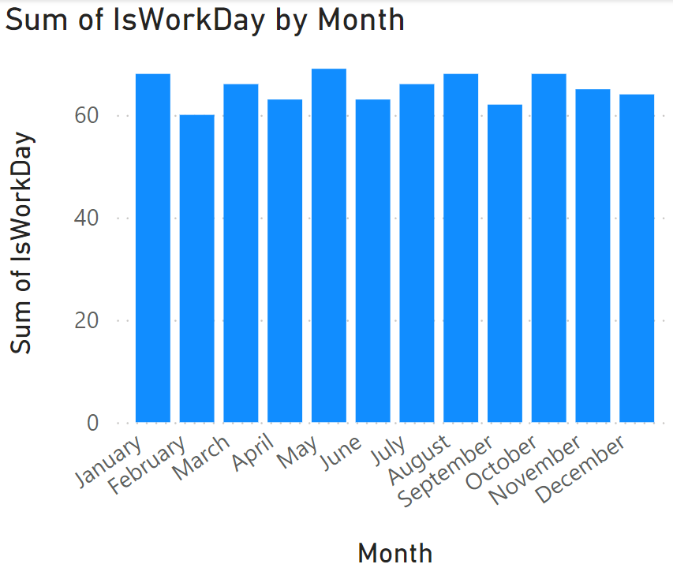
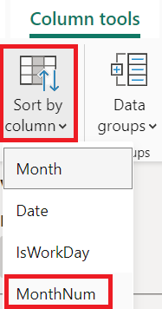
Creating visualizations
In the Data pane, click on the Month column. The Column tools tab of the ribbon becomes active. In the ribbon, in the Sort section, click Sort by column and then MonthNum

Slide 21
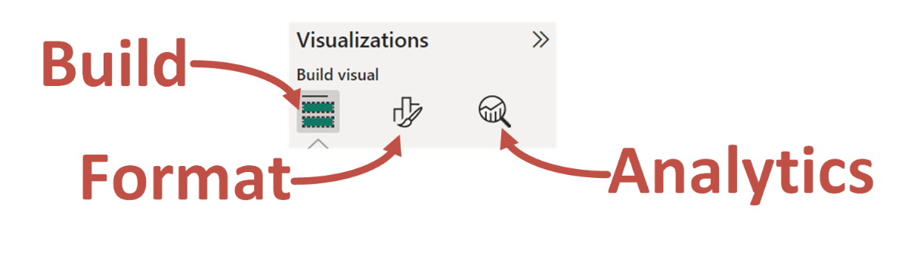
Creating visualizations
The Build, Format and Analytics tabs in the Visualization pane allow editing, formatting, and adding analytics to visuals.

Slide 22

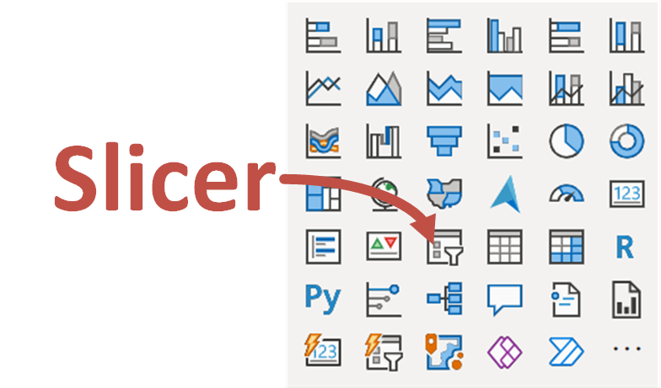
Creating visualizations
The Slicer, visual can be used to filter other visuals. Use the eraser icon to clear selections.

Slide 23
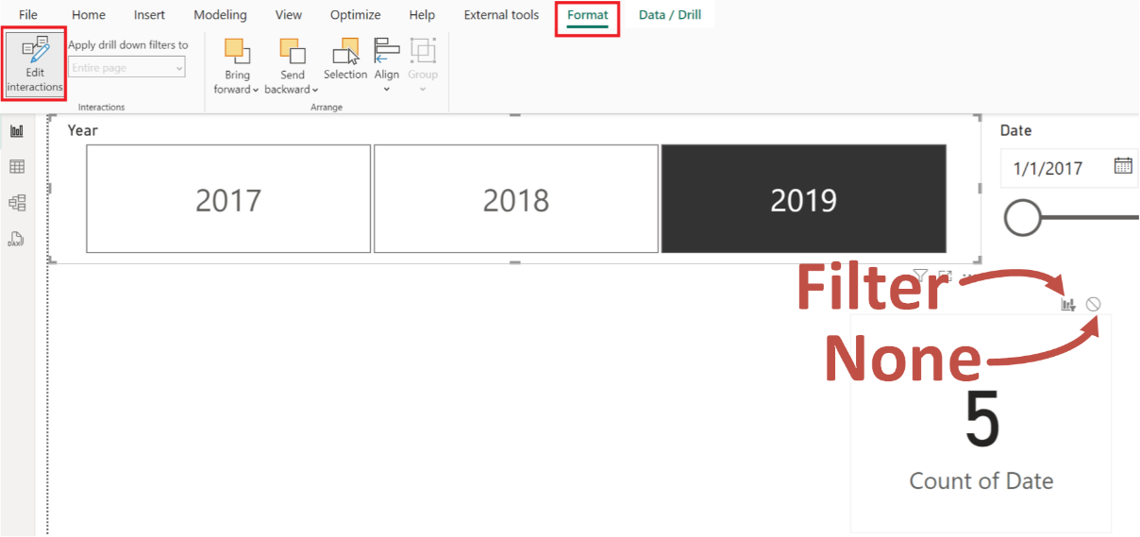
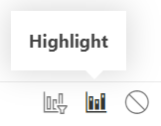
Creating visualizations
Edit interactions controls how visuals interact with one another.

Slide 24
Summary

Slide 25
Review Questions
What are the three different versions of Power BI Desktop?
What are the nine major areas of the Power BI Desktop user interface?
What are the three four different views available in Power BI Desktop?
What is DAX?
What is DAX used for?
What are the seven nine different panes that can be displayed in Power BI Desktop?
What are the three sub-panestabs available in the Visualizations pane?
What three types of interactions can there be between visuals?

Slide 26
Follow-up and Next lesson
NEXT LESSON
To learn more about the topics that were covered in this chapter, please take a look at the following references:
Get Power BI Desktop: https://docs.microsoft.com/en-us/power-bi/fundamentals/desktop-get-the-desktop
Getting started with Power BI Desktop: https://docs.microsoft.com/en-us/power-bi/desktop-getting-started
Apply Learn DAX basics in Power BI Desktop: https://docs.microsoft.com/en-us/power-bi/desktop-quickstart-learn-dax-basics
Add visualizations to a Power BI report (part 1): https://docs.microsoft.com/en-us/power-bi/visuals/power-bi-report-add-visualizations-i
Add visualizations to a Power BI report (part 2): https://docs.microsoft.com/en-us/power-bi/visuals/power-bi-report-add-visualizations-ii
Chapter 4

