Slide 1
Learn Power BI: Chapter 4 Connecting to and transforming data

Slide 2
Lesson Plan
Getting data
Transforming data
Merging, copying, and appending queries
Verifying and loading data
Summary

Slide 3
Getting Data

Slide 4
Requirements
You will need a connection to the internet.
Power BI Desktop

Slide 5
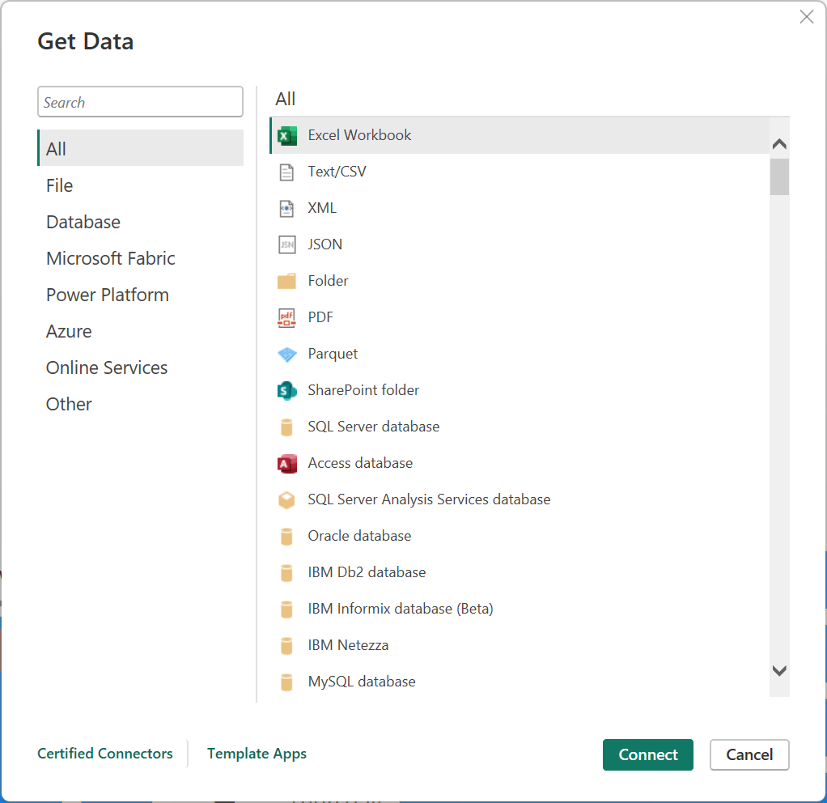
In Power BI Desktop, choose Get Data from the Home tab of the ribbon. Note the default list of potential data sources and select More... at the bottom of the list:

Slide 6
There are approximately 200 default connectors available for ingesting data. These connectors are broken down into several categories:
All: This lists all of the available connectors.
File: File connectors, including Excel, text/CSV, XML, JSON, folder, PDF, Parquet, and SharePoint folders.
Database: The Database section lists sources such as SQL Server, Access, Oracle, IBM DB2, IBM Informix, IBM Netezza, MySQL, PostgreSQL, Sybase, Teradata, SAP, Impala, Google BigQuery, Vertica, Snowflake, Essbase, and AtScale.
Microsoft Fabric: Includes traditional Power BI assets such as semantic models, Datamarts, and Dataflows as well as Fabric assets such as Warehouses, Lakehouses and KQL Databases.
Power Platform: Power Platform includes Dataflows and Dataverse.
Azure: Azure lists many different services, such as Azure SQL Database, Azure Synapse Analytics, Azure Analysis Services, Azure Blob Storage, Azure Table Storage, Azure Cosmos DB, Azure Data Lake Storage, Azure HDInsights (HDFS), Azure HDInsights Spark, Azure Data Explorer (Kusto), Azure Databricks, and Azure Cost Management.
Online Services: There is a substantial collection of online services, including Microsoft technologies such as SharePoint Online, Exchange Online, Dynamics 365, Common Data Service, DevOps, and GitHub, as well as third parties such as Salesforce, Google, Adobe, QuickBooks, Smartsheet, Twilio, Zendesk, and many others.
Other: other connectors include Web, OData, Spark, Hadoop (HDFS), ODBC, R, Python, and OLE DB.

Slide 7
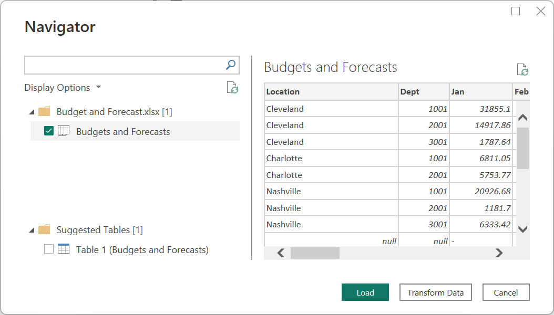
The Navigator dialog allows you to choose specific data from a data source as well as preview that data.

Slide 8
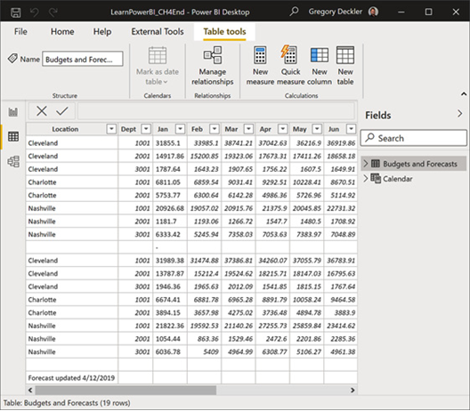
Once the loading dialog completes, click on the Data view in Power BI Desktop to view the loaded data.

Slide 9
Transforming data

Slide 10
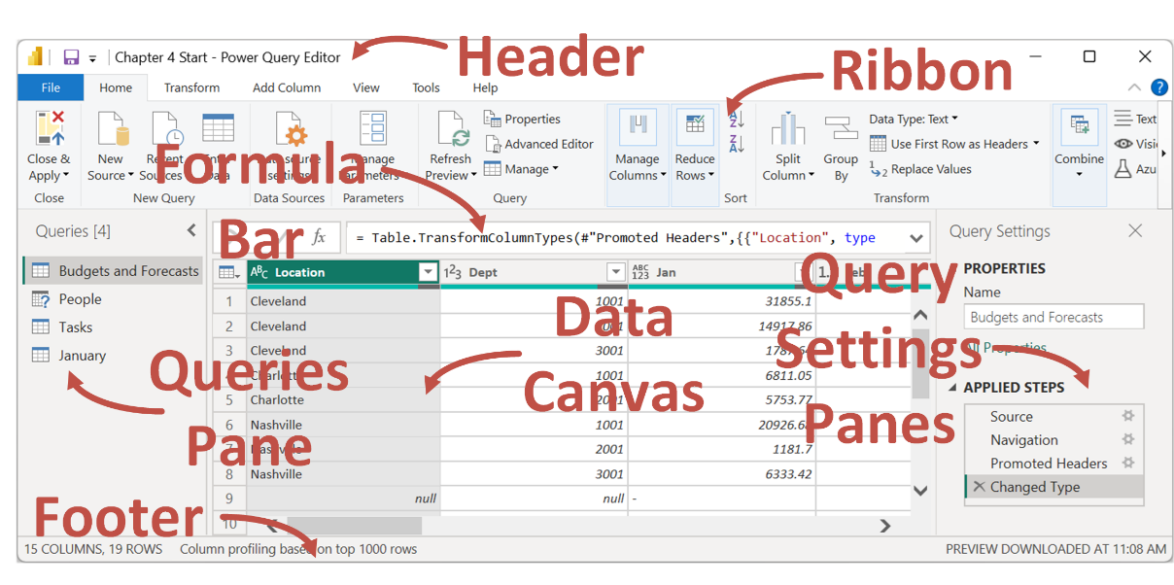

Slide 11
Touring the Power Query Editor
Header: Standard for Windows applications.
Ribbon: Includes tabs for File, Home, Transform, Add Column, View, Tools, Help
Formula Bar: Is contextual and allows the input of Power Query formula language (M) code.
Queries Pane: Displays a list of the various queries associated with the current Power BI file. As queries are created, those queries are displayed here. This area also allows you to group queries, as well displays any errors that are generated by data rows within queries.
Data Canvas: Main area where preview data is displayed. Is contextual depending on the query chosen.
Query Settings: Provides access to properties for the query, such as the name of the query. By default, the name of the query becomes the name of the table within the semantic model. Also includes a list of Applied Steps for the query
Footer: Contextual depending on what is selected and provides information such as number of rows, colums, etc.

Slide 12
Merging, copying, and appending queries

Slide 13
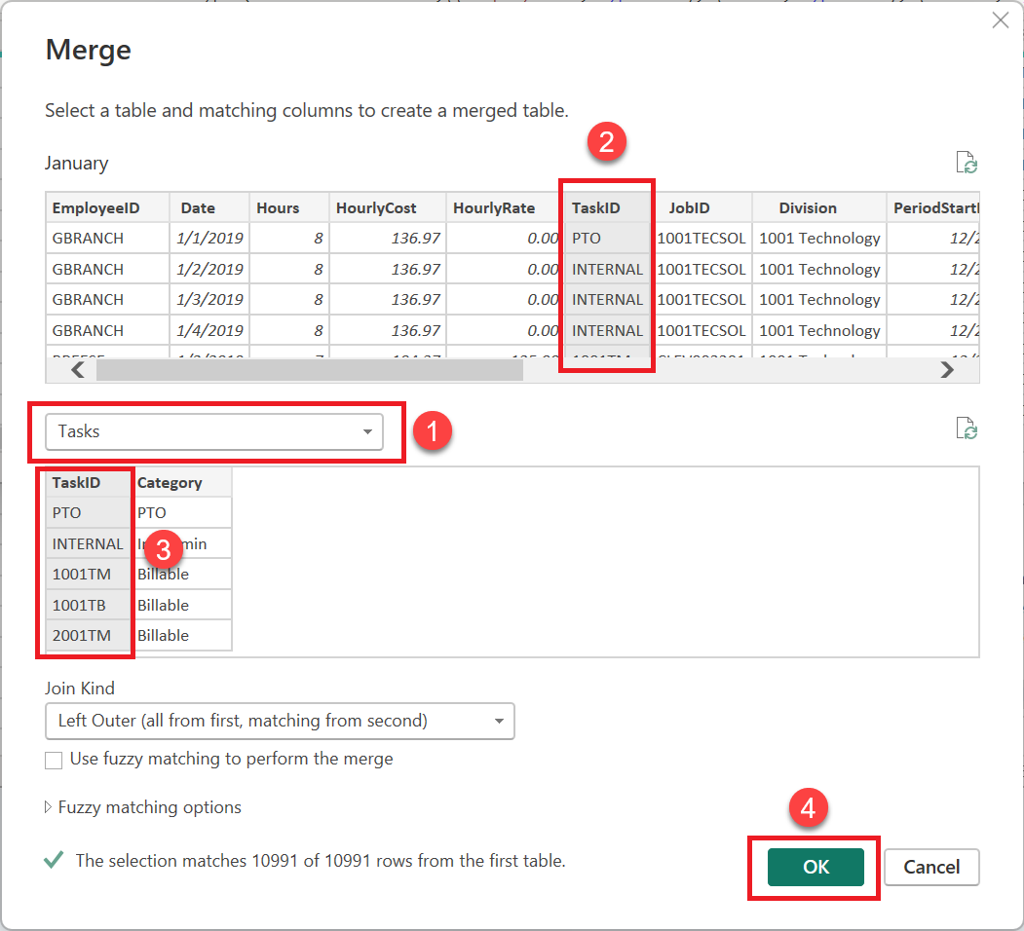
Merging queries
The Join Kind dialog displays Left Outer (all from first, matching from second). Other types of joins are listed in the dropdown, including the following:
Left Outer (all rows from first table, matching from second)
Right Outer (all rows from second table, matching from first)
Full Outer (all rows from both)
Inner (only matching rows)
Left Anti (rows only in first)
Right Anti (rows only in second)

Slide 14
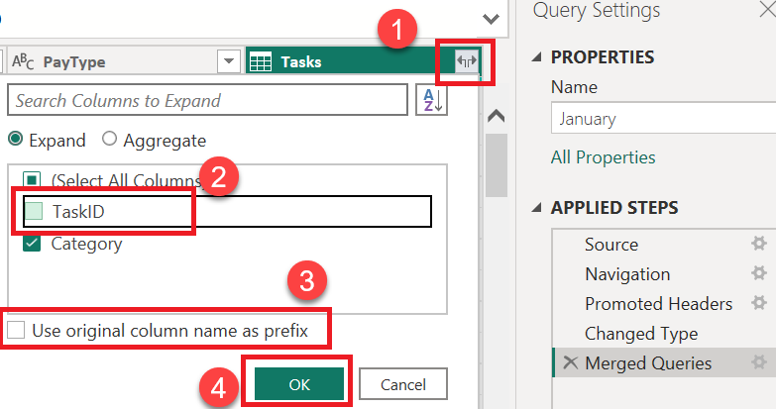
Expand table

Slide 15
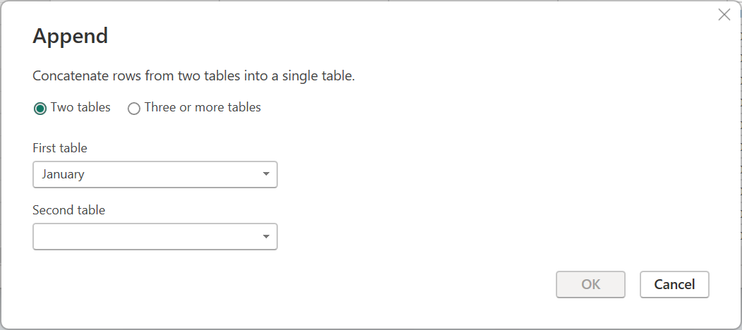
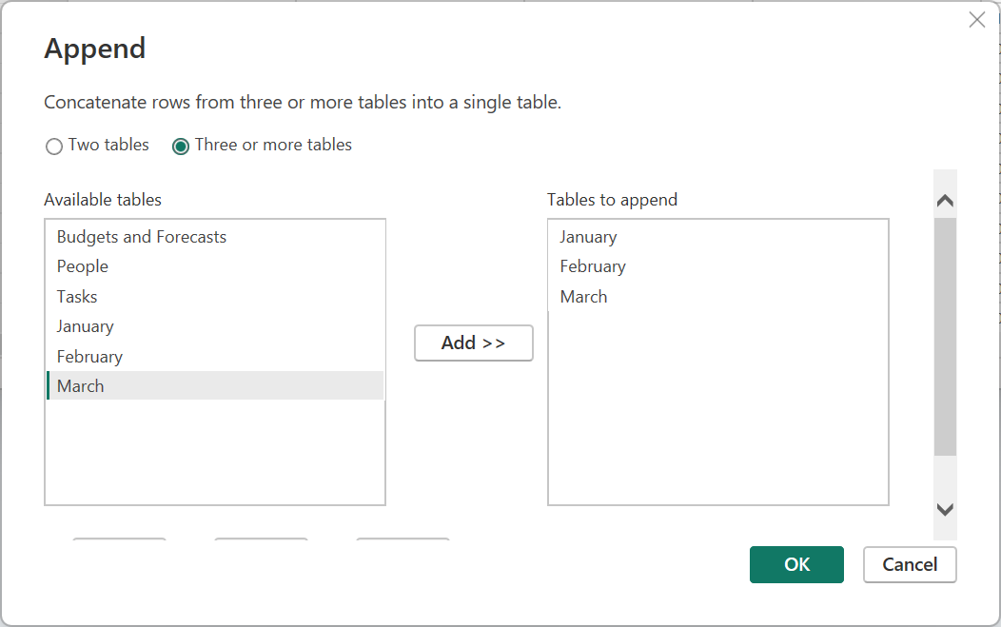
Appending Queries

Slide 16
Verifying and loading data

Slide 17
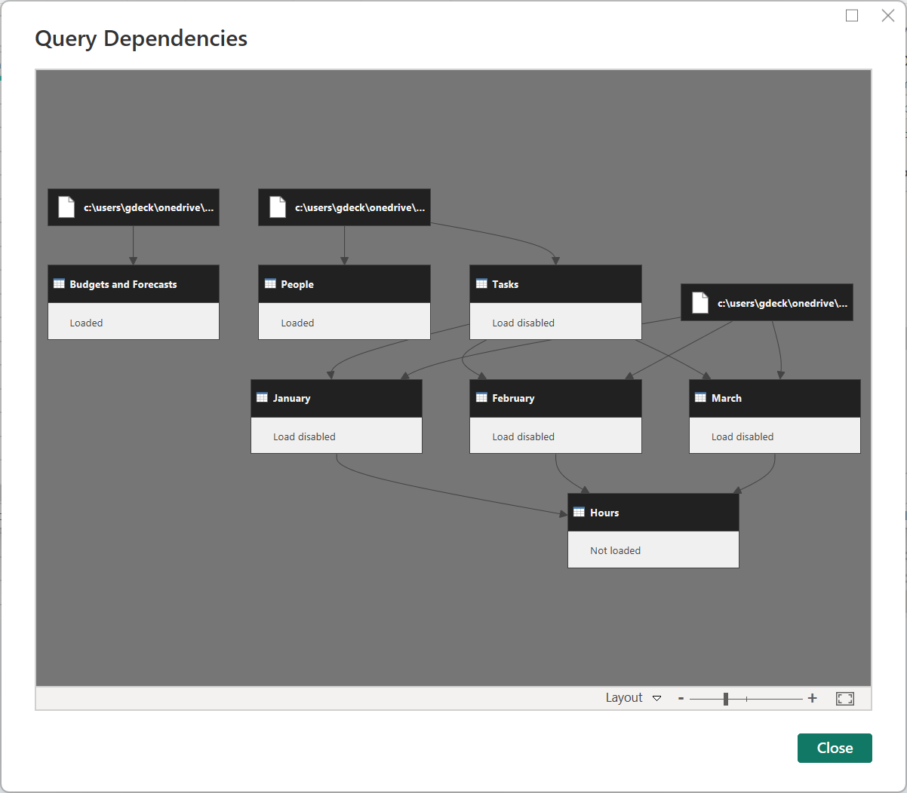
In Power Query Editor, click on the View tab of the Ribbon.
Click the Query Dependencies button in the Dependencies area of the Ribbon. This displays the Query Dependencies window, as shown in the following screenshot:

Slide 18
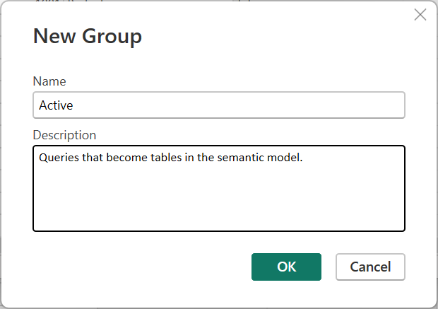
Organizing Queries
In Power Query Editor, in the Queries pane, right-click a query and select Move To Group and then New Group…. The New Group dialog is displayed, as shown in the following screenshot:

Slide 19
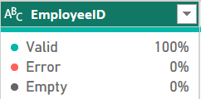
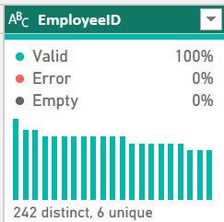
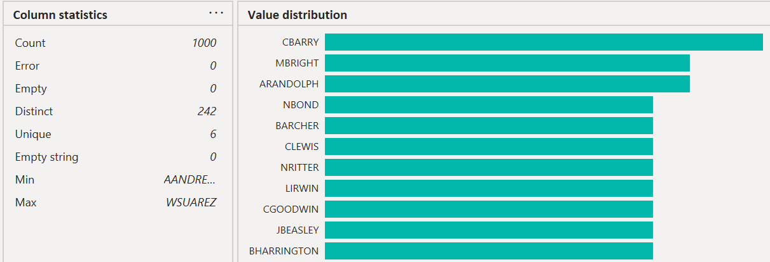
Checking column quality, distribution, and profiles
Click the View tab of the Ribbon and check the box next to Column quality, Column distribution, and Column profile in the Data Preview section.

Slide 20
Summary

Slide 21
Review Questions
How many different connectors are available for ingesting data in Power BI?
What is the powerful sub-application included with Power BI that's used for ingesting and shaping data?
What is the name of the language that's used behind the scenes when creating queries?
Turning columns into rows is called what?
What icons are displayed in the headers of columns for text, whole number, decimal, and date columns?
Joining two queries together based on columns is called what?
What are the six different kinds of join operations that can be performed when joining queries?
Adding one query to another query is called what?

Slide 22
Follow-up and Next lesson
NEXT LESSON
To learn more about the topics that were covered in this chapter, please take a look at the following references:
Data sources in Power BI Desktop: https://learn.microsoft.com/en-us/power-bi/connect-data/desktop-data-sources
Excel: https://learn.microsoft.com/en-us/power-query/connectors/excel
Query overview in Power BI Desktop: https://learn.microsoft.com/en-us/power-bi/transform-model/desktop-query-overview
Perform common query tasks in Power BI Desktop: https://learn.microsoft.com/en-us/power-bi/transform-model/desktop-common-query-tasks
Chapter 5 – Creating Semantic Models and Calculations

