Slide 1
Learn Power BI: Chapter 5 Creating Semantic Models and Calculations

Slide 2
Lesson Plan
Creating a semantic model
Creating calculations
Checking and troubleshooting calculations
Summary

Slide 3
Creating a semantic model

Slide 4
Requirements
You will need a connection to the internet.
Power BI Desktop

Slide 5
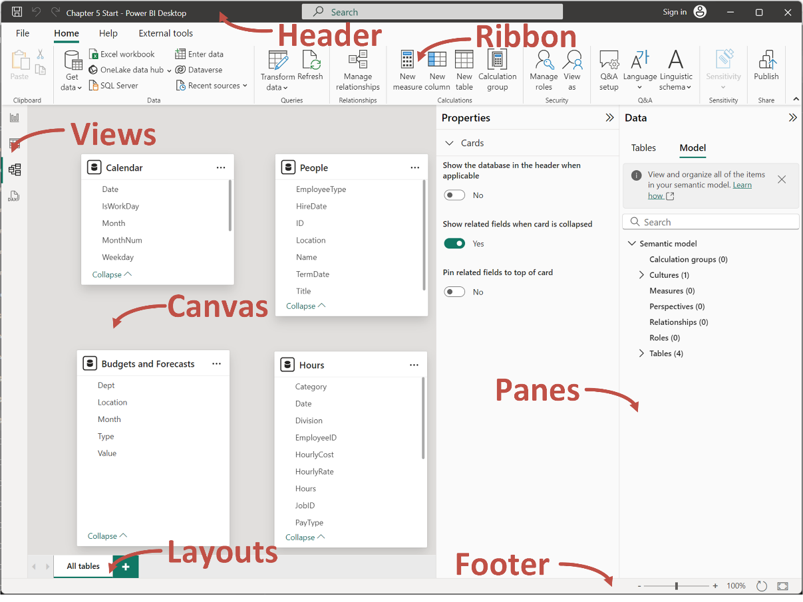

Slide 6
Touring the Model View
Header: Standard for Windows applications. Provides a search bar and the ability to Sign in to the Power BI Service.
Ribbon: Has File, Home, and Help tabs. Other tabs include External tools.
Views: There are four views, the Report view for building visuals, Table view for viewing data, Model view for viewing and editing the semantic model, and DAX Query view for creating DAX queries.
Canvas: Displays layouts of tables within the semantic model, as well as their relationships to one another. A default All tables layout is created automatically. Wallpaper: Only shown in Report view.
Panes: Displays the Data pane and the Properties pane. The Properties pane is exclusive to the Model view and allows us to associate metadata with various fields or columns within the tables of the semantic model. This includes the ability to specify synonyms and descriptions, as well as data types, data categories, and default aggregations or summarizations.
Layouts: The Pages area from the Report view is replaced by Layouts. The Layouts area allows us to create multiple layouts or views of the data tables within the model, as well as rename and reorder the layouts.
Footer: Provides zoom controls, reset the layout, and fit the model to the current display area.

Slide 7
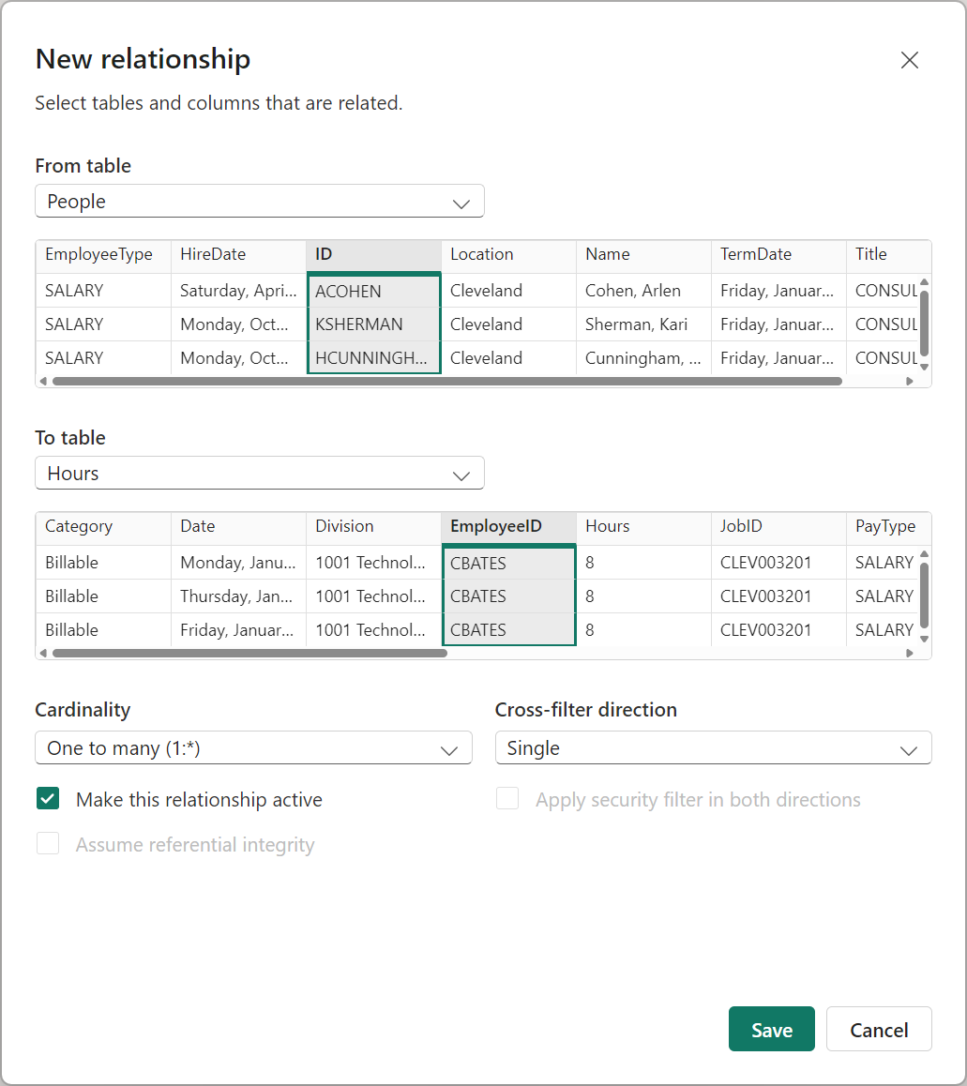
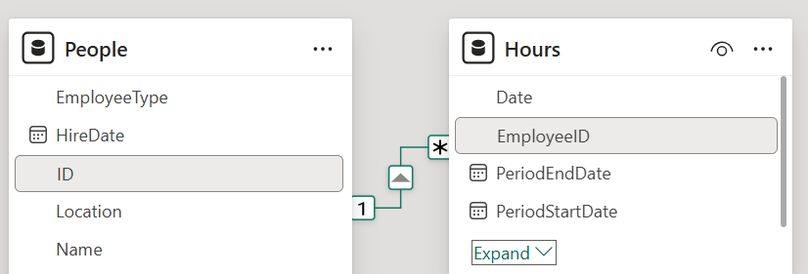
Drag and drop columns in one table to a matching column in another table to create a relationship.

Slide 8
Relationships and Cardinality
There are actually four different cardinalities for relationships in Power BI, as outlined here:
One-to-one: This means that there are unique values in each table.
Many-to-one: This means that there are unique values in one table that match multiple rows in another table.
One-to-many: This means that there are unique values in one table that match multiple rows in another table.
Many-to-many: This means that neither table has unique values for rows. It is generally good practice to avoid these types of relationships because of their complexity and the amount of processing and resources required.
The designation of many-to-one versus one-to-many is simply a matter of which table is defined first within a relationship. In other words, the relationship between our People table and Hours table could be either many-to-one or one-to-many, depending on which table we defined first in our relationship.

Slide 9
Creating calculations

Slide 10
Columns versus Measures
Calculated columns are additional columns that are created in semantic model tables through the use of the DAX (short for Data Analysis eXpressions) formula language. Calculated columns are computed for each row in a table at the time of the calculated column’s creation, as well as during the refresh process. Calculated columns are only calculated at the time of their creation and during data refresh, it is not possible to have the calculations be dynamically based on user interaction with the report.
Measures can be either implicit or explicit. Implicit measures are created automatically by Power BI whenever a numeric field is used within a visualization and are sometimes created for text fields as well, within certain visualizations in certain circumstances. These implicit measures include the standard aggregations—such as, sum, average, maximum, minimum, distinct count, count, standard deviation, variance, and median for numeric fields, and first, last, distinct count, and count for text fields.

Slide 11
Example dax measure
Measure =
VAR __Table =
FILTER(
'Hours',
'Hours'[Category] = "Billable"
)
VAR __Result = SUMX( __Table, [Hours] )
RETURN
__Result

Slide 12
Checking and troubleshooting calculations

Slide 13
Boundary cases
A common method of performing checks is to look at boundary cases, or the maximums and minimums of our calculations.
Slicing
Another common technique that's used for troubleshooting calculations is slicing. To use this technique, you need to create multiple slicers to slice the data based on different criteria and then check the results and boundary cases for the sliced data.
Grouping
Be sure that calculations work at individual row levels of visuals as well as rollup and total correctly.

Slide 14
Summary

Slide 15
Review Questions
What are the seven major areas of the Model view in Power BI?
What are the four different types of relationship cardinalities that Power BI supports?
What is cross filter direction and what are the two types of cross filter direction supported by Power BI?
What are the two ways to create relationships in Power BI?
What are calculated columns?
When are calculated columns calculated?
What are measures?

Slide 16
Follow-up and Next lesson
NEXT LESSON
To learn more about the topics that were covered in this chapter, please take a look at the following references:
Create and manage relationships in Power BI Desktop: https://learn.microsoft.com/en-us/power-bi/transform-model/desktop-create-and-manage-relationships
Work with Table : https://learn.microsoft.com/en-us/power-bi/connect-data/desktop-data-view
Create calculated columns in Power BI Desktop: https://learn.microsoft.com/en-us/power-bi/transform-model/desktop-calculated-columns
Create measures for data analysis in Power BI Desktop: https://learn.microsoft.com/en-us/power-bi/transform-model/desktop-measures
Apply many-to-many relationships in Power BI Desktop: https://learn.microsoft.com/en-us/power-bi/transform-model/desktop-many-to-many-relationships
Chapter 6 – Unlocking Insights

