Slide 1
Learn Power BI: Chapter 6 Unlocking Insights

Slide 2
Lesson Plan
Segmenting data
Using report navigation features
Advanced analysis techniques
Summary

Slide 3
Segmenting data

Slide 4
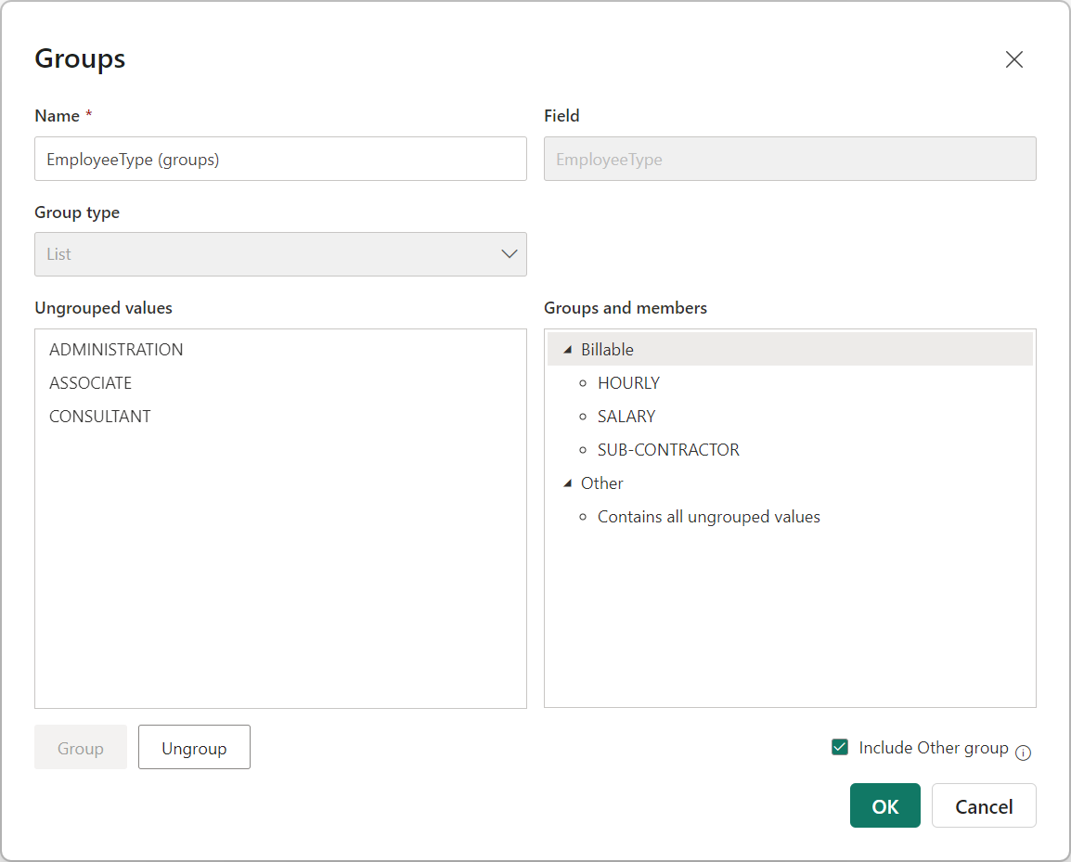
Grouping
Right-click a column in the Data pane and choose New group. The Groups dialog opens.

Slide 5

Hierarchies
Ad-hoc hierarchies: Created by placing columns from the same or different tables into the appropriate field well of a visual such as a Matrix visual.
Semantic model hierarchies: Created using the Data pane by right-clicking a column and choosing Create hierarchy. All columns must come from the same table.
Up arrow: Navigates to the next level up in the hierarchy
Down arrow: Turns drill down on and off
Double down arrow: Drills down into the second level of the hierarchy
Forked down arrow: Expands the hierarchy to the next level

Slide 6
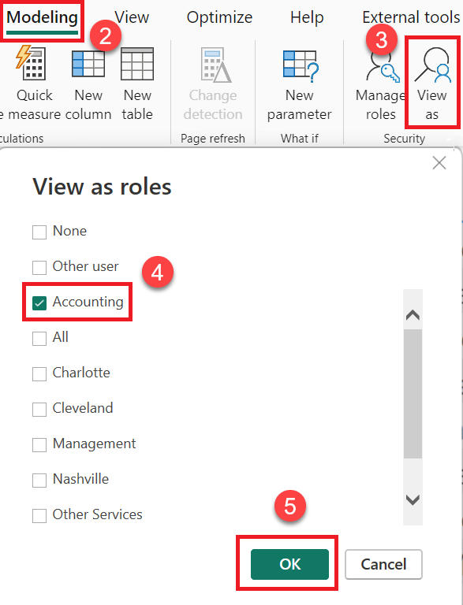
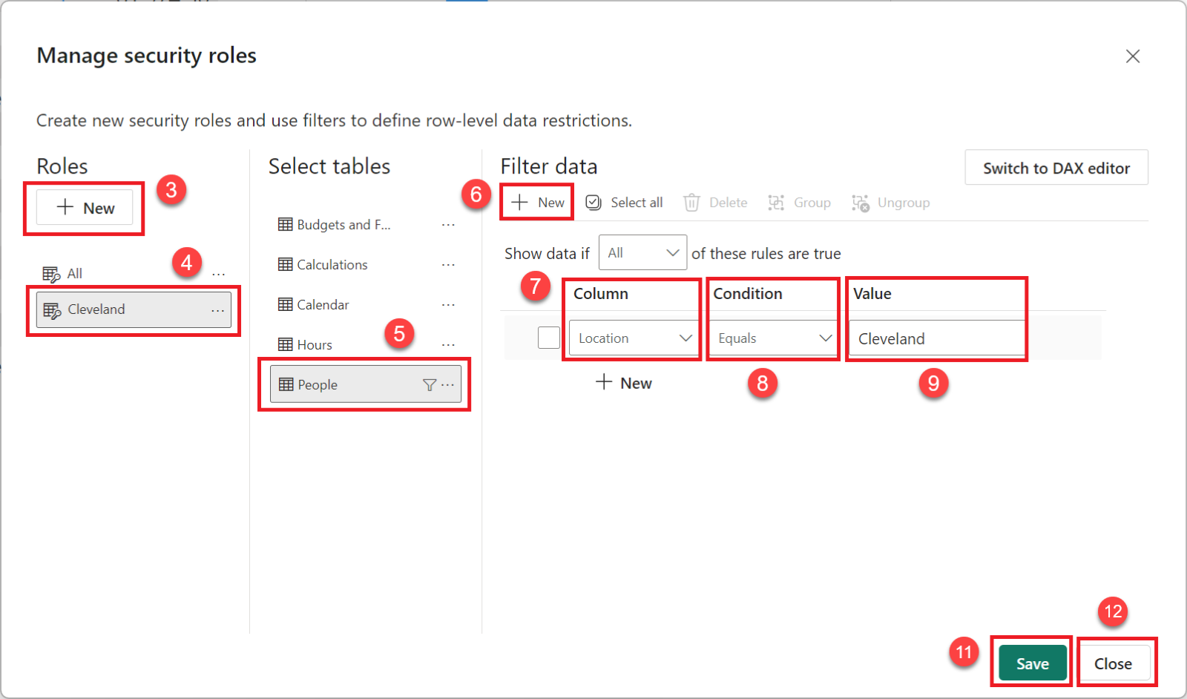
Row Level Security
Row level security (RLS) segments data by rows of a table using rules based upon DAX formulas. Roles are created using the Modeling | Manage roles feature in the ribbon. The roles created can be tested using the Modeling | View as feature

Slide 7
Using report navigation features

Slide 8
Drill through
Drill through is a method that's used for segmenting data as well as navigating a report. Drill through allows us to connect pages of reports. A report page can be created that focuses on a particular data entity, such as a division, location, or employee. Users can then right-click on a data element on one page and drill through to a different page while maintaining the original filter context from the first page.

Slide 9
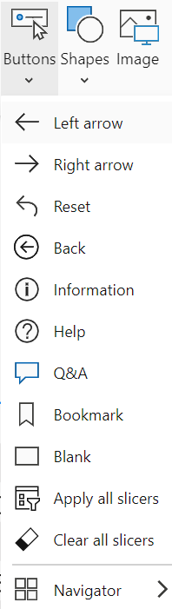
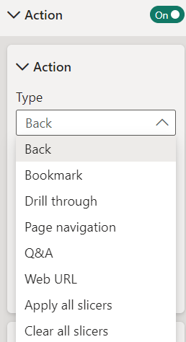
buttons
There are many different types of Buttons in Power BI including page and bookmark navigator buttons that create a button for every page or bookmark respectively. Buttons can perform an Action when pressed.

Slide 10
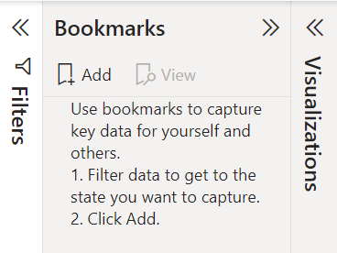
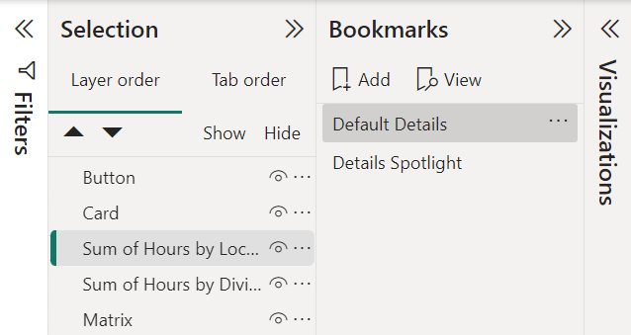
Bookmarks
Bookmarks allow you to capture the state of a report page and save this state to be referred to later. When creating a bookmark, the following elements are saved as part of the bookmark's definition by default:
The current page, along with all of the visuals on the page
All filters, including the states of slicers and selections within visuals (such as cross-highlight filters)
The sort order of visuals
The drill to locations of visuals
Visibility of visuals and shapes
The Focus and Spotlight settings of visuals and shapes

Slide 11
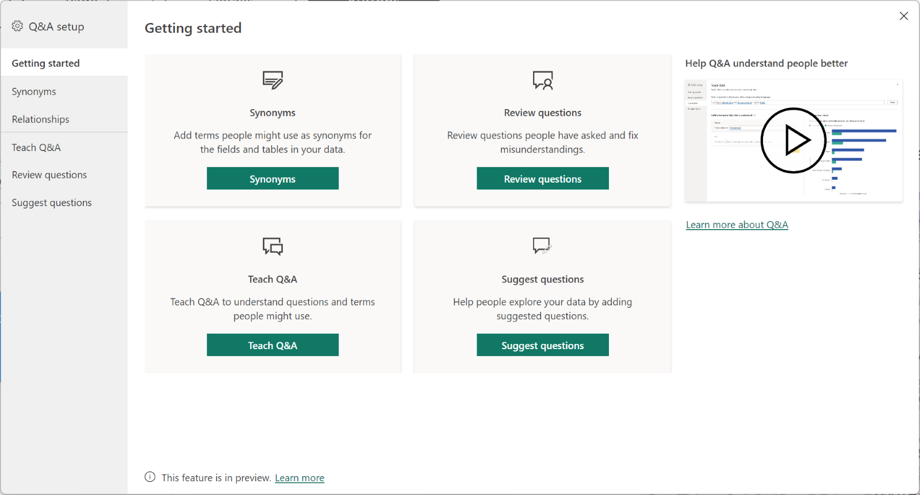
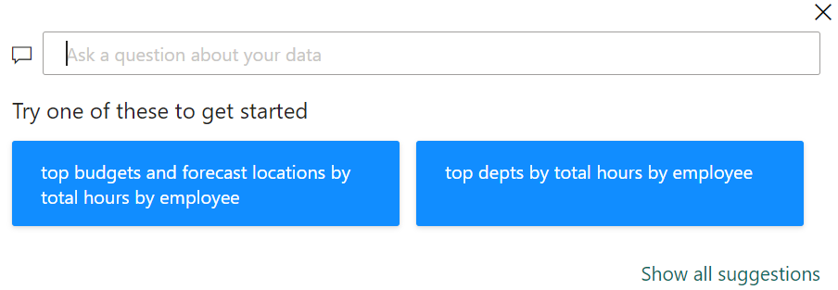
Q&A
Q&A is a powerful tool that was built into the Power BI Service since its inception. More recently, Q&A was added to Desktop as well. Q&A allows the user to use natural language to ask questions about the data contained within the semantic model. The answers received are in the form of visualizations.
With synonyms, the report author can add additional names for tables, columns, and measures that Q&A will then recognize as referring to those semantic model entities.

Slide 12
Advanced analysis techniques

Slide 13
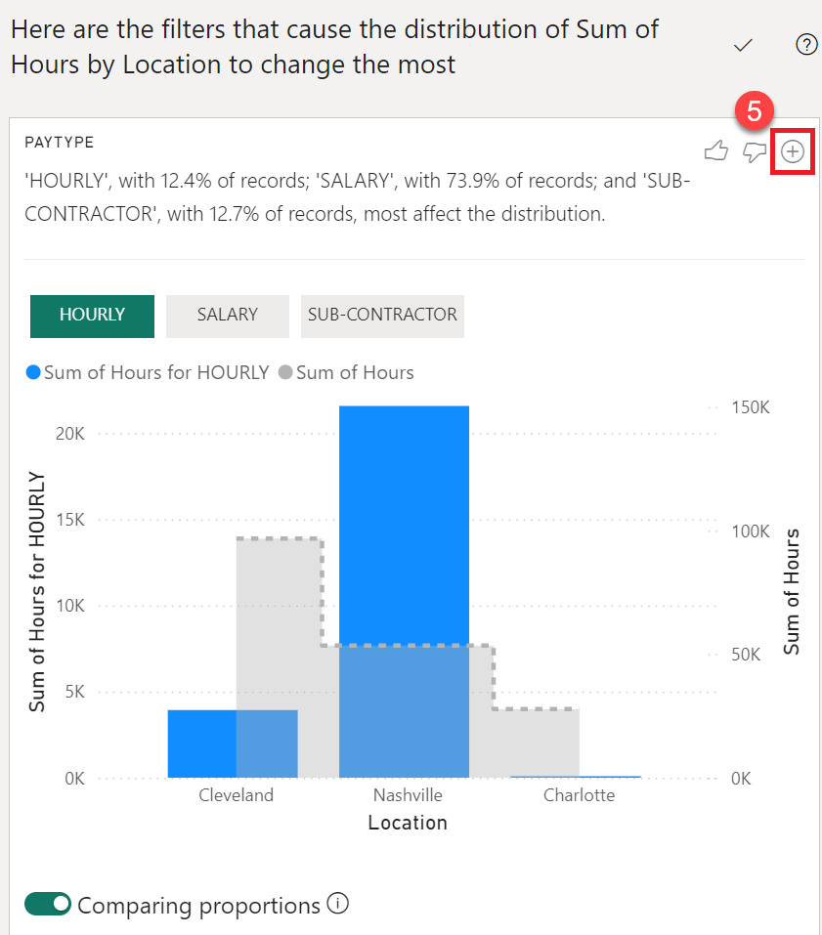
Analyze and summarize
Power BI provides powerful machine learning and artificial intelligence features that can aid in exploring and analyzing data within a semantic model. Two of these features are called Analyze and Summarize. These can be accessed by right-clicking within certain visuals.

Slide 14
Top-N Filtering
Proper use of Top-N filtering allows report viewers to quickly focus on the most important information within visualizations. This feature is accessed in the Filters pane.

Slide 15
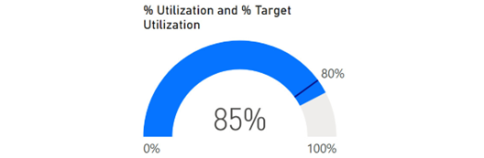
Gauges and KPIs
A good way to display a metric concerning a goal is to use a gauge visualization.

Slide 16
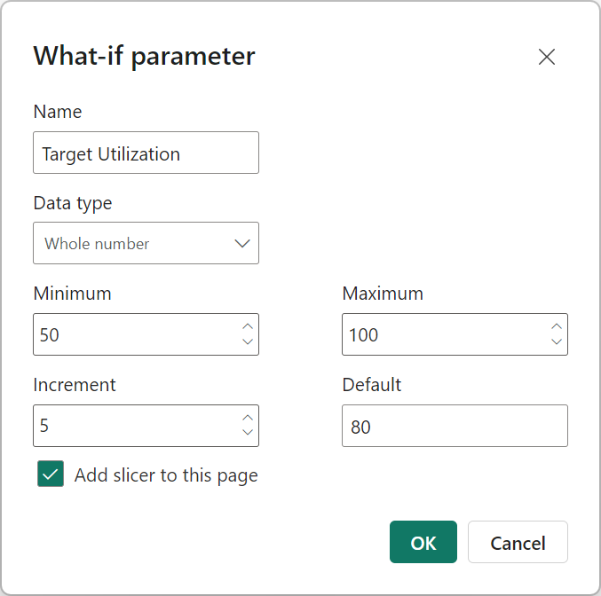
What-If Parameters
What-if parameters provide an easy and convenient mechanism for report viewers to interact with reports to set goals, control DAX calculations, and filter information on report pages.

Slide 17
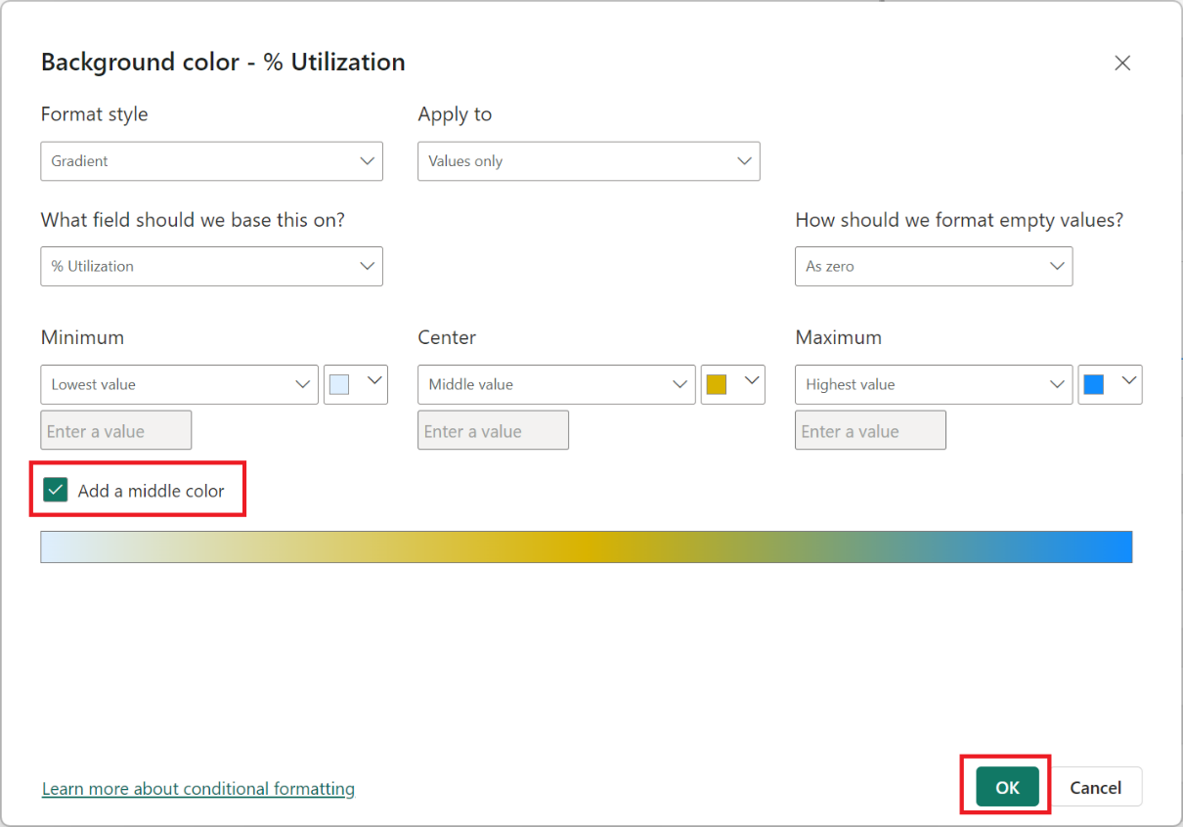
Conditional Formatting
Power BI supports visual cues in the form of conditional formatting. Conditional formatting can be used with tables, matrixes, and other visuals to provide background colors, font colors, data bars, and icons within the visualization.

Slide 18
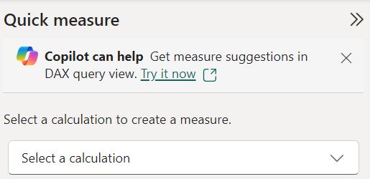
Quick Measures
Power BI provides a feature called Quick measures that can help with much of the DAX heavy lifting. Right-click a column in the Data pane to access this feature.

Slide 19
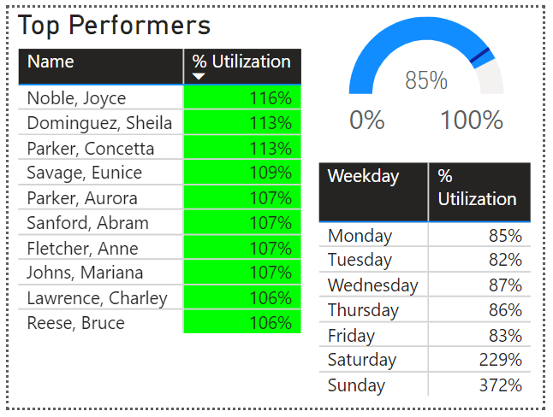
Report Page Tooltips
Report tooltip pages allow entire report pages to be used as tooltips for visuals on a different page.

Slide 20
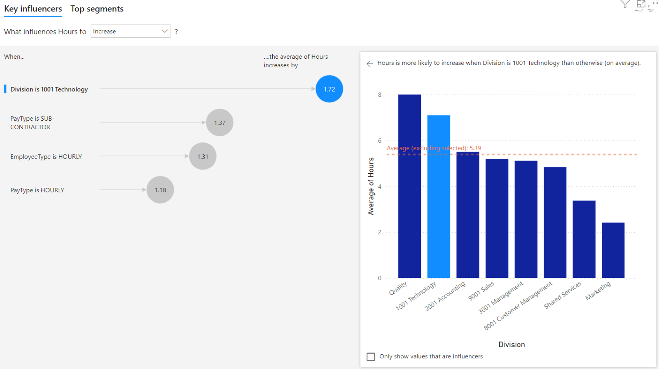
Key Influencers
The key influencers visual adds machine learning functionality to Power BI.

Slide 21
Summary

Slide 22
Review Questions
What are the two different methods of segmenting data in Power BI?
What are the four operations for working with hierarchies?
What feature would a report author use to ensure that people within different roles only see the information that's relevant to their particular role?
How is drill through different than drilling up and down through hierarchies?
What are the six actions buttons can perform?
Why is data categorization important for Q&A?
What are synonyms and where can they be added within Power BI Desktop?
What is a bookmark and what information can it save as part of its definition?
What advanced visualization feature allows you to create a measure that can be adjusted by a report viewer?
What are the three settings that must be adjusted when creating a report tooltip page, and how is a report tooltip page activated for use?

Slide 23
Follow-up and Next lesson
NEXT LESSON
To learn more about the topics that were covered in this chapter, please take a look at the following references:
Using grouping and binning in Power BI Desktop: https://learn.microsoft.com/en-us/power-bi/create-reports/desktop-grouping-and-binning
Row-level security (RLS) with Power BI: https://learn.microsoft.com/en-us/fabric/security/service-admin-row-level-security
Set up drillthrough in Power BI reports: https://learn.microsoft.com/en-us/power-bi/create-reports/desktop-drillthrough
Create buttons in Power BI reports: https://learn.microsoft.com/en-us/power-bi/create-reports/desktop-buttons?tabs=powerbi-desktop
Specify data categories in Power BI Desktop: https://learn.microsoft.com/en-us/power-bi/transform-model/desktop-data-categorization
Best practices to optimize Q&A in Power BI: https://learn.microsoft.com/en-us/power-bi/natural-language/q-and-a-best-practices
Create report bookmarks in Power BI to share insights and build stories: https://learn.microsoft.com/en-us/power-bi/create-reports/desktop-bookmarks?tabs=powerbi-desktop
Create and use parameters to visualize variables in Power BI Desktop: https://learn.microsoft.com/en-us/power-bi/transform-model/desktop-what-if
Create tooltips based on report pages: https://learn.microsoft.com/en-us/power-bi/create-reports/desktop-tooltips?tabs=powerbi-desktop
Chapter 7 – Creating the Final Report

