Slide 1
Learn Power BI: Chapter 7 Creating the Final Report

Slide 2
Lesson Plan
Preparing the final report
Creating the final report pages
Finishing up
Summary

Slide 3
Preparing the final report

Slide 4
Planning and Cleanup
Planning the final report
Make sure to understand the different audiences involved with the report and plan out what pages will be included in the final report.
Cleaning up
Clean up any pages or visual artifacts used during the initial exploration of the data.

Slide 5
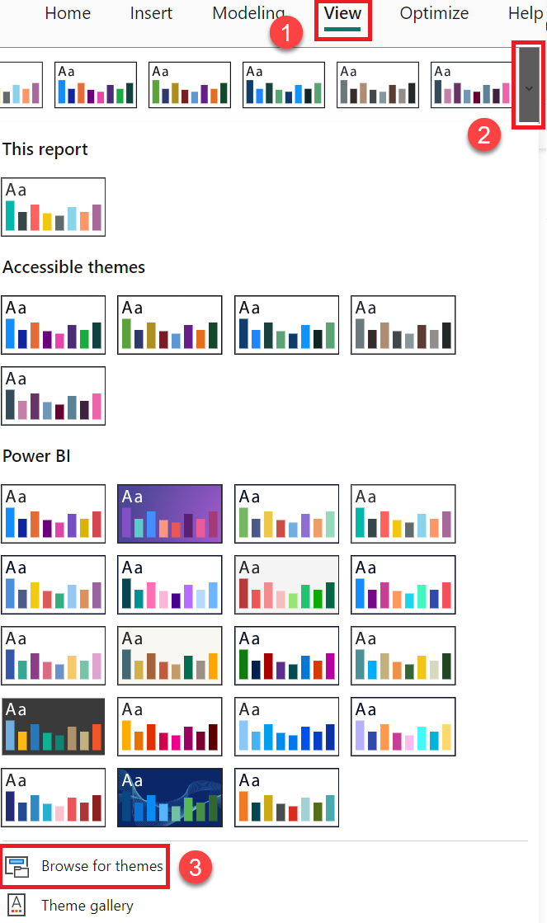
Using a theme
Theme files are JavaScript files that can contain all of the approved corporate branding colors and standards as well as default font sizes and other settings for visuals, report pages, etc. Themes can save a lot of time and effort when it comes to formatting the final report

Slide 6
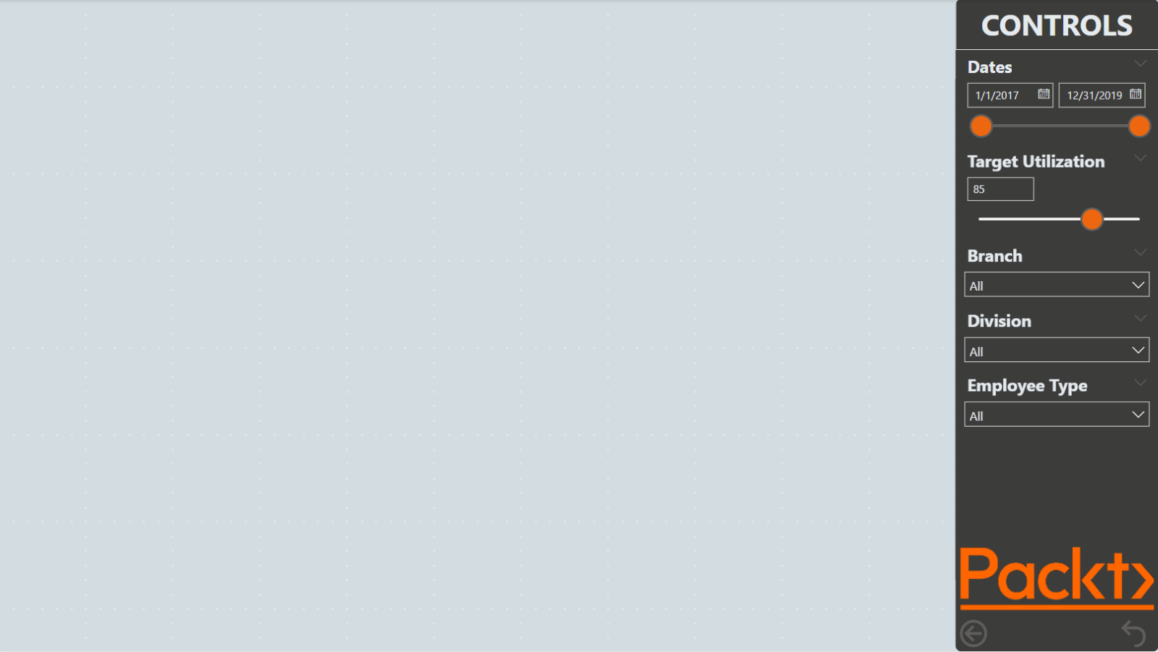
Page Templates
Think of the value of a template page this way: instead of setting up the layout and format for each page of a report individually, we do these operations only once instead.

Slide 7
Sync Slicers, Calendar Adjustments, and report filters
Using Sync slicers
Sync slicers allow slicers to be synchronized across pages of a report.
Adjusting the calendar
Calendar tables can be adjusted to only include relevant dates based upon fact tables
Calendar = CALENDAR( MIN( 'Hours'[Date] ), MAX( 'Hours'[Date] ) )
Adding report filters
Adjust Report-level filters appropriately to ensure that only relevant information is displayed.

Slide 8
Creating the final report pages

Slide 9
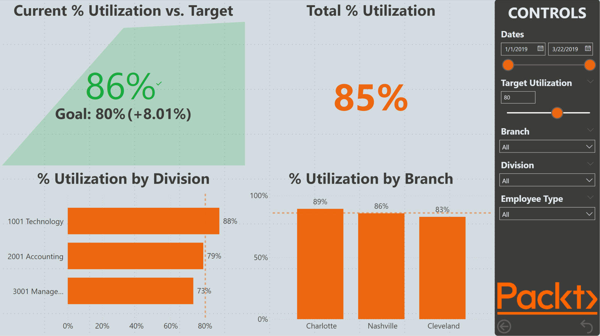
Executive summary page

Slide 10
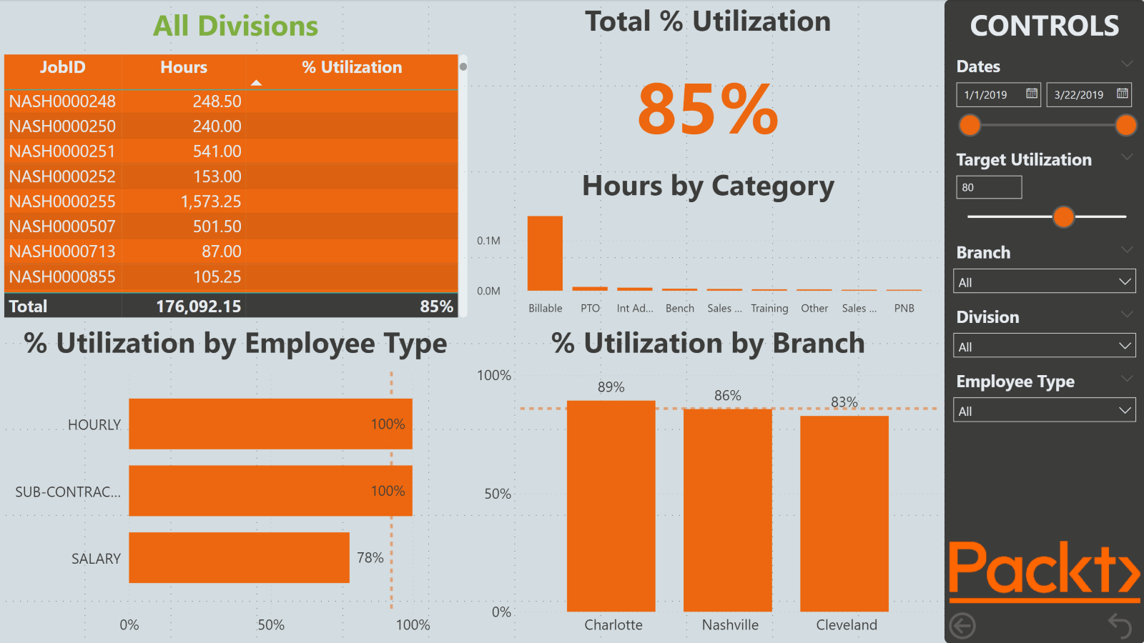
Division Management page

Slide 11
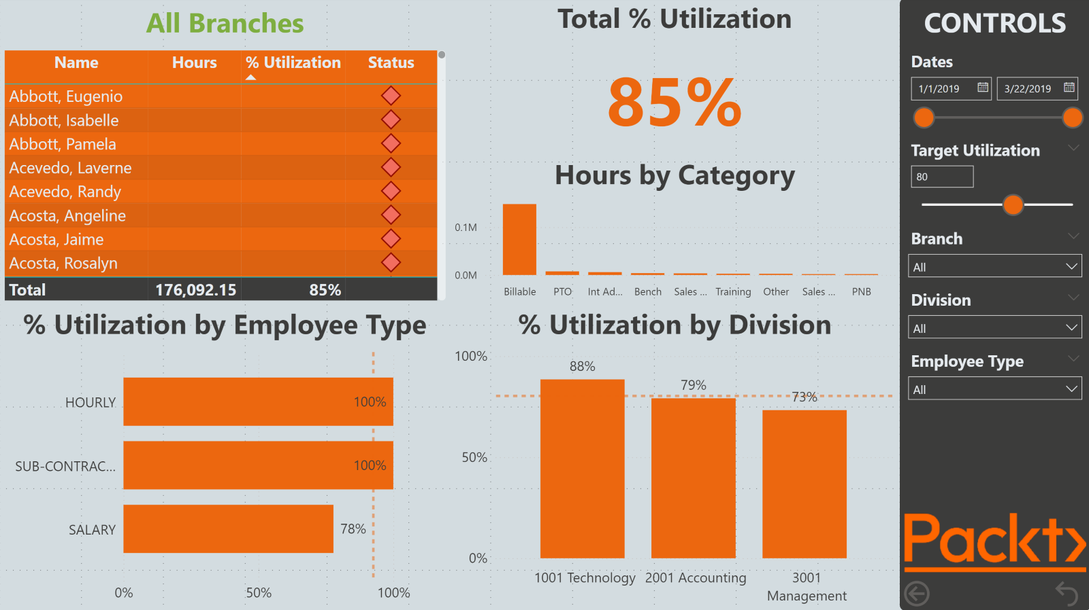
Branch Management page

Slide 12
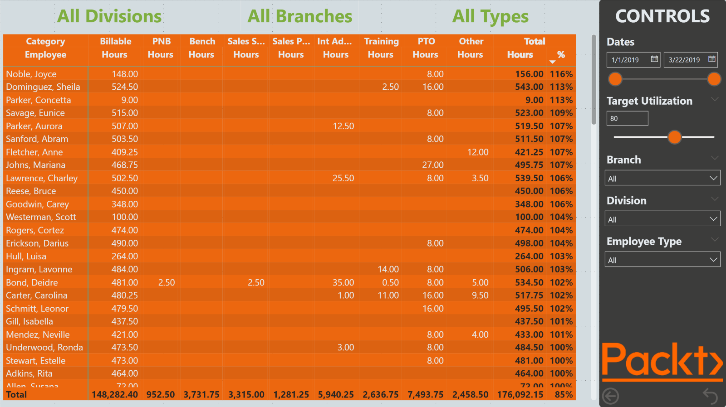
Hours Detail page

Slide 13
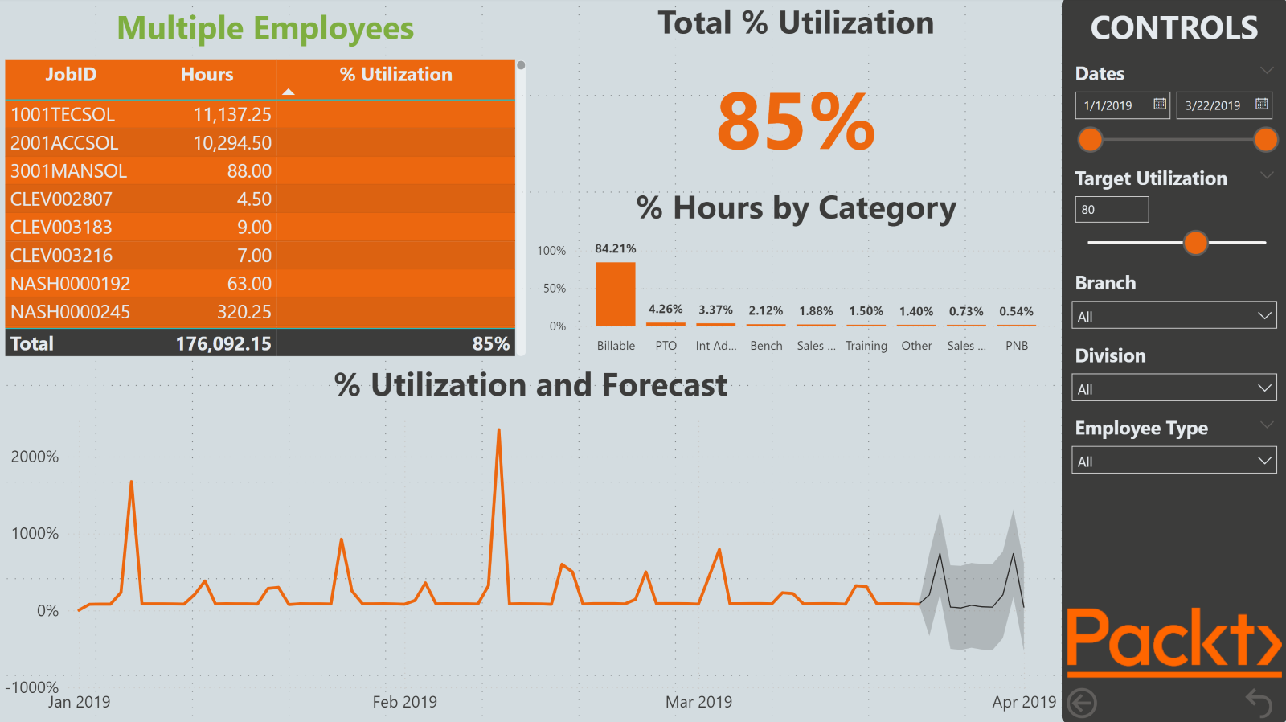
Employee Details page

Slide 14
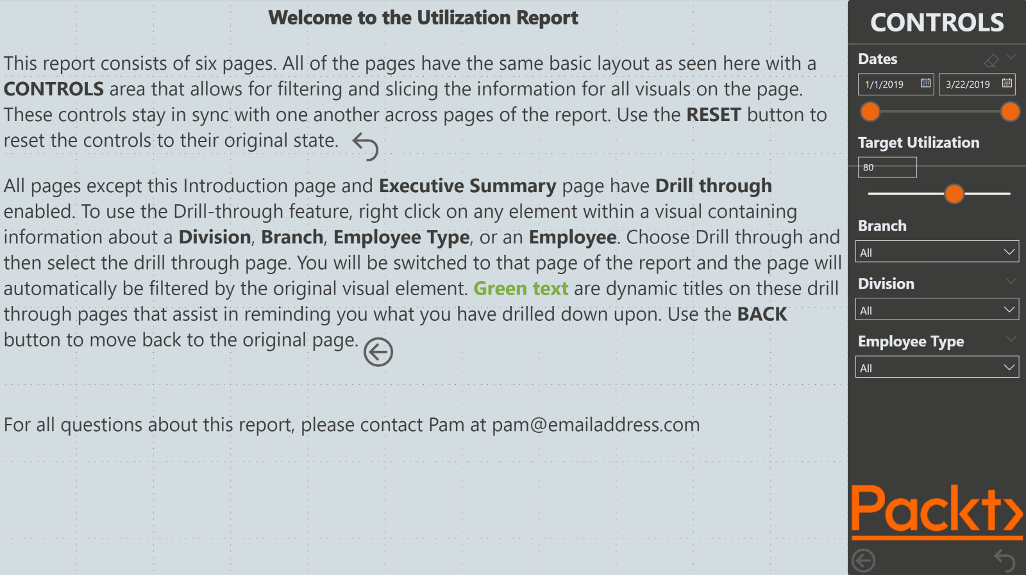
Introduction page

Slide 15
Finishing up

Slide 16
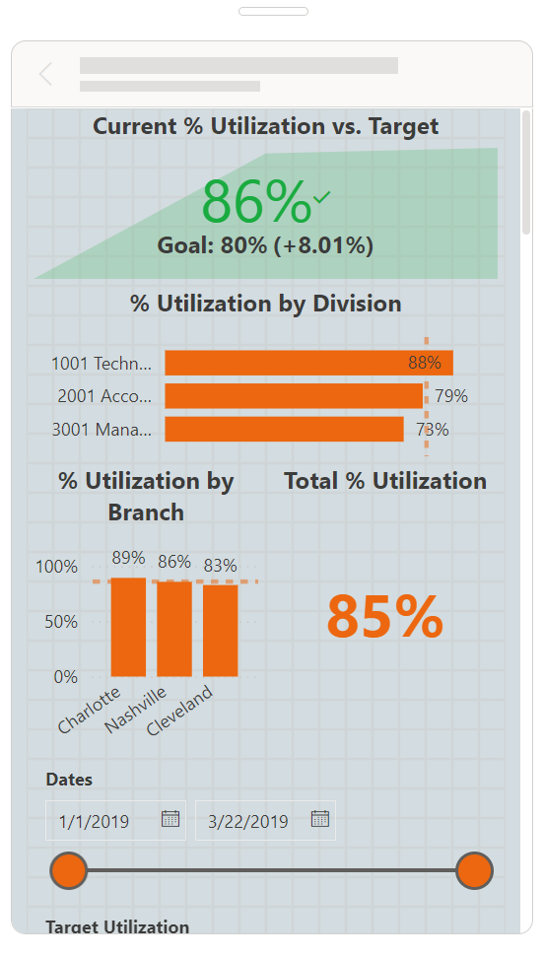
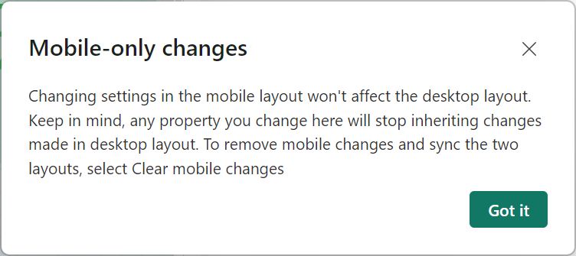
Creating Mobile Views
Creating Mobile Views
The Power BI ecosystem includes mobile apps that allow users to access reports from their phone or tablet.

Slide 17
Testing and Cleaning up
Testing
Be certain to run basic tests to verify report navigation and feature functionality before releasing the report to production. This testing should include testing RLS if the report uses row level security.
Cleaning up
Be sure to clean up report artifacts such as hiding the page template page as well as hiding any tables, columns, and measures that should not be accessible to report viewers.

Slide 18
Summary

Slide 19
Review Questions
What Power BI feature allows the report author to preset elements such as colors and font sizes?
What are the three preparation steps that are taken before creating the final report pages?
What feature keeps the settings for slicers consistent across pages?
What type of visual can display the current value of a metric and the trend of that metric and track that metric against a goal?
What two features of Power BI are used to allow report viewers to reset the slicers on a page?
What DAX function can be used to determine whether a column has a single value?
What Power BI feature allows ad hoc information to be entered into the semantic model?
What two analytics features were used on the report pages?
What report and data elements can be hidden from report viewers?

Slide 20
Follow-up and Next lesson
NEXT LESSON
To learn more about the topics that were covered in this chapter, please take a look at the following references:
Using Report Themes in Power BI Desktop: https://learn.microsoft.com/en-us/power-bi/create-reports/desktop-report-themes
Using gridlines and snap-to-grid in Power BI Desktop reports: https://learn.microsoft.com/en-us/power-bi/create-reports/desktop-gridlines-snap-to-grid?tabs=powerbi-desktop
Add text boxes, shapes, and smart narrative visuals to Power BI reports: https://learn.microsoft.com/en-us/power-bi/create-reports/power-bi-reports-add-text-and-shapes?tabs=powerbi-desktop
Apply conditional formatting in tables and matrixes: https://learn.microsoft.com/en-us/power-bi/create-reports/desktop-conditional-table-formatting
Sort one column by another column in Power BI: https://learn.microsoft.com/en-us/power-bi/create-reports/desktop-sort-by-column?tabs=powerbi-desktop
Create report bookmarks in Power BI to share insights and build stories: https://learn.microsoft.com/en-us/power-bi/create-reports/desktop-bookmarks?tabs=powerbi-desktop
Using the Analytics pane in Power BI Desktop: https://learn.microsoft.com/en-us/power-bi/transform-model/desktop-analytics-pane
Tips and tricks for creating reports in Power BI Desktop: https://learn.microsoft.com/en-us/power-bi/create-reports/desktop-tips-and-tricks-for-creating-reports
Chapter 8 – Publishing and Sharing

