Slide 1
Learn Power BI: Chapter 8 Publishing and Sharing

Slide 2
Lesson Plan
Creating an account
Introducing the service
Publishing and sharing
Summary

Slide 3
Creating an account

Slide 4
Creating an Account
Microsoft 365
If you already have a Microsoft 365 account, then you are all set. You can use that account's email address to sign up for a free trial of Power BI or have your IT department or Microsoft 365 administrator assign you a free or Pro Power BI license. If you do not have a Microsoft 365 account, then you will need to sign up for a free Microsoft 365 trial. You can sign up for a free trial here: https://www.microsoft.com/en-us/microsoft-365/try. Under the Explore Microsoft 365 for free heading, click on Start your free trial. The free trial is for one month, which should give you plenty of time to read the rest of this chapter!
Microsoft Fabric trial
Once you have a Microsoft 365 account, you will also need a Microsoft Fabric trial license, Power BI Pro license, or Power BI Premium Per User (PPU) license. Your IT administrator or Microsoft 365 administrator can assign you a Pro or PPU license for Power BI.

Slide 5
Introducing the service

Slide 6
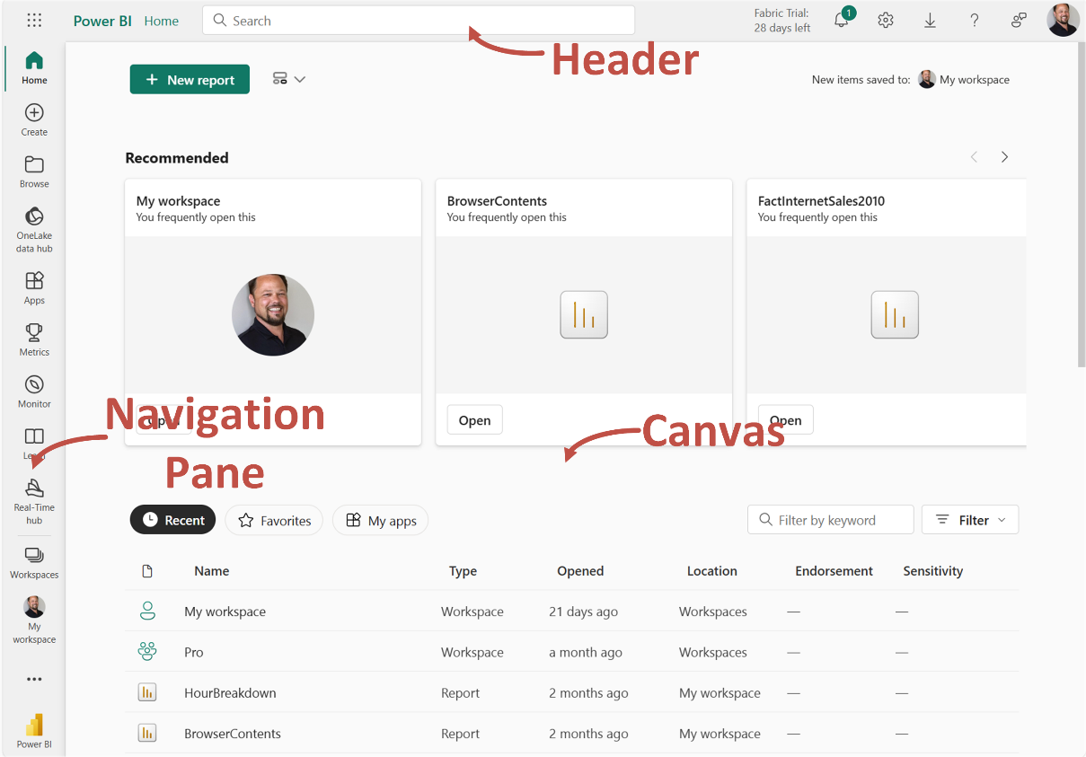

Slide 7
Touring the Service
Header
The header area contains a number of useful items including a breadcrumb widget that helps you to keep track of where you are within the Power BI service. In the right-center of the screen, there is a Search bar.
Navigation pane
The navigation pane contains a number of useful navigational links and is the main way to navigate within the Power BI Service. Links include Home, Metrics, Monitor, OneLake, and Workspaces.
Canvas
Similar to the Canvas area in the Desktop, the particular content and use of the Canvas area in the service depends on exactly where you are in the service and what you are doing. Suffice to say, this is the main area where view and interact with reports and other content within the service.

Slide 8
Publishing and sharing

Slide 9
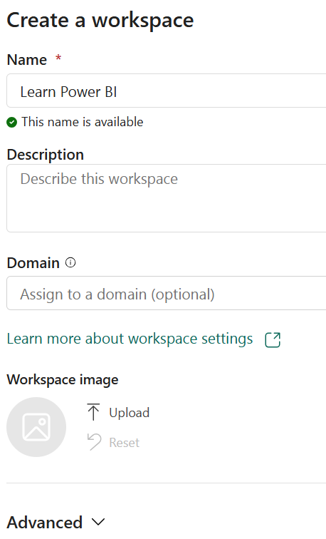
Creating a Workspace
Workspaces is a fly-out menu that lists any workspaces that have been created by, or shared with, the currently logged-in user. Workspaces are a way of organizing your dashboards, reports, workbooks, semantic models, dataflows, and other content. Workspaces also serve as shared environments for a group of users, and a workspace is the technology underlying apps in Power BI. Every user starts with one workspace, My workspace.

Slide 10
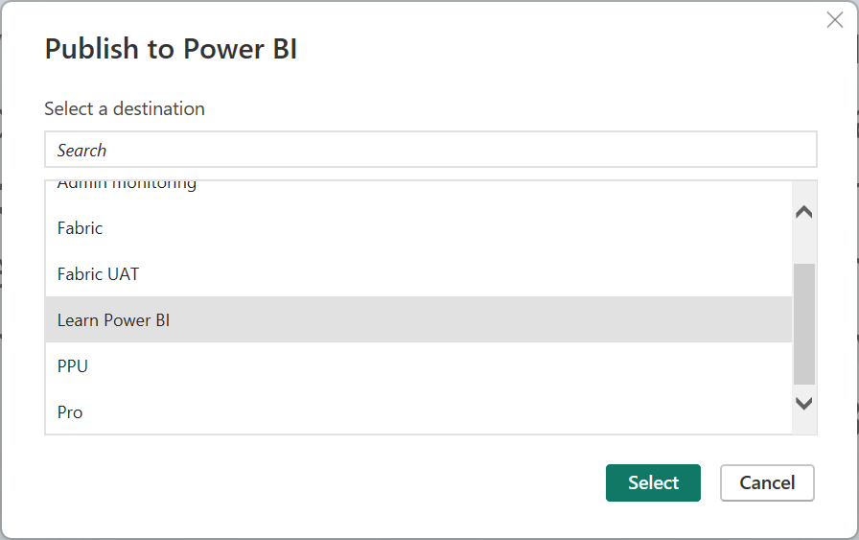
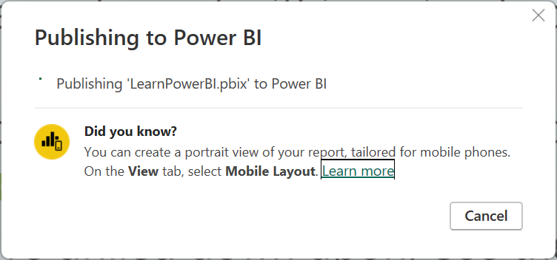
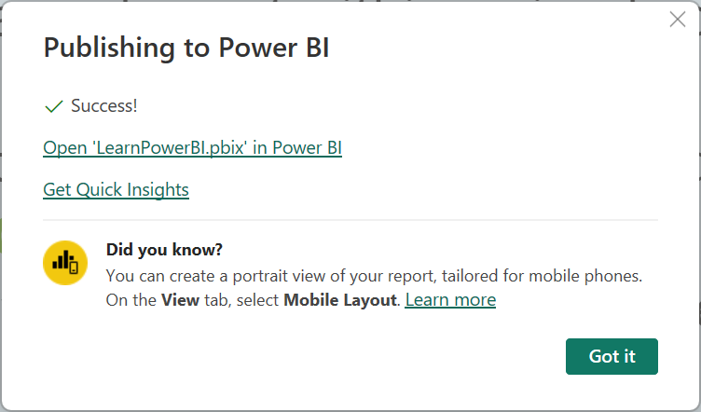
Publishing
Publishing reports is done in Power BI Desktop.

Slide 11
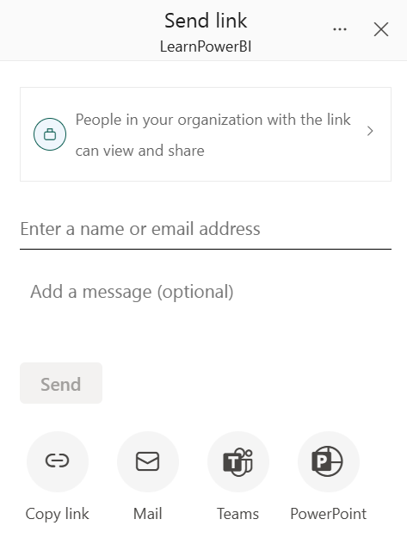
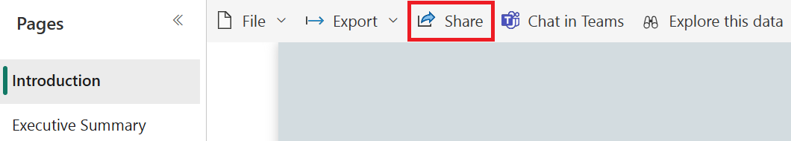
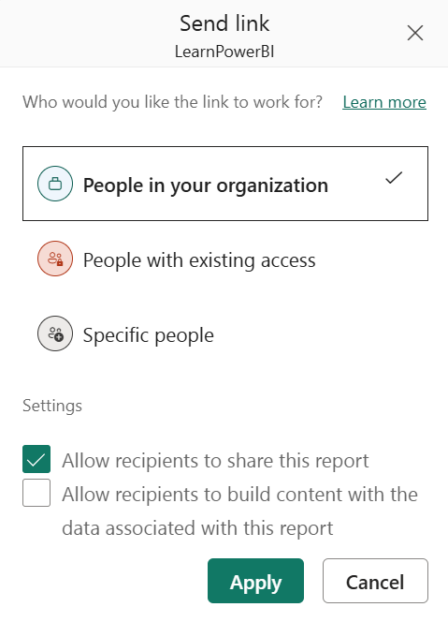
Sharing
Sharing is a paid feature that requires a Power BI Pro or Premium Per User license . This means that all of the users that can view a shared report must have a Power BI Pro license to view a shared report. Power BI PPU works similarly. If the user publishing the report publishes the report to a Premium Per User workspace, then all users must have a Premium Per User license to view the report.

Slide 12
Summary

Slide 13
Review Questions
What are the two ways of getting a Power BI account?
What are the three main interface elements of the Power BI service?
What is a workspace and why would you use one?
Do you publish reports from the Desktop version or the service?
What two objects are created/updated in the Power BI service when a report is published?
True or false: reports can only be shared with internal users of an organization?
True or false: reports can only be shared with single users?
What options are available when sharing reports?

Slide 14
Follow-up and Next lesson
NEXT LESSON
To learn more about the topics that were covered in this chapter, please take a look at the following references:
Tutorial: Get started creating in the Power BI service: https://learn.microsoft.com/en-us/power-bi/fundamentals/service-get-started
Publish semantic models and reports from Power BI Desktop: https://learn.microsoft.com/en-us/power-bi/create-reports/desktop-upload-desktop-files
Ways to collaborate and share in Power BI: https://learn.microsoft.com/en-us/power-bi/collaborate-share/service-how-to-collaborate-distribute-dashboards-reports
Workspaces in Power BI: https://learn.microsoft.com/en-us/power-bi/collaborate-share/service-new-workspaces
Chapter 9 – Using Reports in the Power BI Service

