Slide 1
Learn Power BI: Chapter 9 Using Reports in the Power BI Service

Slide 2
Lesson Plan
Viewing and using reports
Editing and creating reports
Summary

Slide 3
Viewing and Using Reports

Slide 4
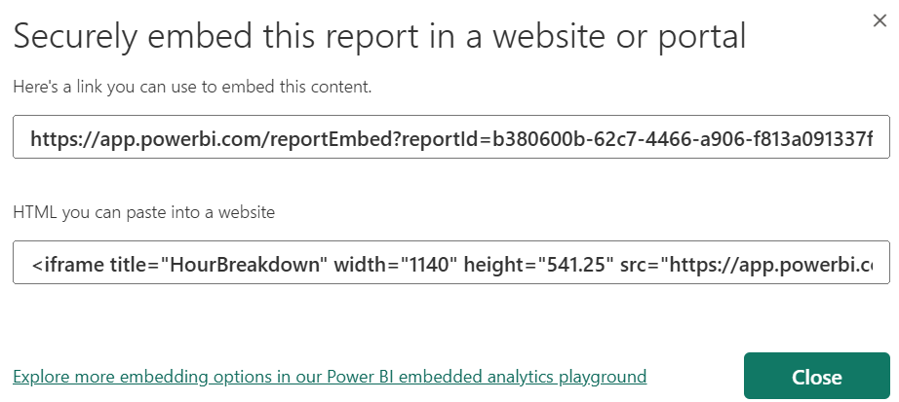
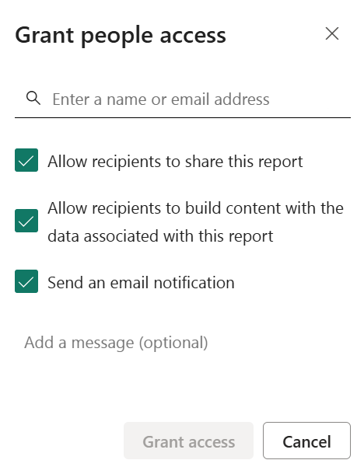
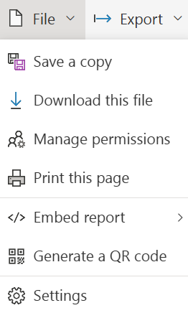
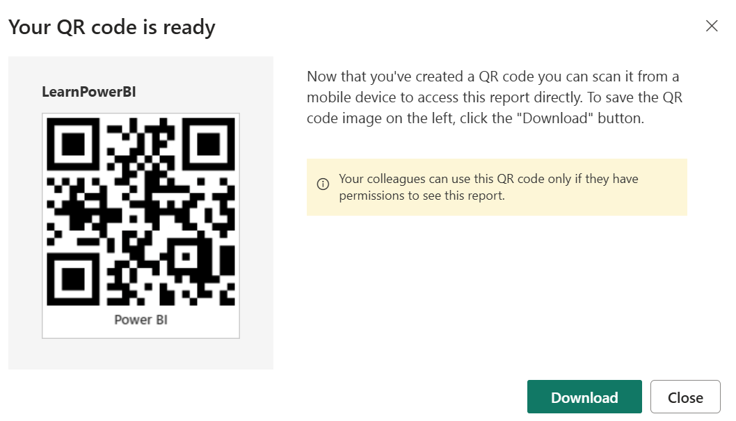
File Menu
The File menu provides a variety of important options and features for managing and working with reports while in the service.

Slide 5
Settings
Choosing Settings from the File menu opens a pane on the right-hand side of the screen that lists many different settings that can be enabled, disabled, or changed for the report. These settings mainly control the experience of others viewing the report
Report name: The name of the report.
Description: A description for the report.
Contact: Who to contact regarding the report.
Snapshot: An image snapshot of the report.
Endorsement: Endorsing a report helps other organizational users find your report and trust that its content is reliable. Endorsement can be set to None, Promoted, or Certified. The Certified option may be grayed out, depending upon your Power BI administrator settings. You can also check the box for Feature on Home to display the report in the Features section of the Power BI home screen.
Persistent filters: Enables or disables the ability of other users to save filters on the report.
Pages pane: Controls whether the report pages are displayed in the Pages pane or as tabs along the bottom of the report, as in the Desktop version.
Visual options: Visual options include the ability to enable or disable the header for visuals when in reading view, whether to use the modern visual header with updated styling options, and whether the default interaction between visuals is cross-highlighting or cross-filtering.
Export data: This setting controls the kind of data users are allowed to export from the report and whether this can be done at all.
Filtering experience: These settings enable or disable the ability of users to change filter types as well as enable or disable search functionality for the Filters pane. Filter types refer to such things as manual filters, auto filters, include/exclude filters, drill-down filters, and so on.
Cross-report drill through: Enables or disables the ability of visuals in the report to use other reports as drill-through targets.
Comments: You can either enable or disable comments for the report.
Personalize visuals: Toggles on or off the ability of users to personalize visuals.
Modern visual tooltips: Enables or disables modern visual tooltips.
Tooltips auto-scale (preview): Controls whether tooltips automatically scale based on canvas size.
Insights (preview): Enables notification if key insights are available for a report.
Default summarizations: If enabled, aggregated fields always show the default summarization type.

Slide 6
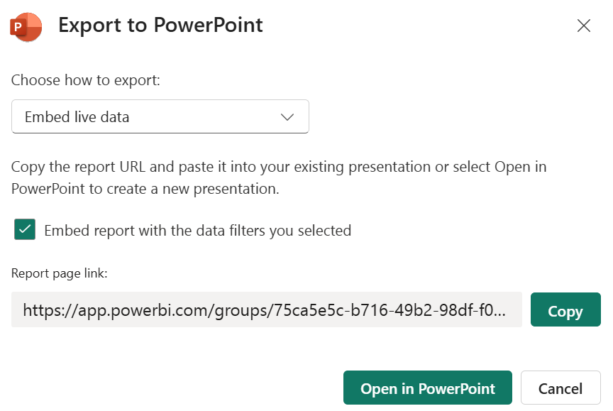
Export menu
Analyze in Excel
Choosing this option results in an Excel file being created on OneDrive that contains a live link to the Power BI semantic model for the report. A button is provided to open the file in Excel Online. To utilize the file, you need to enable external data connections when prompted in Excel. Once enabled, you may use the semantic model's tables and columns to create PivotTables and PivotCharts within the Excel file.
PowerPoint
The PowerPoint option is used to export or embed all of the pages of a report to a PowerPoint file.
PDF
The PDF option is used to export all of the pages of the report to a Portable Document Format (PDF) file. Clicking on the PDF option displays the same Export dialog options as when using the Export as an image option for exporting as a PowerPoint.

Slide 7
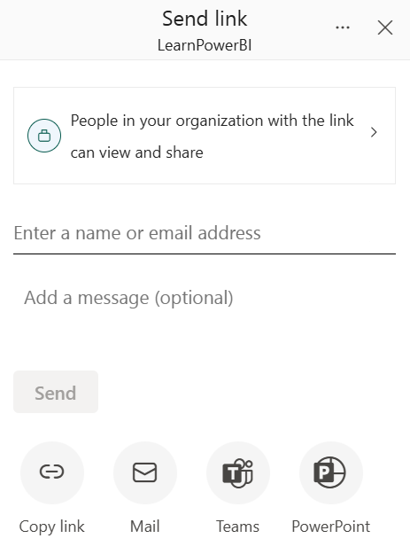
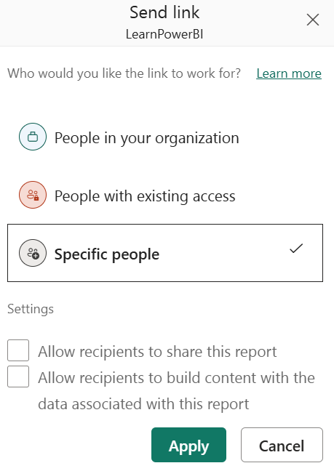

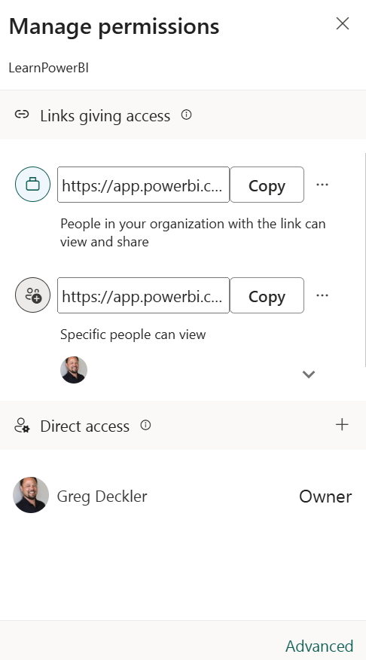
Share
Clicking the Share button in the ribbon opens the Send link dialog.

Slide 8
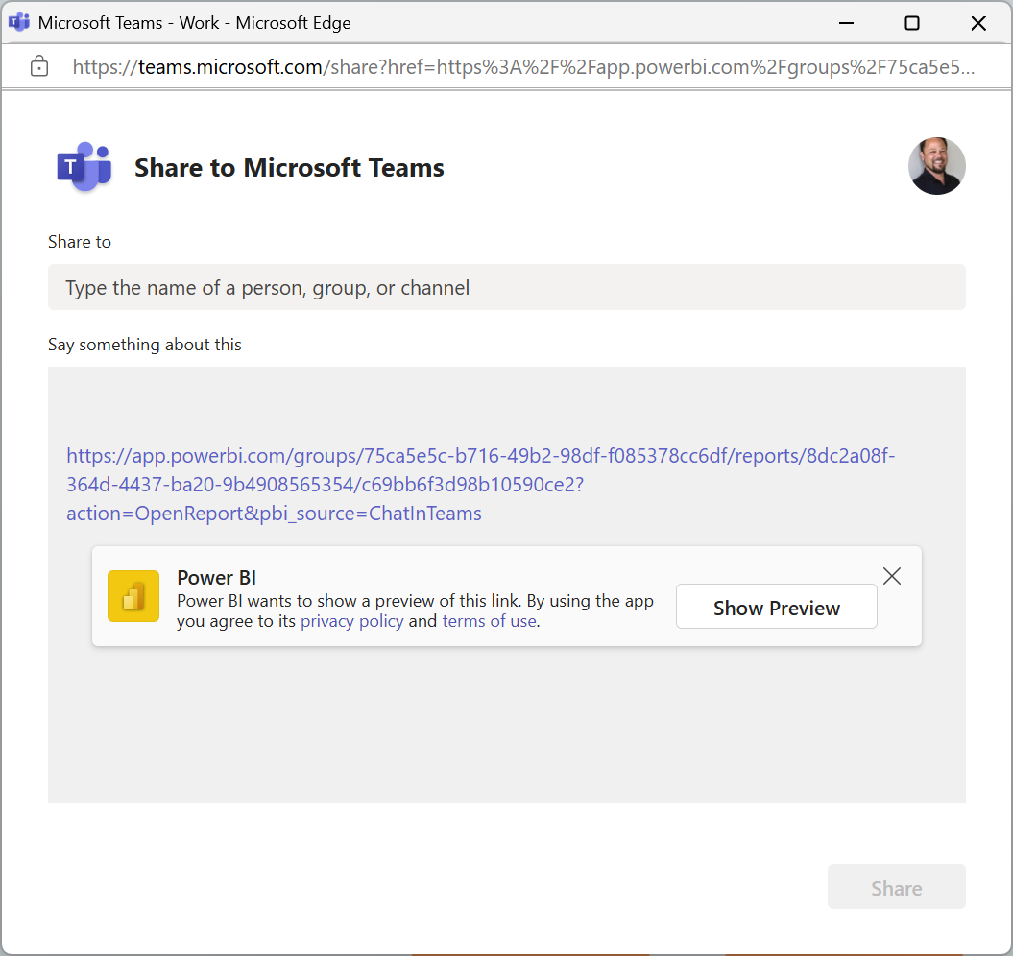
Teams
Clicking the Teams button opens the Share to Microsoft Teams dialog.

Slide 9
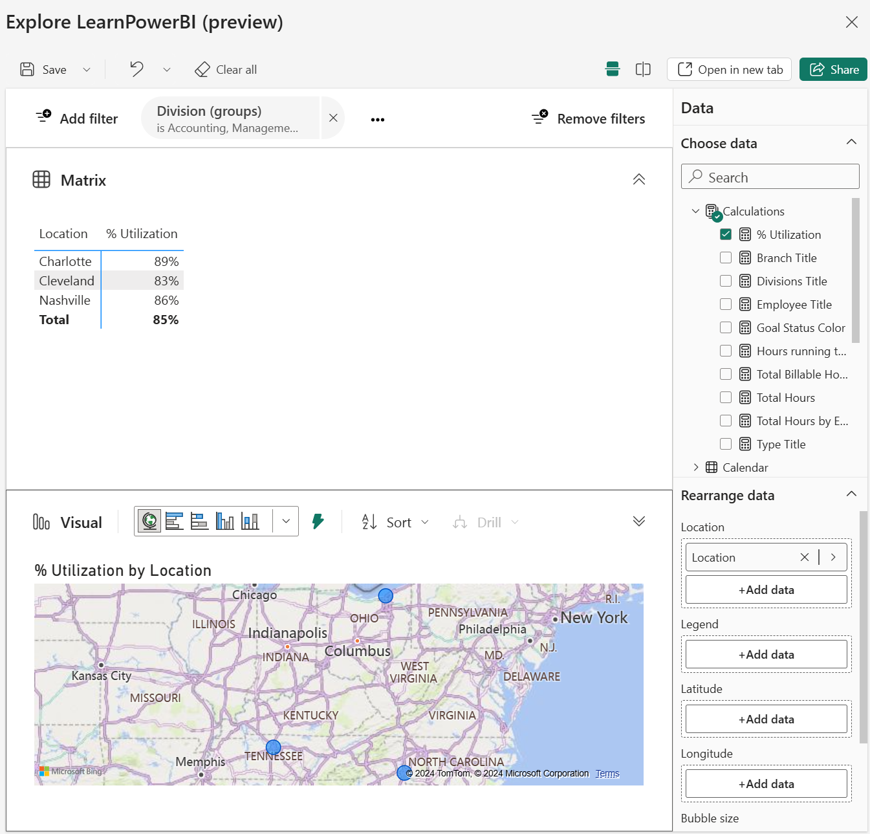
Explore
The Explore option is a preview feature that opens an interface that provides a limited authoring experience.

Slide 10
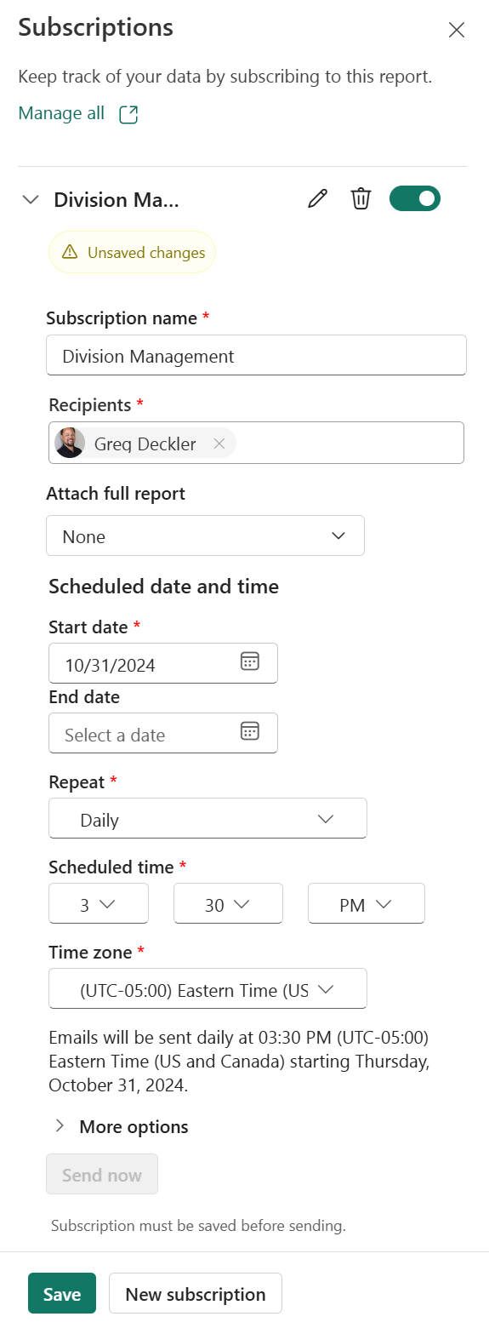
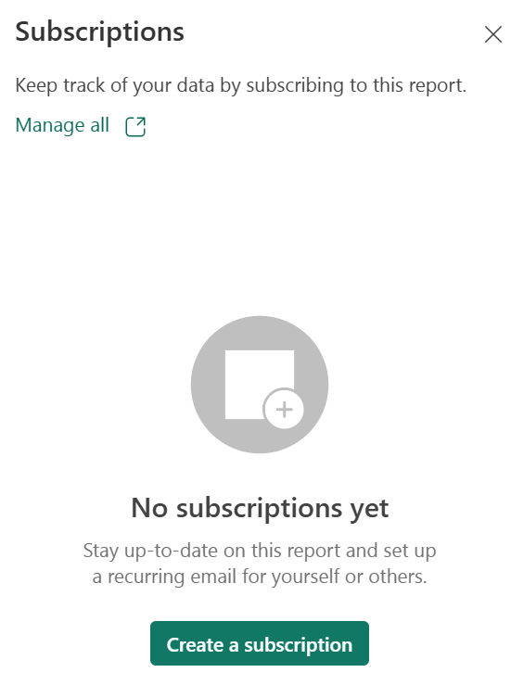
Subscribe to Report
The Power BI service provides the ability for you to subscribe to reports. This means that you will receive an email with an image of a particular page of a report with a link to open the report in a browser or mobile application. The frequency of these emails is set at the time of subscribing to the report.

Slide 11
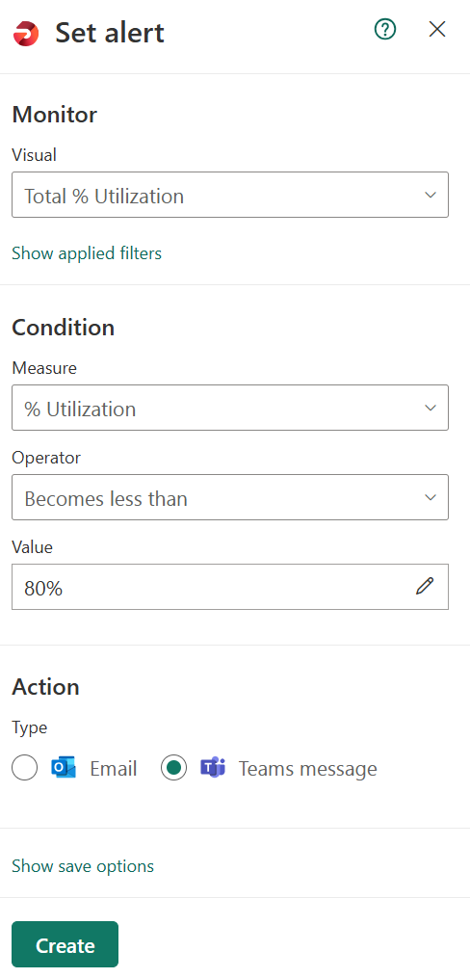
Set Alert
Set alert opens a Set alert pane on right-hand side of the page. Set alert is a Data Activator feature that allows you to set alerts based on the visuals on report pages. Data Activator evaluates these alerts each time the semantic model for the report is refreshed.

Slide 12
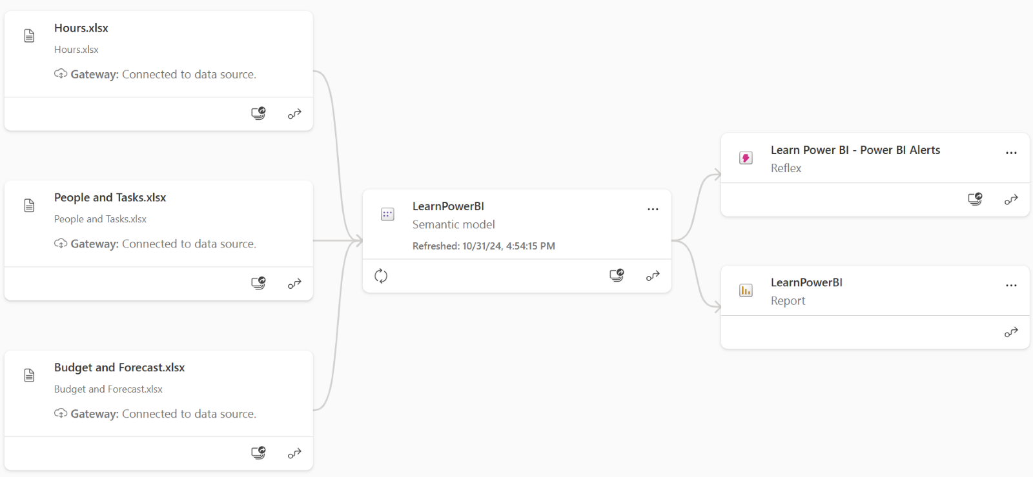
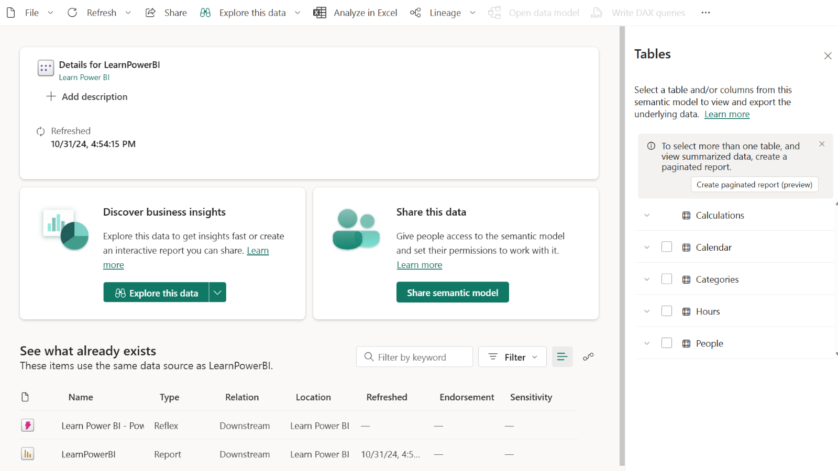
Ellipsis (…)
The ellipsis in the report ribbon provides additional functions.
Get insights: Insights are available for PPU and F64+ capacities. Clicking Get insights opens a collapsable pane on the right-hand side. These insights include anomalies, trends and KPI analysis and are presented as a series of cards.
See related content: Displays related dashboards and semantic models related to the report in a pane on the right-hand side of the screen.
Open lineage: Opens a page that displays related dashboards and semantic models as well as the relationships between those content items graphically
Open usage metrics: This opens a report that displays how many users are accessing the report, including the total views of the report, total viewers, views by user, views per day, and unique viewers per day.
Pin to a dashboard: Pins the entire report page to a dashboard of your choosing.
View semantic model: Opens an interface for exploring the semantic model.

Slide 13
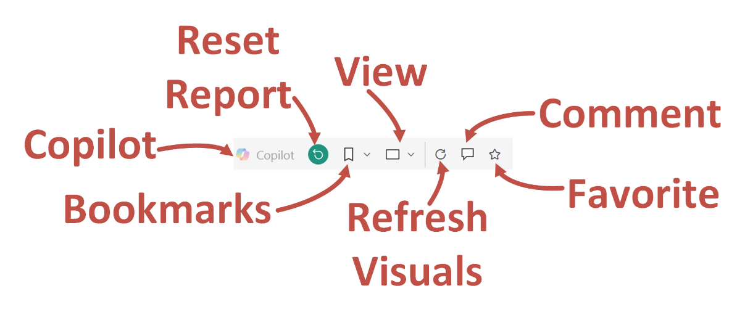
Viewing and Using REports

Slide 14
Reset
The Reset button returns a report to its original state at the time of publishing, clearing all persistent filters and personal bookmark filters. If you are having trouble seeing information in a report, your first step should be to click Reset to restore a report to its original, published state.
Note that this icon only appears if something is changed compared to how the report was originally published.

Slide 15
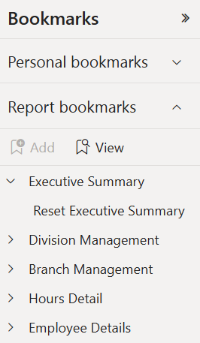
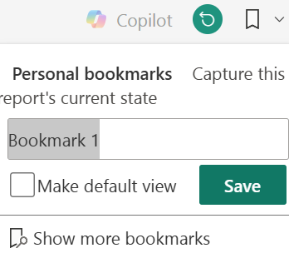
Bookmark
The Power BI service provides expanded functionality for bookmarks. In addition to bookmarks that are created by the report author in Power BI Desktop, users in the Power BI service can create their own personal bookmarks.
Report bookmarks
The Power BI service includes a Bookmarks pane that can be displayed to the right of the Filters pane. This pane is activated by clicking the Bookmarks icon in the ribbon and then Show more bookmarks.
Personal bookmarks
Personal bookmarks are bookmarks created by report viewers and not the report author.
Persistent filters
Persistent filters use the underlying technology of bookmarks to automatically save a report's state.

Slide 16
View
Listed under the View menu in the ribbon are various options for controlling the size of the report in relation to the browser window, including the following:
Full screen: Enters full screen mode; click the Esc key to exit this mode
Fit to page: Fits the report into the overall page's width and height
Fit to width: Fits the report into the width of the page but not the height
Actual size: Displays the report at its actual size, regardless of the width or height of the browser window
The View menu in the ribbon also contains options for viewing the report using high-contrast colors, including the following:
None: Displays the report with the original colors
High contrast #1: Displays the report on a black background with neon yellow font and accents
High contrast #2: Displays the report on a black background with neon green font and accents
High contrast black: Displays the report on a black background with white font and accents
High contrast white: Displays the report on a white background with black font and accents

Slide 17
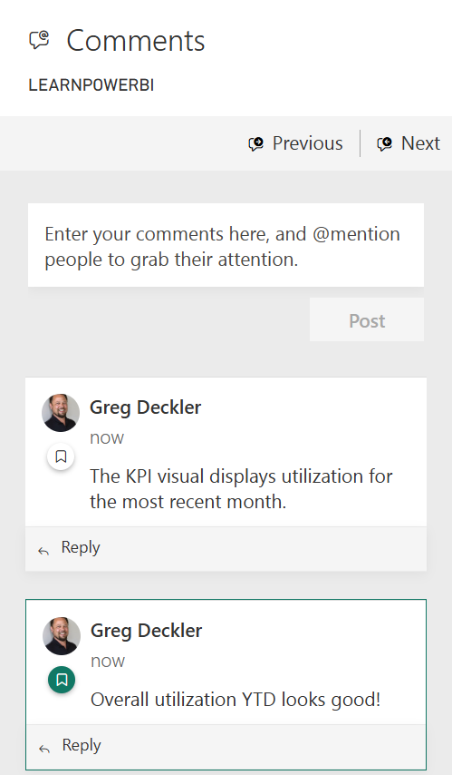
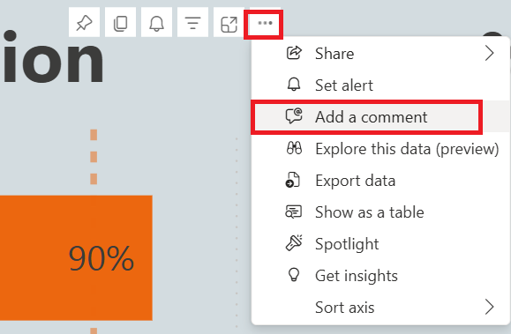
Comment
Individuals with any kind of permission to the report can comment on reports as well as individual visuals.

Slide 18
Refresh Visuals and Add to Favorites
Refresh visuals
This refreshes the report visuals based on the semantic model. It is important to understand that this does not refresh the data within the semantic model from the source data.
Add to Favorites
The Add to Favorites (star) icon adds a report to Browse | Favorites in the Navigation pane. When viewing a report marked as a favorite, the icon will be filled in.

Slide 19
Editing and Creating REports

Slide 20
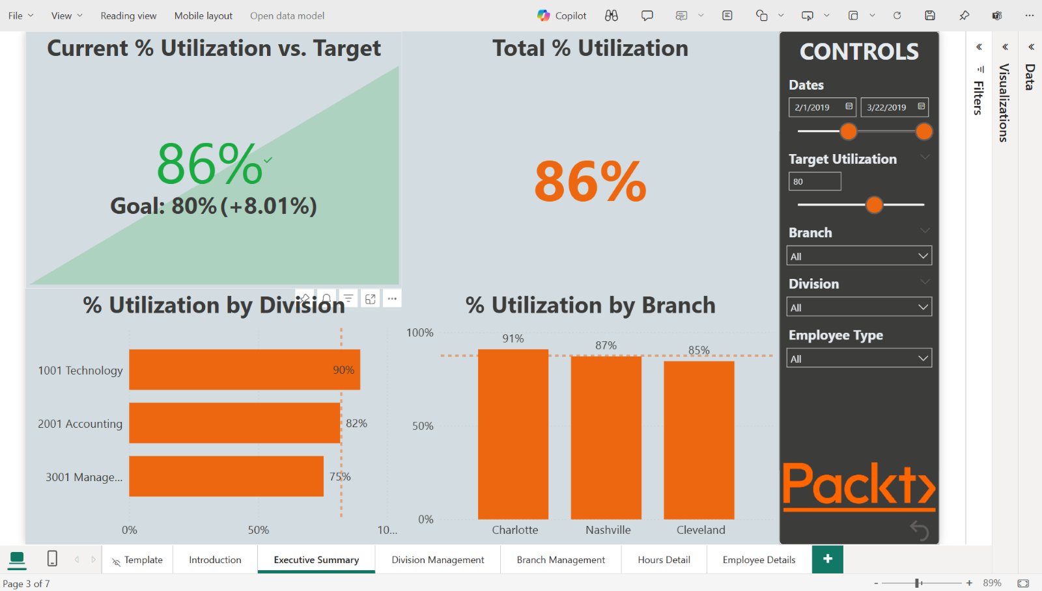
Editing Reports
When in edit mode, the ribbon and layout change to be more similar to Power BI Desktop, with the pages as page tabs at the bottom of the report, and options for inserting shapes and textboxes and editing visual interactions.

Slide 21
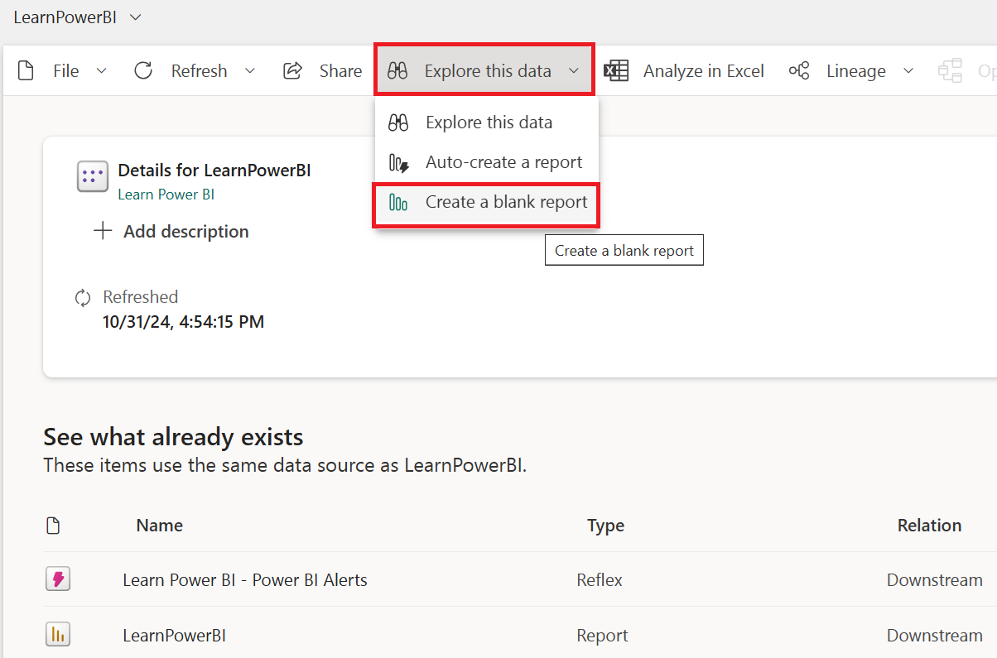
Creating a Report
Power BI also allows the creation of new reports from existing semantic models. This brings up an identical interface to the one that appears when we're editing a report, except with a blank report canvas. To access this interface, simply select a semantic model from a workspace. In the ribbon, select Explore this data and then Create a blank report.

Slide 22
Summary

Slide 23
Review Questions
How do you tag another user in a comment?
What are the key differences between report bookmarks, personal bookmarks, and persistent filters?
Which formats can users export Power BI reports to?
What are three different ways in which reports can be embedded in other websites?
True or false: Using the Publish to web feature maintains the security of a report.
Once Publish to web is used, how do you remove an embed link?
What is the most important thing to remember about editing reports in the Power BI service?

Slide 24
Follow-up and Next lesson
NEXT LESSON
To learn more about the topics that were covered in this chapter, please take a look at the following references:
Embed a report in a secure portal or website: https://learn.microsoft.com/en-us/power-bi/collaborate-share/service-embed-secure
Filter a report using query string parameters in the URL: https://learn.microsoft.com/en-us/power-bi/collaborate-share/service-url-filters
Embed a report web part in SharePoint Online: https://learn.microsoft.com/en-us/power-bi/collaborate-share/service-embed-report-spo
Publish to the web from Power BI: https://learn.microsoft.com/en-us/power-bi/collaborate-share/service-publish-to-web
Announcing Persistent Filters in the Power BI Service: https://powerbi.microsoft.com/en-us/blog/announcing-persistent-filters-in-the-service/
Create report bookmarks in Power BI to share insights and build stories: https://learn.microsoft.com/en-us/power-bi/create-reports/desktop-bookmarks?tabs=powerbi-desktop
Email subscriptions for reports and dashboards in the Power BI Service: https://learn.microsoft.com/en-us/power-bi/collaborate-share/end-user-subscribe?tabs=creator
Types of filters in Power BI reports: https://learn.microsoft.com/en-us/power-bi/create-reports/power-bi-report-filter-types
Chapter 10 – Understanding Dashboards, Apps, Metrics, and Security

