Slide 1
Learn Power BI: Chapter 10 Understanding Dashboards, Apps, Metrics, and Security

Slide 2
Lesson Plan
Understanding dashboards
Creating and using apps
Working with metrics
Understanding security and permissions
Summary

Slide 3
Understanding dashboards

Slide 4
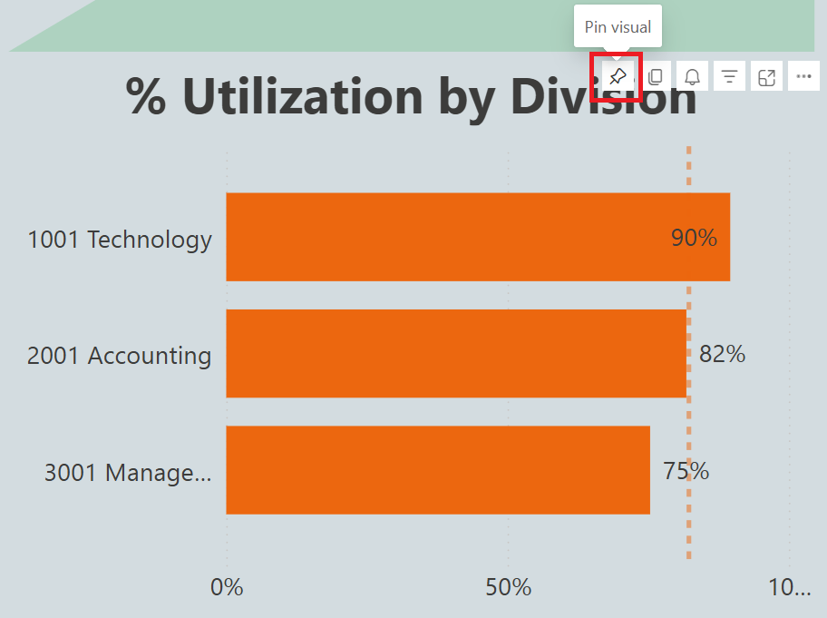
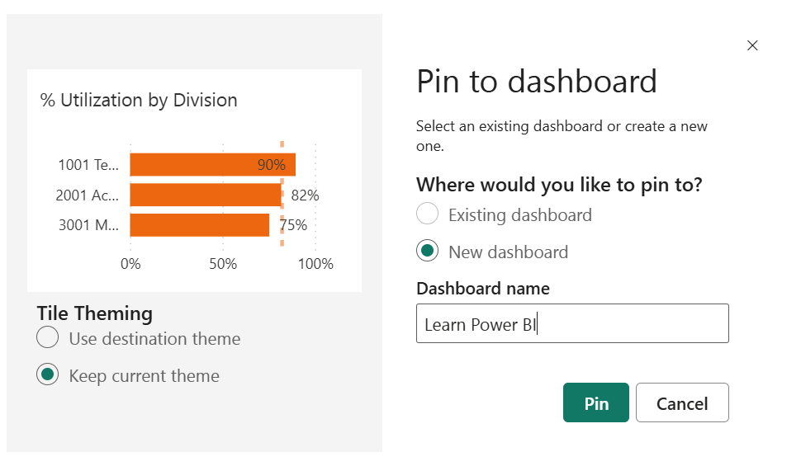
Creating Dashboards
Dashboards are single-page canvases that contain visualizations called tiles. These tiles are visualizations pinned from reports, other dashboards, Question and Answer (Q&A) displays, or other sources such as quick insights. Single visuals or entire report pages can be pinned.

Slide 5
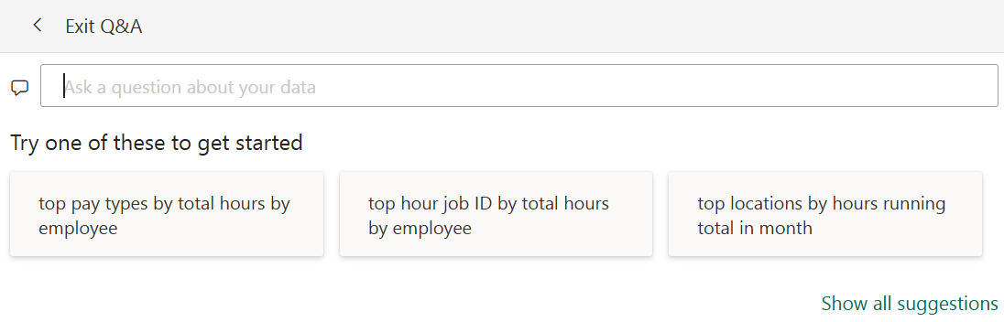
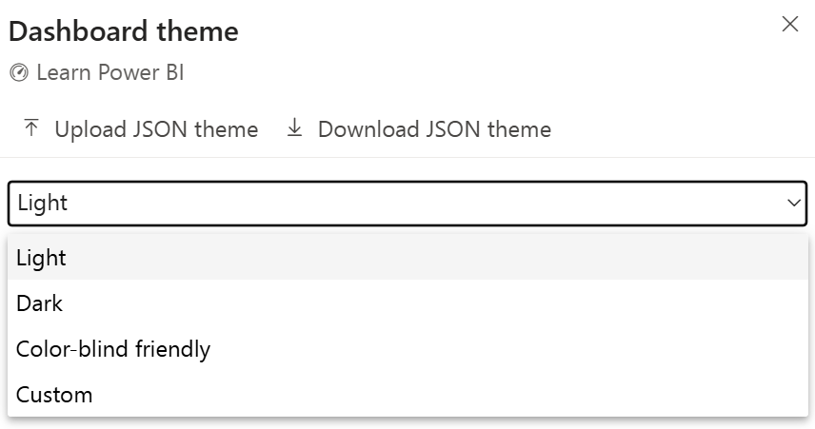
Working with Dashboards
Working with dashboards in the service is in some ways very similar to working with reports.
While tiles can be added from a variety of sources, certain types of tiles can be added directly to the dashboard. These types of tiles are listed here:
Web content
Image
Text box
Video
Custom Streaming Data

Slide 6
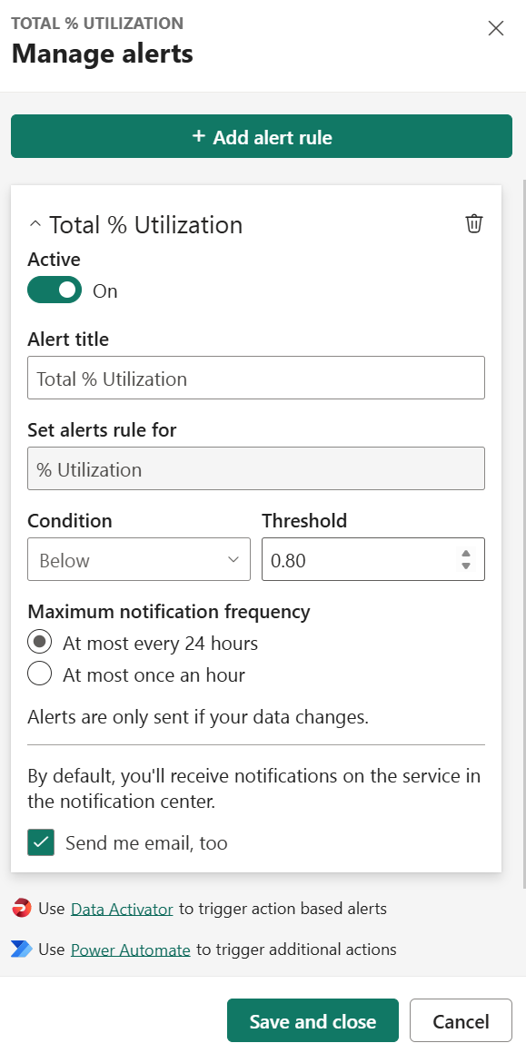
Working with Tiles
The size and position of tiles can be adjusted on the dashboard canvas. In addition, tiles provide additional functionality, such as the creation of alerts and overall navigation.
Options for tiles can be accessed by hovering over a tile and then clicking on the ellipsis (…) in the upper-right corner of the tile:
Add a comment
Chat in Teams
Copy visual as image
Go to report
Go to Q&A
Open in focus mode
Manage alerts
Export to .csv
Edit details
View Insights
Pin tile
Delete tile
Not all options are available for all types of dashboard tiles. For example, only tiles created via Q&A will list the Go to Q&A option.

Slide 7
Creating and using apps

Slide 8
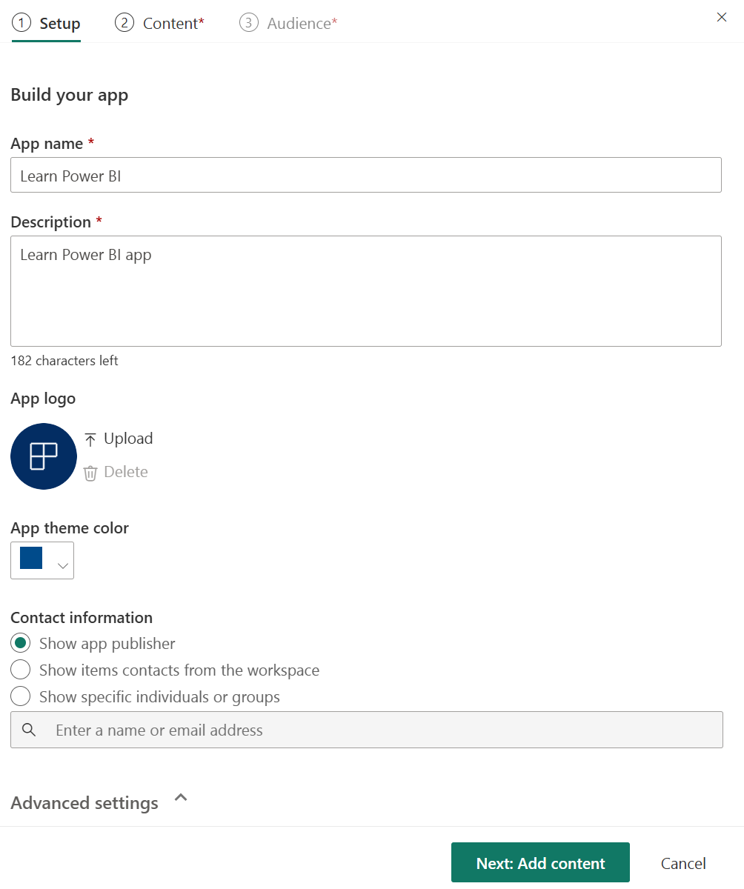
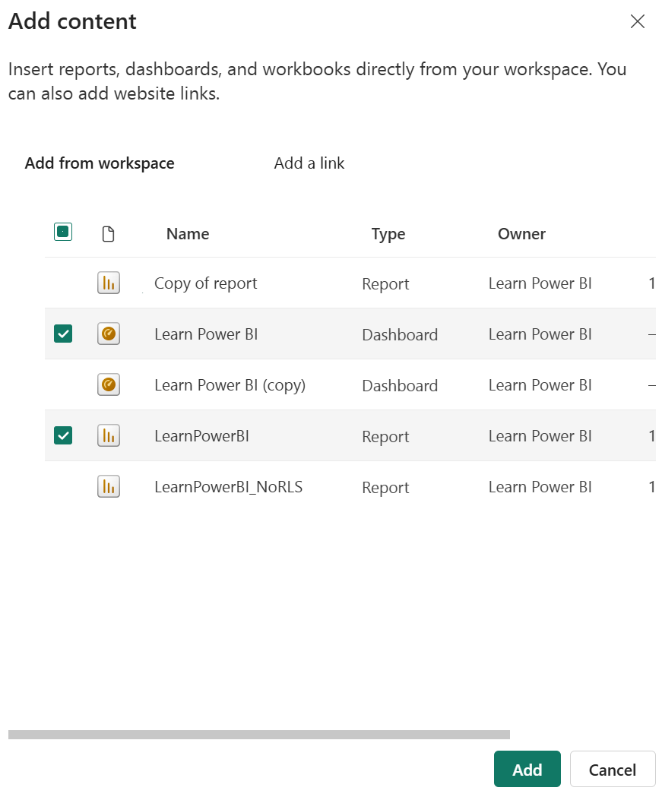
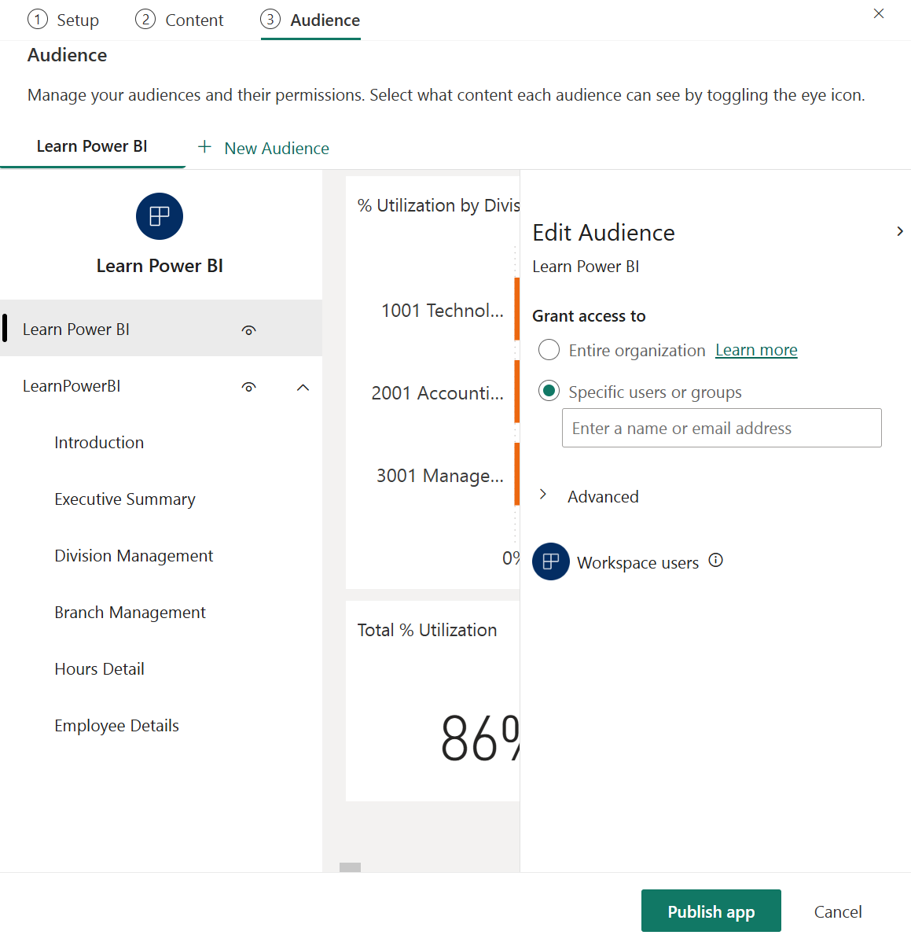
Creating an App
Withing a Workspace, click the Create app button to display the app's publishing interface

Slide 9
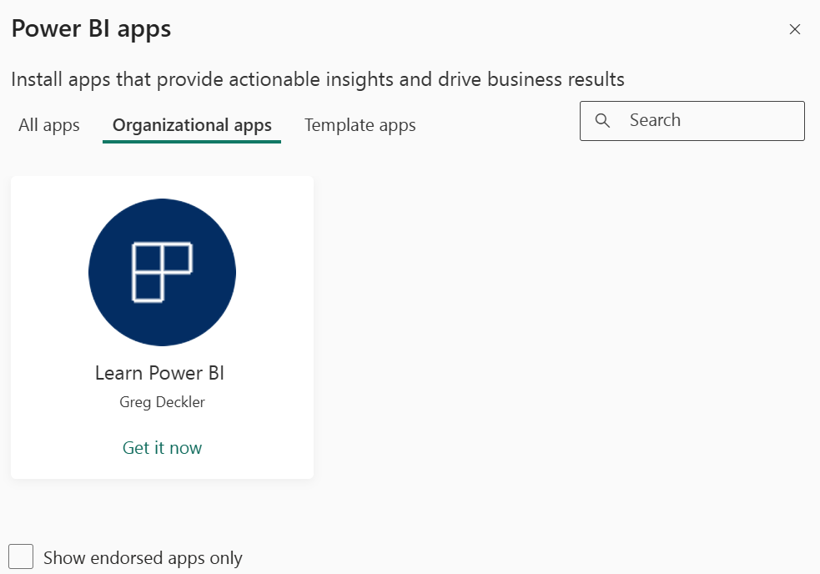
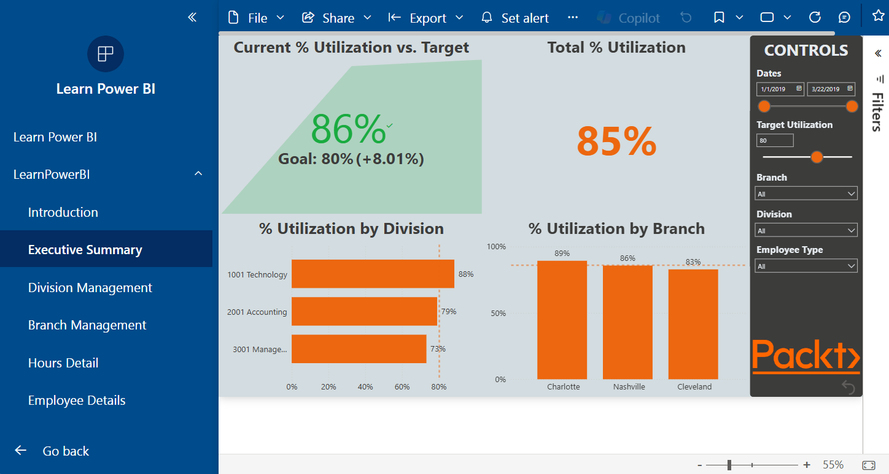
Getting and Using apps
Once an app has been published, the app can be accessed directly through the link that's provided when publishing the app or via the Apps link in the Navigation pane.

Slide 10
Working with metrics

Slide 11
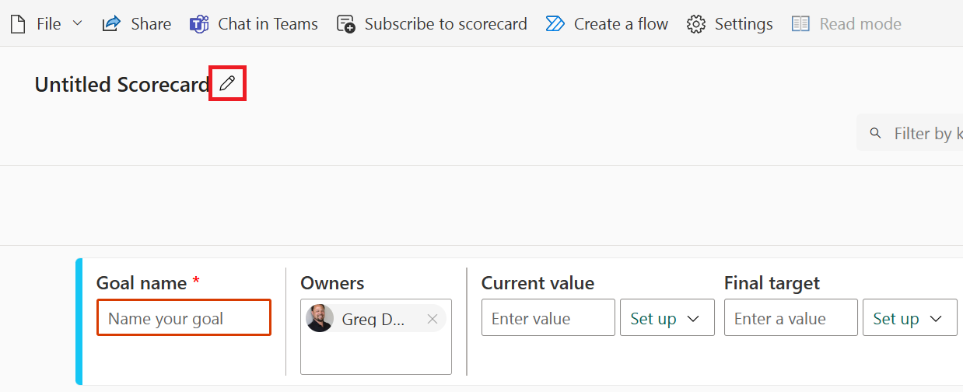
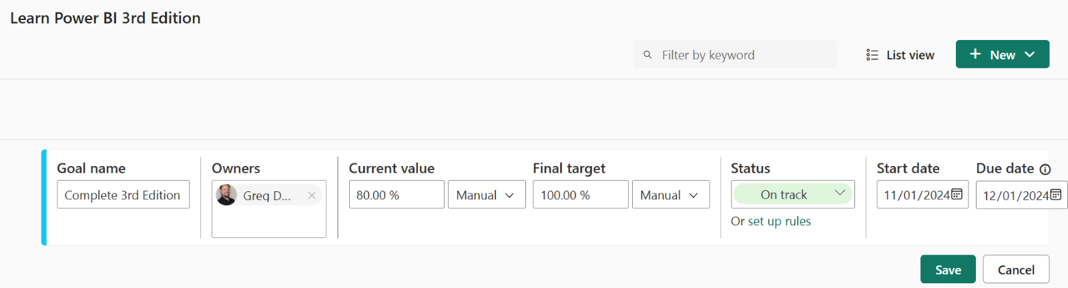
Creating Scorecards and Goals
To create a new scorecard, click Metrics in the Navigation pane.

Slide 12
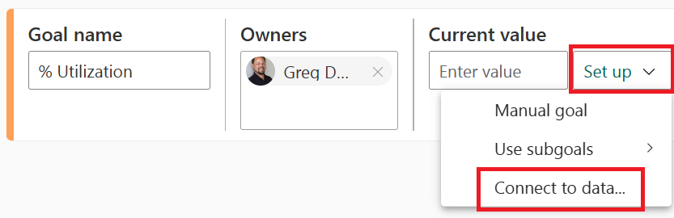
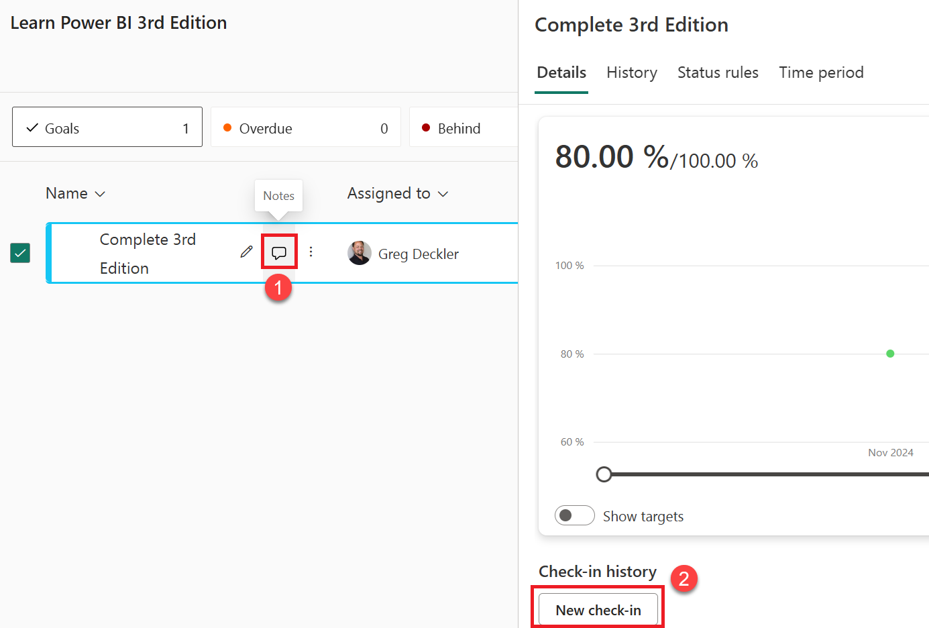
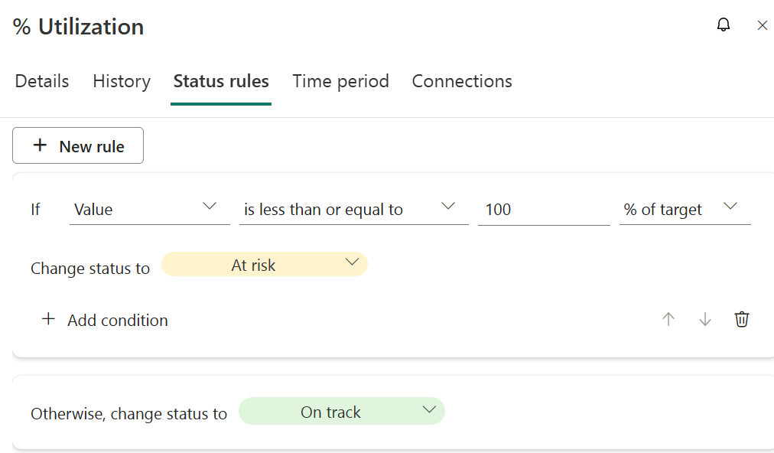
Using Scorecards and Goals

Slide 13
Understanding security and permissions

Slide 14
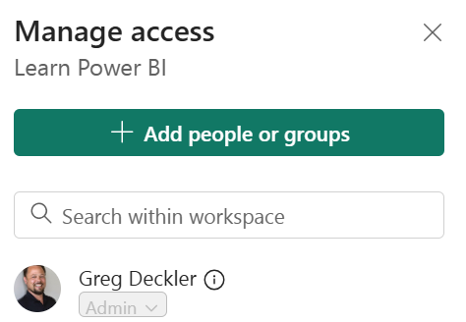
Workspace Permissions
Workspaces serve as logical containers in which you store dashboards, reports, scorecards, workbooks, semantic models, and dataflows.
The Viewer role provides the following permission:
View items within the workspace.
The Contributor role includes the Viewer role permission, plus the following permissions:
Publish reports to the workspace and delete content.
Create, edit, and delete content in the workspace.
The Member role includes all of the Contributor and Viewer role permissions, plus the following permissions:
Allow others to reshare items.
Share an item or share an app.
Publish and update an app.
Add members or others with lower permissions.
The Admin role includes all of the Member, Contributor, and Viewer role permissions, plus the following permissions:
Add/remove people, including other admins.
Update and delete the workspace.
By default, the creator of a workspace is assigned the Admin role.

Slide 15
Object Permissions
Four permissions can be assigned to objects outside of workspace permission settings. These permissions are listed as follows:
Read
Build
Reshare
Write
Sharing an object grants read access to the object. Reshare permissions can be added for all objects, allowing the user or group members to share the object with others. Build permissions can only be added for semantic model objects, and this allows users or group members to build new reports and content from the semantic model.

Slide 16
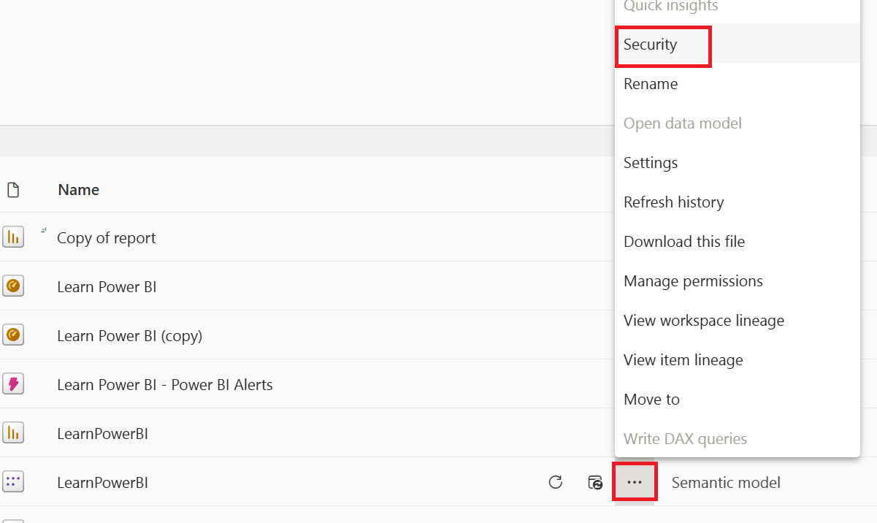
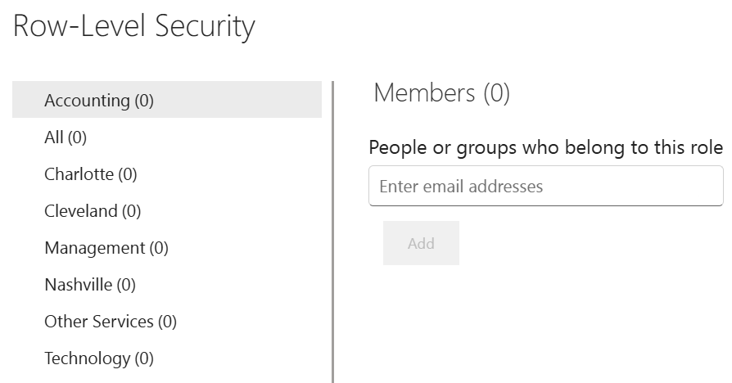
RLS
In addition to workspace-level permissions, which assign permissions to everything within a workspace, and object-level permissions, which assign permissions to one or more objects, individual rows of data within a semantic model can be secured as well. This is the purpose of RLS.

Slide 17
Summary

Slide 18
Review Questions
What is a dashboard and what purpose does it serve?
Which types of tiles can be added to dashboards?
Which tiles allow for the creation of a data alert?
What is an app and why would you use one?
What are the two publishing methods that can be used with apps?
Once an app has been published, how can the app be modified?
What are the three main security/permission levels within the Power BI service?
What are the four roles that are available for workspaces?
What is the hierarchy of objects within the Power BI service?
What are the four permissions that are available for objects?

Slide 19
Follow-up and Next lesson
NEXT LESSON
To learn more about the topics that were covered in this chapter, please take a look at the following references:
Introduction to dashboards for Power BI designers: https://learn.microsoft.com/en-us/power-bi/create-reports/service-dashboards
Intro to dashboard tiles for Power BI designers: https://learn.microsoft.com/en-us/power-bi/create-reports/service-dashboard-tiles
Add images, text, video, and more to your dashboard: https://learn.microsoft.com/en-us/power-bi/create-reports/service-dashboard-add-widget
Publish an app in Power BI: https://learn.microsoft.com/en-us/power-bi/collaborate-share/service-create-distribute-apps
Get started with metrics in Power BI: https://learn.microsoft.com/en-us/power-bi/create-reports/service-goals-introduction
Give users access to workspaces in Power BI: https://learn.microsoft.com/en-us/power-bi/collaborate-share/service-give-access-new-workspaces
Semantic model permissions: https://learn.microsoft.com/en-us/power-bi/connect-data/service-datasets-permissions
Chapter 11 – Refreshing Content

