Slide 1
Learn Power BI: Chapter 11 Refreshing Content

Slide 2
Lesson Plan
Installing and using data gateways
Refreshing semantic models
Summary

Slide 3
Installing and using data gateways

Slide 4
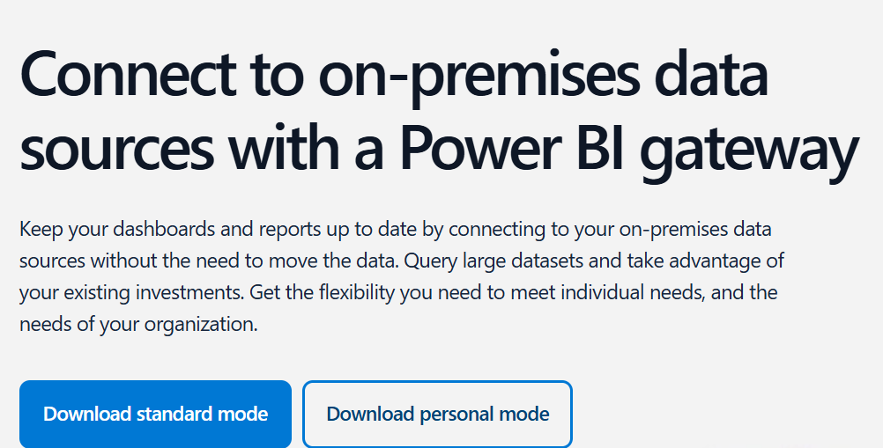
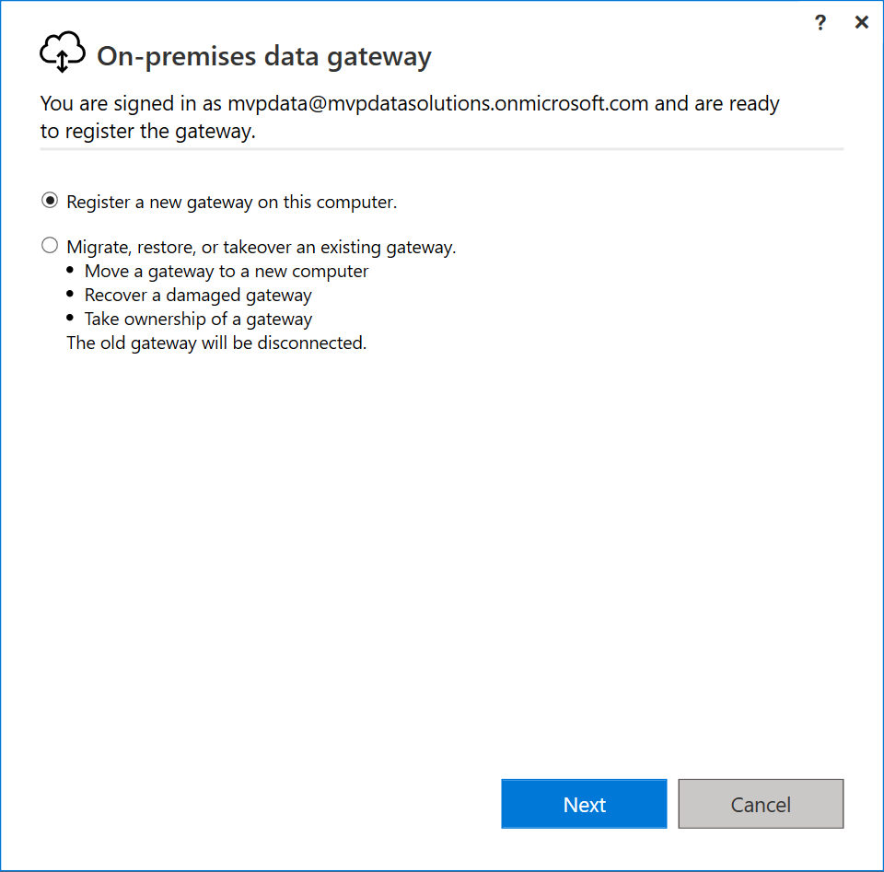
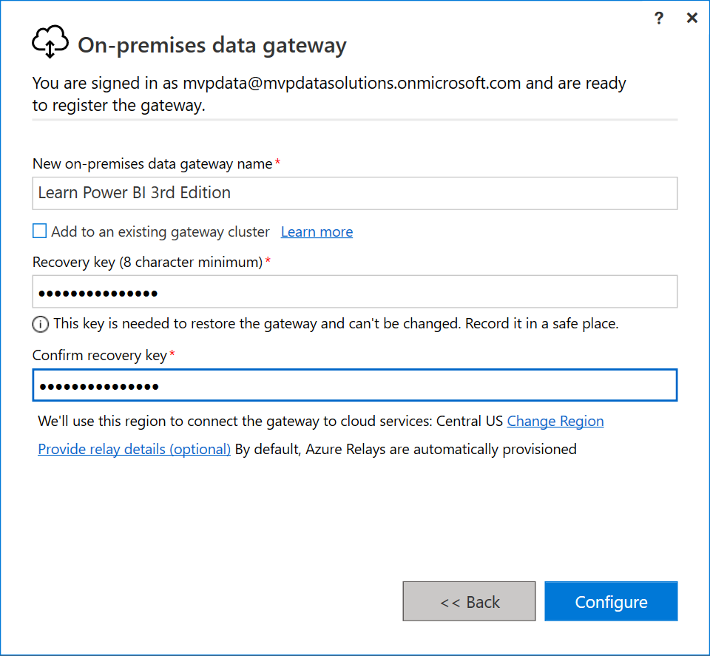
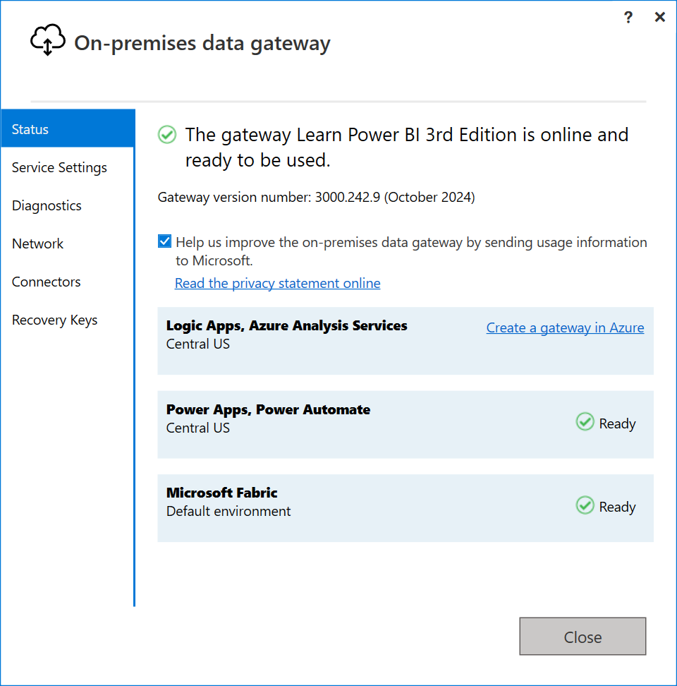
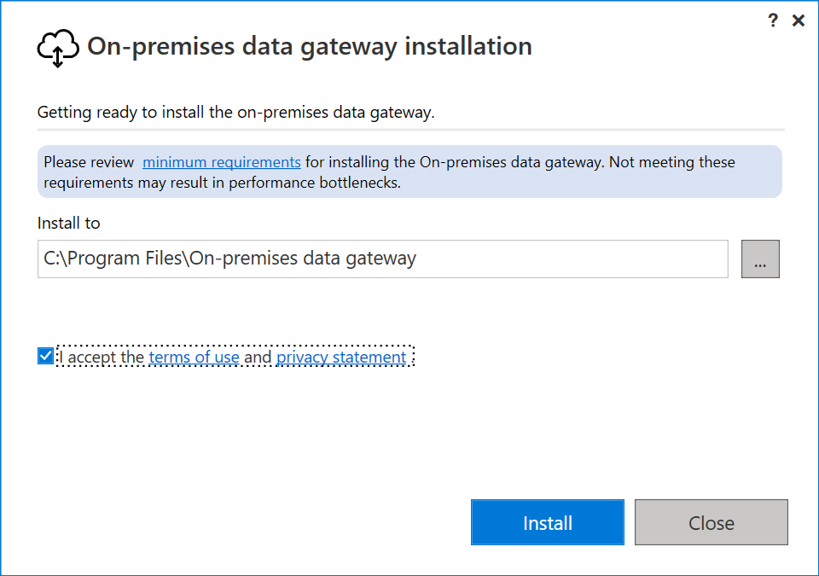
Downloading and installing a data gateway
In the Power BI service in the header area, click the down arrow icon or the ellipsis. Choose Data Gateway. This is a link that takes you to Microsoft's data gateway home page, https://powerbi.microsoft.com/gateway/.

Slide 5
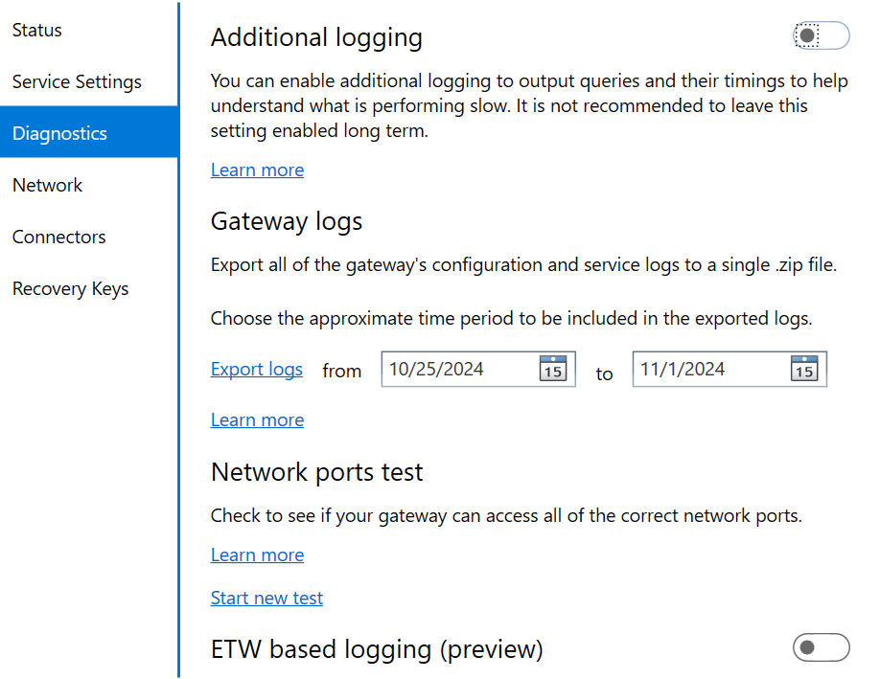
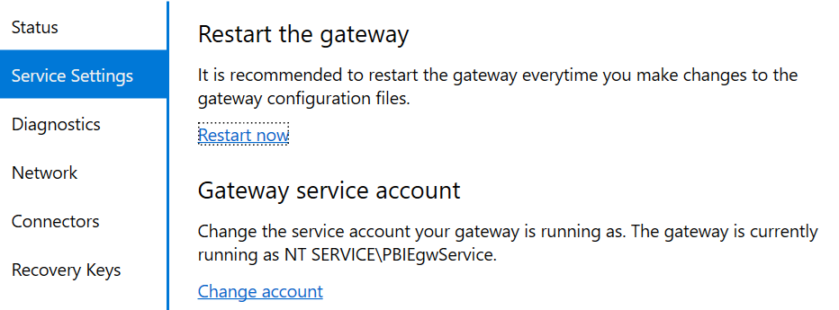
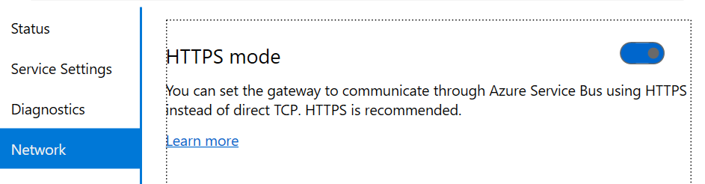
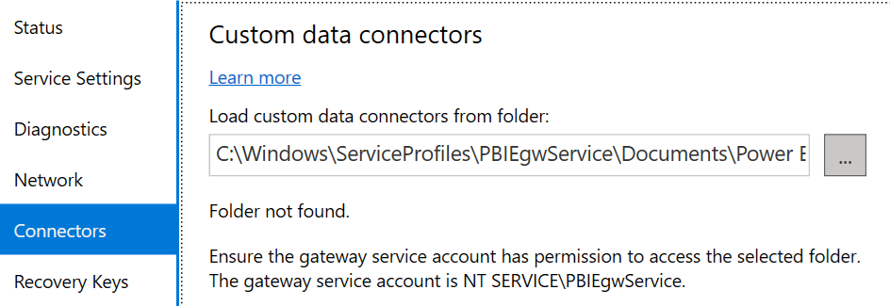
Running a data gateway
Recovery Keys
The Recovery Keys page only appears when you sign-in to the data gateway. This page simply allows you to set new recovery keys. You will need the current recovery key to set a new recovery so make certain to keep your recovery keys safe!
When installed in standard mode, the gateway runs as a Windows service, which is why you need to run the installation as an administrator. This service's name is PBIEgwService with a Description of On-premises data gateway service and the background process is called Microsoft.PowerBI.EnterpriseGateway.

Slide 6
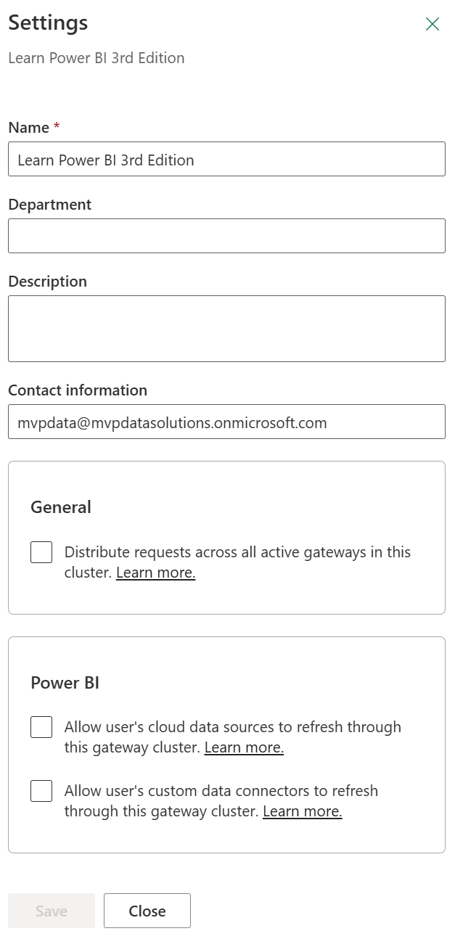
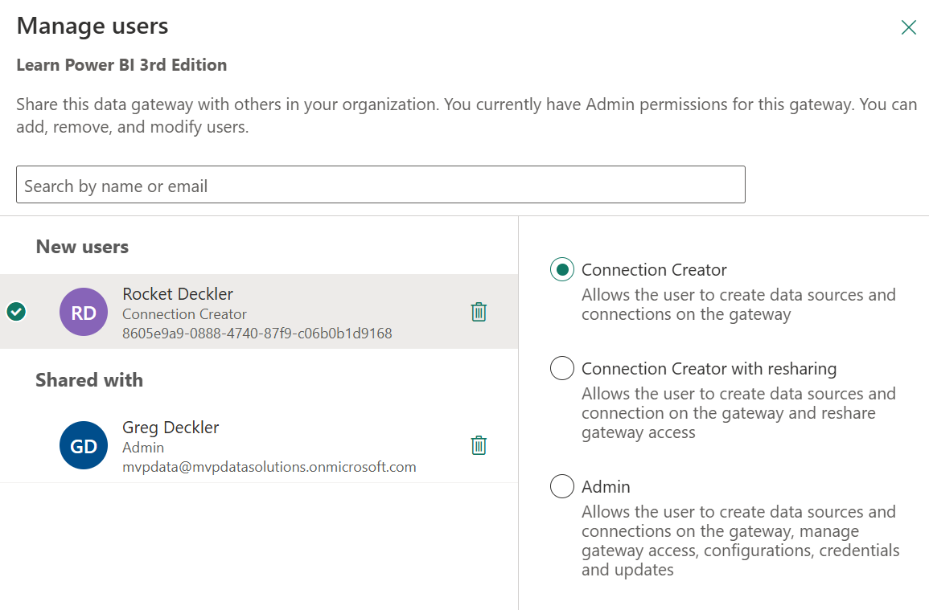
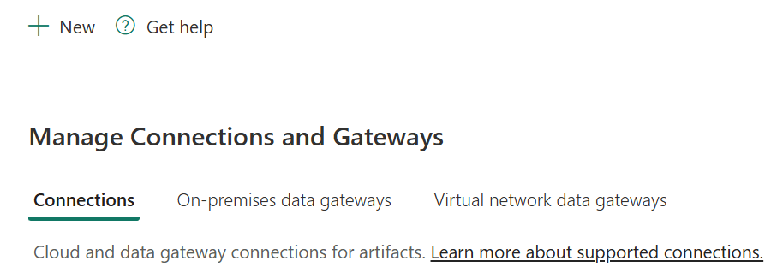
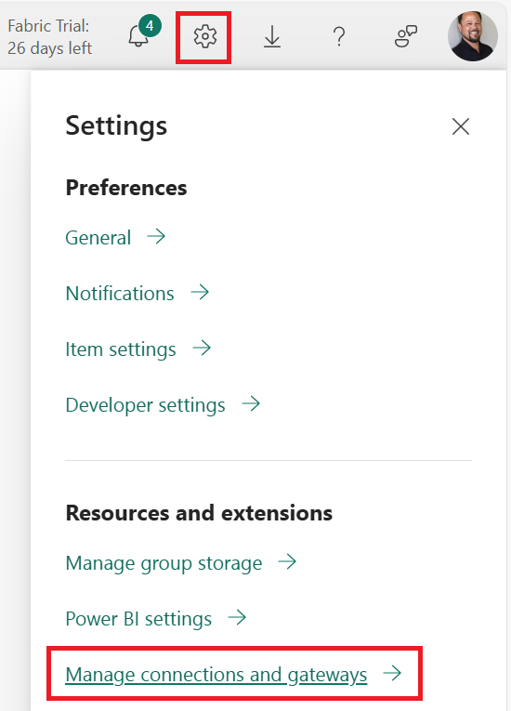
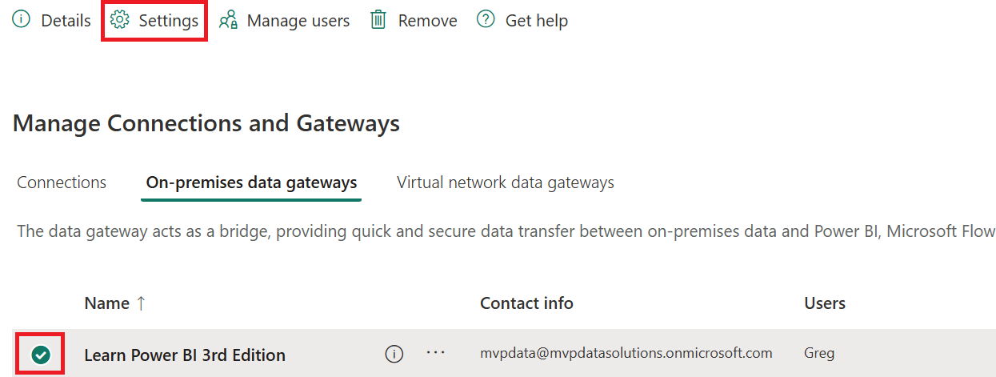
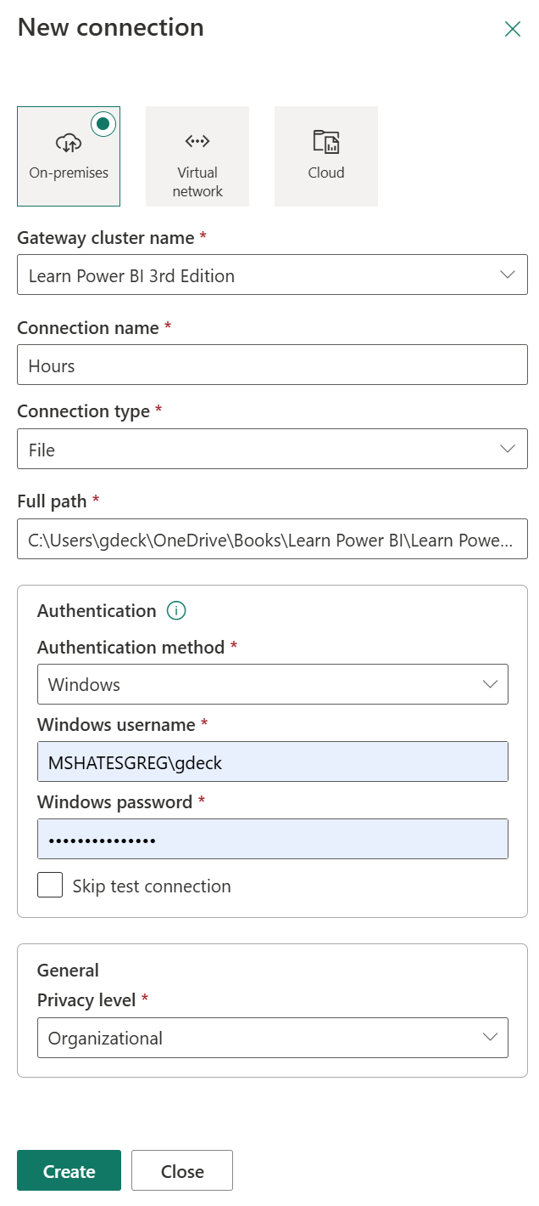
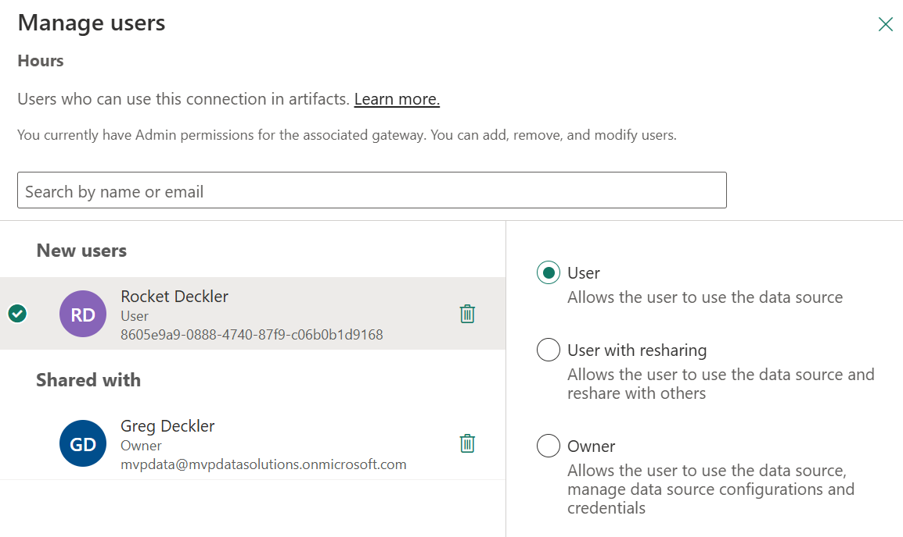
Managing a data gateway
Once the gateways have been installed and configured, standard mode gateways can be managed via the Power BI service.

Slide 7
Refreshing semantic models

Slide 8
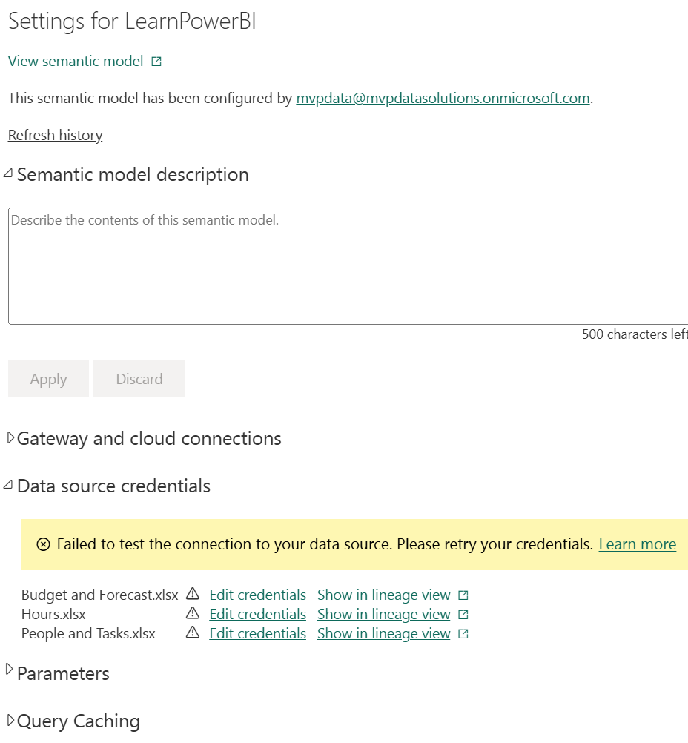
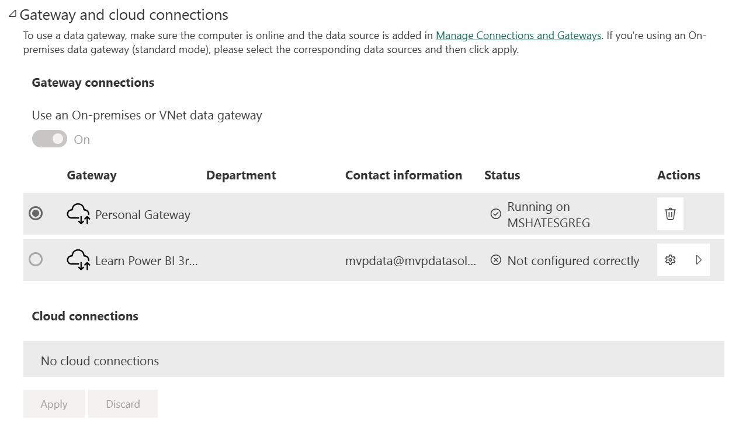
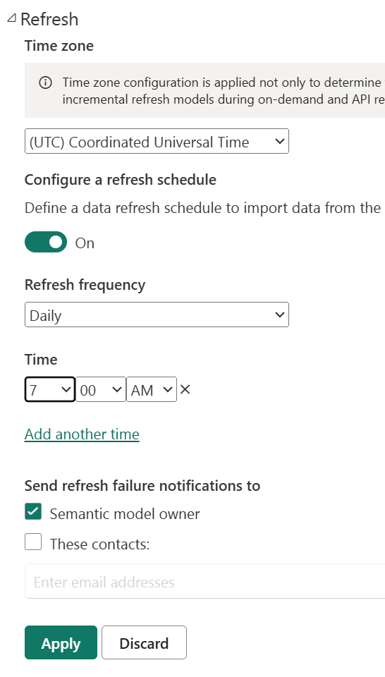
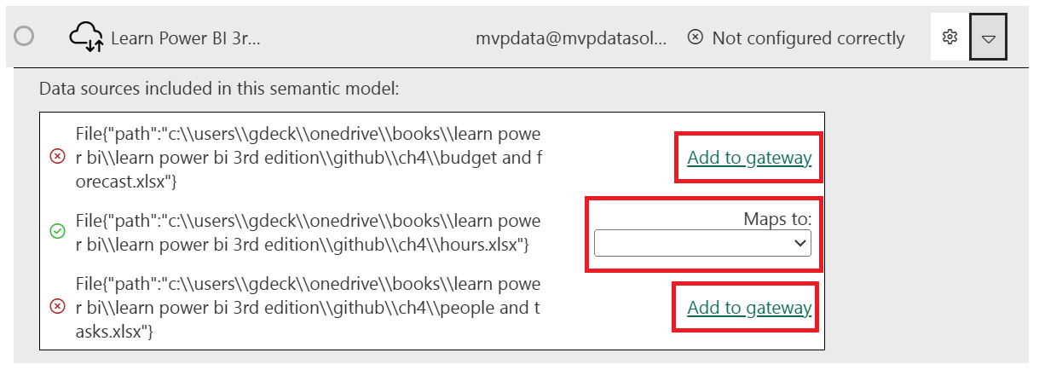
Scheduling a Refresh
Now that a gateway is installed and configured, it is time to enable our semantic model so that it can automatically refresh. This means that if we add or replace the data to/in our file or database, the Power BI service can automatically refresh that data within the published semantic model so that the associated dashboards and reports are kept up to date.

Slide 9
Summary

Slide 10
Review Questions
What is the purpose of the on-premises data gateway?
In what two modes can the data gateway be installed?
What must you do to ensure that the data gateway starts after rebooting the computer that the gateway is installed on?
What feature allows for redundancy and load balancing when you're refreshing data?
What two methods can be used to add a data source to a data gateway?
How many times can a semantic model be refreshed per day?

Slide 11
Follow-up and Next lesson
NEXT LESSON
To learn more about the topics that were covered in this chapter, please take a look at the following references:
What is an on-premises data gateway?: https://learn.microsoft.com/en-us/power-bi/connect-data/service-gateway-onprem
Installing an on-premises data gateway: https://learn.microsoft.com/en-us/data-integration/gateway/service-gateway-install
On-premises data gateway in-depth: https://learn.microsoft.com/en-us/power-bi/connect-data/service-gateway-onprem-indepth
On-premises data gateway architecture: https://learn.microsoft.com/en-us/data-integration/gateway/service-gateway-onprem-indepth
Use a personal gateway in Power BI: https://learn.microsoft.com/en-us/power-bi/connect-data/service-gateway-personal-mode
Troubleshooting gateways – Power BI: https://learn.microsoft.com/en-us/power-bi/connect-data/service-gateway-onprem-tshoot
Getting started with data connectors: https://github.com/Microsoft/DataConnectors
Data refresh in Power BI: https://learn.microsoft.com/en-us/power-bi/connect-data/refresh-data
Configuring scheduled refresh: https://learn.microsoft.com/en-us/power-bi/connect-data/refresh-scheduled-refresh
Chapter 12 – Deploying, Governing, and Adopting Power BI

