Slide 1
Learn Power BI: Chapter 12 Deploying, Governing, and Adopting Power BI

Slide 2
Lesson Plan
Understanding usage models
Governing and administering Power BI
Adopting Power BI
Summary

Slide 3
Understanding usage models

Slide 4
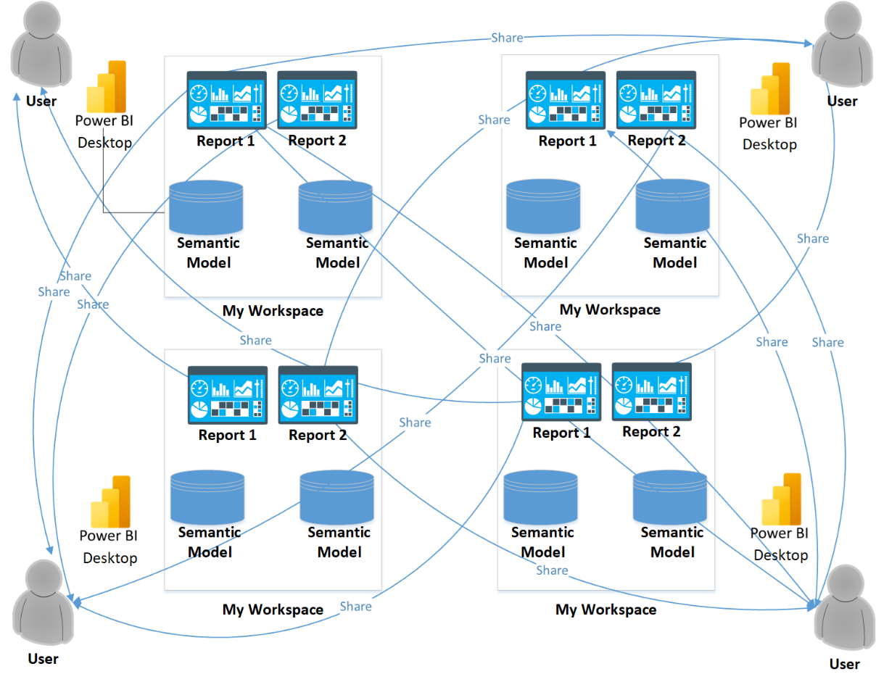
Anarchy
Many Power BI implementations start out as near chaos or anarchy, the grassroots adoption of Power BI by end users.

Slide 5
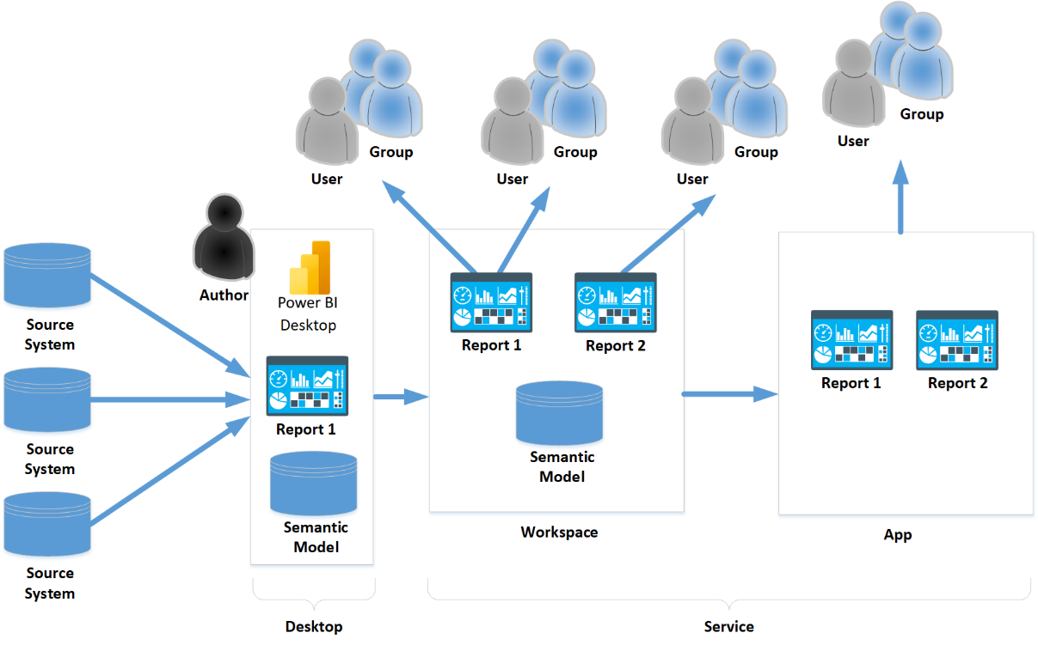
Centralized
At the opposite end of the spectrum from the anarchy model is the centralized model. In the centralized model, a single individual or group of individuals (often the IT department) control the creation of all official semantic models, reporting, and distribution.

Slide 6
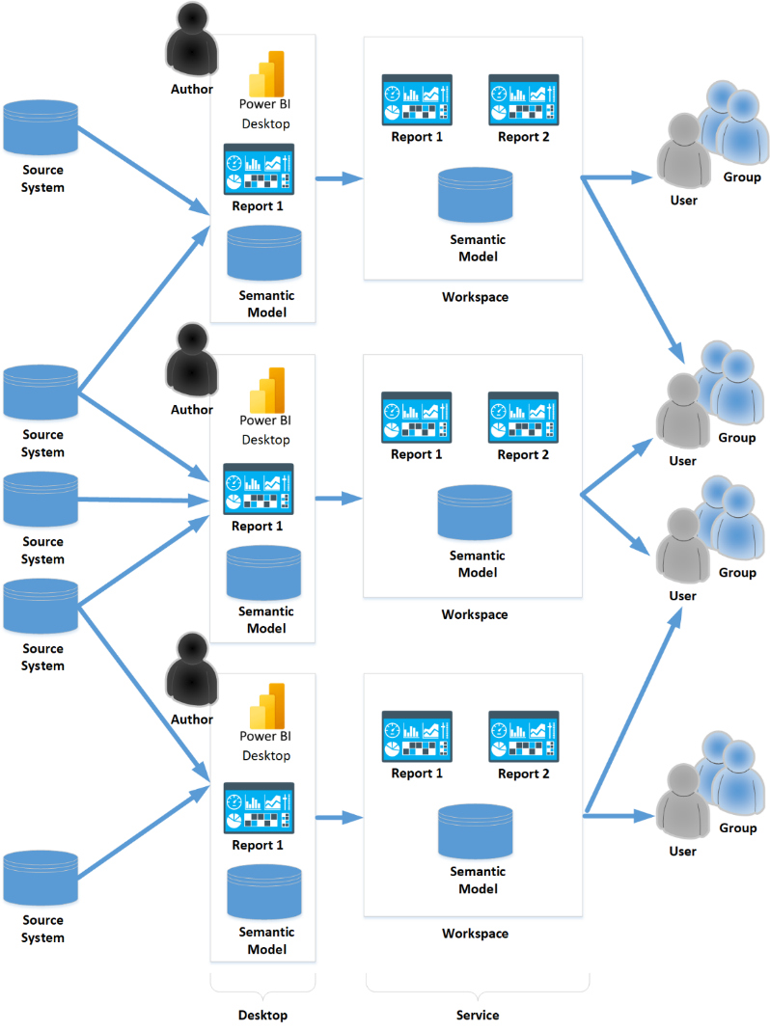
Federated
To solve the scale issues inherent in the centralized model, organizations can adopt the federated model instead.

Slide 7
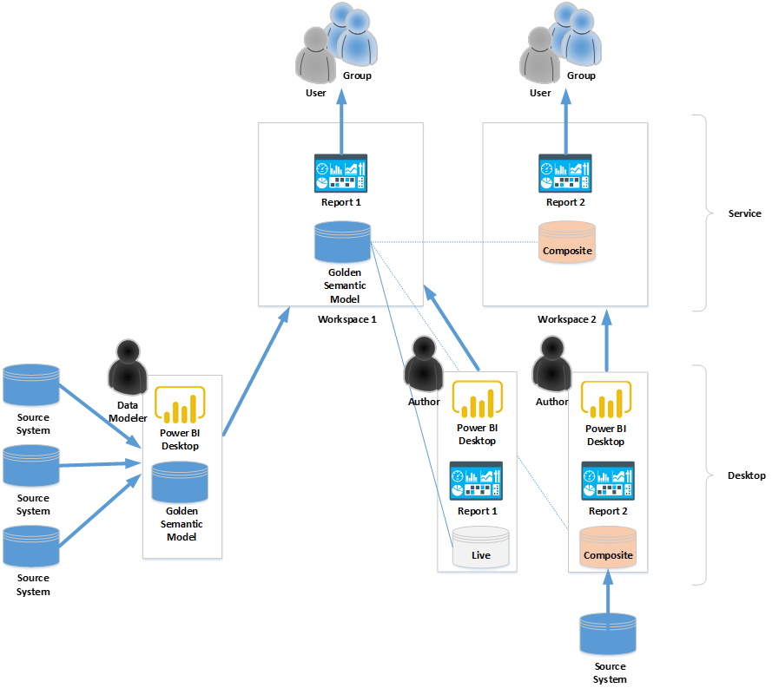
Golden Semantic Models
A popular method of asset development and deployment includes the concept of creating multiple reports from a single, central semantic model that effectively serves as a sort of data mart, sometimes called a golden semantic model.

Slide 8
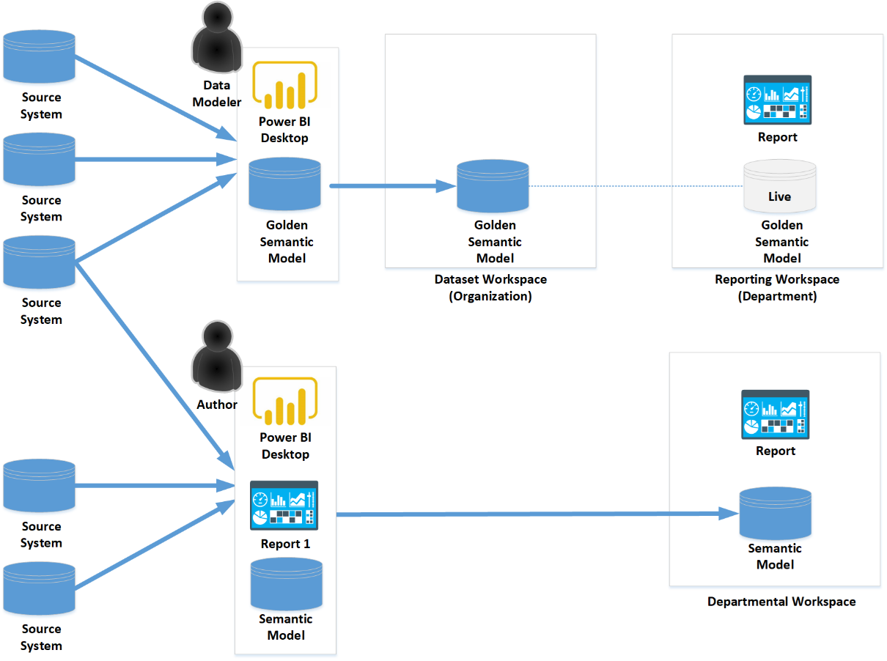
Hybrid
It is not uncommon for multiple usage models to be used simultaneously within the same organization in order to accommodate different needs within the organization.
In the hybrid model depicted here, the organization has chosen to combine the golden semantic model model with the federated model. The golden semantic models are used for official organizational content created by the centralized team of IT business professionals. However, departmental workspaces are also created to allow the individual departments within the organization flexibility in creating content that is used internally within the department.

Slide 9
Governing and administering

Slide 10
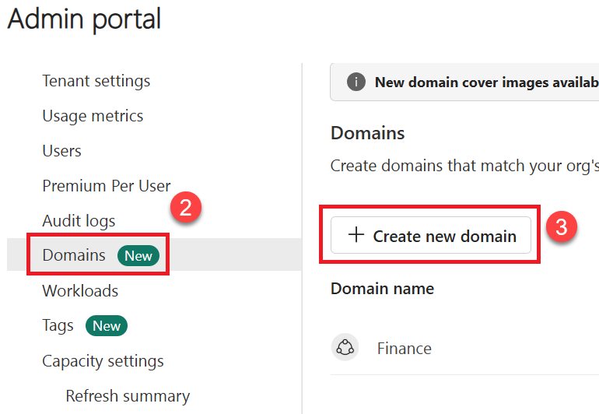
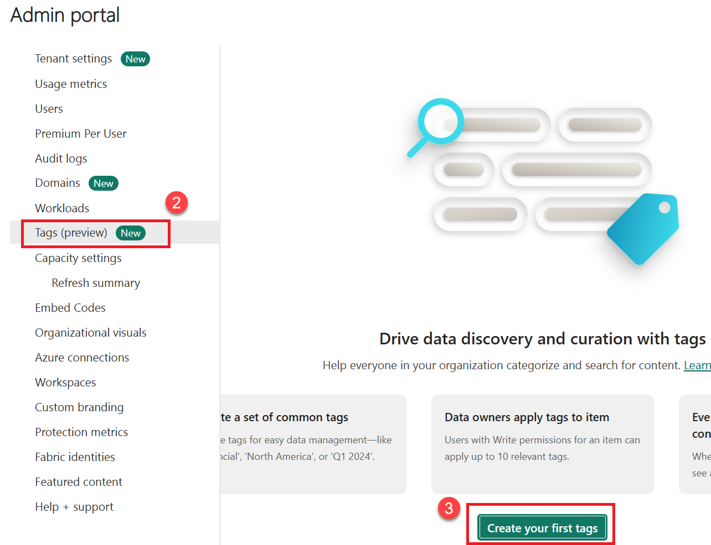
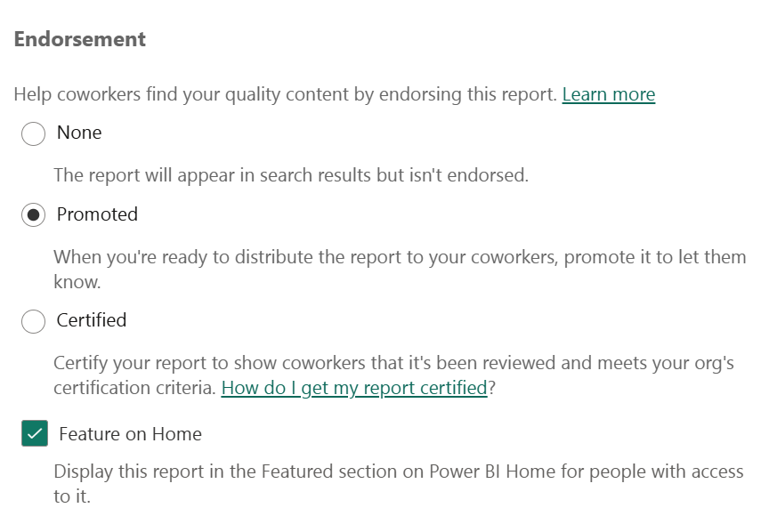
Classifying content
Power BI includes a number of different methods for classifying content within the Power BI service. Classifying content helps users discover relevant information more easily.
Domains
Domains are simply a logical container or tag, enabling workspaces to be organized based on domains and users to filter content by domain.
Tags
Tags are simply additional labels or metadata that can be applied to content items such as reports, dashboards, semantic models, and other content items. Like domains, tags help increase or otherwise enhance the discoverability , organization, and data categorization of content.
Endorsements and featured content
Endorsements and featured content are related concepts in Power BI. Endorsements are another method of classifying content as either Promoted or Certified. In general, a promoted item simply highlights content that the user deems as valuable or worthwhile to others while certified items indicate that the content is aligned with an organizations overall quality requirements meaning that it is an authoritative and reliable source of information.

Slide 11
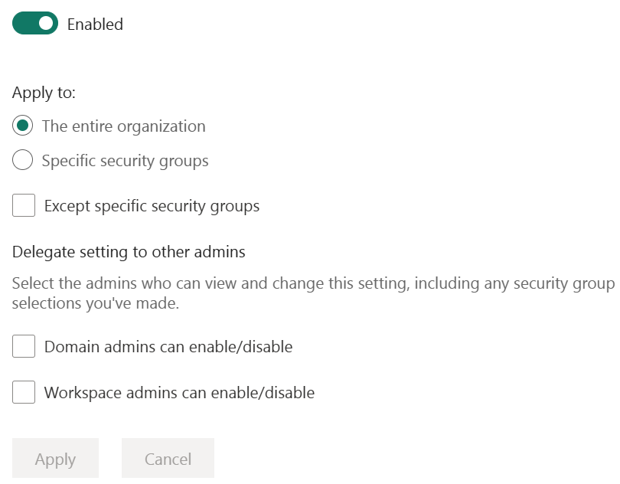
Tenant Settings
Tenant settings are accessed in the Power BI service by clicking on the gear icon in the upper-right corner of the Power BI service, choosing Admin portal and then Tenant settings. Or, alternatively, the ellipsis (…) in the upper-right corner, then Settings, Admin portal, and finally Tenant settings.

Slide 12
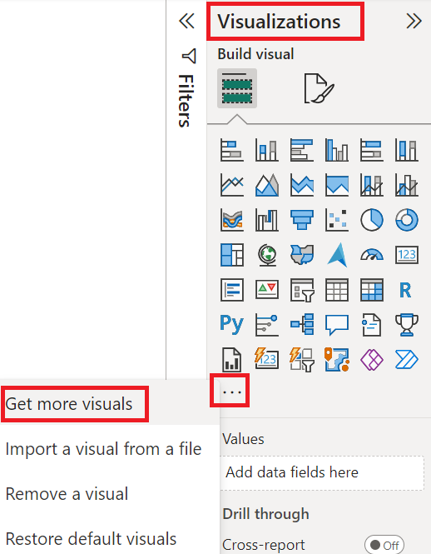
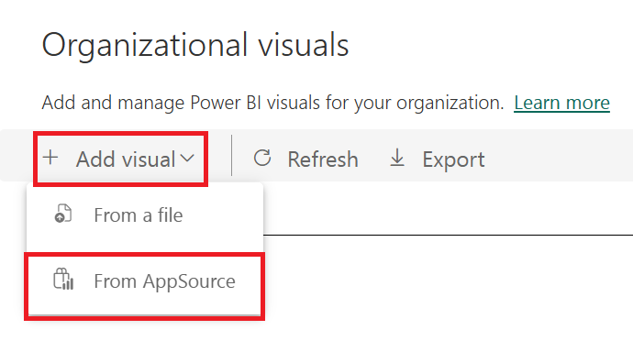
Organizational Visuals
Organizational visuals allow administrators to control exactly which custom visuals users are allowed to use within their Power BI reports. In addition to the array of default visuals included with Power BI Desktop, additional visuals are available via AppSource. You can access these visuals from Power BI Desktop via the Visualizations pane

Slide 13
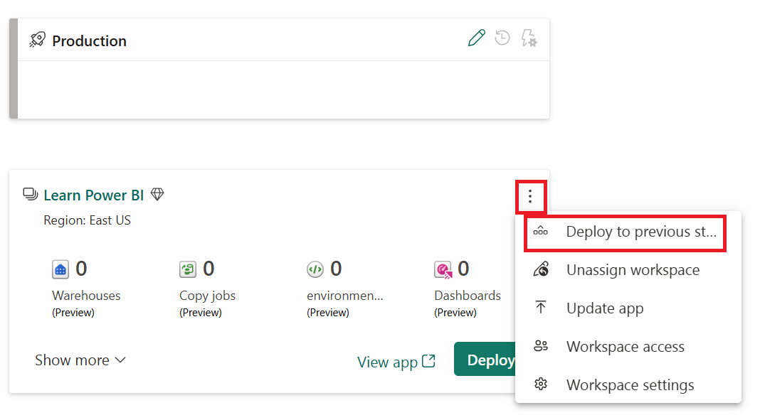

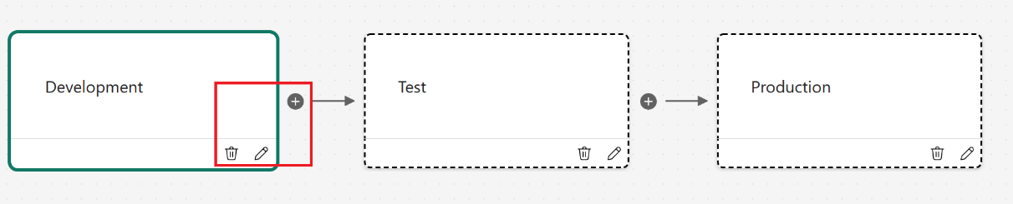
Deploying Power BI Content
Another way in which governance is commonly enforced is through the use of a phased approach for the development and deployment of content. A common approach used in software testing and engineering is called DTAP for Development, Testing, Acceptance, and Production. The letters of the acronym denote the environments and steps used during the engineering and testing of software and the particular steps and environments used can vary between three and five.

Slide 14
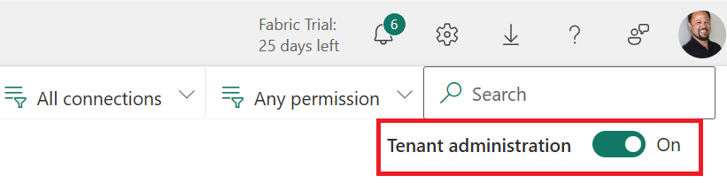
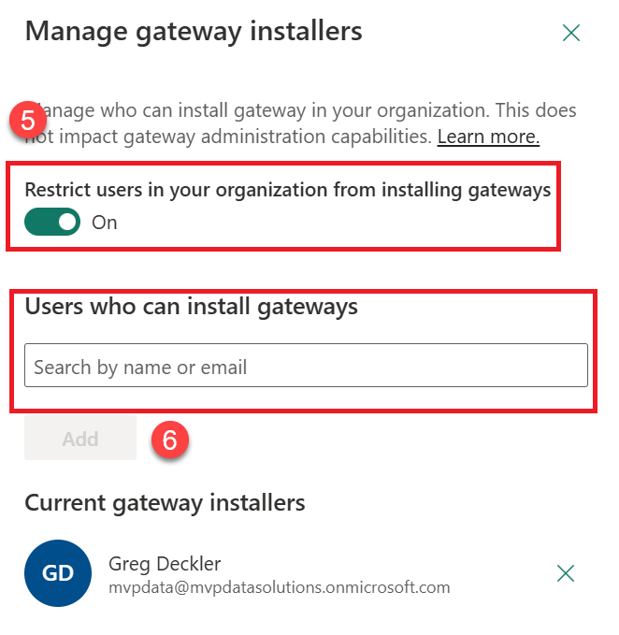
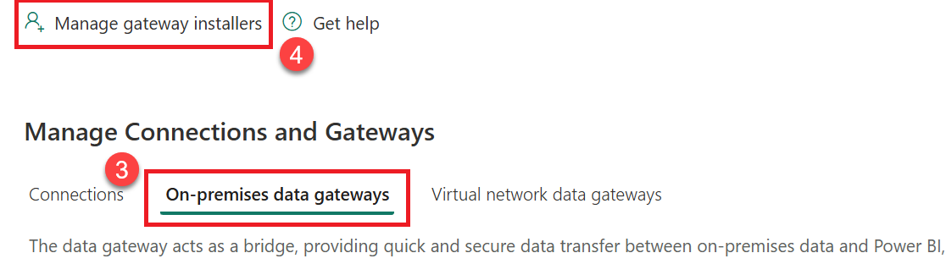
Gateway Governance
You can govern who can install data gateways if you have the Global Admin or Fabric Admin role within Entra.

Slide 15
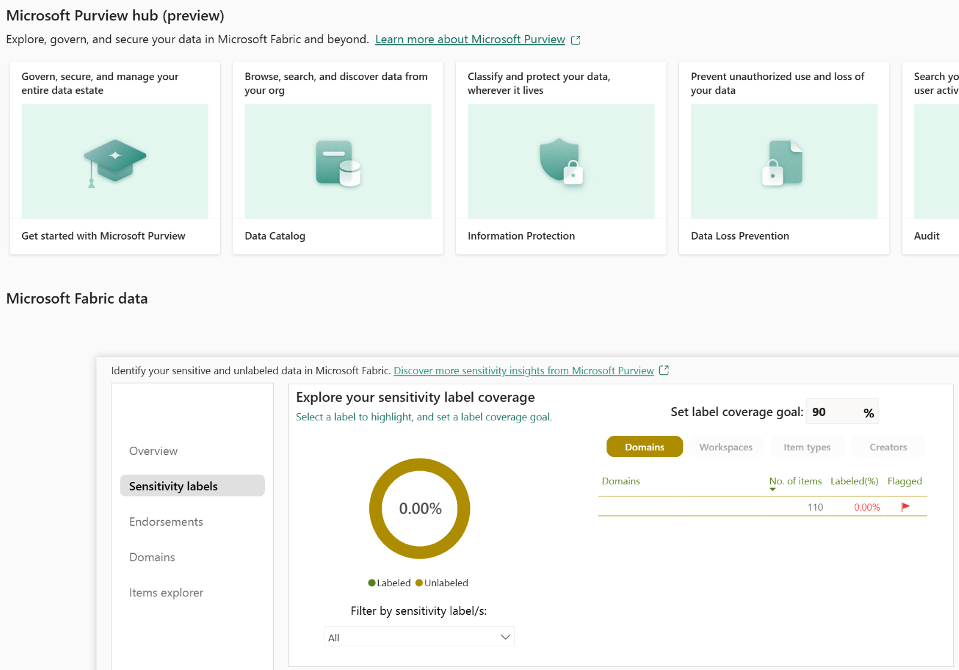
Purview
Microsoft Purview assists organizations in managing, protecting and governing their data. In fact, Microsoft Purview is essentially an umbrella for a number of previous loosely related data security and compliance solutions including:
Data Loss Prevention
Information Barriers
Information Protection
Insider Risk Management
Privileged Access Management
Certain Microsoft Purview functionality is included in a Microsoft Fabric trial. However, to make full use of Purview requires separate licensing such as Purview Information Protection for Office 365 licenses.

Slide 16
Adopting Power BI

Slide 17
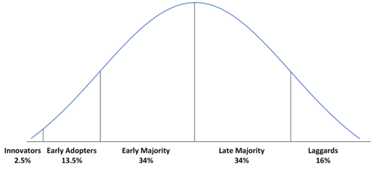
Adoption Strategies
Adoption as covered here is the diffusion of a disruptive technology within an organization. It means that a technology progresses from being used infrequently by a small percentage of an organization to being used by the entire organization on a daily basis. Power BI, a self-service business intelligence technology, should be viewed as a disruptive technology that must be evangelized in order to promote its use throughout an organization.

Slide 18
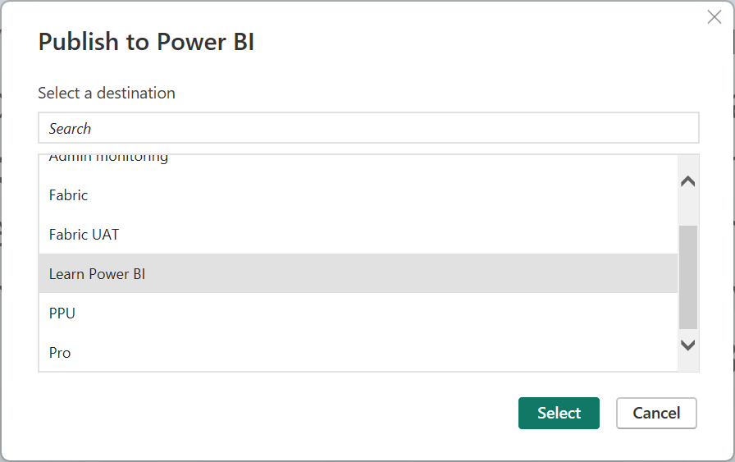
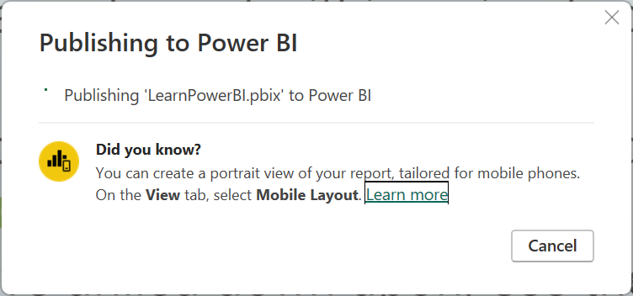
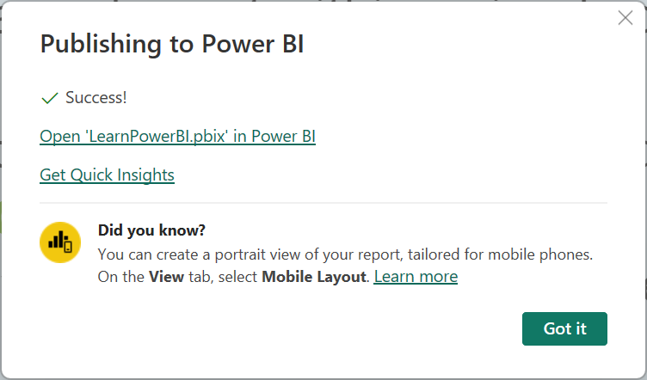
Publishing
Publishing reports is done in Power BI Desktop.

Slide 19
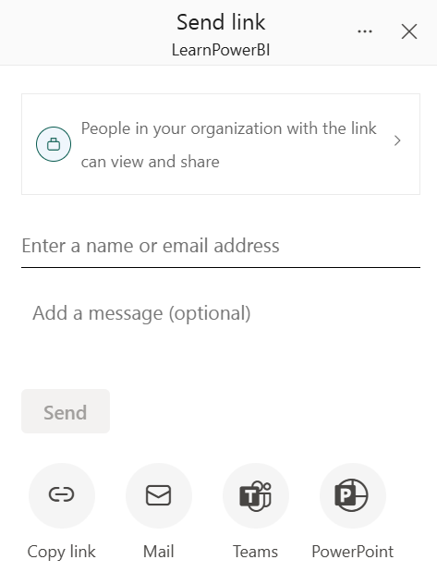
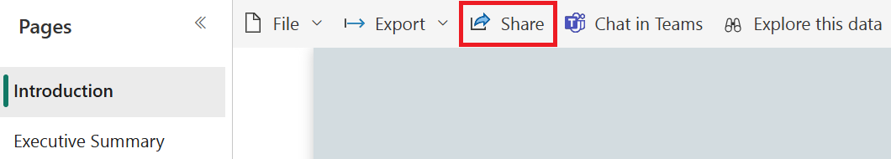
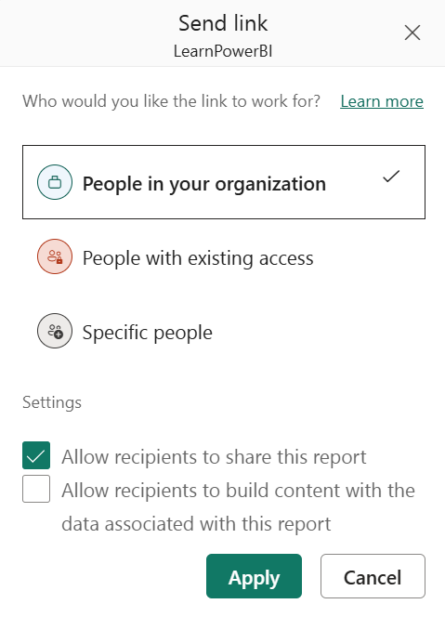
Sharing
Sharing is a paid feature that requires a Power BI Pro or Premium Per User license . This means that all of the users that can view a shared report must have a Power BI Pro license to view a shared report. Power BI PPU works similarly. If the user publishing the report publishes the report to a Premium Per User workspace, then all users must have a Premium Per User license to view the report.

Slide 20
Summary

Slide 21
Review Questions
What is a Power BI usage model?
What usage model is used by many new Power BI deployments?
What are the strengths and weaknesses of the centralized usage model?
How do the federated and golden semantic model usage models address the weaknesses of the centralized usage model?
What are the overall goals of governance in terms of Power BI?
What are three ways to classify content in Power BI?
What approach is recommended when it comes to configuring Power BI tenant settings?
How are Power BI tenant settings accessed?
How to do organizational visuals assist in governance?
A phased approach for the development and deployment of content is called what?
What feature in Power BI Premium enables the phased development and deployment of content?
What Entra roles allow the governance of gateway installers?
What is Microsoft Purview?
What is an important trait of early adopters?

Slide 22
Follow-up and Next lesson
To learn more about the topics that were covered in this chapter, please take a look at the following references:
What is the admin portal?: https://learn.microsoft.com/en-us/fabric/admin/admin-center
Fabric domains: https://learn.microsoft.com/en-us/fabric/governance/domains
Tags in Microsoft Fabric: https://learn.microsoft.com/en-us/fabric/governance/tags-overview
Endorse your content: https://learn.microsoft.com/en-us/power-bi/collaborate-share/service-endorse-content
Manage Power BI visuals admin settings: https://learn.microsoft.com/en-us/fabric/admin/organizational-visuals
About tenant settings: https://learn.microsoft.com/en-us/fabric/admin/about-tenant-settings
Using the Power BI REST APIs: https://learn.microsoft.com/en-us/rest/api/power-bi/
Configure Azure Log Analytics for Power BI: https://learn.microsoft.com/en-us/power-bi/transform-model/log-analytics/desktop-log-analytics-configure
Private lines for secure access to Fabric: https://learn.microsoft.com/en-us/fabric/security/security-private-links-overview
The deployment pipeline process: https://learn.microsoft.com/en-us/fabric/cicd/deployment-pipelines/understand-the-deployment-process
Learn about Microsoft Purview: https://learn.microsoft.com/en-us/purview/purview
Sensitivity Labels in Power BI: https://learn.microsoft.com/en-us/power-bi/enterprise/service-security-sensitivity-label-overview
Microsoft Fabric adoption roadmap: https://learn.microsoft.com/en-us/power-bi/guidance/fabric-adoption-roadmap
NEXT LESSON
Chapter 13 – Working with Microsoft Fabric and Copilot

