Slide 1
Learn Power BI: Chapter 13 Working with Microsoft Fabric and Copilot

Slide 2
Lesson Plan
Leveraging Data Factory
Working with Data Warehouse
Using Microsoft Fabric items
Working with Copilot
Summary

Slide 3
Leveraging Data Factory

Slide 4
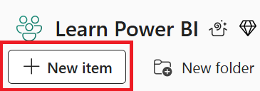
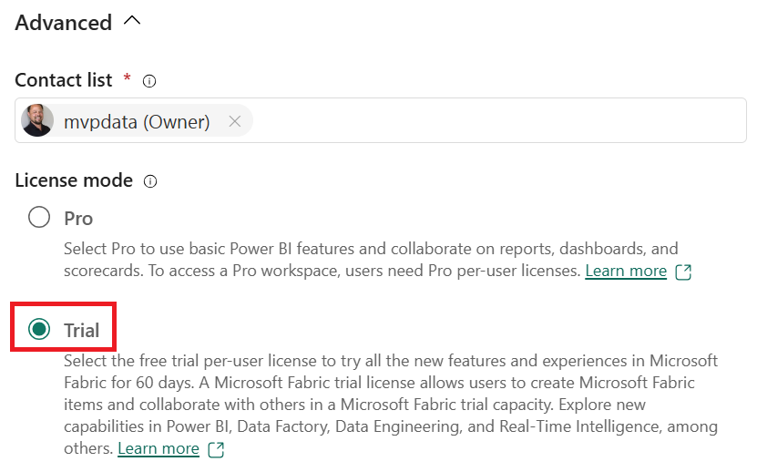
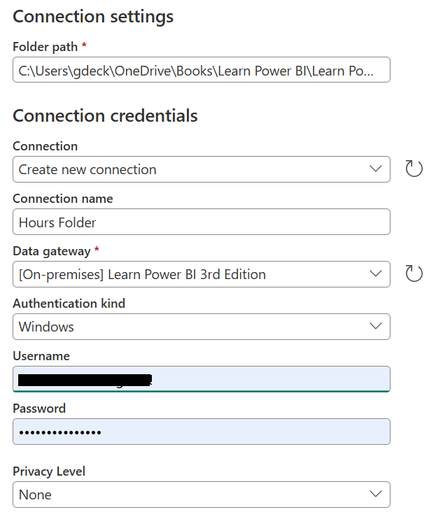
Leveraging Data Factory
Dataflows are reuseable queries created in the service. These queries can then be used across multiple solutions both within Power BI Desktop as well as within the service.

Slide 5
Working with Data Warehouse

Slide 6
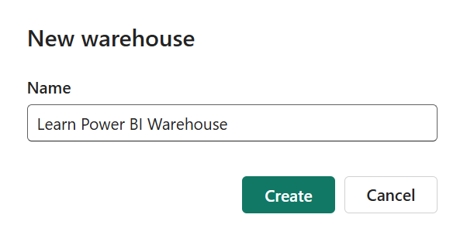
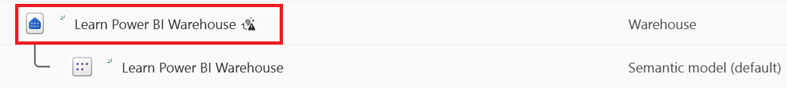
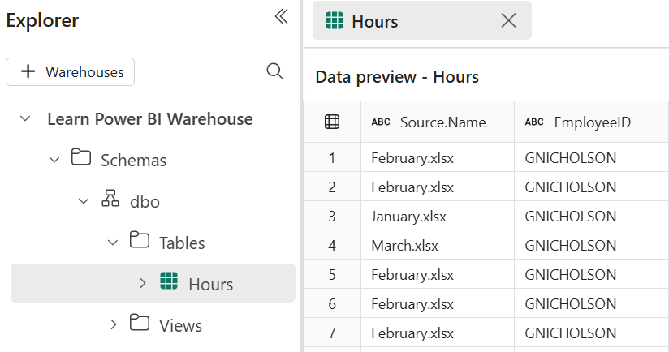
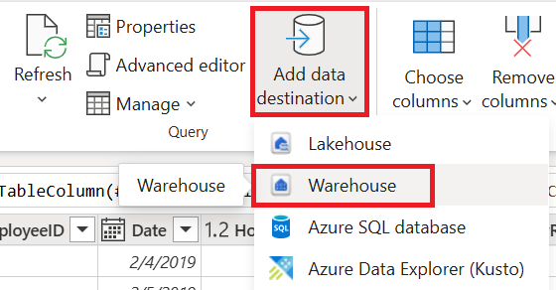
Working with Data Warehouse
Microsoft describes Fabric Data Warehouses as a next-generation solution consisting of a lake warehouse with a SQL analytics endpoint and a Fabric data warehouse.

Slide 7
Using Microsoft Fabric items

Slide 8
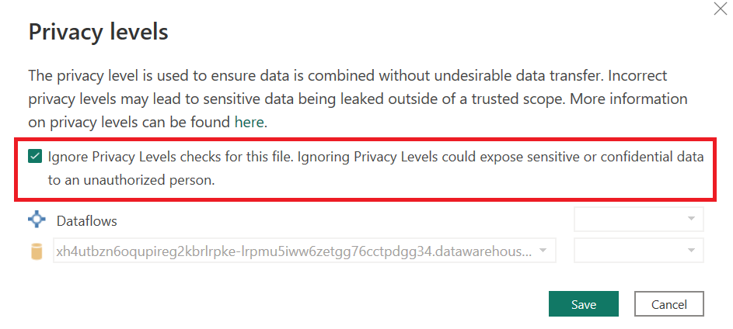
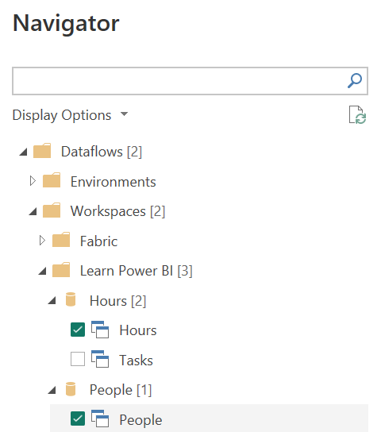
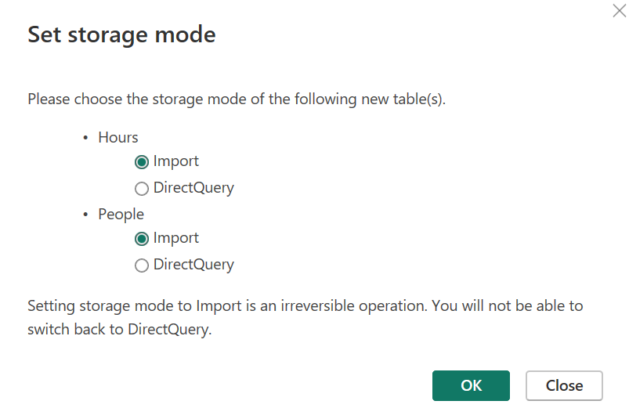
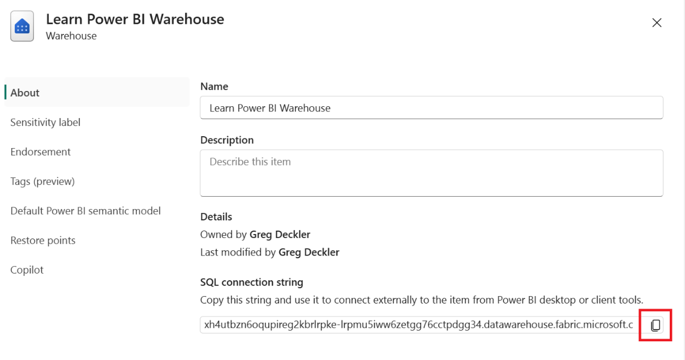
Using Microsoft Fabric Items
Once Microsoft Fabric content such as dataflows and warehouses are created, there are multiple ways to use these items within the Power BI/Fabric service as well as in Power BI Desktop.

Slide 9
Working with Copilot

Slide 10
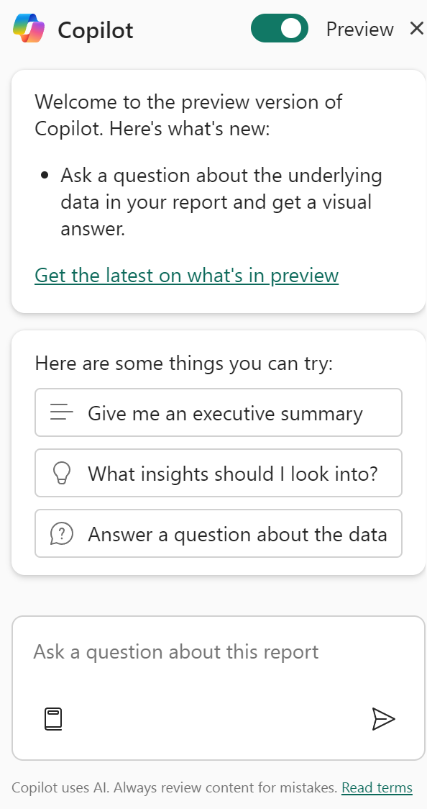
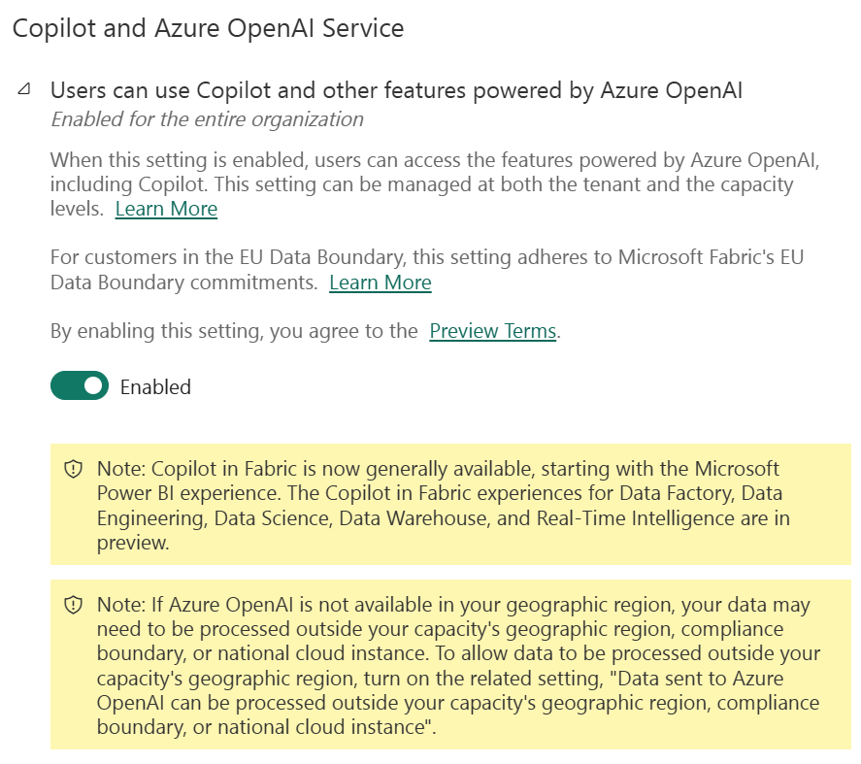
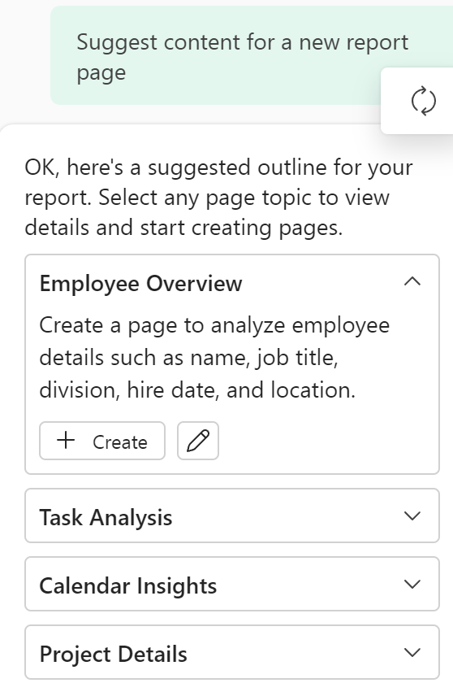
Working with Copilot
Copilot is Microsoft’s generative artificial intelligence feature designed to enable alternative ways to create reports and visuals, analyze and transform data, and generate insights.

Slide 11
Summary

Slide 12
Review Questions
What are the seven Fabric workloads mentioned in this chapter?
What are the three primary types of objects that can be created in Data factory?
What are the differences between Gen1 and Gen2 dataflows?
When should you use a warehouse versus a lakehouse in Fabric?
True or false, Copilot is available for all Fabric capacities including trial capacities and capacities in sovereign clouds.

Slide 13
Follow-up and Next lesson
NEXT LESSON
To learn more about the topics that were covered in this chapter, please take a look at the following references:
What is Microsoft Fabric?: https://learn.microsoft.com/en-us/fabric/get-started/microsoft-fabric-overview
What is Data Factory in Microsoft Fabric?: https://learn.microsoft.com/en-us/fabric/data-factory/data-factory-overview
What is data warehousing in Microsoft Fabric?: https://learn.microsoft.com/en-us/fabric/data-warehouse/data-warehousing
Overview of Copilot in Fabric: https://learn.microsoft.com/en-us/fabric/get-started/copilot-fabric-overview
Chapter 14 – Putting Your Knowledge to Use

