Slide 1

Learn SQL in Practical & DataBase Testing from Scratch

Slide 2
Course FAQ’s
I do not have any knowledge on SQL concepts or Database Testing. Will this course helps me to get through all the concepts?
What kind of approach you follow in Teaching this course?
Course Syllabus – More than 60+ Top class Videos
Are videos provided for Life Time?
Will you provide any Material or code for references?
How about Practise Exercises ,Interview Questions and Resume Preparation

Slide 3
Basic Terminologies :
What is Database?
A database is a collection of information that is organized so that it can easily be accessed, managed, and updated.
What DataBase consists of ?

Slide 4
Database is collection of Tables
A table is a collection of related data entries and it consists of columns and rows.
Each row is treated as Record
Why Database store information in Tables?

Slide 5
SQL Introduction
What is SQL ??
SQL stands for Structured Query Language
SQL is used to communicate with a database.
SQL can execute queries against a database
SQL can retrieve data from a database
SQL can insert records in a database
SQL can update records in a database
SQL can delete records from a database

Slide 6
SQL can create new databases
SQL can create new tables in a database
SQL can create stored procedures in a database
SQL can delete records from a database
SQL can create views in a database

Slide 7
DBMS Introduction
What is Database Management system?
It is software through which we execute sql queries
There are many such databases like - Oracle, Microsoft SQL Server, SQLite and many others are examples of such.

Slide 8
MYSQL
MYSQL is one of the Database management System
It is open source dbms and you can use it for free
Runs on various platforms , And have good performance results
This course is completly based upon MYSQL

Slide 9
Download MYSQL complete Product from
https://dev.mysql.com/downloads/windows/installer/

Slide 10
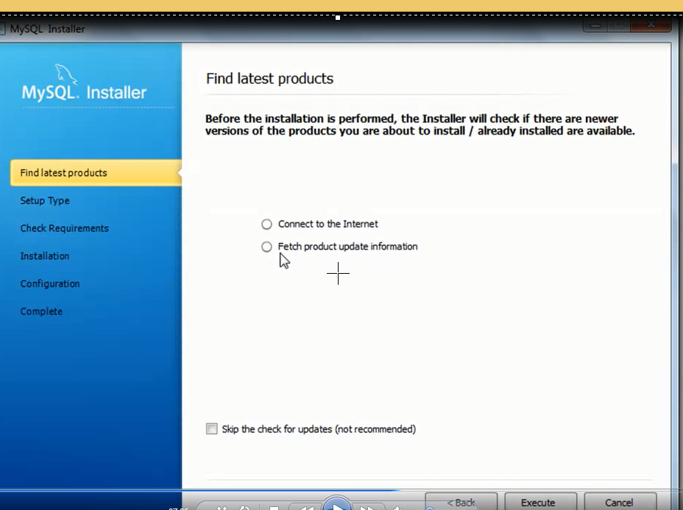

Slide 11
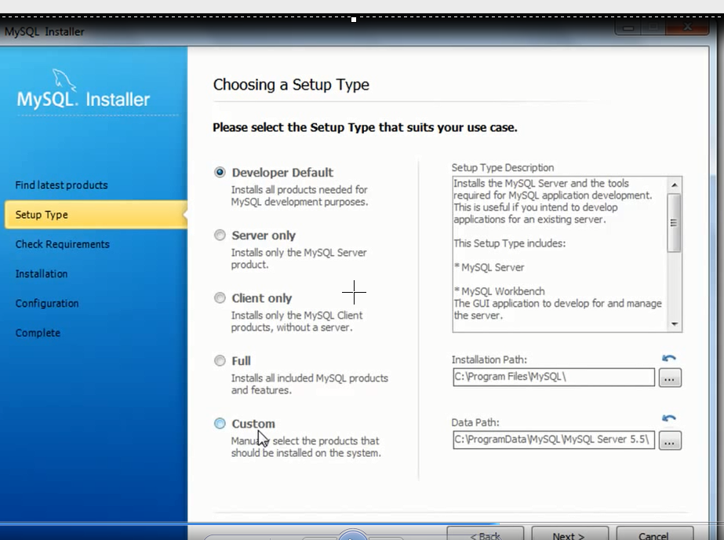

Slide 12
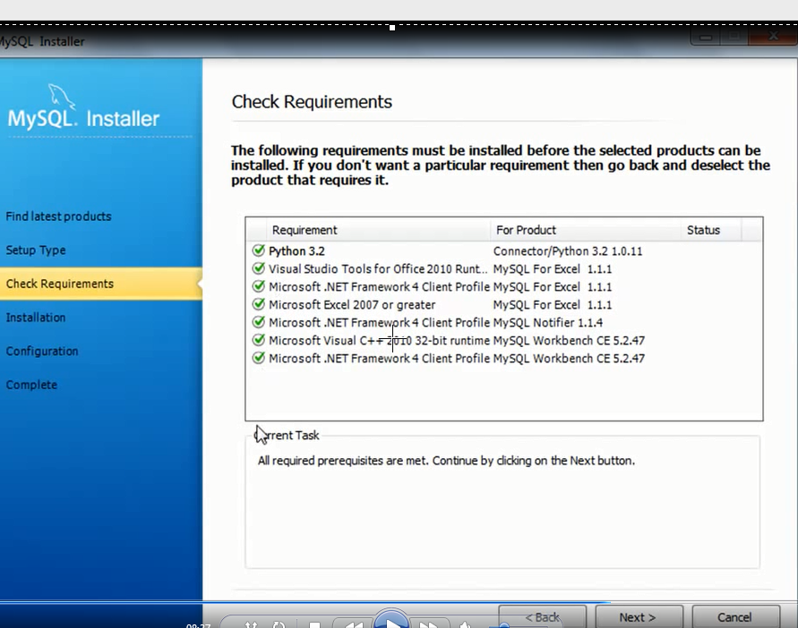

Slide 13
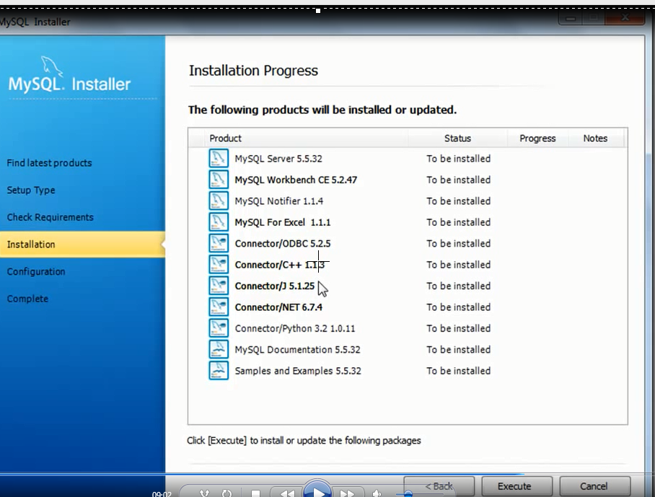

Slide 14
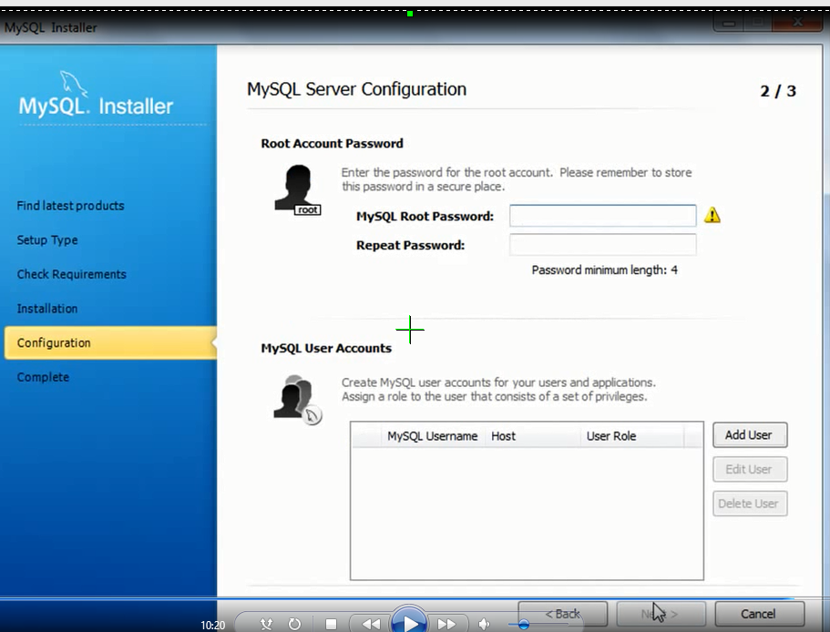

Slide 15
