Slide 1
Introduction to Fluid Boxes
Adobe Captivate 2019

Slide 2
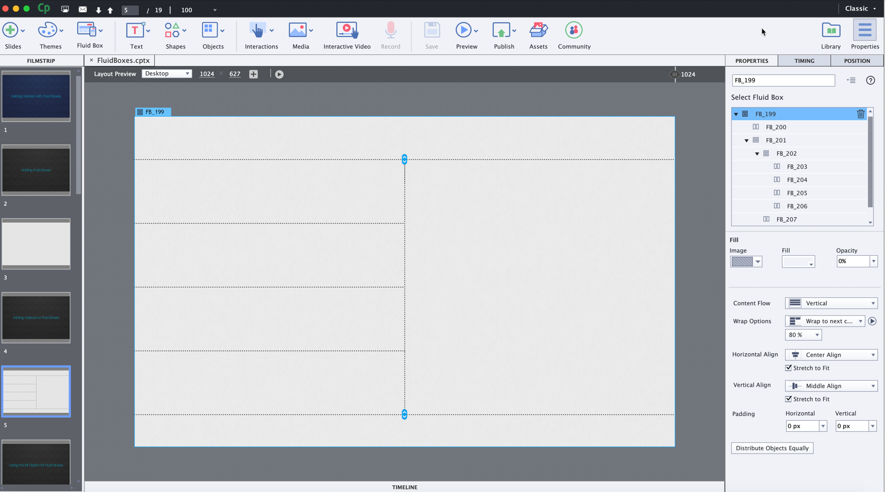
What are Fluid Boxes?
Fluid Boxes are the containers which lay out your content intelligently as per the defined settings.
Notes:
The first step to design the responsive eLearning courses in Captivate 2019 is to add the Fluid Boxes.
Fluid Boxes are the containers which lay out your content intelligently as per the defined settings.

Slide 3
Steps to AddED Fluid Boxes
1
2
3
4
5
On the Toolbar, click Fluid Box, and select either Horizontal or Vertical flow based on your screen layout requirement.
Select the number of Fluid Boxes you wish to add. You can add up to 10 Fluid Boxes in each direction on the slide.
Resize the child Fluid Boxes by selecting the main Fluid Box, and then clicking and dragging the resize handles on the slide.
To add child Fluid Boxes to these Fluid Boxes, select the Fluid Box, click Fluid Box | Horizontal or Vertical on the Toolbar, and then select the number.
Continue adding Fluid Boxes until you get the desired layout for the screen.

Slide 4
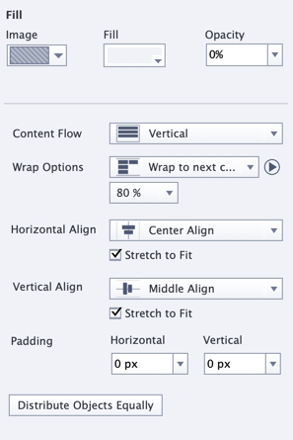
Fluid Box Properties
Flow
Wrap
Align
Padding
Optional
Static

Slide 5
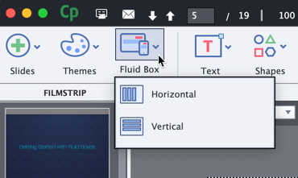
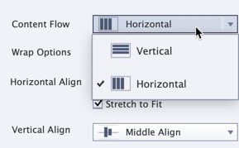
Flow
The Flow property denotes the direction in which the objects will be laid out.
You can decide the flow as Vertical or Horizontal at the time of adding the Fluid Box to the slide.
If, after adding the Fluid Box, you wish to change the direction, you can change it from the Properties inspector.

Slide 6
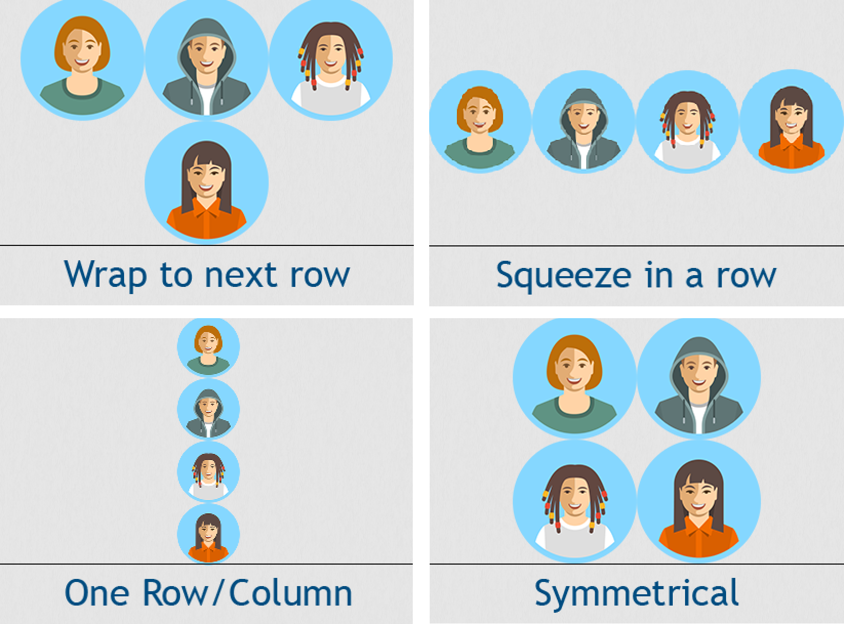
WrapP
With the Wrap property, you can control when and how the objects wrap to the next row on the smaller device sizes.
Wrap to the next row
Squeeze in a row
One Row/Column
Symmetrical

Slide 7
Align
This option will allow you to decide how to align the objects in the Fluid Boxes.
Left align | Use this option to left align the objects. The first object will be placed at the left of the Fluid box and the others will follow.
Center align | The objects will be center aligned in the Fluid Box.
Right align | The objects will be right aligned in the fluid box. The last object will be placed at the right of the Fluid box and the others will be placed after it in right to left direction.
Top align | The objects will be top aligned in the Fluid Box.
Middle align | The objects will be middle aligned in the Fluid Box.
Bottom align | The objects will be bottom aligned in the Fluid Box.
Space in Between | The objects will be evenly distributed in the Fluid Box. The first object will be placed in the left and the last object on the right side of the Fluid Box.
Space Around | The objects will be evenly distributed in the Fluid Box with equal space around the objects.

Slide 8
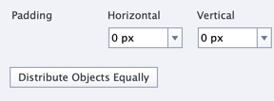
Padding
If you need some space around the objects in the Fluid Boxes, you can add padding from 0 to 100 pixels in both horizontal and vertical direction.

Slide 9
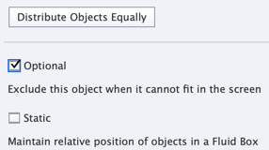
Optional
You can mark the decorative or less important fluid boxes or objects as optional. This will show all the objects on the bigger screen dimensions, but as the screen dimension decreases, the optional objects automatically disappear to make more space for critical objects.

Slide 10
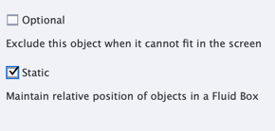
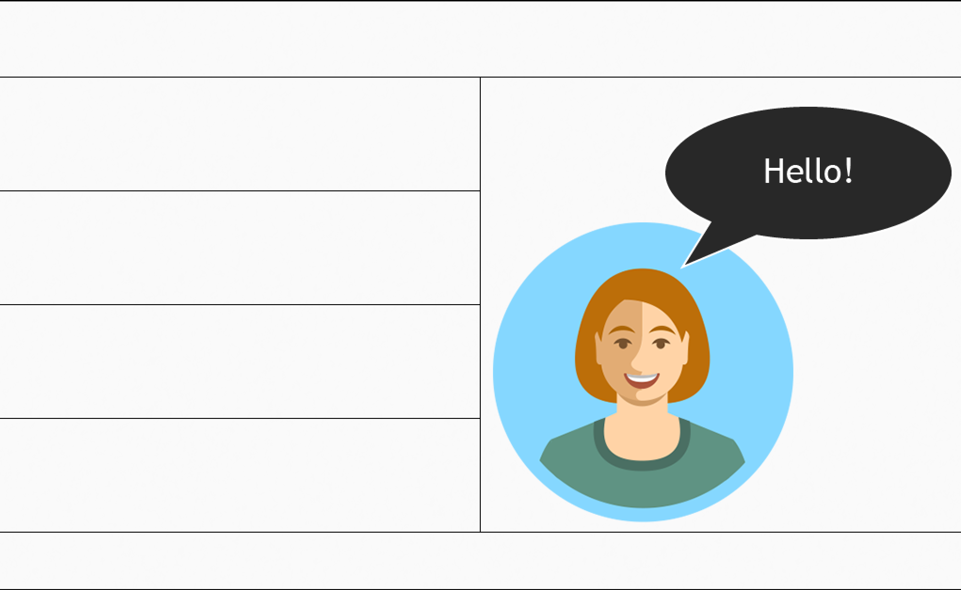
Static
This option will allow you to overlay objects on each other and assign an absolute position to objects in the Fluid Box.

Slide 11

for viewing this course!
Click here to learn more about Fluid Boxes.

