Slide 1
Set

Slide 2
Set
Unordered collection of distinct objects

Slide 3
Set
Unordered collection of distinct objects
Unordered?

Slide 4
Set
Unordered collection of distinct objects
Unordered?
Distinct?

Slide 5
Set
Unordered collection of distinct objects
Unordered?
Distinct?
Object?

Slide 6
Next Video
Terminology including elements, finite and infinite Sets and more…

Slide 7
Set
Element or Member

Slide 8
Set
Element or Member
Empty Set

Slide 9
Set
Element or Member
Empty Set
Finite Set

Slide 10
Set
Element or Member
Empty Set
Finite Set
Infinite Set

Slide 11
Set
Element or Member
Empty Set
Finite Set
Infinite Set
Countable Set

Slide 12
Set
Element or Member
Empty Set
Finite Set
Infinite Set
Countable Set
Uncountable Set

Slide 13
Next Video
Terminology including subsets, powersets and more…

Slide 14
Set
Subset

Slide 15
Set
Subset
Power Set

Slide 16
Set
Subset
Power Set
Universal Set

Slide 17
Next Video
Operations on sets, union, intersection, difference and more…

Slide 18
Set Operations
Union

Slide 19
Set Operations
Union
Intersection

Slide 20
Set Operations
Union
Intersection
Difference

Slide 21
Set Operations
Union
Intersection
Difference
Complement

Slide 22
Set Operations
Union
Intersection
Difference
Complement
De Morgan’s Law

Slide 23
Set Operations
Union
Intersection
Difference
Complement
De Morgan’s Law
Partition

Slide 24
Next Video
Venn Diagrams, union, intersection, difference and more…

Slide 25
Venn Diagrams
Intersection

Slide 26
Venn Diagrams
Intersection
Union

Slide 27
Venn Diagrams
Intersection
Union
Difference

Slide 28
Venn Diagrams
Intersection
Union
Difference
Complement

Slide 29
Venn Diagrams
Intersection
Union
Difference
Complement
Disjoint

Slide 30
Venn Diagrams
Intersection
Union
Difference
Complement
Disjoint
Partition

Slide 31
Sets in Python
Practice

Slide 32
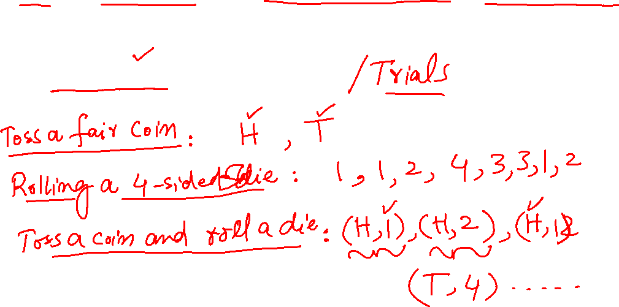
Experiment: Random Experiment
Random Experiment
Notes:
32

Slide 33
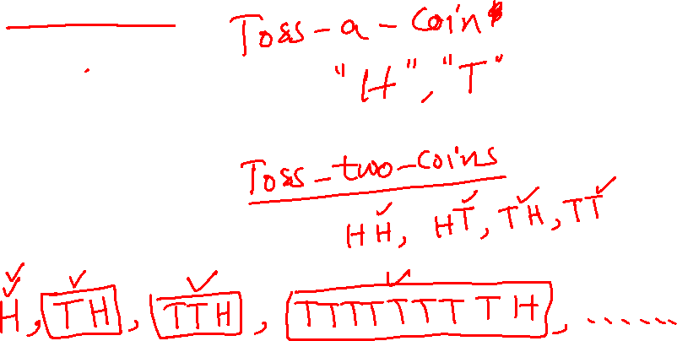
Experiment : Outcome
Outcome
Notes:
33

Slide 34
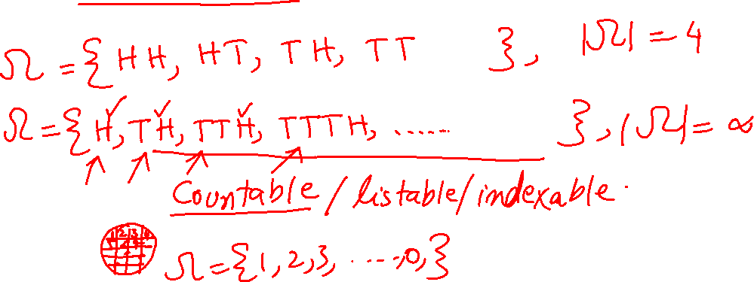
Experiment : Sample Space
Sample Space
Notes:
34

Slide 35
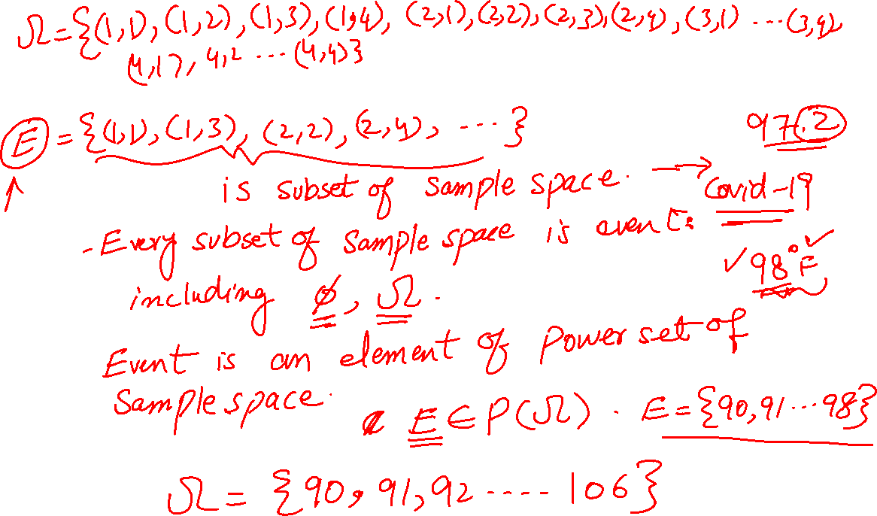
Experiment : Event
Event
Notes:
35

Slide 36
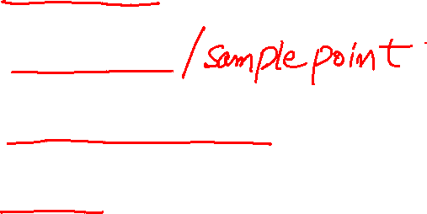
Experiment : Recap
Random Experiment
Outcome
Sample Space
Event
Notes:
36

Slide 37
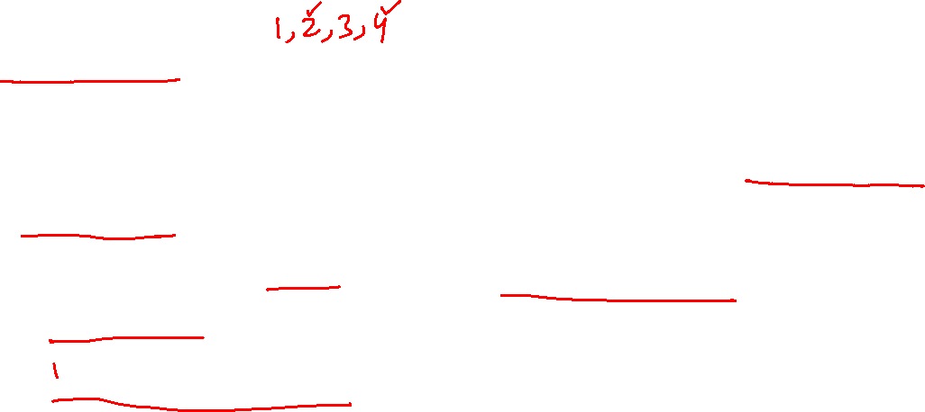
Experiment : Homework
Experiment: A four-sided die is rolled repeatedly, until the first time (if ever) that an even number is obtained.
What is the Sample Space for this experiment? Is the sample space finite?
Write down the event that the sum of rolls of the experiment/trial is even.
Is the above event finite?
Notes:
37

Slide 38
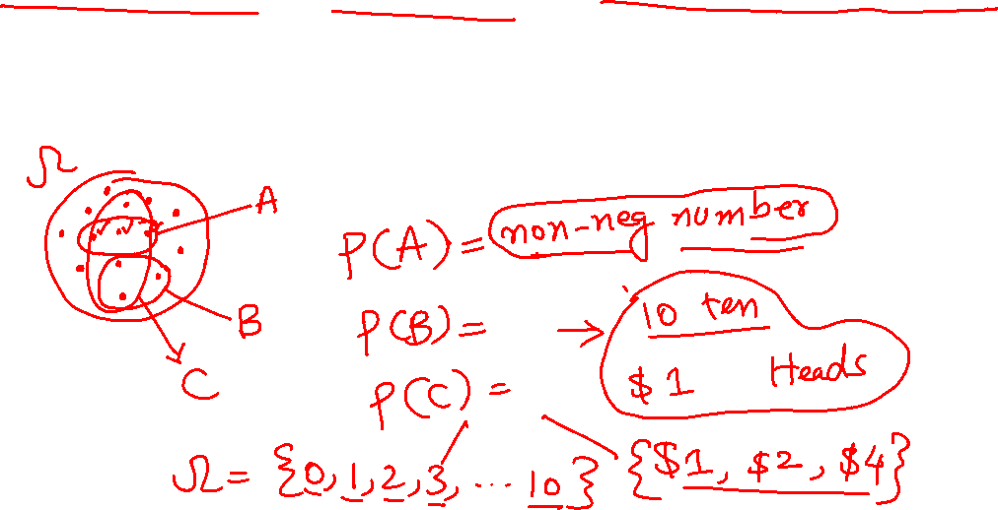
Probability Model: Probability Law
From Event to a number
Notes:
38

Slide 39

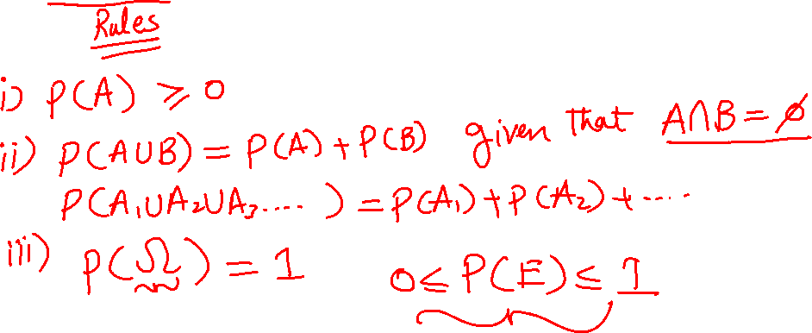
Probability Model: Probability Axioms
Axioms of Probability
Notes:
39

Slide 40
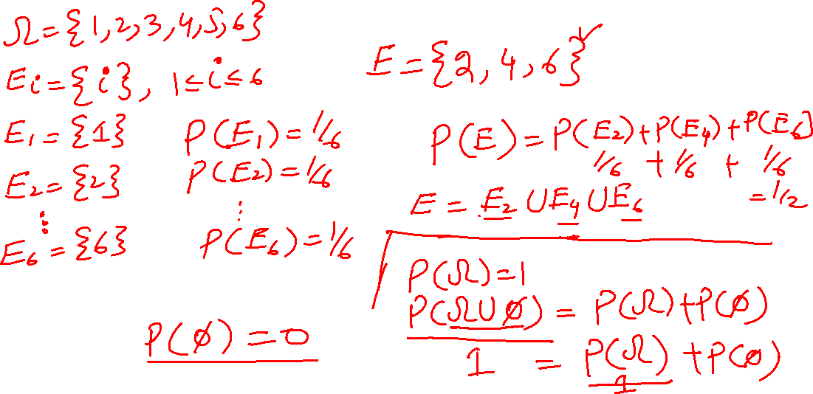
Probability Model: Axioms
Notes:
40

Slide 41
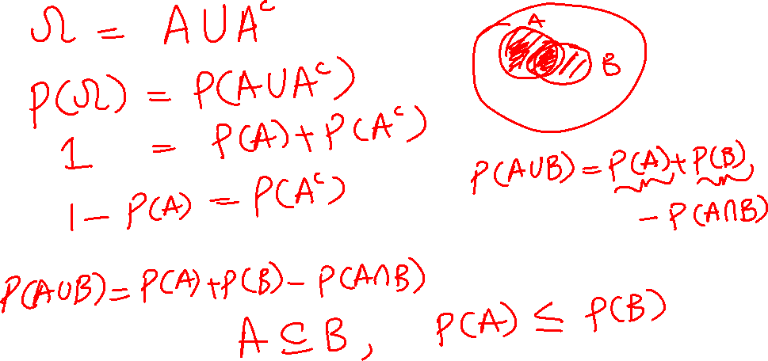
Probability Model: Axioms
Notes:
41

Slide 42
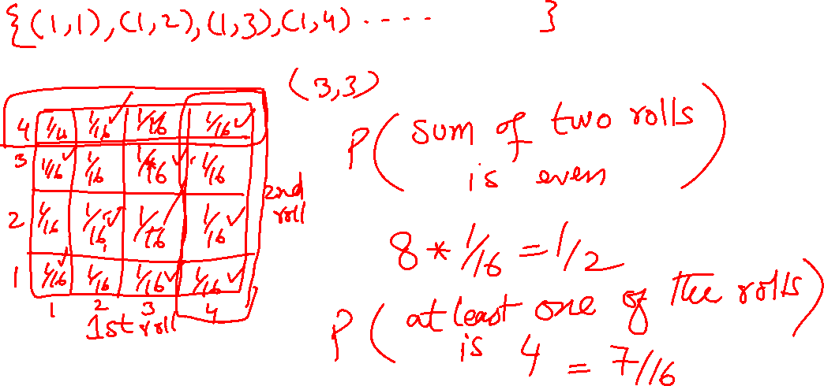
Probability Model: Examples
Notes:
42

Slide 43
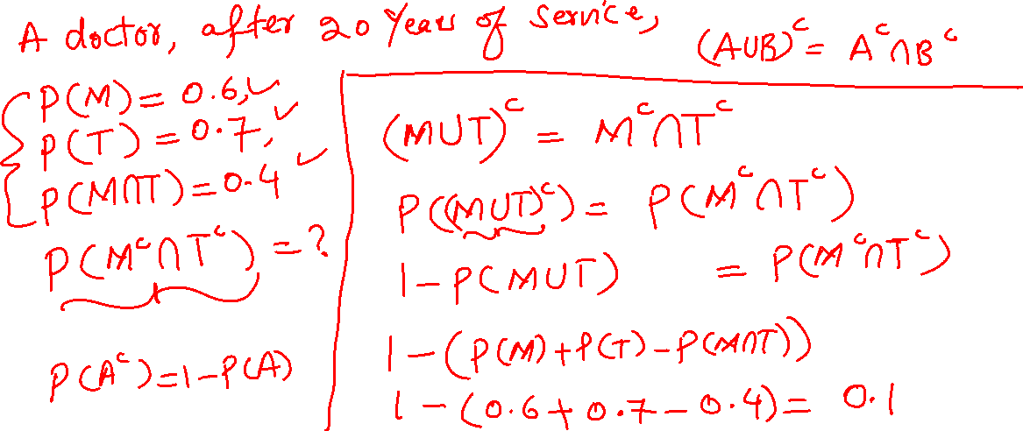
Probability Model: Examples
Notes:
43

Slide 44
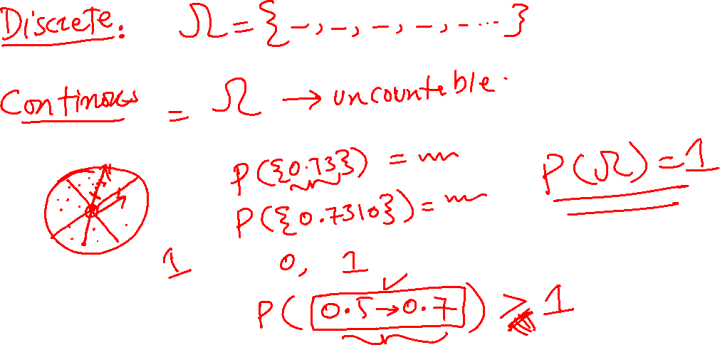
Probability Model: Continuous
Notes:
44

Slide 45
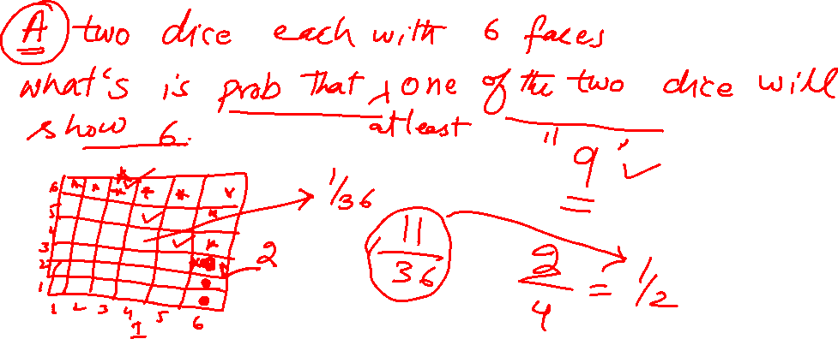
Probability Model: Conditioning
Conditional Probability
Notes:
45

Slide 46
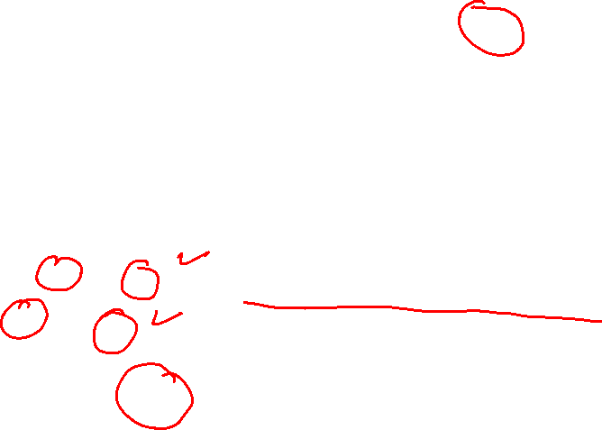
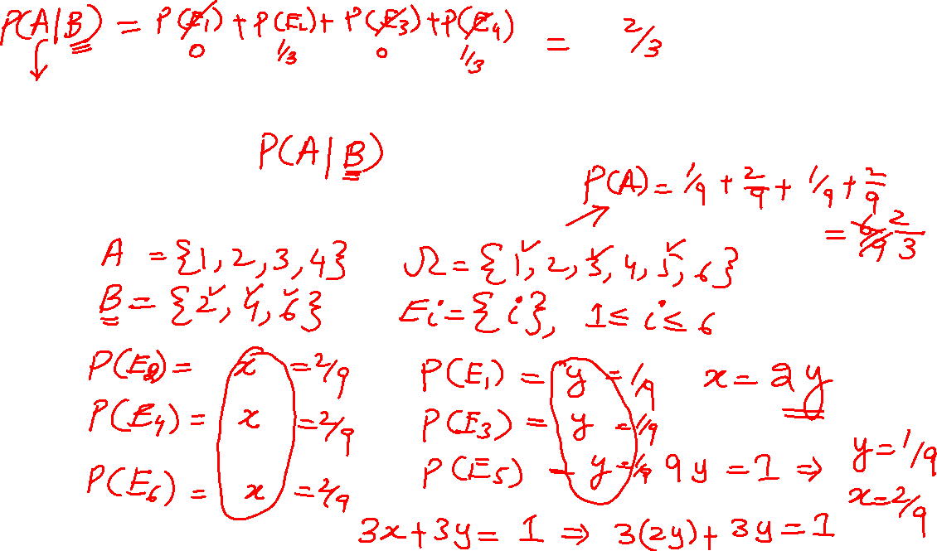
Probability Model: Conditioning
Conditional Probability
Notes:
46

Slide 47
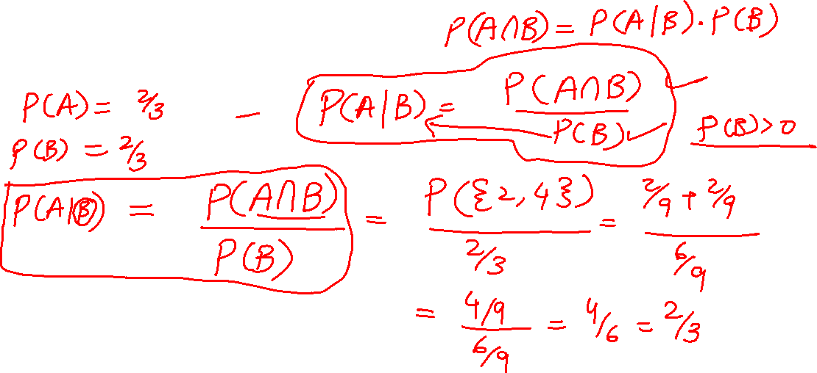
Probability Model: Conditioning
Conditional Probability
Notes:
47

Slide 48
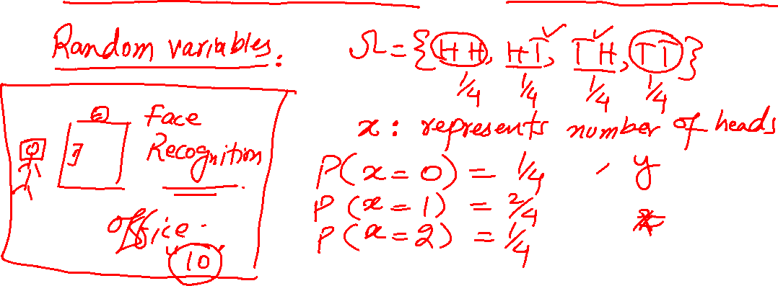
Probability Model: Conditioning
Conditional Probability in Machine Learning
Notes:
48

Slide 49
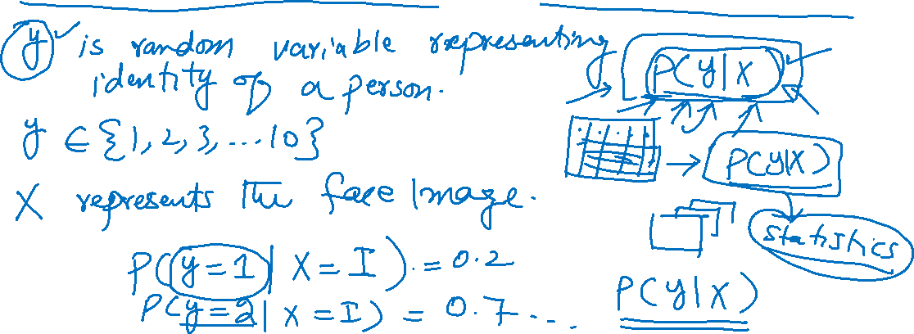
Probability Model: Conditioning
Conditional Probability in Machine Learning
Notes:
49

Slide 50
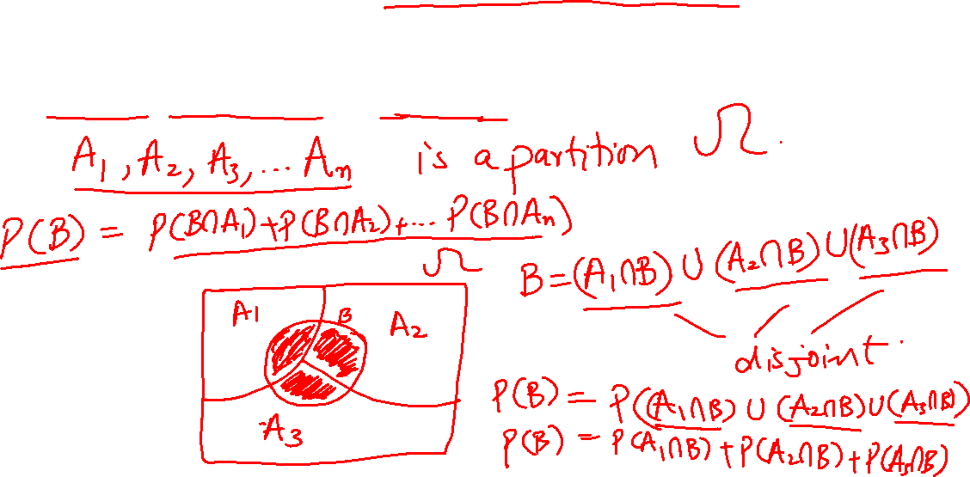
Probability Model: Law of Total Probability
Total Probability Theorem
Notes:
50

Slide 51
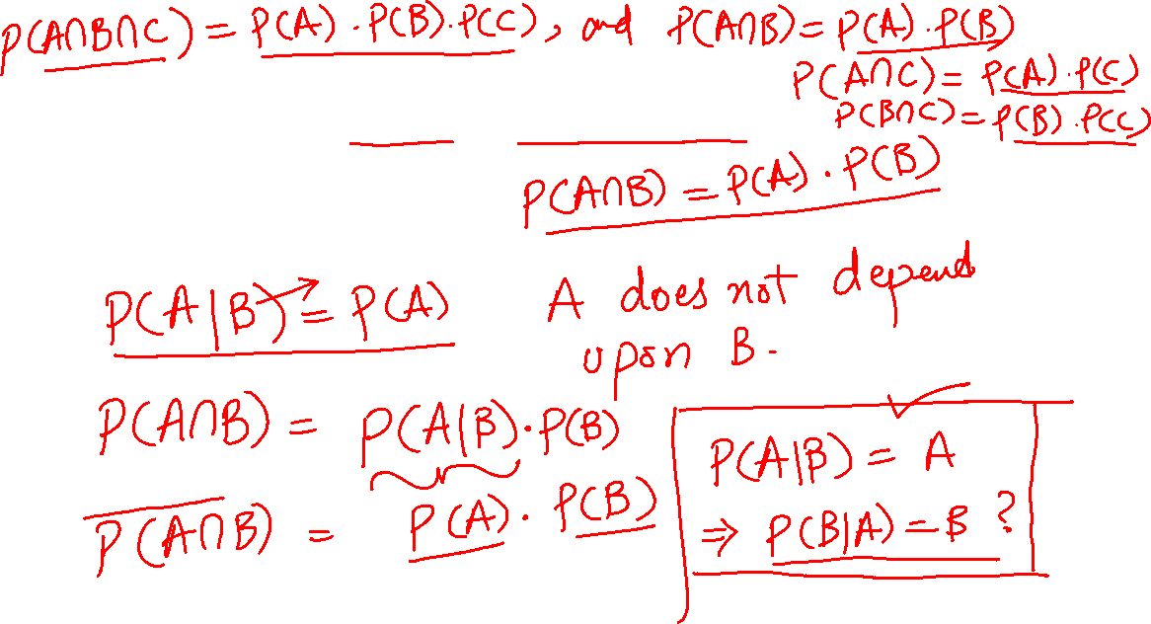
Independence
Independence
Notes:
51

Slide 52
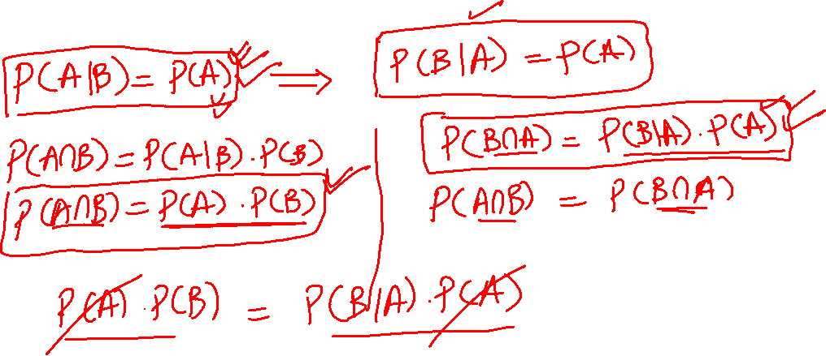
Independence cont.…
Independence
Notes:
52

Slide 53
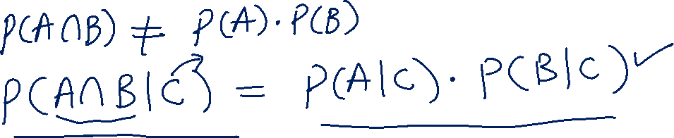
Independence
Independence
Conditional Independence
Notes:
53

Slide 54
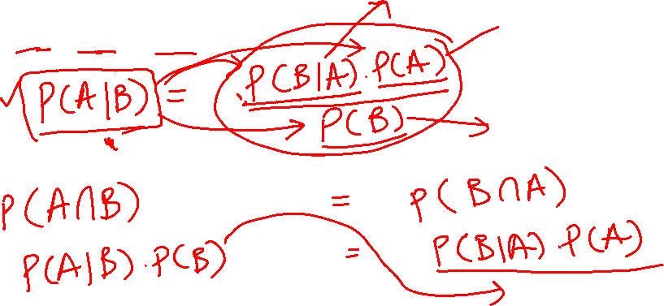
Bayes Rule
Bayes Rule
Notes:
54

Slide 55
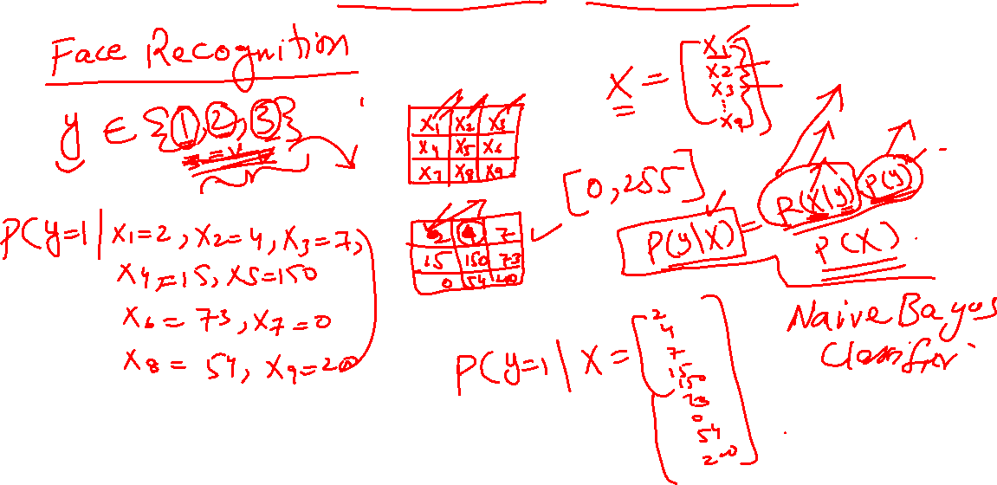
Towards Random Variables
Notes:
55

Slide 56

Home Work
Let say you roll a 4 sided die and toss two coins simultaneously. Build a probability model where all outcomes are equally likely.
What is the probability that the roll will result even and the tosses will both result heads?
Notes:
56

Slide 57

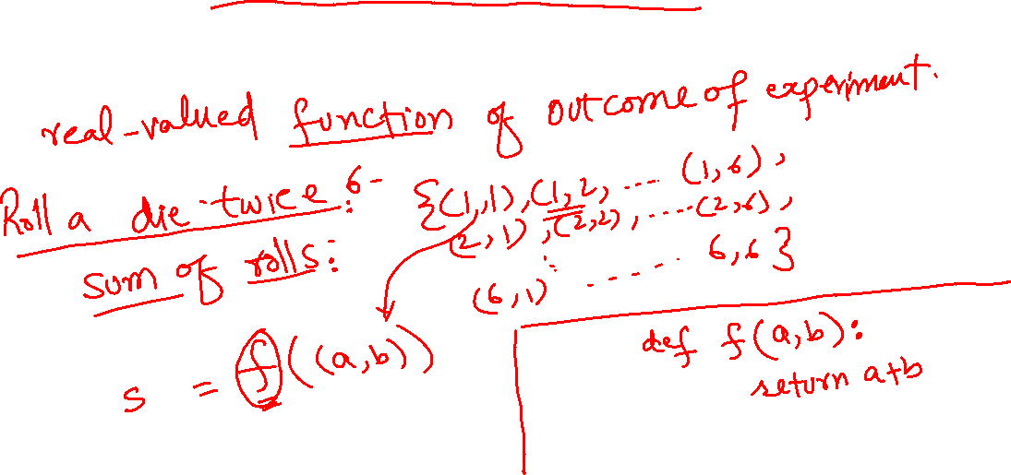
Random Variables
From Events to Variables
Notes:
57

Slide 58
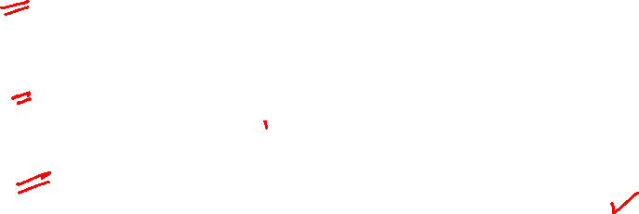
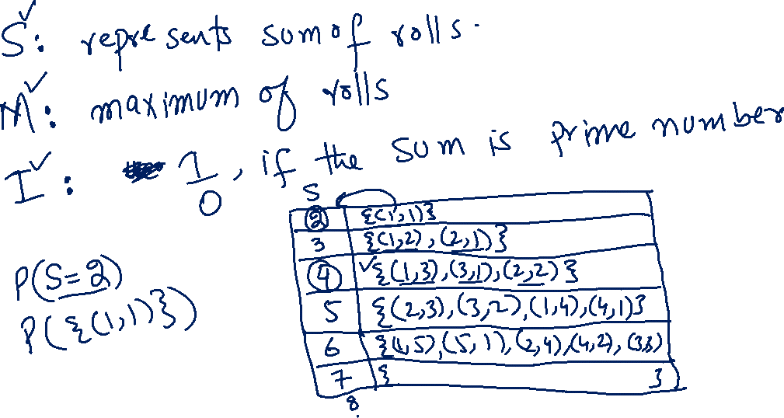
Random Variables
Notes:
58

Slide 59
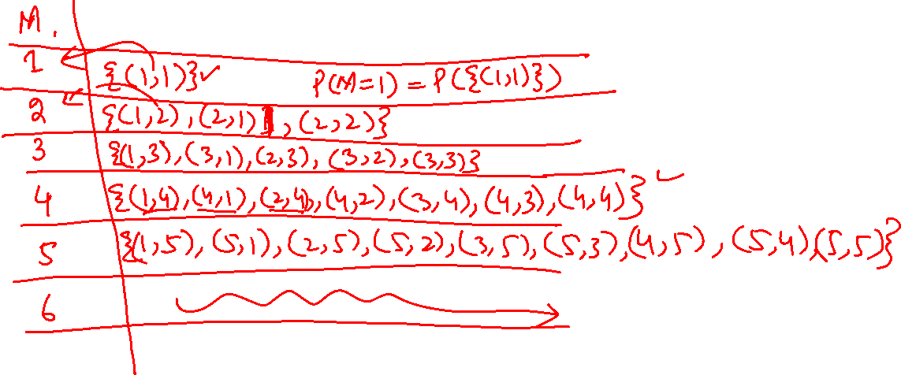
Random Variables
Notes:
59

Slide 60
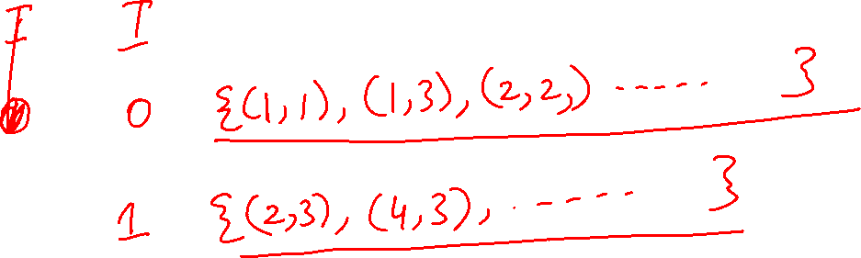
Random Variables
Notes:
60

Slide 61
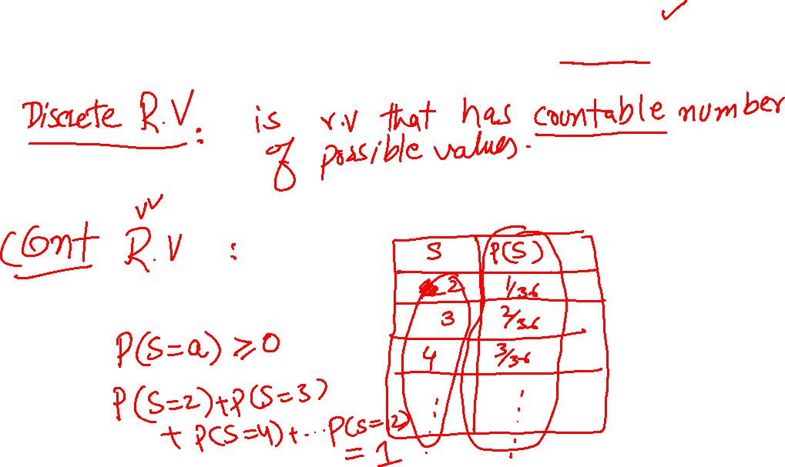
Random Variables: PMF
Notes:
61

Slide 62
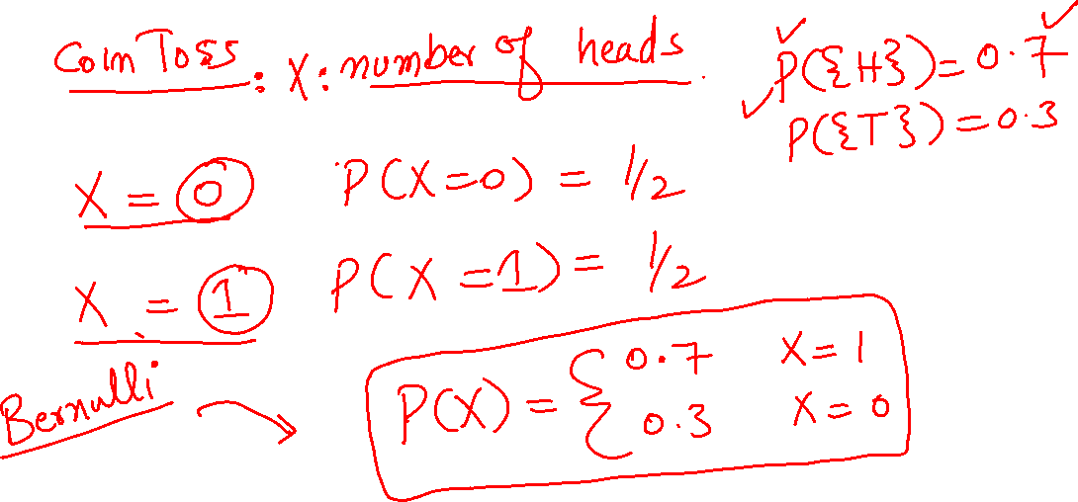
Random Variables: PMF
Notes:
62

Slide 63

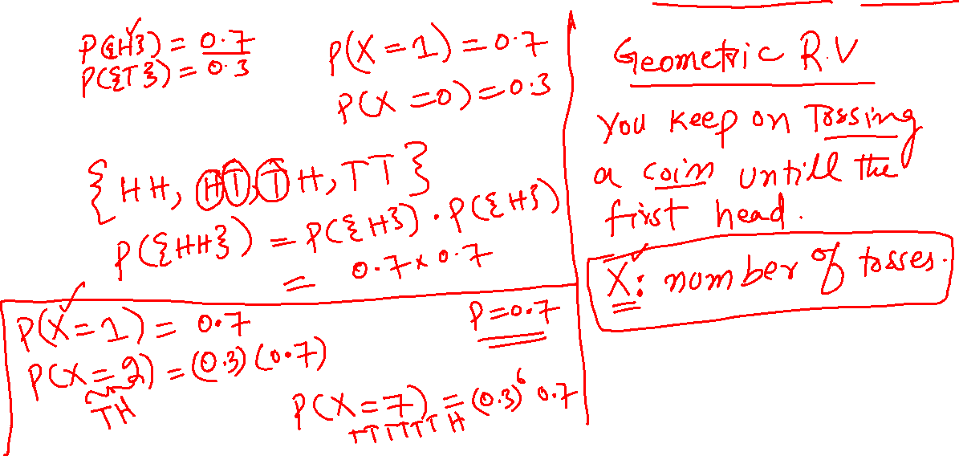
Random Variables: Independent Bernoulli Trials
Notes:
63

Slide 64
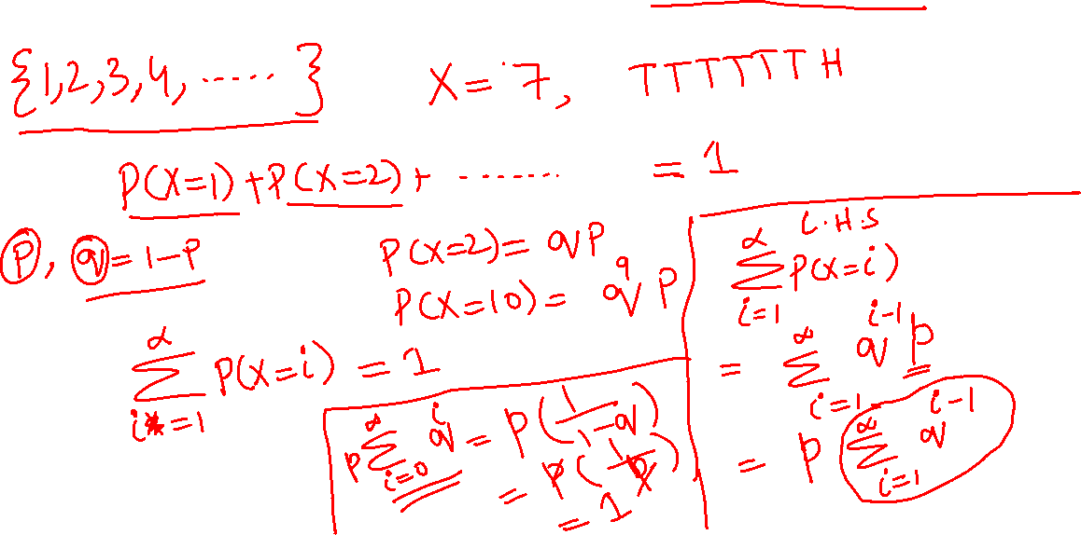
Random Variables: Geometric
Notes:
64

Slide 65
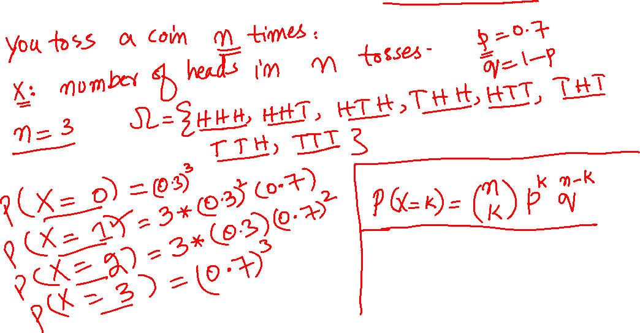
Random Variables: Binomial
Notes:
65

Slide 66
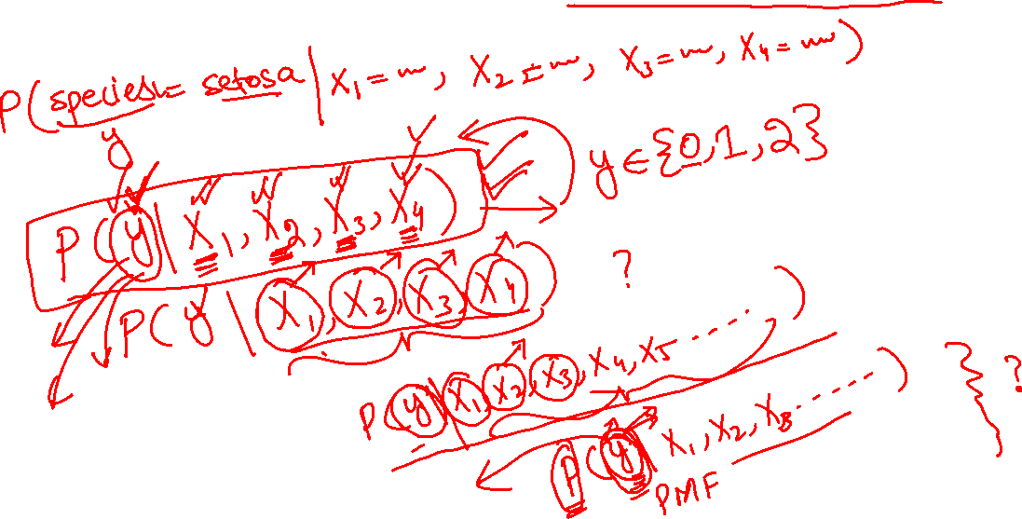
Random Variables: Real Data Sets
Notes:
66

Slide 67
Home Work
Let say you roll a 4 sided die 3 times and the random variable you are interested in is the max roll. What is the probability that the max roll will result even if the PMF is uniform.
Notes:
67

Slide 68
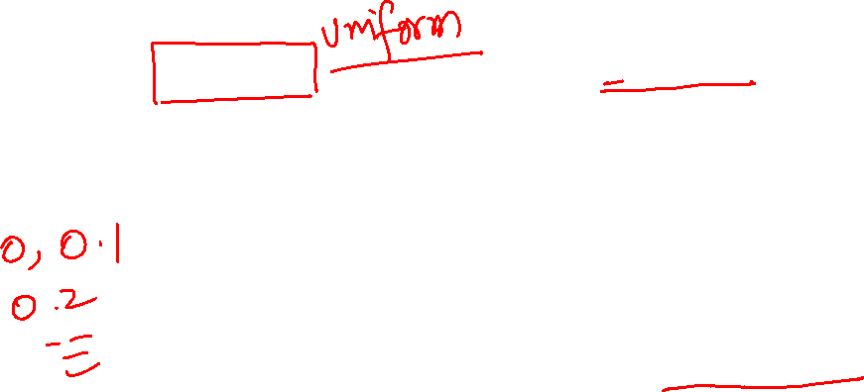
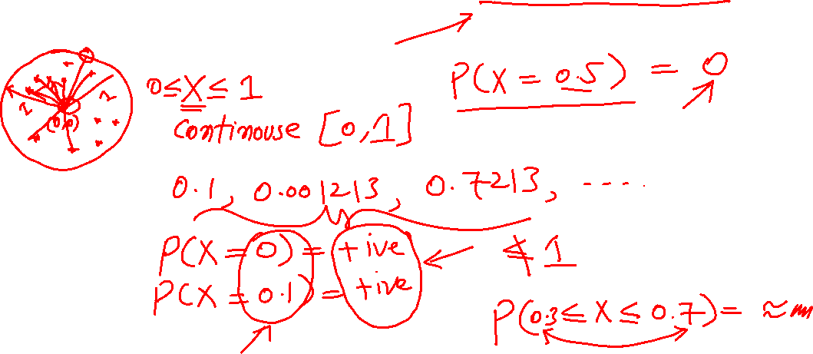
Random Variables: Continuous
Notes:
68

Slide 69
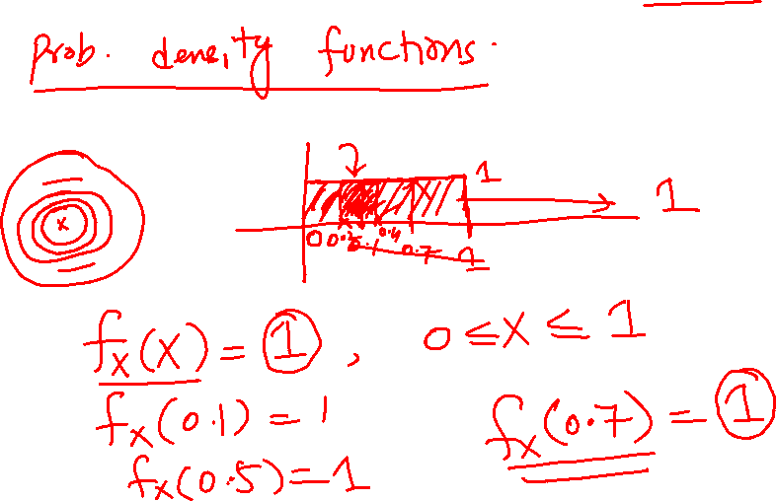
Random Variables: PDF
Notes:
69

Slide 70
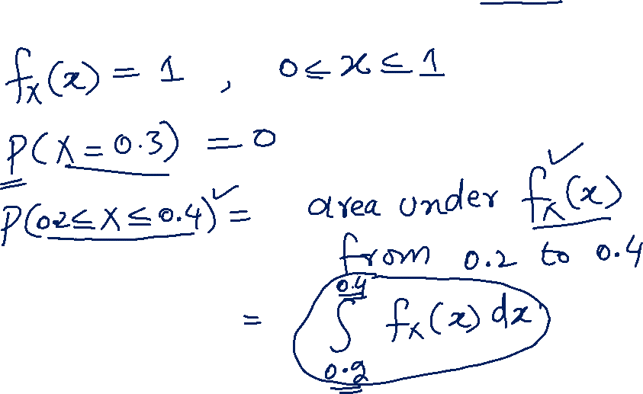
Random Variables: PDF
Notes:
70

Slide 71
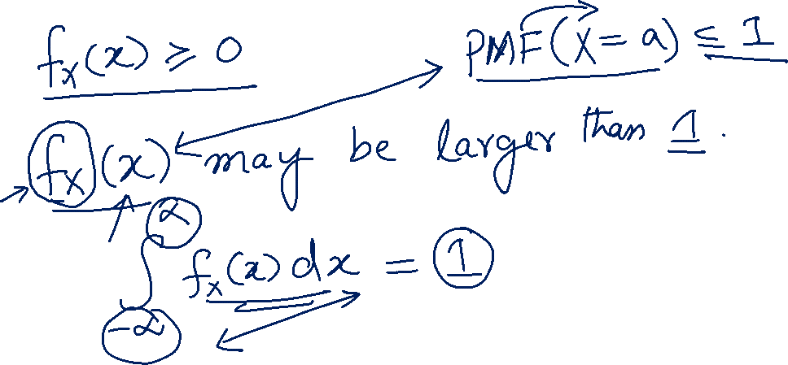
Random Variables: PDF
Notes:
71

Slide 72
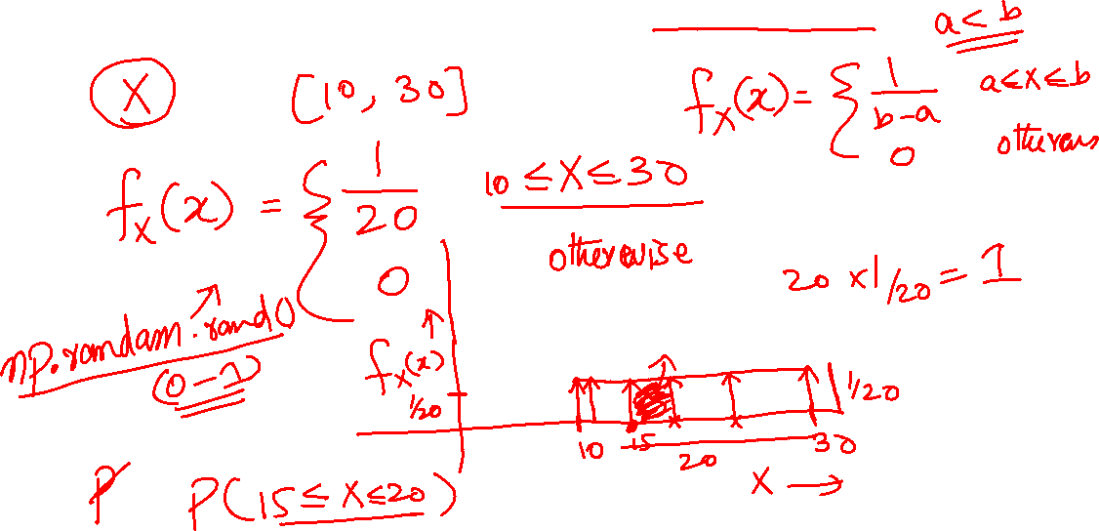
Random Variables: Uniform
Notes:
72

Slide 73
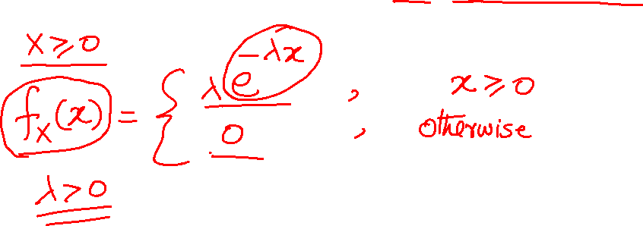
Random Variables: Exponential
Notes:
73

Slide 74
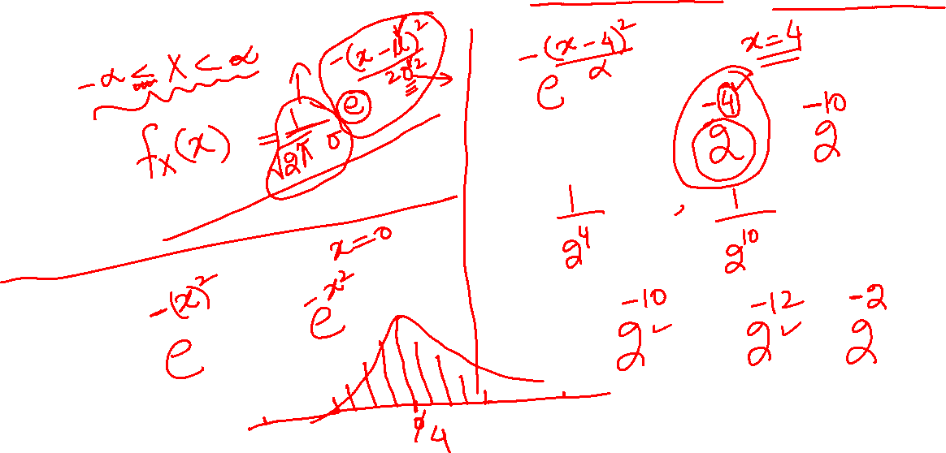
Random Variables: Gaussian/Normal
Notes:
74

Slide 75
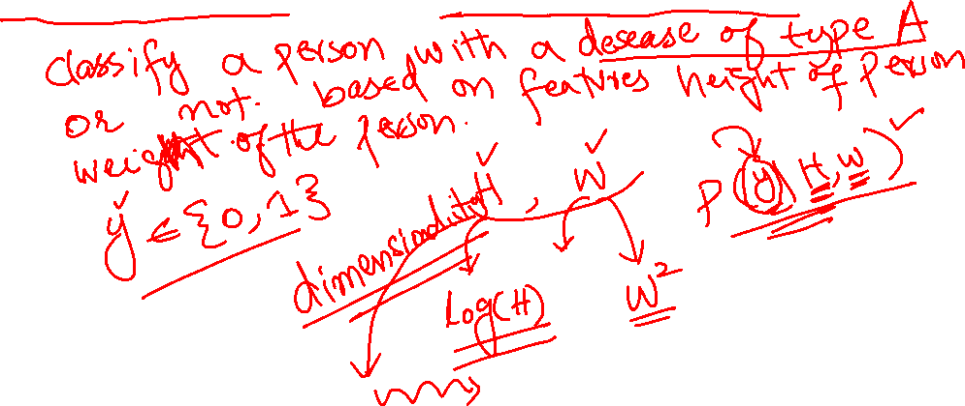
Random Variables
Transformation of a random variable
Notes:
75

Slide 76
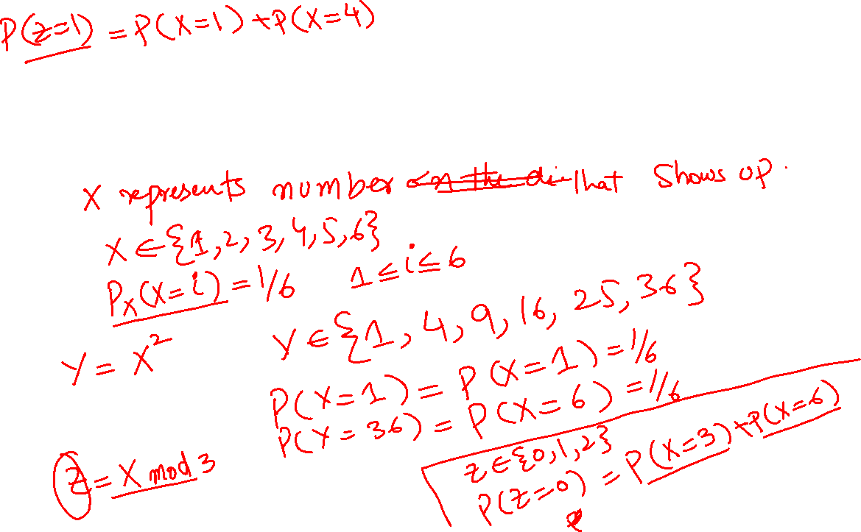
Random Variables
Transformation of a random variable
Notes:
76

Slide 77
Home Work
What is a Cumulative Distribution Function (CDF)?
Notes:
77

Slide 78
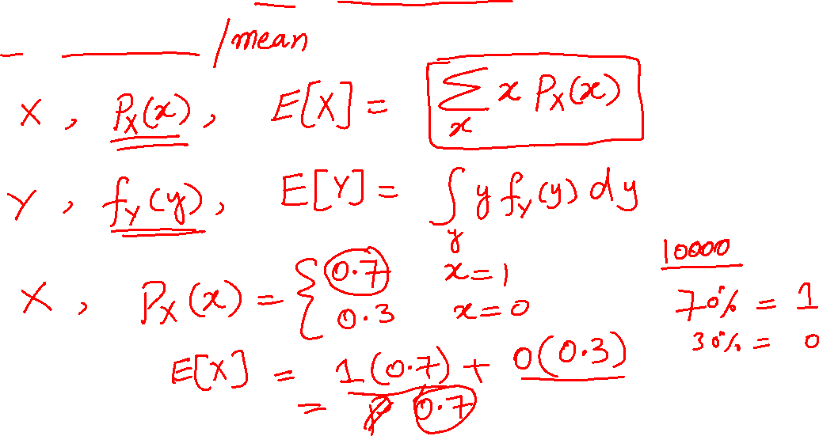
Expectation
Expectation
Notes:
78

Slide 79
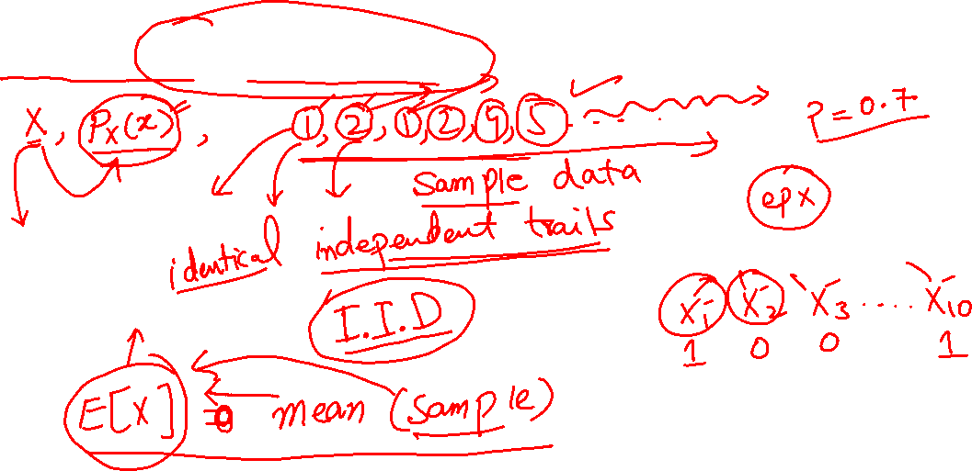
Expectation
Law of Large Numbers
Notes:
79

Slide 80
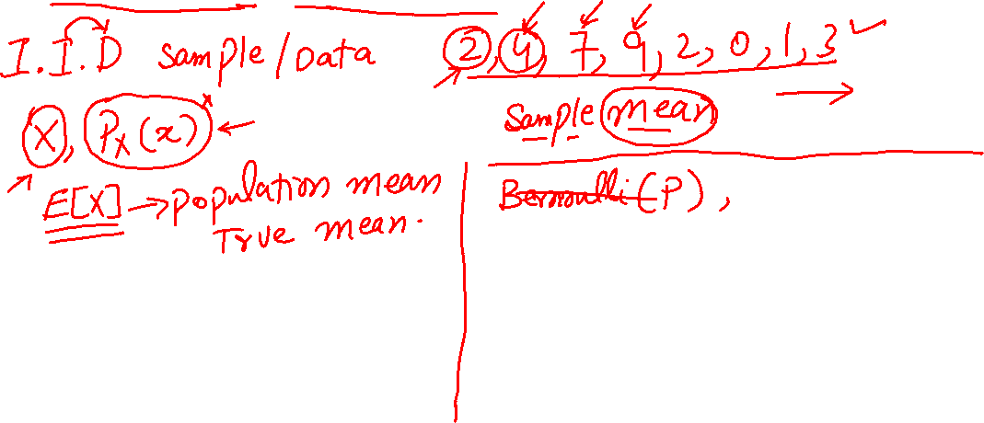
Expectation
Law of Large Numbers
Notes:
80

Slide 81
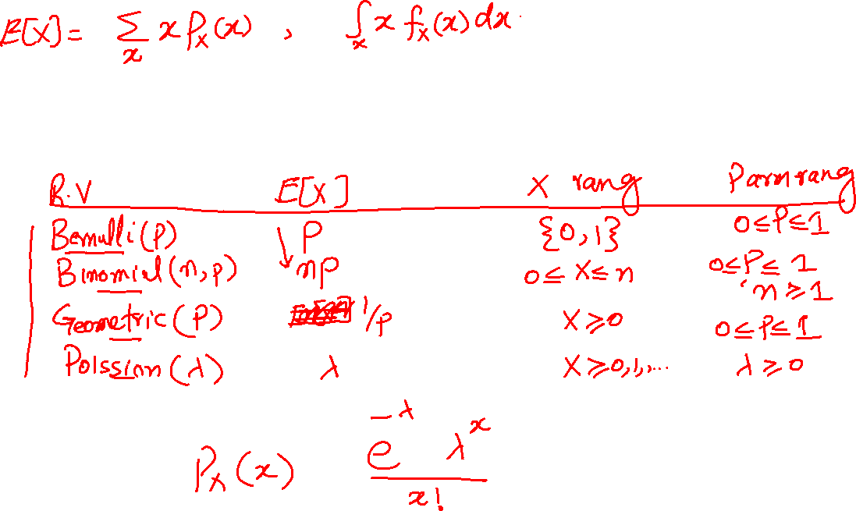
Expectation
Law of Large Numbers
Notes:
81

Slide 82

Expectation
Law of Large Numbers
Notes:
82

Slide 83

Expectation
Transformation of a random variable
Notes:
83

Slide 84


Expectation
Moments and Variance
Notes:
84

Slide 85

Home Work
Let say you roll a 4 sided die 3 times and the random variable you are interested in is the max roll. If the PMF is uniform, find out the expected value, variance and 4th moment of the random variable.
Notes:
85

Slide 86

Project: Bayes Classifier
Notes:
86

Slide 87

Multiple Random Variables
Joint Distribution
Notes:
87

Slide 88

Multiple Random Variables
Joint Distribution
Notes:
88

Slide 89

Multiple Random Variables
Multivariate Gaussian
Notes:
89

Slide 90

Multiple Random Variables
Conditioning random variables
Notes:
90

Slide 91

Multiple Random Variables
Independence of random variables
Notes:
91

Slide 92

Multiple Random Variables
Classification
Notes:
92

Slide 93

Multiple Random Variables
Naïve Bayes classifier
Notes:
93

Slide 94

Multiple Random Variables
Regression
Notes:
94

Slide 95


Curse of Dimensionality
Notes:
95

Slide 96

Home Work
Implement a naïve Bayes classifier in python using iris data from seaborn. Report your classification results
Notes:
96

Slide 97

Estimation
What is a parametric distribution?
Notes:
97

Slide 98

Estimation
Maximum Likelihood Estimate (MLE)
Notes:
98

Slide 99

Estimation
MLE: Log Likelihood
Notes:
99

Slide 100

Estimation
Maximum A Posterior Estimate (MAP)
Notes:
100

Slide 101


Logistic Regression
MLE on Bernoulli random variables
Notes:
101

Slide 102

Ridge Regression
MAP estimate
Notes:
102

Slide 103


Deep Neural Networks
$$p(y|X)$$
Notes:
103

