Slide 1
Sets Home Work
What are the collections that have ordered elements?

Slide 2
Sets Home Work
What are the collections that have ordered elements?
Write a Python function that decides weather a given list of sets forms a partition of a set or not

Slide 3
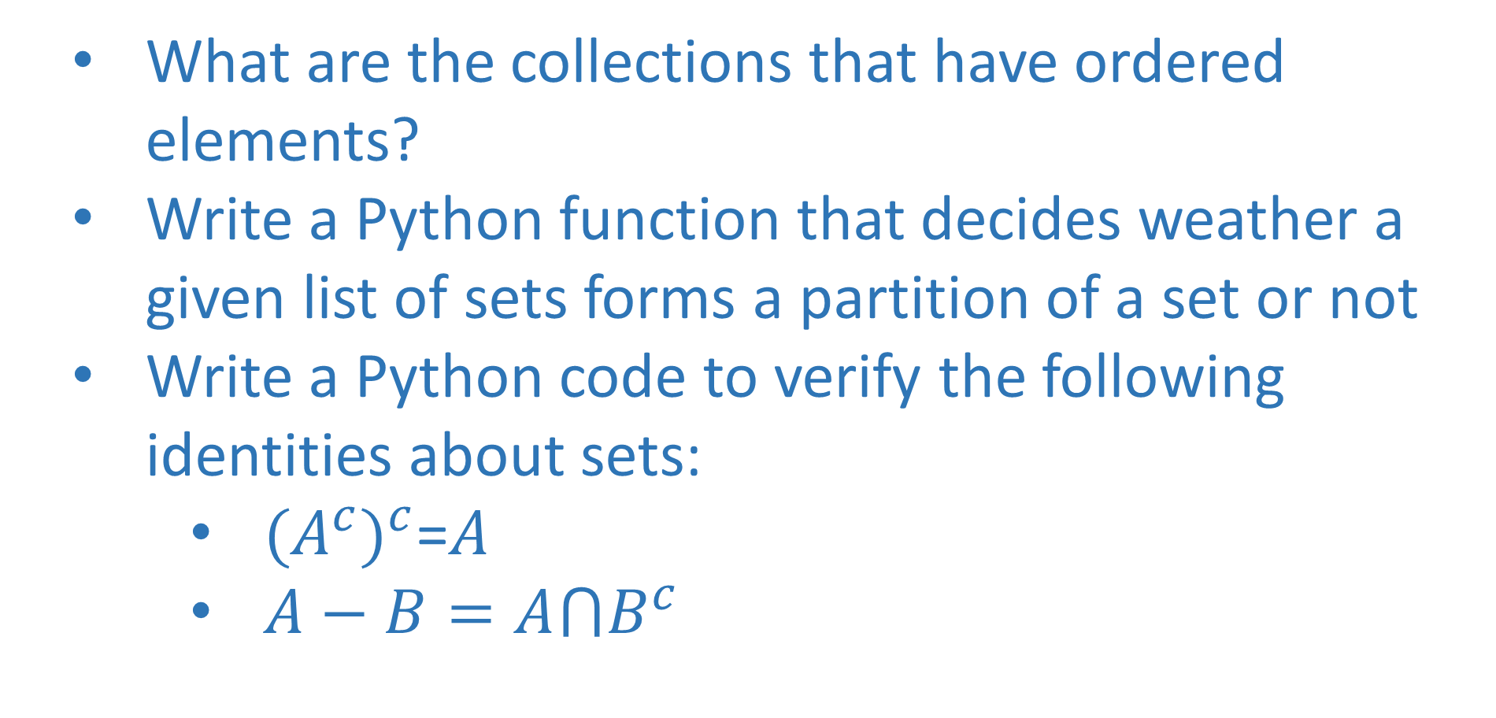
Sets Home Work
What are the collections that have ordered elements?
Write a Python function that decides weather a given list of sets forms a partition of a set or not
Write a Python code to verify the following identities about sets:
${(A^{c})}^{c}$=$A$
$A−B=A⋂B^{c}$

