Slide 1
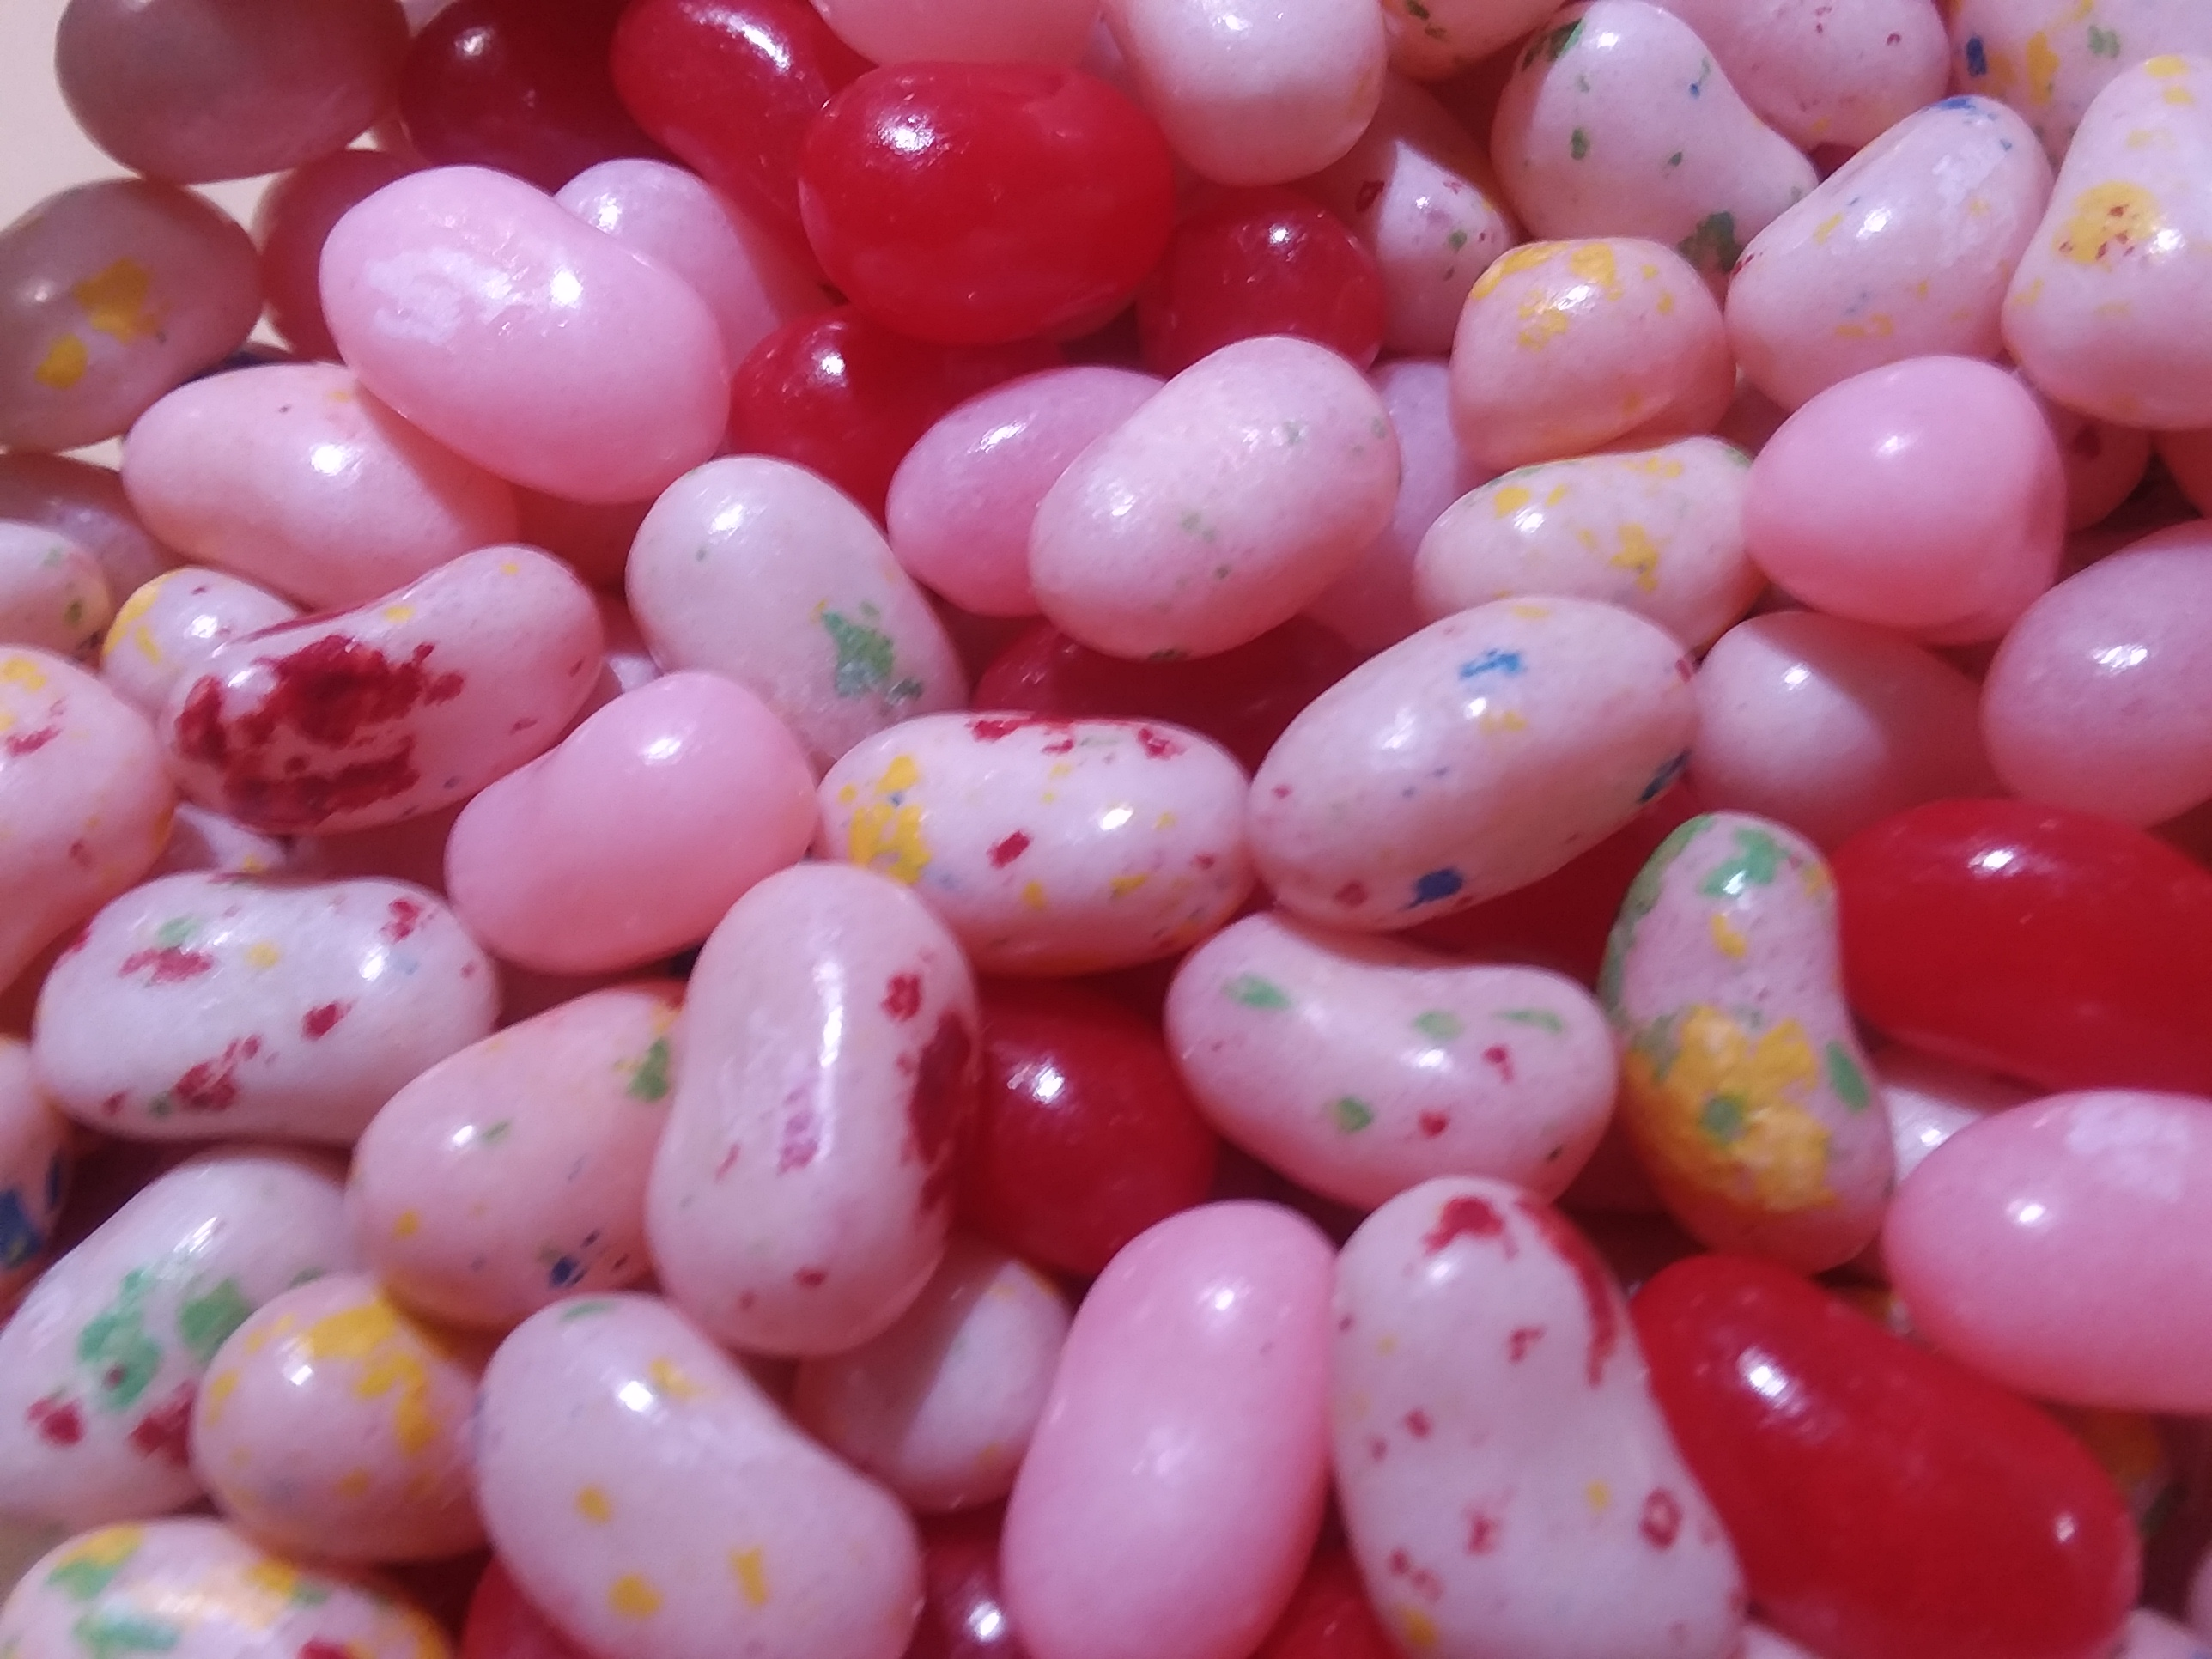
The DNA of Candy

