Slide 1
Salesforce AI Associate exam Prep Course
Deepika Khanna
Mytutorialrack.com

Slide 2
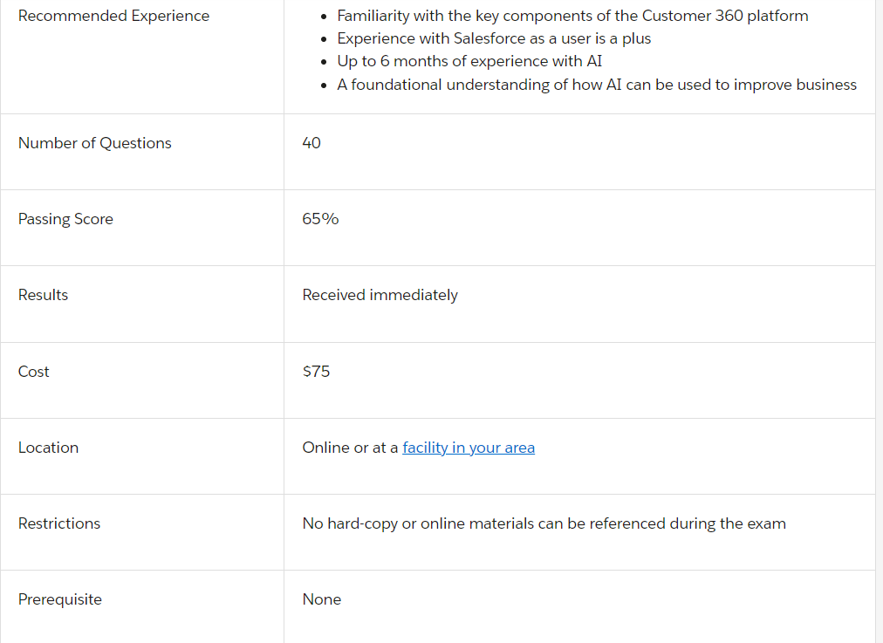
About the exam

Slide 3
Prerequisite
No prior certification is needed before taking the exam but salesforce recommends to Salesforce Certified Associate exam.

Slide 4
Topics and the weightage
AI Fundamentals: 17% of exam
AI Capabilities in CRM: 8% of exam
Ethical Considerations of AI: 39% of exam
Data for AI: 36% of exam

Slide 5
AI FUNDAMENTALS
What is AI ? (Artificial Intelligence).
Each of us have different capabilities. We are excellent at something and might not be good at other things.
There are specific kinds of AI that are good at specific kinds of tasks

Slide 6
Main types of AI Capabilities
Right now, there’s no singular AI that’s good at everything. That idea, known as general AI, is still far into the future. Instead, over the years scientist have developed several specialized AI systems that are designed to perform specific tasks. The kinds of tasks they do generally fall into one of a few broader categories.
Numeric Predictions
Classifications
Robotic Navigation
Language Processing

Slide 7
Numeric Prediction
Is this customer likely to renew their subscription?
Are you at risk for a medical condition?
Will there be high demand on the power grid this evening?
Your business wants to predict next quarter’s sales?
the Airline tickets, hotel room, ridesharing, and travelers' insurance are all likely to be priced by AI to perfectly balance supply and demand.

Slide 8
Classifications
Is this plant edible or poisonous?
Is that email legitimate or a phishing attempt?
Financial institutions need to flag fraudulent transactions
Medical professionals must diagnose illnesses
Social media platforms want to identify toxic comments
AI can effectively make the first pass at classifying, and then the professionals can take it from there.

Slide 9
Robotic Navigation
AI that can adapt to changing environmental conditions have all sorts of real-world applications.
AI-powered cars are already quite capable of keeping centered in a lane and following at a safe distance on the highway.
Even the modest robot floor sweeper can avoid stairs and chairs.
Assembly lines are being fitted with robots that become faster and more efficient over time.
Rescue robots that can traverse disaster areas, such as a collapsed building.
A robot-caterpillar that can squeeze through tiny cracks could deliver aid and hope to those trapped inside.

Slide 10
Natural Language Processing
ChatGPT is one of the most capable AIs built to interpret everyday language and act on it in some meaningful way. This is known in the industry as natural language processing, or just NLP.
Alexa is another AI which understands human language and give you answer accordingly.
Natural language processing relies on an understanding of how words are used together, and that lets AI extract the intention behind the words.

Slide 11
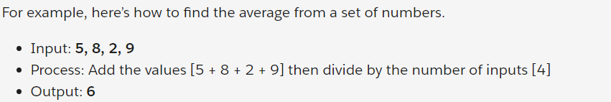
How its all done? The Trick Behind the Magic
What AI can do may seem like magic. And like magic, it’s natural to want a peek behind the curtain to see how it’s all done. What you’ll find is that computer scientists and researchers are using lots of data, math, and processing power in place of mirrors and misdirection.
For decades, programmers have written code that takes an input, processes it using a set of rules, and returns an output.

Slide 12
Algorithm
This simple set of rules for turning an input into an output is an example of an algorithm. Algorithms have been written to perform some pretty sophisticated tasks. But some tasks have so many rules (and exceptions) that it’s impossible to capture them all in a hand-crafted algorithm.
Some things are learned best by experience.

Slide 13
How to train your AI?
Experience Required: Imagine you are going for grocery, and you are estimating the total time. How will you predict?
Is it the weekend?
Time of day
Is it raining or not?
Distance to store
Total minutes of trip
After several trips you start getting a feel for how conditions affect how long it’ll take. Like, rain makes the drive longer, but it also means fewer people are shopping. Your brain makes connections between the inputs (weekend [W], time [T], raining [R], distance [D]) and the output (minutes [M]).

Slide 14
How AI works?
Step 1: Assign all of your inputs a “weight.” This is a number that represents how strongly an input should affect the output. It’s OK to start with the same weight for everything.
Step 2: Use the weights with your existing data (and some clever math we won’t get into here) to estimate the minutes for a milk run. We can compare the estimate to the historic data. It’ll be way off, but that’s OK.
Step 3: Let the computer guess a new weight for each input, making some a little more important than others. For example, the time of day might be more important than whether or not it’s raining.
Step 4: Rerun the calculations to check if the new weights result in a better estimate. If so, it means the weights are a better fit, and changing in the right direction.
Step 5: Repeat steps 3 and 4, letting the computer tweak weights until its estimates aren’t getting any better.
At this point the computer has settled on weights for each input. If you think of weight as how strongly an input is connected to the output, you can make a diagram that uses line-thickness to represent the weight of a connection.

Slide 15
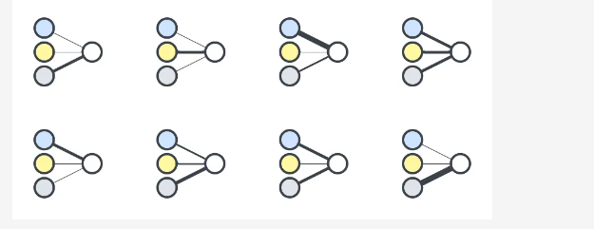
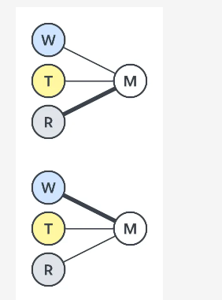
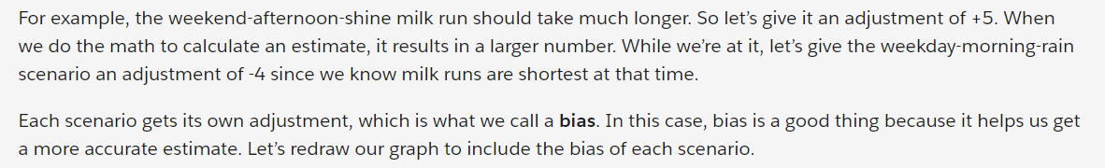
The Need for Neural Networks
We can train an AI model by letting it guess-and-check the importance-weight of each input. For e.g. Grocery Example.

Slide 16
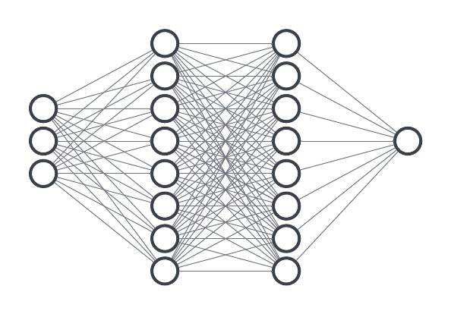
What is a Neural Network??
The web of connections, guided by weights and biases, is an example of a neural network.
Each of the scenario is called a node.
To summarize, neural networks are a mix of
nodes, layers, weights, biases, and a bunch of math. Together they mimic our own organic neural networks.
Each neural network is carefully tuned for a specific task. Maybe it’s great at predicting rain, maybe it categorizes plants, or maybe it keeps your car centered in the lane on the highway. Whatever the task, neural networks are a big part of what makes AI seem magical.

Slide 17
Types of Data
machine learning (ML), is the process of using large amounts of data to train a model to make predictions, instead of handcrafting an algorithm.
Types of Data:
Structured Data : It is well organized, with labels on every column so you know the significance of every cell. For example, spreadsheets.
Unstructured Data : unstructured data would be something like a news article, or an unlabeled image file. For e.g. Email
Input + Previous Data + Weightage = Desired Outcome ➔ AI Model.

Slide 18
Types of learning based on Data :
Supervised Learning: the structured data from our spreadsheet lets computers do supervised learning. It’s considered supervised because we can make sure every piece of input data has a matching, expected output that we can verify.
Unsupervised Learning : unstructured data is used for unsupervised learning, which is when AI tries to find connections in the data without really knowing what it’s looking . In this case, it can establish patterns. It will identify the pattern and club them together.
Grouping / Clustering : For e.g. If lot of people are leaving services of a telephone company. It will find the people who are leaving, what is the trait of the people, what is the pattern of the people leaving, what is the common factor in each of these people and will determine the answer.
Association: Similar type of items. Milk + Butter + Bread + Eggs . Shoes + Socks

Slide 19
What all AI Can do?
yes-and-no predictions
Numeric Predictions
Classifications
Recommendations
Workflow and Rules
Summarization

Slide 20
Yes-and-No Predictions and Answers
“Is this a good lead for my business?” or “Will this prospect open my email?” AI helps you answer these questions by analyzing historical data you’ve stored in your system.
Yes-and-no predictions generally come in the form of a probability (for example, “Mary Smith has a 67% chance of opening this type of email).
probabilities are converted into scores. Scores are just a different representation of the likelihood of “yes”

Slide 21
Numeric Predictions
Numeric predictions often power predictive forecasting solutions (for example, “How much revenue will this new customer bring in?”).
How many days will it take us to resolve this customer’s issue?”.
Numeric predictions also use your historical data to arrive at these numbers.

Slide 22
Classifications
Classifications frequently use “deep learning” capabilities to operate on unstructured data like free text or images.
classification is used to extract useful information from unstructured data.
How many soda cans are in this picture?
“I’d like to buy another pair of the same shoes I bought last time,”
Clustering: This type of AI ingredient gathers insights from your data that you may not otherwise have noticed. For example, if you are a clothing vendor, AI might learn that both rural older men and urban twentysomethings like to buy a certain type of sweater. Where your intuition might tell you that these are two totally different groups, the data shows they behave similarly with respect to the products they buy, and you may want to market to those two groups in a similar way.

Slide 23
Recommendations
Recommendations are key when you have a large set of items that you’d like to recommend to users.
Many ecommerce websites apply recommendation strategies to products; they can detect that people who bought a specific pair of shoes also often order a certain pair of socks. When a user puts those shoes in their cart, AI automatically recommends the same socks.

Slide 24
Workflow and Rules
Workflow and rules aren’t technically part of AI, but they’re an essential part of how AI is used.
Let’s say that AI predicts a given customer has a 25% likelihood of not renewing their contract. Just knowing this is not enough—you need to do something about it. That’s where workflow and rules come into play. In this example, your workflow might mean kicking off a retention campaign when the AI predicts that a customer is unlikely to renew

Slide 25
Summarization
Summarization plays a huge role in how gen AI works. Imagine you have hours worth of recordings to listen to or you need to read a 10 page paper on Salesforce values. Gen AI helps summarize chunks of information into quick and easy to digest notes for you. Instead of taking hours to review recordings or notes, Einstein summarizes the most important information and retains its value so you can stay in the loop without spending long hours on a subject.

Slide 26
Types of AI
Generative AI
Predictive AI
Generative AI creates content, code, music and marketing material and can translate data into different formats.
Generative AI focuses on creating new and original content, such as images, text and other media, by learning from existing data patterns. It fosters creativity and is valuable in creative fields and novel problem-solving.
Predictive AI makes predictions, recommendations and decisions using various AI and machine learning (ML) techniques.
Predictive AI uses patterns in historical data to forecast future outcomes or classify future events. It provides actionable insights and aids in decision-making and strategy formulation.

Slide 27
Risks with Artificial Intelligence
Sustainability: Achieving Zero carbon Footprint will not be possible. As model gets bigger and so their carbon footprint will also increase.
Hallucination: Your machine can be biased. If your data is biased and that will result in biased output. Its away from facts. If the data that you are feeding to your AI model is biased, it will lead to biased output. Hallucination will be there because of biased data.

Slide 28
Risks with Artificial Intelligence
Lack of Transparency : When people can’t comprehend how an AI system arrives at its conclusions, it can lead to distrust and resistance to adopting these technologies.
Bias and Discrimination : AI systems can amplify societal biases due to biased training data or algorithmic design. To minimize discrimination and ensure fairness, it is crucial to invest in the development of unbiased algorithms and diverse training data sets.
Privacy Concerns : AI technologies often collect and analyze large amounts of personal data, raising issues related to data privacy and security. To mitigate privacy risks, we must advocate for strict data protection regulations and safe data handling practices.
User Spoofing : Chatbots. AI generated calls. It feels like you are talking to a real person.

Slide 29
Risks with Artificial Intelligence
Security Risks : As AI technologies become increasingly sophisticated, the security risks associated with their use and the potential for misuse also increase. Hackers and malicious actors can harness the power of AI to develop more advanced cyberattacks, bypass security measures, and exploit vulnerabilities in systems.
Dependence on AI : Overreliance on AI systems may lead to a loss of creativity, critical thinking skills, and human intuition. Striking a balance between AI-assisted decision-making and human input is vital to preserving our cognitive abilities.
Loss of Human Connection: Increasing reliance on AI-driven communication and interactions could lead to diminished empathy, social skills, and human connections.

Slide 30
Salesforce’s Trusted AI Principles
Responsible
Salesforce strive to safeguard human rights, to protect the data we are trusted with, observe scientific standards and enforce policies against abuse.
Accountable
We believe in holding ourselves accountable to our customers, partners, and society. We will seek independent feedback for continuous improvement of our practice and policies and work to mitigate harm to customers and consumers.
Transparent
We strive to ensure our customers understand the “why” behind each AI-driven recommendation and prediction so they can make informed decisions, identify unintended outcomes and mitigate harm.
Empowering
We believe AI is best utilized when paired with human ability, augmenting people, and enabling them to make better decisions. We aspire to create technology that empowers everyone to be more productive and drive greater impact within their organizations.
Inclusive
AI should improve the human condition and represent the values of all those impacted, not just the creators. We will advance diversity, promote equality, and foster equity through AI.

Slide 31
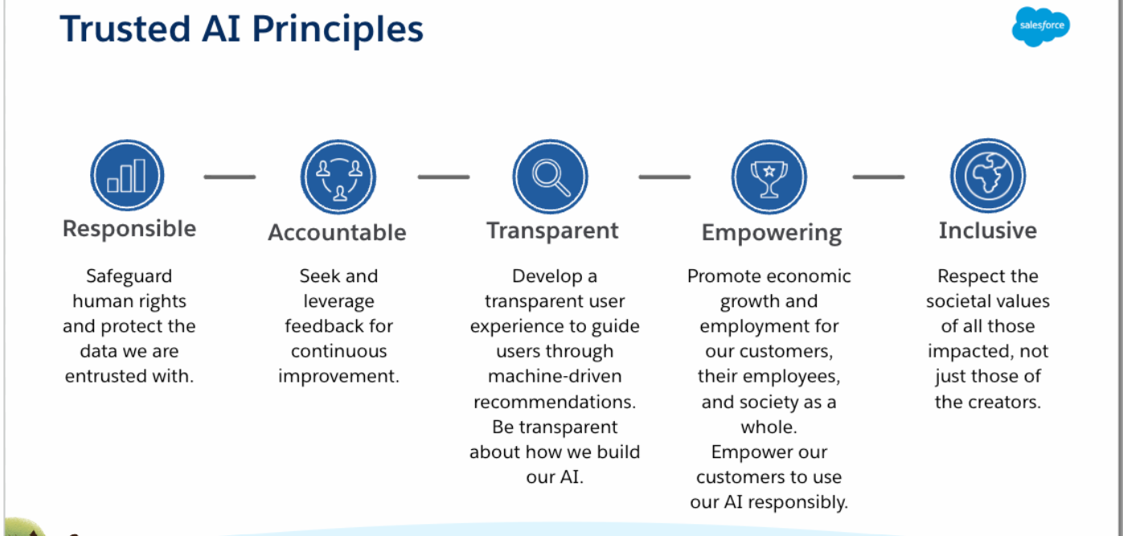
Salesforce’s Trusted AI Principles

Slide 32
Concerns Using AI
Plagiarism
Data Security
User Spoofing
Sustainability
Hallucination

Slide 33
Einstein prediction Builder
With Einstein Prediction Builder, make custom predictions about what happens next in your business without writing any code.
Sign up for prediction builder account.
Project :Einstein Prediction Builder: Predict Medical Appointment No-Shows

Slide 34
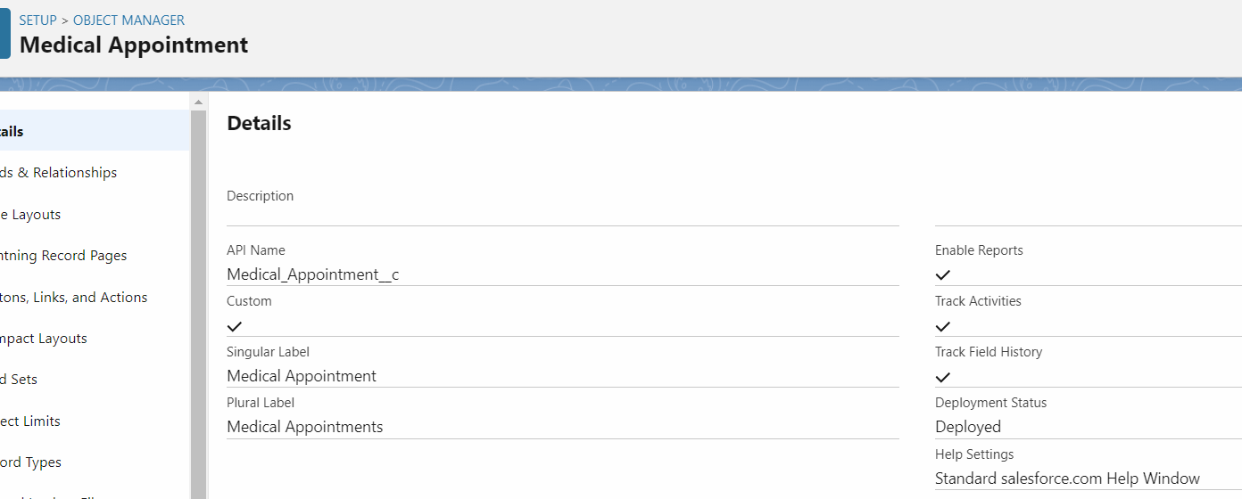
Einstein Prediction Builder: Predict Medical Appointment No-Shows
Create a custom Object : Medical Appointment

Slide 35
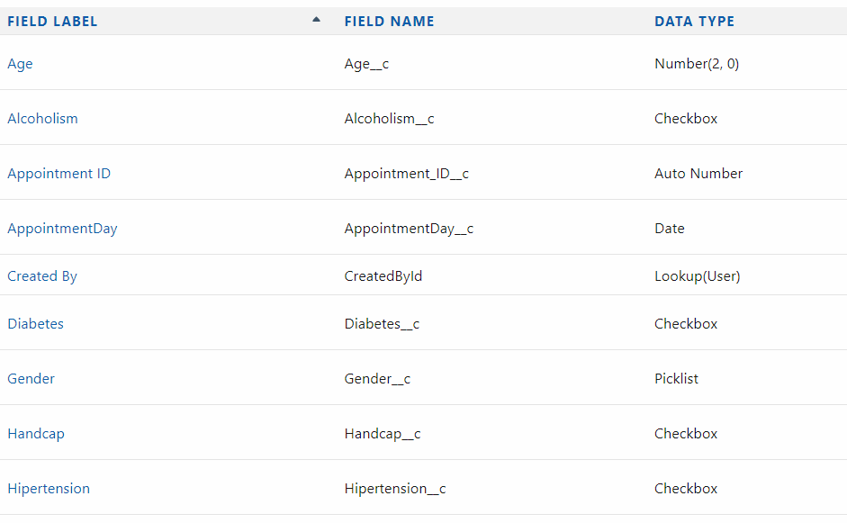
Einstein Prediction Builder: Predict Medical Appointment No-Shows
Add fields to the object

Slide 36
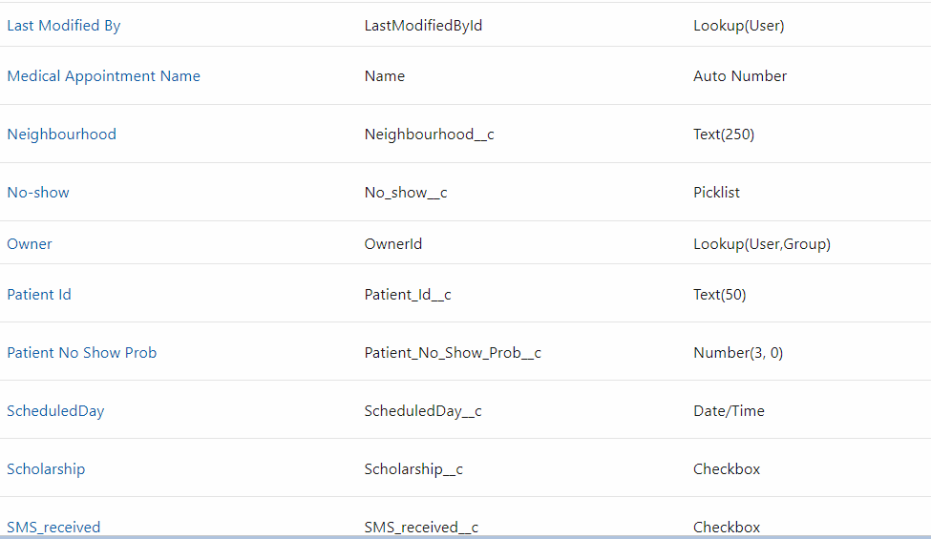
Einstein Prediction Builder: Predict Medical Appointment No-Shows
Add remaining fields to the object

Slide 37
Einstein For Developers
Quickly generate code suggestions using natural language instructions with Einstein for Developers to enhance developer productivity.
Einstein for Developers is an AI-powered developer tool that’s available as an easy-to-install Visual Studio Code.

Slide 38
Instructions
Enable Einstein For Developers
Install Visual studio code
Install Salesforce extension pack
Install Salesforce CLI
Install Einstein for Developer extension
Create a Project
Authorize the org

Slide 39
Einstein Activity Capture
Einstein Activity Capture enables you to capture the right data from Gmail and Outlook and add it to Salesforce, which is great for syncing data between these platforms.
Einstein Activity Capture connects Salesforce to Gmail or Office 365, which means that events and emails will automatically be captured and added to the correct records in Salesforce.

Slide 40
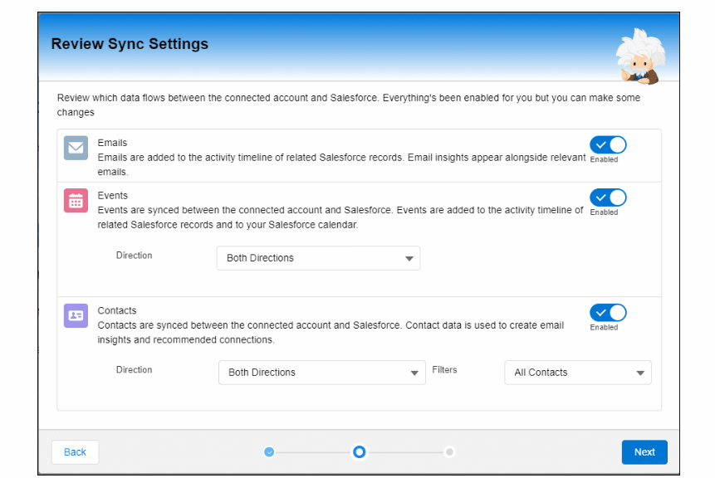
Benefits of Einstein Activity Capture
You don’t need to manually enter your email data in Salesforce
All your inbound and outbound emails will also be auto-captured and displayed in the activity timeline of related account, contact, lead, opportunity, contract, and quote records. You no longer have to transfer data manually.
You can send emails directly from Salesforce

Slide 41
How to setup Einstein Activity Capture
Assign License to the user
Assign Permission set to the user.
Get started with einstein Activity Capture
Connect your gmail with Salesforce

Slide 42
Einstein Bot
With Einstein Bots taking over the simple tasks during a chat or messaging session, your agents can focus more on complex issues or value-added activities.

Slide 43
Set Up Your First Einstein Bot
Create a new developer account.
Enable Chat. Before you can use Einstein Bots, you must enable Chat in your org
Implement Chat and/or Messaging. To use your bot, you must connect it to a Chat implementation, a Messaging channel, or both!

Slide 44
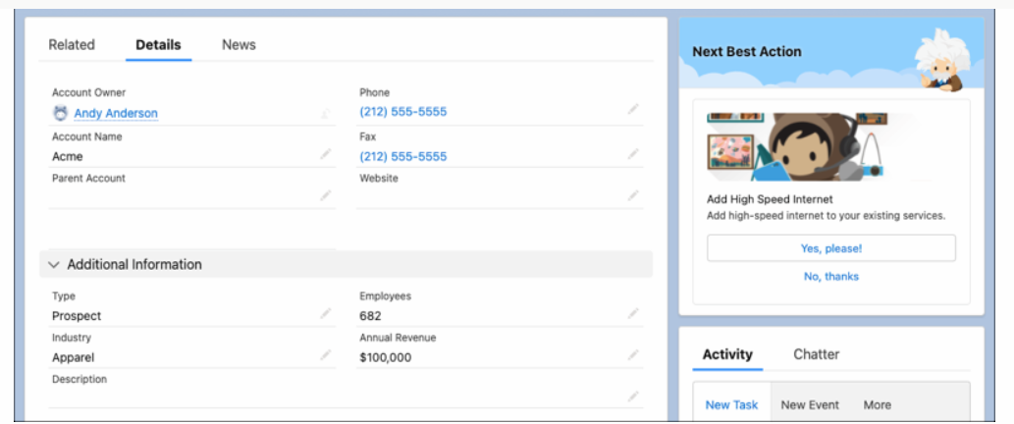
Einstein next best action
Einstein Next Best Action is a solution that uses flows, strategies, and the Recommendation object to recommend actions to users. You can display these recommendations on many different types of pages, including Lightning pages in your Salesforce org, Experience Cloud sites, or external sites

Slide 45
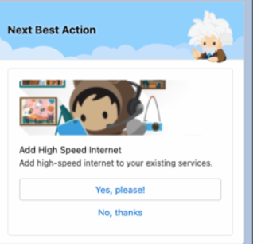
Recommendations are displayed to users with the option to accept or reject the recommended action.
Each recommendation contains an image, important text values such as button text and a description, and an assigned flow that runs when a user responds. They can be stored and referenced in the Recommendation standard object, or they can be manually assembled when building a strategy.
Strategies determine which recommendations to display to users, based on your data and business processes. When you set up Einstein Next Best Action on a page, you assign a strategy to that location, which then defines the recommendations that appear there.

Slide 46
Einstein Next Best Action
Use a Next Best Action component on the Lightning Account record page to offer a gift basket to each of your accounts. When a customer accepts the offer, a form opens to collect the recipient’s name and shipping address. After the form is submitted, a request email is sent to the shipping department.
To configure this Einstein Next Best Action recommendation:
Create an action flow that executes when the gift basket recommendation is accepted.
Create a recommendation that specifies how to present the gift basket offer.
Create a recommendation strategy flow that determines when and how the recommendation is presented.
Add a Next Best Action component that displays the recommendation on the Account record page and executes the strategy.

Slide 47
AI capabilities in CRM : 8% ( 3 Questions)

Slide 48
AI capabilities in CRM
DISCOVER insights that bring new clarity about your company’s customers.
PREDICT outcomes so your users can make decisions with confidence.
RECOMMEND the best actions to make the most out of every engagement.
AUTOMATE routine tasks so your users can focus on customer success.
GENERATE tailored content – from emails, to knowledge articles to code.

Slide 49
Einstein Discovery
Einstein Discovery Enables you to:
Identify, surface and visualize insights into your business data.
Predict future outcomes and suggest ways to improve predicted outcomes in your workflows.

Slide 50
Einstein Discovery-powered solutions address these use cases:
Regressions for numeric outcomes represented as quantitative data (measures), such as currency, counts, or any other quantity.
Binary Classification for text outcomes with only two possible results. These are typically yes or no questions that are expressed in business terms, such as churned or not churned, opportunity won or lost, employee retained or not retained etc.
Multiclass Classification for text outcomes with 3 to 10 possible results. For example, a manufacturer can predict, based on customer attributes, which of five service contracts a customer is most likely to choose.

Slide 51
Salesforce Guidelines to guide the development of trusted Generative AI
Accuracy : Deliver verifiable results that balance accuracy, precision in the models by enabling customers to train models on their own data. Communicate when there is uncertainty about the veracity of the Ai’s response and enable users to validate these responses.
Safety: Make every effort to mitigate bias, toxicity and harmful output by conducting unbiased, and robust assessments.
Honesty: When collecting data to train and evaluate out models, we need to respect data provenance and ensure that we have consent to use data.
Empowerment: Identify the appropriate balance to “supercharge” human capabilities and make these solutions accessible to all.
Sustainability : Developer right –sized models wherever possible to reduce carbon footprint.

Slide 52
Data For AI (36%) 14 questions

Slide 53
Factors that determine Data Quality
Missing records
Duplicate records
No Data standards
Incomplete records
Stale data

Slide 54
Bad Data results in:
Lost revenue
Missing or inaccurate insights
Wasted time and resources
Inefficiency
Slow info retrieval
Poor customer service
Reputational damage
Decreased adoption by reps

Slide 55
Good data benefits :
Prospect and target new customers
Identify cross-sell and upsell opportunities
Gain account insights
Increase efficiency
Retrieve the right info fast
Build trust with customers
Increase adoption by reps
Plan and align territories better
Score and route leads faster

Slide 56
Data Quality Dimensions
Age – what was the last time each records was updated?
Completeness - Are all key business fields on records are filled in?
Accuracy – Has it been matched against a trusted source?
Consistency – is the same formatting, spelling and language used across records?
Duplication – Are records and data duplicated in your org ?
Usage – Is your data being harnessed in reports, dashboards and apps ?

Slide 57
Standards for creating, processing and maintaining data
Formatting – Figure out how dates and money are represented.
Workflow - Determine processes for record creation, reviewing, updating and archiving. Determine all the stages a record goes through during its life cycle.
Quality – Set appropriate standards for data quality.
Roles and Ownership – Determine the appropriate levels of privacy for data. Make sure to comply with regulatory, legal and contractual obligations.
Monitoring – Outline a process for ensuring quality control of data.

Slide 58
Steps to clean your data to make it AI ready
Remove duplicate or irrelevant observations – Duplications happens when you combine data sets from multiple places and duplicate entries are created.
Fix Structural errors: This happens when data includes typos, incorrect capitalization or mislabeling.
Filter unwanted outliers – There are often one-off observations that don’t appear to align with the data you are analyzing. That might be the result of incorrect data entry.
Handle missing data – Eliminate observations that include missing values, input missing values based on other observations or consider altering the way the data is used to effectively navigate the missing values.
Validate – Does the data make sense, does the data follow the appropriate rules for its field?

Slide 59
Data Management Best Practices
Build a Data Management Strategy – A clear data strategy helps keep your organization on track. It’s a great way to align your team on how data will be collected, reviewed and used to drive your business goals.
Improve data quality – Tracking, reporting and the effectiveness of your Salesforce deployment depend on getting clean data.
Import Data – Bring your existing data into Salesforce so you can include past records in your tracking and reporting.
Maintain and Clean Up Data – Remove duplicates.

Slide 60
Salesforce AI Associate Exam Preparation Course
Cover all the topics from the exam perspective
Practice tests are included with the course
Quizzes are added

Slide 61
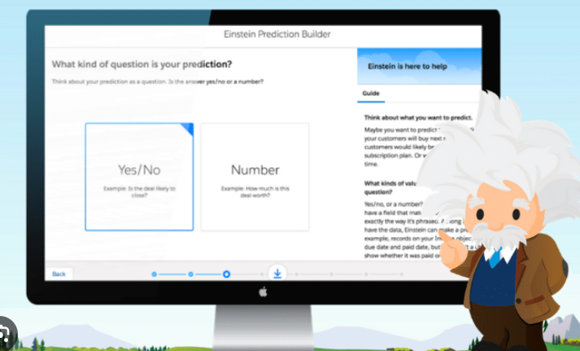
What else is included in the course ?
Einstein Prediction Builder

Slide 62
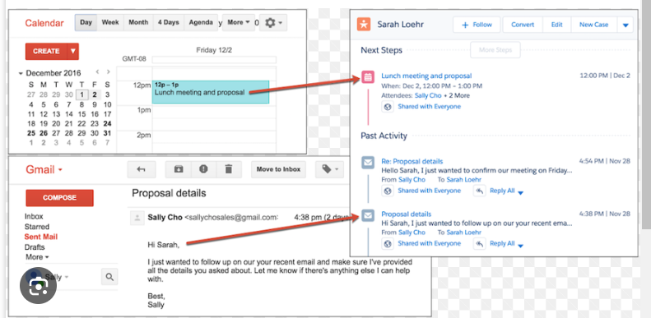
Einstein Activity Capture

Slide 63
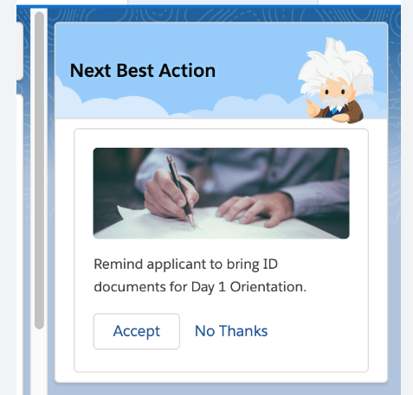
Einstein Next Best Action

Slide 64
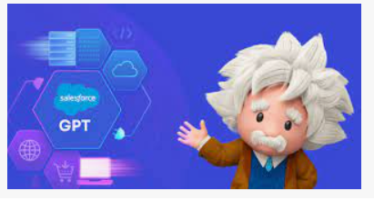
Einstein For Developers

Slide 65
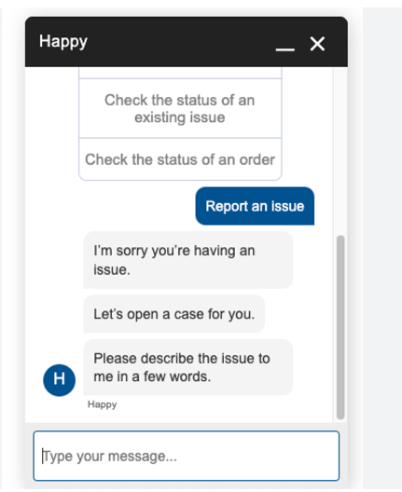
Einstein Bot

Slide 66
See You inside the course

