Slide 1
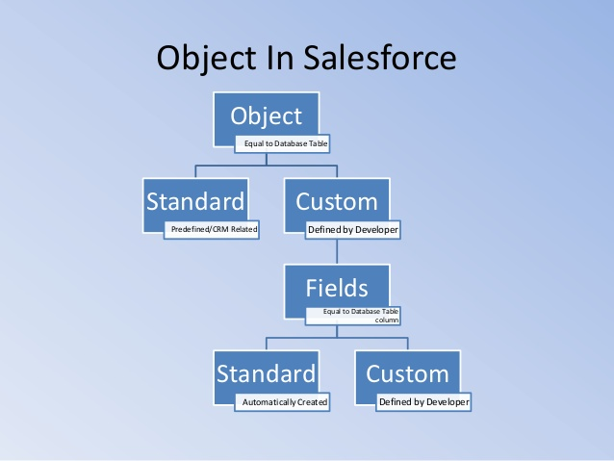
What is object in Sales force?
Custom objects are database tables that allow you to store data specific to your organization in salesforce.com.
You can use custom objects to extend salesforce.com functionality or to build new application functionality.

