Slide 1
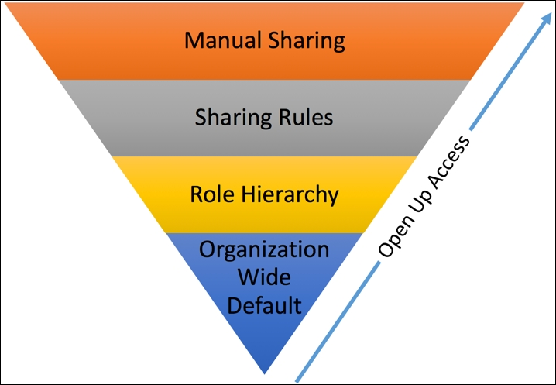
Secure organization data using OWD
John is the system administrator at Universal Containers.
As per the business requirement, he wants to set the security setting for the lead object so that the user who has created or owns the lead records, as well as users that are higher in the role hierarchy, can access the records. What you will do??
OWD for lead will be set to Private

