Slide 1




Tableau Masterclass
By Ben Butters

Slide 2
About The Course
Course structure:
Module | Name
1 | Connecting to & Preparing Data
2 | Important Tableau Concepts
3 | Visualisation Building & Analysing Data
4 | Functions & Calculations
5 | Dashboard Building & Sharing Insights
6 | Publish & Manage Content on Tableau Cloud
7 | Tableau Prep
8 | Exam
9 | Bonus Content

Slide 3
Module 1
Connecting to & Preparing Data

Slide 4
Connecting to Data Sources
Before building visualisations, we must connect to data.
We need to understand the different data sources we can connect to.

Slide 5


Live Connections Vs Extracts
Understanding the differences between live connections and extracts is vital.
Live Connections:
Real time data
Tableau relies on the database for all queries.
Extracts:
Snapshots of data saved in memory.
Tend to be much faster than live connections.
Must refresh the extract to retrieve the latest data.

Slide 6
Connecting to .hyper Files
Connecting to .hyper files as a data source allows you to use an already taken extract as a data source for a new project.
Please see the lecture for a detailed walkthrough and explanation.

Slide 7
Custom SQL Queries
Custom SQL queries can be used to pull data from a database into a Tableau data source.
The benefits of this can be increased performance when minimizing the amount of data we pull from the table, rather than pulling the full table.
Please see the lecture for a detailed walkthrough and explanation.

Slide 8
Multiple Connection Data Sources
It is possible to create data sources within Tableau that include data from two separate sources, whilst keeping everything within the one Tableau data source.
This feature can be utilised to enhance your analysis by joining together datasets from different places.
Please see the lecture for a detailed walkthrough and explanation.

Slide 9
Joins & Relationships
A join combines two data sets together into one table.
A relationships acts like a join however keeps the tables separate.
Relationships are created in the logical layer and joins are created in the physical layer.
Join Disadvantages:
Joins are static.
May result in losing data.
Can result in poor performance.

Slide 10
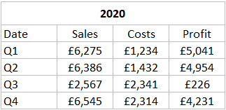
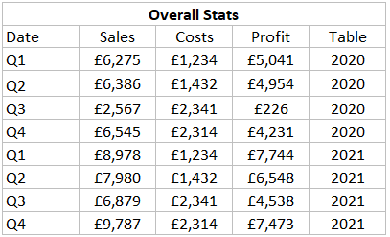
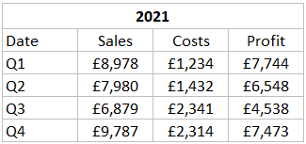
Unions
Unions are another method of combining two or more tables together. This is achieved by appending rows from one table to another. This can only be successful when the tables contain the same columns.

Slide 11
Data Blending
Data blending is another method of combining data sets from different sources without the need for traditional joins or relationships.
Benefits:
Allow you to combine data without altering original dataset.
Easy to implement.
Useful when needing to combine data from different databases.
When to Use Data Blending:
When performance is crucial, data blending may be better than using a traditional join.

Slide 12
Changing Field Names
We might want to change field names for many reasons, but the most likely is to make sure the field names accurately represent the data that field holds.
Please see the lecture for a detailed walkthrough and explanation.

Slide 13
Assigning Aliases
An alias in Tableau is a word or series of words that you use to represent a data value.
Aliases can be used for many reasons such as:
Assigning more appropriate and clear value names
Shortening value names that are too long.

Slide 14
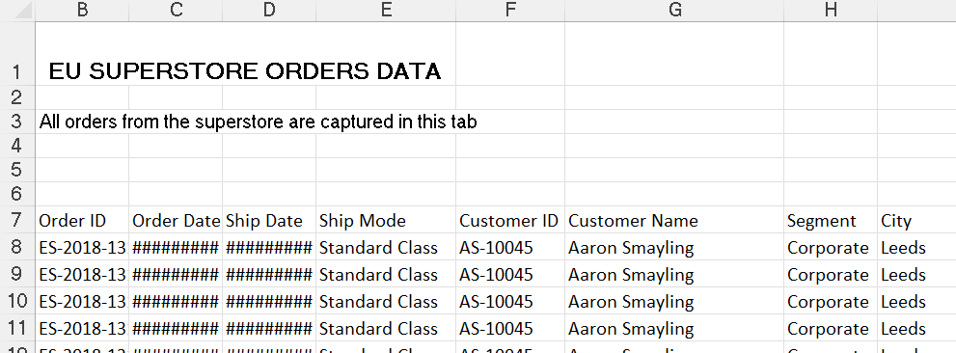
Data Interpreter
The data interpreter is a powerful feature in Tableau that automatically cleans up messy excel, CSV, and PDF files and google sheets.
If the data source that is being connected to holds data that does not conform to the tabular format in which our data needs to be, the interpreter can be used to clean it.

Slide 15
Pivoting
Pivoting is a type of data transformation in which we can shape our data into its best possible state to be ready for analysis. This involves restructuring our data from a wide format to a long format or the other way around.
Pivots are used when the data we are working with has been stored in an inefficient way, and we need to change it to support our analysis.
See the lecture for a detailed explanation and walkthrough of performing a pivot.

Slide 16
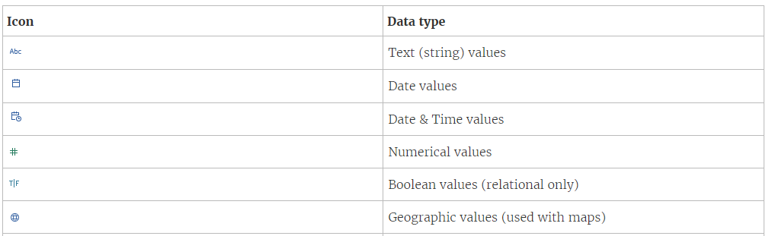
Changing Data Types
Being able to change data types is crucial in data preparation. To do this successfully we need to understand the different data types that exist.

Slide 17
Changing Default Properties
Changing the default properties of our data fields alters the way in which they are presented when used in visualisations.
Changing default properties allows to set our preferences up front saving us time by not having to format the field every time it is used within a worksheet.
The default properties that we can change are dependent on the data type of the field.

Slide 18
Module 2
Important Tableau Concepts

Slide 19
Dimensions & Measures
A value inside a dimension is not dependant on a measure, whereas the value of the measure is dependent on the dimension.
When you drag a dimension onto rows or columns in a view it creates headers, whereas if you drag a measure into rows or columns it creates an axis.

Slide 20
Discrete & Continuous
Another way in which tableau splits fields that has a significant impact on the visualisation that we are trying to build is whether the field is discrete or continuous.
A discrete field can be identified by a blue pill and continuous by a green pill.
Continuous looks at the full range whereas discrete looks at the unique values.
See the lecture for a detailed explanation and walkthrough.

Slide 21
Default Aggregation
When you use a measure in a view Tableau automatically makes the aggregation a SUM.
See the lecture for a detailed explanation and walkthrough.

Slide 22
Module 3
Visualisation Building & Analysing Data

Slide 23
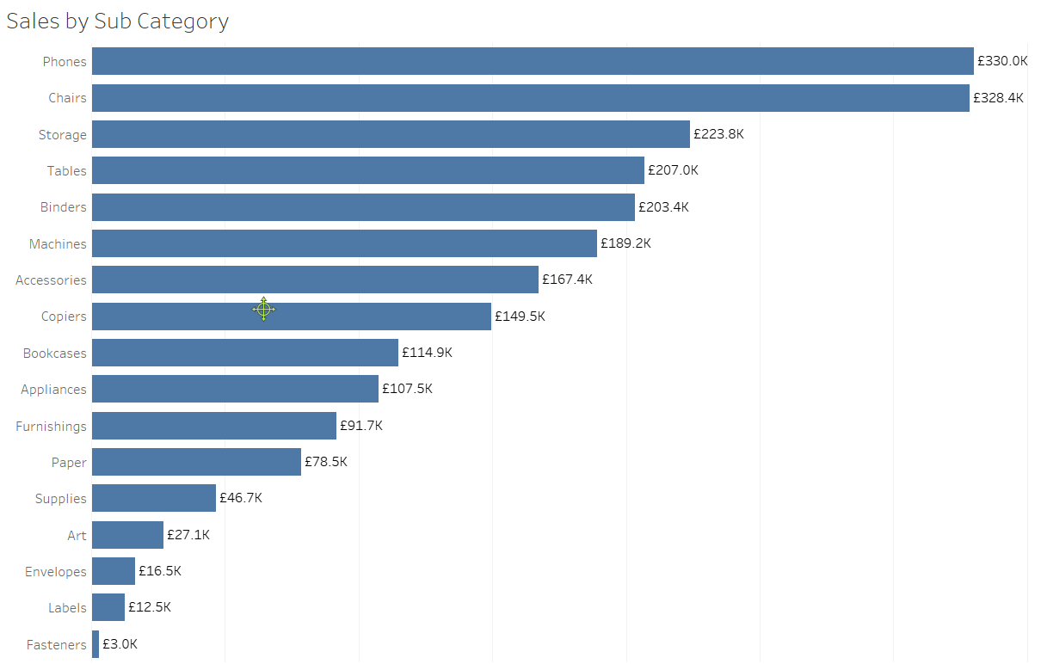
Bar Charts
Bar charts are one of the most popular and effective charts that you can use.
Bar charts allow us to easily compare a measure over different categorical data values.
See the lecture for a detailed explanation and walkthrough.

Slide 24
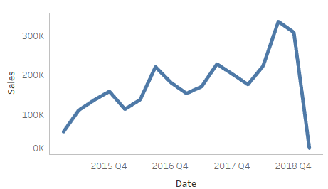
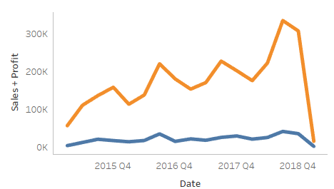
Line Charts
Line charts are used when we want to visualise a measure over time to see how that measure changes from point to point.
To create a line chart, we need a measure and a date field.
We can create a line chart with multiple measures as seen from the images on the left.
See the lecture for a detailed explanation and walkthrough.

Slide 25
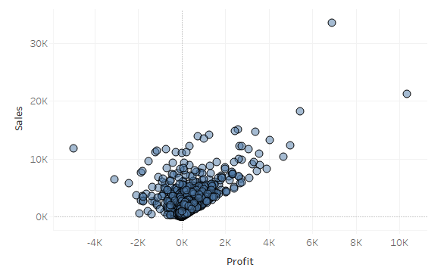
Scatterplots
Scatterplots are used when we want to show the relationship between two things to understand if a relationship exists.
To create a scatterplot, we need two measures and a dimension.
See the lecture for a detailed explanation and walkthrough.

Slide 26
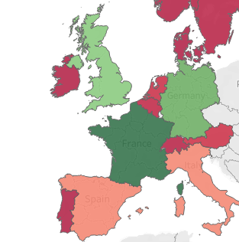
Maps
Maps provide an effective and intuitive way to represent geographical data.
Everyone is familiar with maps which helps users understand where things are located.
Maps allow users to see geographical relationships that might not be obvious when visualised in other ways.
See the lecture for a detailed explanation and walkthrough.

Slide 27
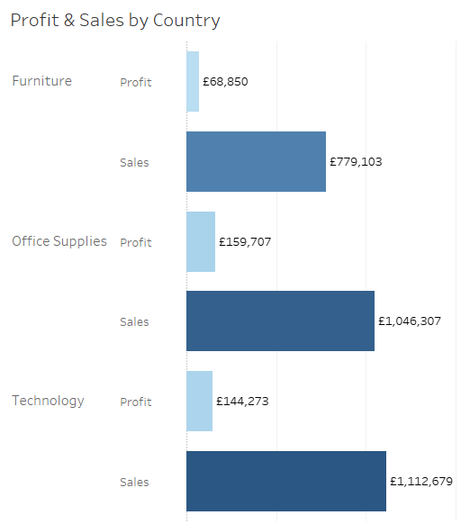
Combined Axis Chart
Combined axis charts are effective as they allow us to display two or more data series on a chart the same axes.
Combined axis charts are a great space saver whilst providing comparison between different measures. Instead of two separate graphs combined axis charts help identify trends and correlations that might not be obvious when looking at the data in isolation.
Overall, combined axis charts allow us to present a more comprehensive visualisation by integrating multiple aspects in a single chart.
See the lecture for a detailed explanation and walkthrough.

Slide 28
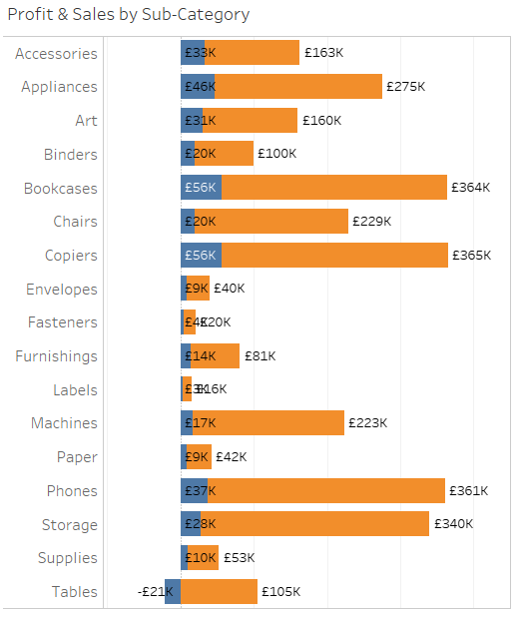
Dual Axis Chart
Dual-axis charts, similar to combined axis charts, differ in that they place two bars representing distinct measures within the same row.
Again, they are a good way of being able to make comparisons between two measures.
Once again, we benefit from saving space by placing two measures within the same visualisation and it provides a more interesting and comprehensive visualisation than comparing the measures in separate graphs.
See the lecture for a detailed explanation and walkthrough.

Slide 29
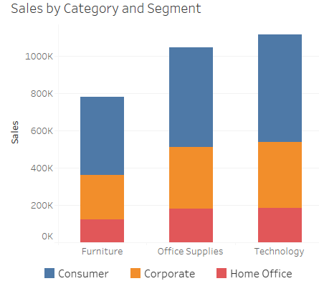
Stacked Bar Chart
Stacked bar charts are effective when we want to demonstrate parts within a whole. Each bar represents the whole and each segment represents an individual section in proportion to that whole.
Stacked bar charts can make it easy to compare how the same breakdown is either similar or different across different categories.
Stacked bar charts are another good example of a simple and effective chart which should be utilized as much as possible rather than going for something more complex for no reason.
See the lecture for a detailed explanation and walkthrough.

Slide 30
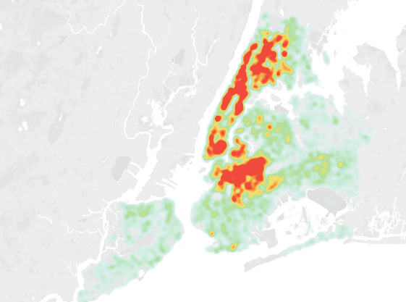
Density Map
Density maps, which you may also hear named heat maps are particularly good when we want to demonstrate the distribution or concentration of data points in a geographical location.
The density maps visualises with intensity where there are larger clusters of data points to make it obvious where the most activity is taking place.
An important feature of density maps isn’t just the areas of large clusters but also outliers, we can identify outliers which can be interesting to analyse.
See the lecture for a detailed explanation and walkthrough.

Slide 31
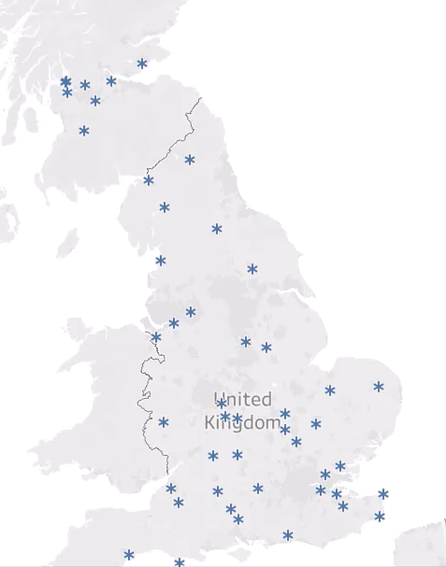
Symbol Map
A symbol map is a visualisation that represents data on a map using a symbol, a symbol being any shape or image we wish to represent the values.
See the lecture for a detailed explanation and walkthrough.

Slide 32
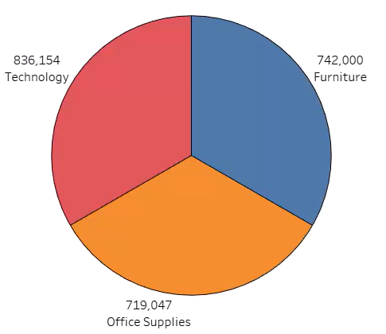
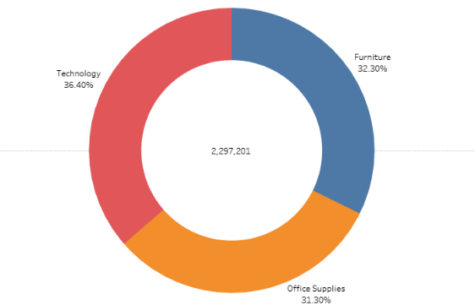
Pie Chart & Donut Chart
Donut charts are a way in which to represent how data is spread across different categorical values.
Donut charts are much the same as pie charts, but with a hole in the middle!
See the lecture for a detailed explanation and walkthrough.

Slide 33
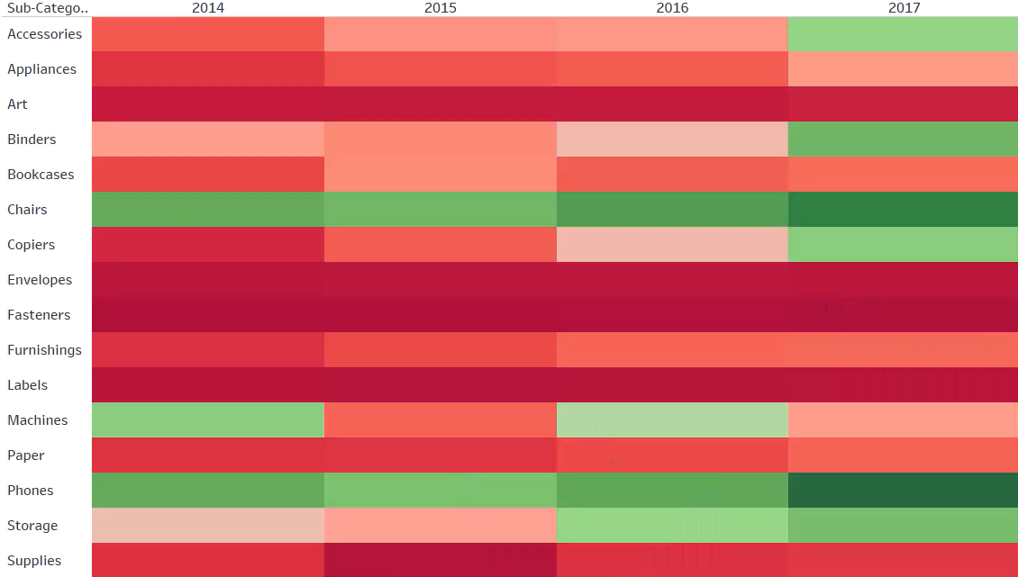
Highlight Table
The highlight table is a very easy and effective visualisation to build.
A highlight table uses diverging colour to demonstrate high and low numerical values across dimensions.
See the lecture for a detailed explanation and walkthrough.

Slide 34
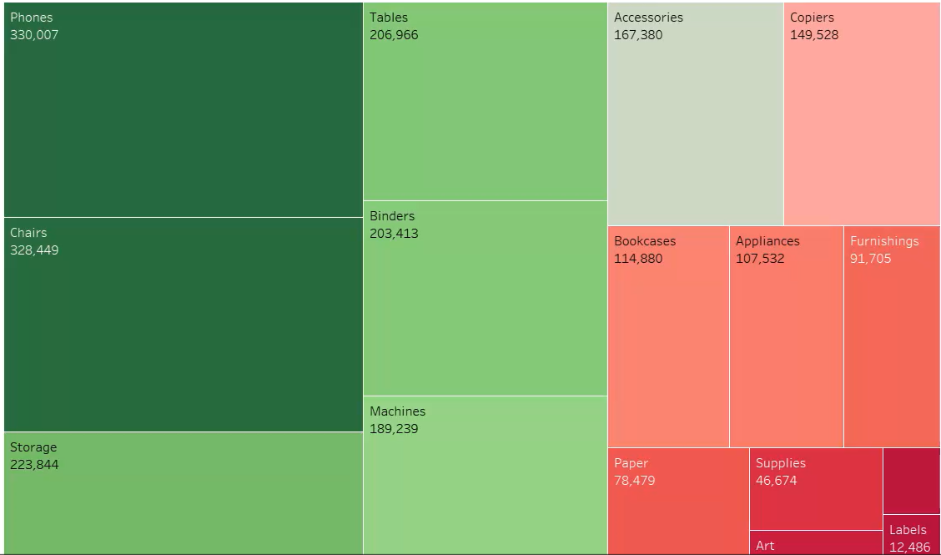
Tree Map
Tree maps are another very effective and easy to build visualisation within Tableau and require one or more dimension and one or two measures to build them.
A tree map uses size to represent data to demonstrate where the highest and lowest values are.
See the lecture for a detailed explanation and walkthrough.

Slide 35
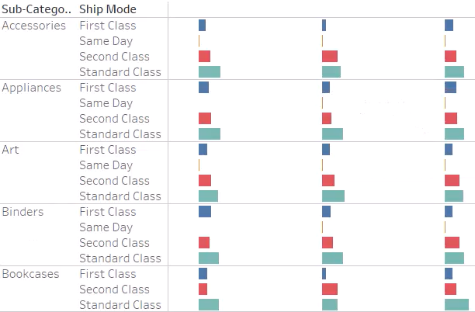
Gantt Chart
Gantt charts provide a visual representation of schedules, tasks and timelines which can be effective in project management and planning.
Gantt charts enable users to track progress, identify dependencies and monitor the length of activities.
See the lecture for a detailed explanation and walkthrough.

Slide 36
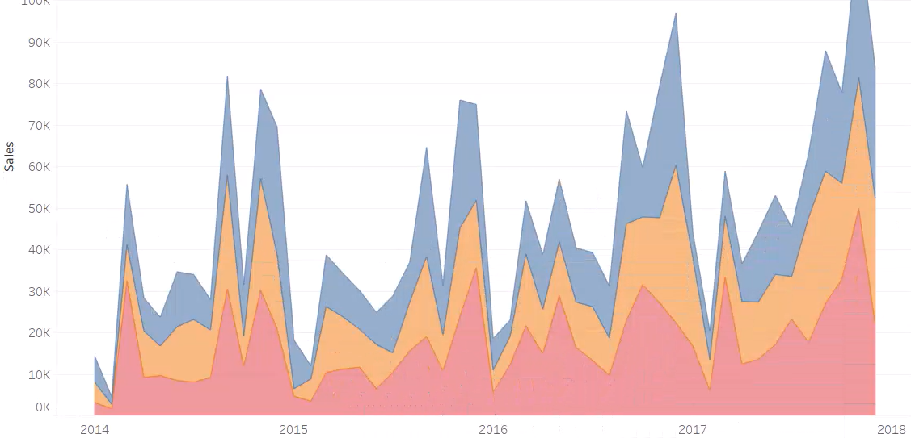
Area Chart
Just like line charts, area charts are used to visualise trends over time.
Area charts, however, allow us to visualise comparisons across multiple categories showing how each category contributes to the overall measure. They do this by filling in each area of the chart with their unique colour as demonstrated in the visual on the left.
See the lecture for a detailed explanation and walkthrough.

Slide 37
Groups
Groups can be created and utilized within visualisations to group certain data values together to enhance visualisations and streamline analysis.
A few examples of when you may want to use a group, is to group top performing products together, group cities within certain regions or group outliers together.
Groups can be created in multiple different ways, including using marks, headers and the data pane.
See the lecture for a detailed explanation and walkthrough.

Slide 38
Sets
Sets are very similar to groups in that they are custom fields created by us as the developer that allow us to group elements together.
The difference in sets is that we can create sets based on specific conditions applied on other fields within our data set. This means the sets we create are dynamic and will update when the data changes, whereas groups are hard coded when we create them and will never change.
See the lecture for a detailed explanation and walkthrough.

Slide 39
Hierarchies
Hierarchies in Tableau are tree-like structures in which fields are stored in which represent fields in a logical order.
Hierarchies can only be created when we have fields that are related, like Country, State and City. This is a perfect example for a hierarchy.
In Tableau we can use a hierarchy as a field itself which allows us and the end user to dynamically change the level of the hierarchy that is used in visualisations, and we can still use the individual fields themselves as well.
See the lecture for a detailed explanation and walkthrough.

Slide 40
Filters
In Tableau filters are used to highlight and remove specific data elements from our visualisations and dashboards.
Tableau has multiple filtering options, and each filter has different options depending on whether the field you are using to filter is a dimension, measure or a date field.
See the lecture for a detailed explanation and walkthrough.

Slide 41
Data Source Filters
Data source filters are filters that are applied at the data source level.
Data source filters improve workbook performance.
Applying a data source filter requires the exact same knowledge of worksheet filters.
See the lecture for a detailed explanation and walkthrough.

Slide 42
Context Filters
Context filters are filters that get applied first before any other filter in the worksheet.
Context filters can improve performance as the filter, since applied first, minimises data for the subsequent filters. By setting a filter as context, Tableau first computes the context filter, then applies subsequent filters to the reduced dataset, resulting in faster query execution and rendering.
See the lecture for a detailed explanation and walkthrough.

Slide 43
Sorting Methods
In Tableau we can sort our data in multiple ways. First, we can use the ascending and descending sorting buttons from the ribbon.
The next sorting method we have is a manual sort which allows us to choose exactly which order our data values should be presented.
Lastly, we have a computed sort which allows us to sort our data by data source order, alphabetically, by field, or nested sorting.
See the lecture for a detailed explanation and walkthrough.

Slide 44
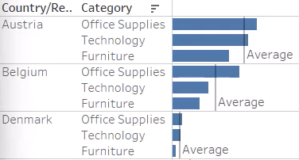
Reference Lines
Reference lines are physical lines that are places inside our visualisations which enhance our view and allow us to understand more about the data we are looking at.
See the lecture for a detailed explanation and walkthrough.

Slide 45
Quick Table Calculations
Quick table calculations in Tableau allow us to use no-code calculations that Tableau automatically computes to enhance our analysis and visualisations.
See the lecture for a detailed explanation and walkthrough.

Slide 46
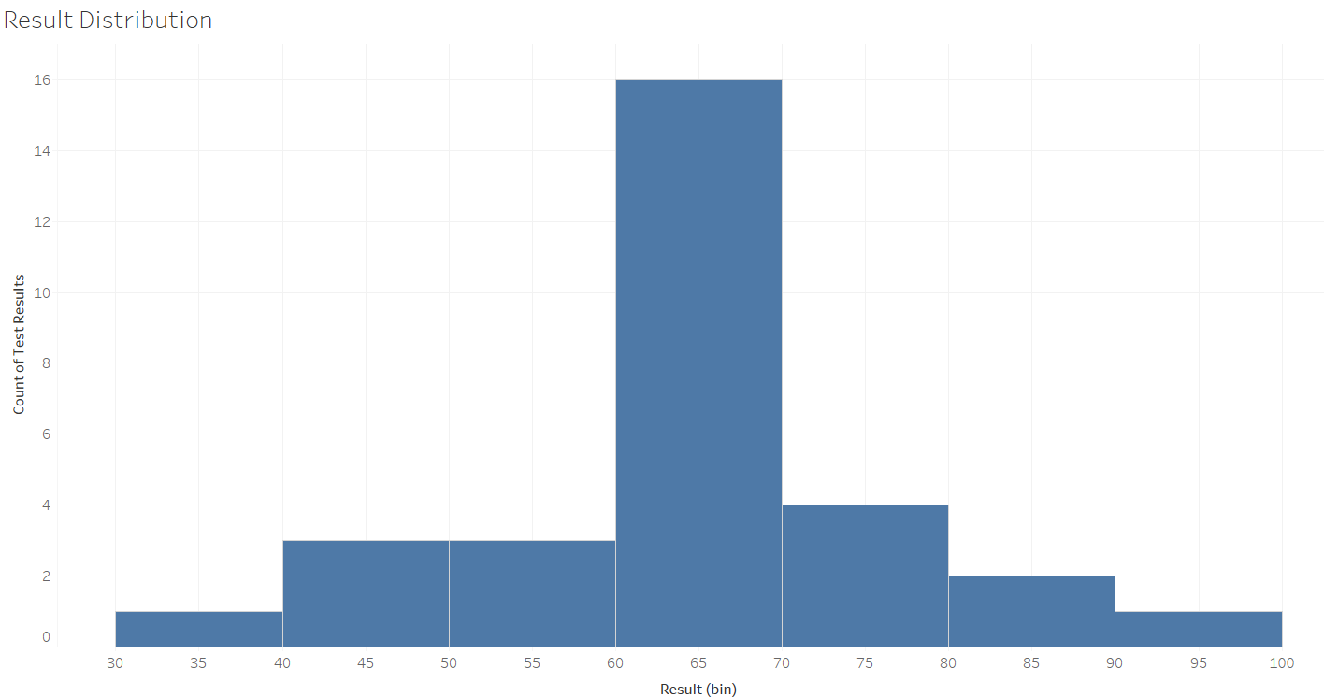
Bins and Histograms
Bins are defined ranges or intervals that we define as developers which group numerical values into the ranges or intervals we choose.
Bins are created before then being used in histograms which are a visualisation type to show the distribution of data within the created bins.
The histogram displays the count of data points that fall into each bin.
See the lecture for a detailed explanation and walkthrough.

Slide 47
Parameters
A parameter is a piece of functionality within Tableau that we can utilise to allow us or the end user to dynamically change a view.
See the lecture for a detailed explanation and walkthrough.

Slide 48
Worksheet Totals
Worksheet totals in Tableau provide the totals of measures used within a table visualisation. The two options that we have for displaying worksheet totals is Row Grand Totals and Column Grand Totals.
See the lecture for a detailed explanation and walkthrough.

Slide 49
Module 4
Functions & Calculations

Slide 50
Date Functions
Date functions enable users to manipulate and analyse date data. There are many manipulation options in Tableau like date parsing, date truncation, calculating differences between dates and much more.
In the lecture we are going to learn about:
DATEPARSE
DATENAME
DATEADD
DATEDIFF
DATETRUNC
TODAY
See the lecture for a detailed explanation and walkthrough.

Slide 51
String Functions
String functions in Tableau allow us to manipulate and analyse text data. Again, there are many options such as concatenation, substring extraction and much more.
In the lecture we are going to learn about:
LEFT
RIGHT
LEN
UPPER
LOWER
CONTAIN
See the lecture for a detailed explanation and walkthrough.

Slide 52
Logical Functions
Logical functions in Tableau allow us to perform conditional evaluations. The functions allow us to evaluate conditions, combining multiple conditions at a time using AND/OR returning True and False values, or specific values set by us as the developer when conditions are either met or not met
In the lecture we are going to learn about:
CASE
IF/ELSEIF
IIF
See the lecture for a detailed explanation and walkthrough.

Slide 53
Number Functions
Number functions in Tableau facilitate the manipulation and analysis of numerical data. These functions offer capabilities such as mathematical calculations, rounding, formatting, and aggregation, allowing users to perform various transformations and calculations on numeric fields within their visualisations.
In the lecture we are going to learn about:
MIN
MAX
AVG
COUNT
COUNTD
RANK
WINDOW_MAX
ROUND
See the lecture for a detailed explanation and walkthrough.

Slide 54
Type Conversion Functions
Type conversion functions in Tableau enable users to convert data from one type to another. These functions provide the ability to convert data types such as strings to numbers, dates to strings, and vice versa.
In the lecture we are going to learn about:
INT
FLOAT
STR
DATE
DATETIME
See the lecture for a detailed explanation and walkthrough.

Slide 55
Aggregate Functions
Aggregate functions in Tableau perform calculations on a set of values and return a single value as output.
In the lecture we are going to learn about:
SUM
MEDIAN
PERCENTILE
STDEV
VAR
ATTR
See the lecture for a detailed explanation and walkthrough.

Slide 56
Fixed LOD Calculations
Fixed Level of Detail (LOD) calculations in Tableau enable users to perform calculations at a specified level of detail, independent of the visualization's level of detail. These calculations allow users to aggregate data based on dimensions that are not part of the visualisation.
In the lecture we are going to learn about:
FIXED
See the lecture for a detailed explanation and walkthrough.

Slide 57
Custom Calculations
Custom calculations in Tableau empower users to create personalized calculations tailored to their specific analytical needs. These calculations can range from simple arithmetic operations to complex logical expressions.
In the lecture we are going to learn about:
Year to Date
Month to Date
Year over Year % Change
Prior Year
Latest Year Sales
Prior Year Sales
See the lecture for a detailed explanation and walkthrough.

Slide 58
Module 5
Dashboard Building & Sharing Insights

Slide 59
Containers
Containers are layout components used to organise the placement of dashboard objects. They act as a grouping mechanism, allowing users to arrange and manage the positioning of multiple items within a dashboard.
There are two layout containers called Vertical and Horizonal.
Containers should always be used when building dashboards, and although a tricky subject to master, once you do, dashboard building becomes easy.
See the lecture for a detailed explanation and walkthrough.

Slide 60
Building The Dashboard
No Notes
See the lecture for a detailed explanation and walkthrough.

Slide 61
Add Interactive Elements
No Notes
See the lecture for a detailed explanation and walkthrough.

Slide 62
Create Device Specific Dashboards
In Tableau you can create dashboards for specific devices such as Desktops, Tablets and Phones. Developing dashboards for phones can be particularly useful if your end users need insights on the go and can access Tableau from the mobile app.
See the lecture for a detailed explanation and walkthrough.

Slide 63
Create a Story
In Tableau, stories provide an alternative to dashboards. They are composed of individual visualisation pages arranged in a sequence to convey a specific message to your audience.
Within stories, you can enhance each "story point" with a concise title or description to offer additional context.
See the lecture for a detailed explanation and walkthrough.

Slide 64
Exporting Dashboards
In Tableau we can export our work to PowerPoint and PDF documents. This can be very beneficial when wanting to save and share specific work with colleagues in meetings or sending as attachments via email.
See the lecture for a detailed explanation and walkthrough.

Slide 65
File Types - .TWB
Tableau workbooks are identified by the .twb file extension and can contain a combination of one or more worksheets, along with zero or more dashboards and stories.
See the lecture for a detailed explanation and walkthrough.

Slide 66
File Types - .TBM
Tableau bookmark files are denoted by the .tbm file extension. These bookmarks consist of a single worksheet and serve as a convenient method for swiftly sharing your work.
See the lecture for a detailed explanation and walkthrough.

Slide 67
File Types - .TWBX
Tableau packaged workbooks bear the .twbx file extension. A packaged workbook is a unified zip file encompassing a workbook, along with any pertinent local file data and background images. This format stands as the optimal means to encapsulate your work for sharing with individuals who lack access to the original data.
See the lecture for a detailed explanation and walkthrough.

Slide 68
File Types - .hyper
Tableau extract files utilize the .hyper extension. These files serve as a localized copy of either a subset or the entire dataset, enabling you to share data, work offline, and enhance performance.
See the lecture for a detailed explanation and walkthrough.

Slide 69
File Types - .tds
Tableau data source files are identified by the .tds file extension. These files act as shortcuts, facilitating swift connections to frequently used original data. It's important to note that data source files do not store the actual data; instead, they contain essential information for connecting to the original data and any modifications applied, such as adjustments to default properties, creation of calculated fields, addition of groups, and more.
See the lecture for a detailed explanation and walkthrough.

Slide 70
File Types - .tdsx
Tableau packaged data source files use the .tdsx file extension. This file format, encapsulated within a zip file, includes the data source file (.tds) discussed in the preceding slide, along with any associated local file data like extract files (.hyper), text files, Excel files, Access files, and local cube files. Opt for this format when you want to create a unified file for sharing with others who might not have direct access to the original data stored on your local machine.
See the lecture for a detailed explanation and walkthrough.

Slide 71
View & Export Data
Exporting the underlying data can be beneficial for collaborating with colleagues. It can also be utilised for validation purposes, as getting access to the underlying data can allow us to interrogate it at a granular level.
See the lecture for a detailed explanation and walkthrough.

Slide 72
Module 6
Publish & Manage Content in Tableau Cloud

Slide 73
Publish a Workbook
In Tableau we will come across three places in which we can share our work. In a professional environment this will be one of either Tableau Server or Tableau Cloud.
In a less professional environment, this will be Tableau Public.
See the lecture for a detailed explanation and walkthrough.
Tableau Server
On prem
Publish & Manage Content
The organisation manages the environment
Tableau Cloud
Cloud
Publish & Manage Content
Tableau manages the environment
Tableau Public
Free to use
Host online portfolio
Connect with the world

Slide 74
Publish a Data Source to Cloud
Reuse and reshare with other workbooks, improving efficiency.
Automatic Data Refreshes
See the lecture for a detailed explanation and walkthrough.

Slide 75
Schedule Data Refresh Extracts
A data refresh extract in Tableau refers to the process of updating the data within an extract. In Tableau cloud this can be automated by scheduling the refreshes.
This refresh ensures that the extract reflects the most current data from the original data source.
See the lecture for a detailed explanation and walkthrough.

Slide 76
Create Alerts in Tableau Cloud
Alerts in Tableau Cloud are notifications that get sent directly to us when data in a dashboard has reached a certain threshold.
We can create alerts on visualisations of our choice so that we can be notified about changes in data that we are most interested in.
See the lecture for a detailed explanation and walkthrough.

Slide 77
Create Subscriptions in Tableau Cloud
In Tableau Cloud, subscriptions allow users to receive automated files of specific views or dashboards via email.
We can set up subscriptions to either send us an image of the view or dashboard, a PDF file of the view or dashboard or an image and a PDF.
See the lecture for a detailed explanation and walkthrough.

Slide 78
Module 7
Tableau Prep

Slide 79
Tableau Prep Intro
Tableau Prep is a data preparation tool designed to help users clean, shape and prepare data for analysis in Tableau Desktop.
Tableau Prep has a wide range of features, with some of the key ones being visual data preparation flows, its intuitive interface and its many data cleaning capabilities.
Tableau Prep helps users overcome key data issues such as messy and inconsistent data, enabling the cleaning and preparation in a tool specifically designed for these tasks before being visualised in Tableau Desktop.
Tableau Prep | Combine, shape, and clean your data

Slide 80
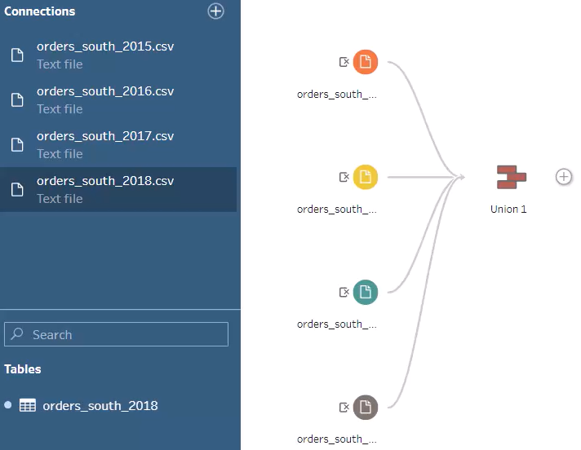
Unions in Prep
No Notes
See the lecture for a detailed explanation and walkthrough.

Slide 81
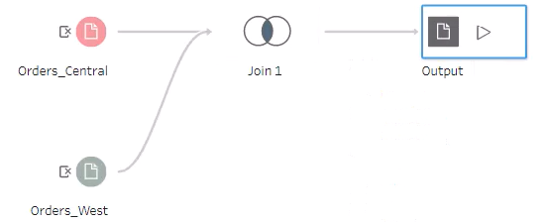
Joining Data In Prep
No Notes
See the lecture for a detailed explanation and walkthrough.

Slide 82
Aggregating Data In Prep
Tableau Prep allows us to create aggregate tables from our data which is very beneficial for analysis. Aggregate tables are summarized versions of large data containing precalculated values like sums, averages counts or other.
Firstly, aggregate tables help improve performance by reducing the computational work required when building aggregate visualisations.
Another benefit of aggregate tables is that they simplify analysis. By creating aggregate tables containing only the data we need at the level of granularity we need it to be it makes working with the data set much more efficient.
See the lecture for a detailed explanation and walkthrough.

Slide 83
Filtering Data In Prep
No Notes
See the lecture for a detailed explanation and walkthrough.

Slide 84
Pivoting Data In Prep
No Notes
See the lecture for a detailed explanation and walkthrough.

Slide 85
Using a Flow Output in Desktop
After finalising and testing the data preparation work in Tableau Prep, you can save the data set you have created in your flow as a .hyper file which can be used as a data source in Tableau Desktop.
Running the flow in Tableau Prep will produce the .hyper file and save it to the location you have chosen, or the default location in your documents. Then you can go to Tableau Desktop and connect to the .hyper file just as if it were any other data source.
The Tableau data source type you want to connect to is ‘More’ under the ‘To a File’ section.
See the lecture for a detailed explanation and walkthrough.

Slide 86
Module 8
Exam

Slide 87
Module 9
Bonus Content

Slide 88
Further Training Resources
Makeover Monday
Workout Wednesday
Tableau Public
YouTube

Slide 89
Free Online Data Sources
Kaggle
Data.gov
Google Dataset Search
UNICEF
Awesome Public Datasets

Slide 90
Congratulations!

