Slide 1


Section 10 Overview
We will build our skills in OOP
Learning the last two of the three primary principles of OOP
Encapsulation
Inheritance
Polymorphism
Inheritance
Base classes and derived classes
Polymorphism
We also look at enums as a side topic

Slide 2
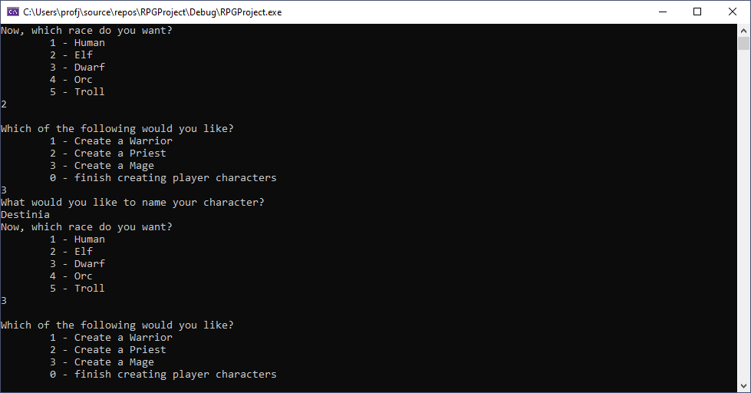
Section 10 Overview

