Slide 1


Section 11 Overview
Templates
Function and class templates
Standard Template Library (STL)
Tons of helpful data structures and algorithms!
Smart Pointers
Pointers that manage their own memory
Friend functions and friend classes
Operator overloading

Slide 2
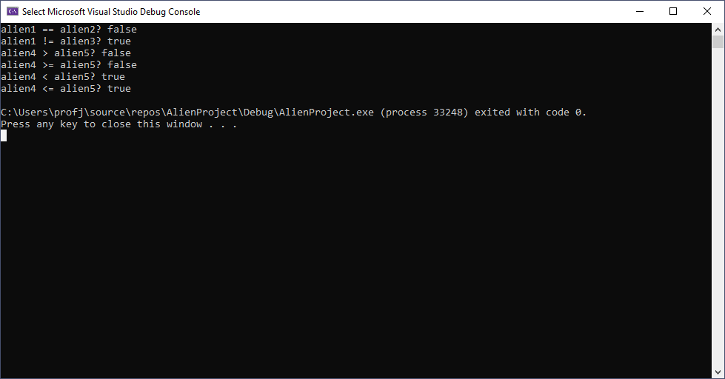
Section 11 Overview

