Slide 1


Section 2 Overview
Storing different types of data in memory
Performing operations on the data
Taking our first steps toward helping our programs make decisions
Communicating with the users of our programs
Projects such as
Mad Libs clone
Average-of-Three program

Slide 2
Section 2 Overview
Syntax
The grammar rules of a language
Natural languages
Languages people speak
Programming languages
Languages that ultimately are written to communicate with the computer

Slide 3
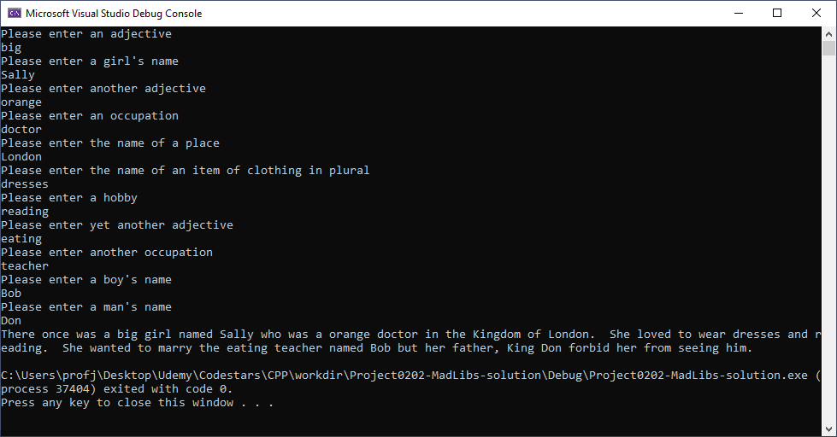
Section 2 Overview

