Slide 1


Section 5 Overview
Functions
Reusable, named pieces of code
We can call or invoke them when we need them
Help us break problems down into more manageable parts
Great projects
Including a more advanced big Tic-Tac-Toe project!

Slide 2
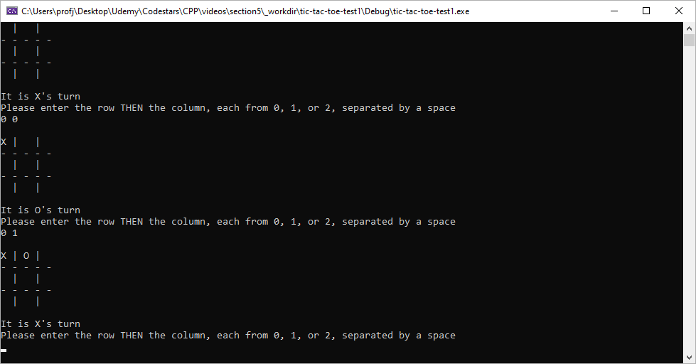
Section 5 Overview

